Slide 1


AIRCRAFT ACQUISITION RISK ASSESSMENT
MINIMIZING INVESTMENT RISK THROUGH DATA DRIVEN INSIGHTS

Slide 2
INTRODUCTION
Overview
The presentation identifies aircraft makes and models that reduce incident & fatalities risk, optimize operations, and improving safety records. This presentation provides actionable recommendations to ensure , low-risk factors into expansion into the aviation industry.
Key Business Questions Answered
Which aircraft models have the most and fewest fatal accidents?
What are the top causes of aircraft incidents?
How does weather impact incident frequency and severity?
What aircraft types are safest for passenger vs. non-passenger flights?
How does flight purpose (personal, business, instruction) relate to accident risk?

Slide 3
BUSINESS UNDERSTANDING
Our company is expanding into the aviation industry, with plans to purchase and operate airplanes for commercial and private use. However, we currently lack insight into the potential risks associated with different aircraft types.
This project aims to analyze aircraft incident and fatality data to identify which models present the lowest risk. Our findings will provide actionable recommendations to guide the new aviation division in selecting safer, more reliable aircraft for purchase.

Slide 4
DATA UNDERSTANDING
For this analysis, we worked with historical aircraft incident and accident data. The dataset includes key details such as aircraft type, number of incidents, fatal incidents, fatalities, and location information.
We assessed the data for completeness, accuracy, and consistency to ensure reliable analysis. Early exploration helped us identify patterns, spot missing values, and understand how different aircraft models vary in terms of safety performance.
This understanding shaped how we approached the analysis and developed insights for business decision-making.

Slide 5
DATA PREPARATION, CLEANING AND
MANIPULATION
Before analysis, we cleaned and prepared the dataset to improve its quality and usability. This involved handling missing values, correcting inconsistencies in aircraft model names, and filtering out irrelevant or incomplete records.
We also created new variables, such as total incident rates, to better compare aircraft safety performance. This process ensured that our data was accurate, consistent, and ready for meaningful analysis and visualization.

Slide 6
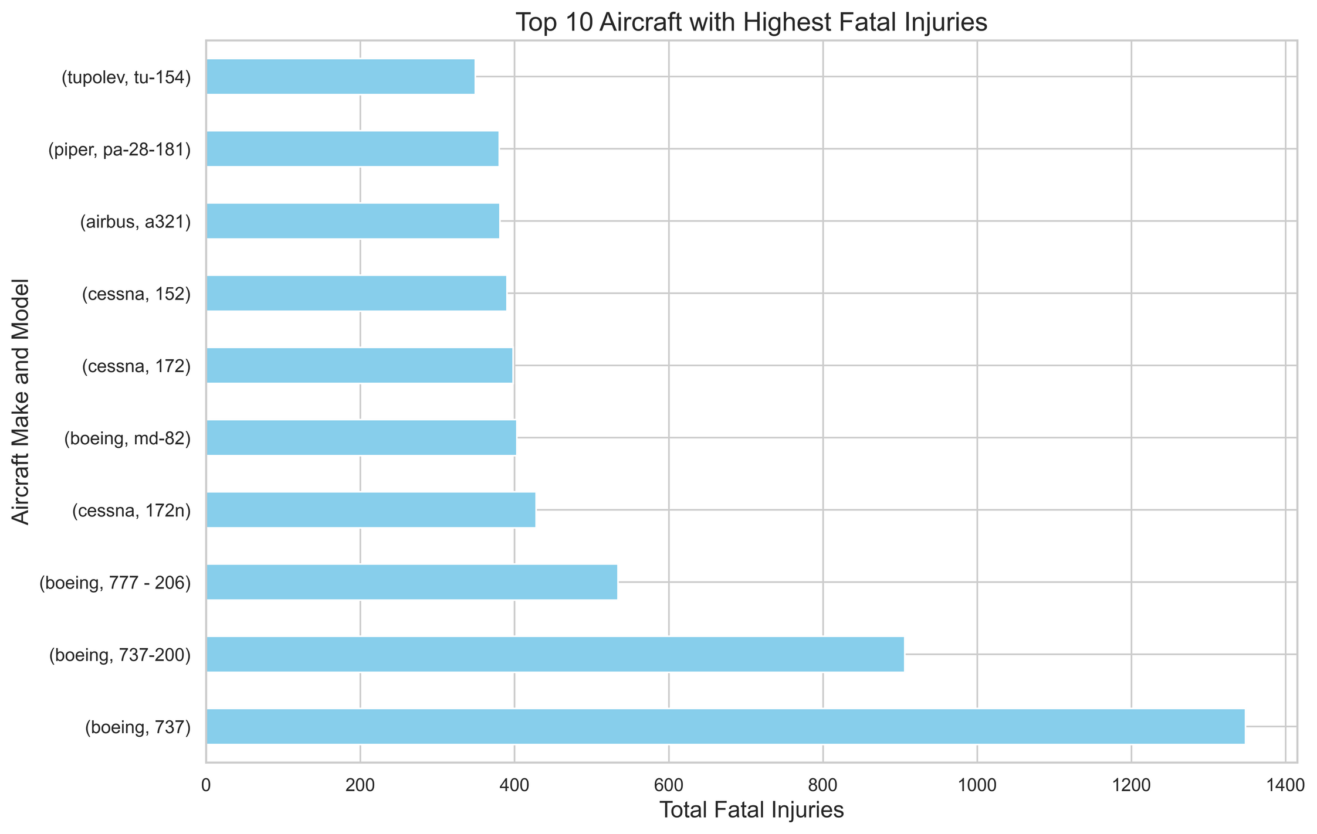
DATA ANALYSIS
Top 10 Aircraft with Highest fatal injuries
The bar chart shows higher fatal injuries in models like Boeing 737 and 777-206, indicating a need for further investigation into usage, maintenance, and operational factors before acquisition.

Slide 7
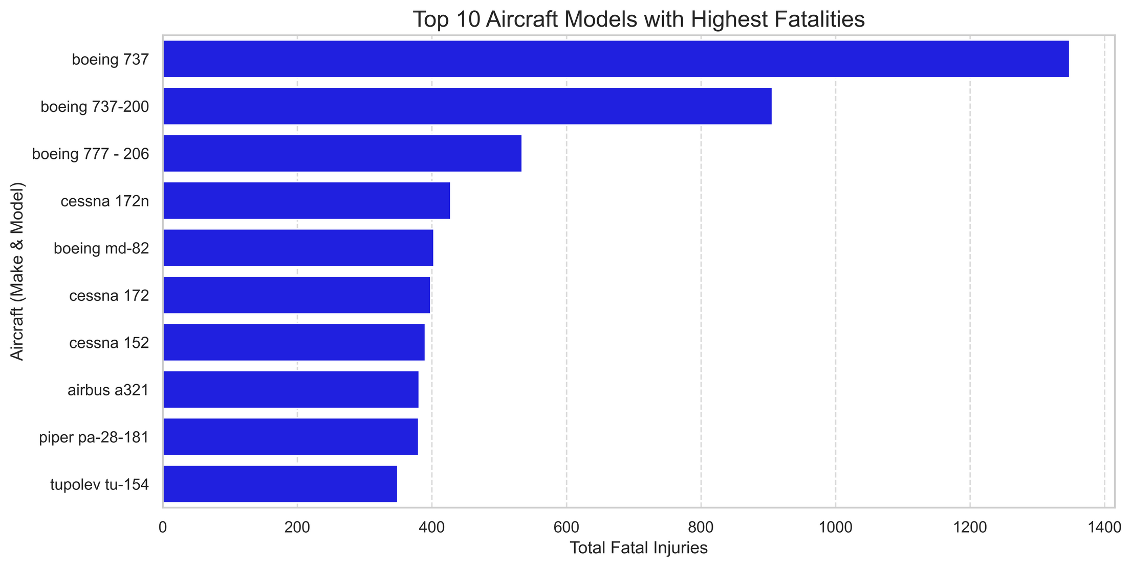
Top 10 Aircraft Models with Highest fatalities
This graph highlights the top 10 aircraft models with the highest fatalities such as boeing 737, 737-200, helping prioritize safety reviews and deeper investigations into high-risk models before acquisition.

Slide 8
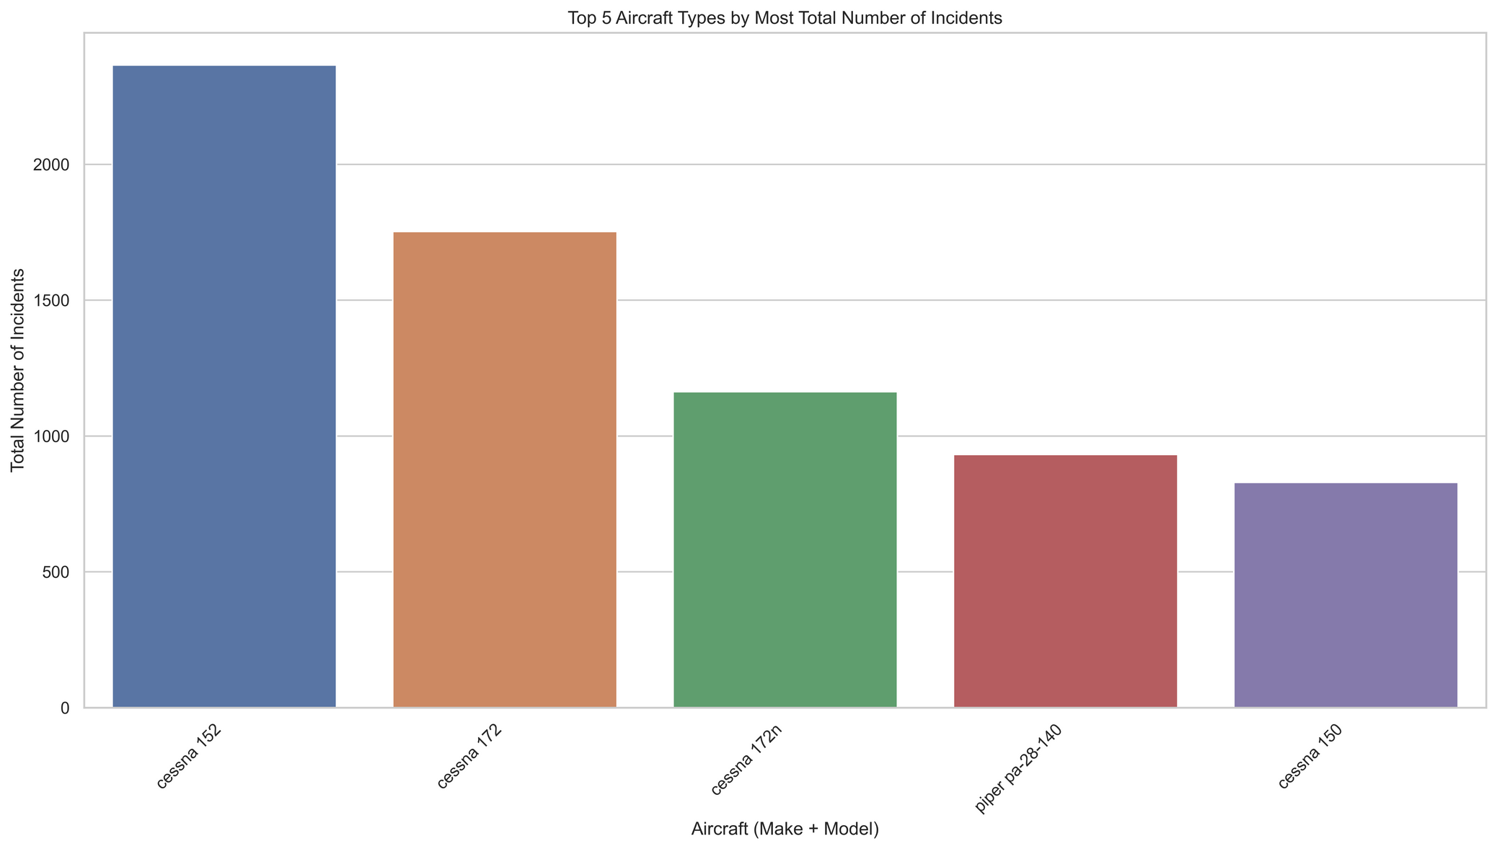
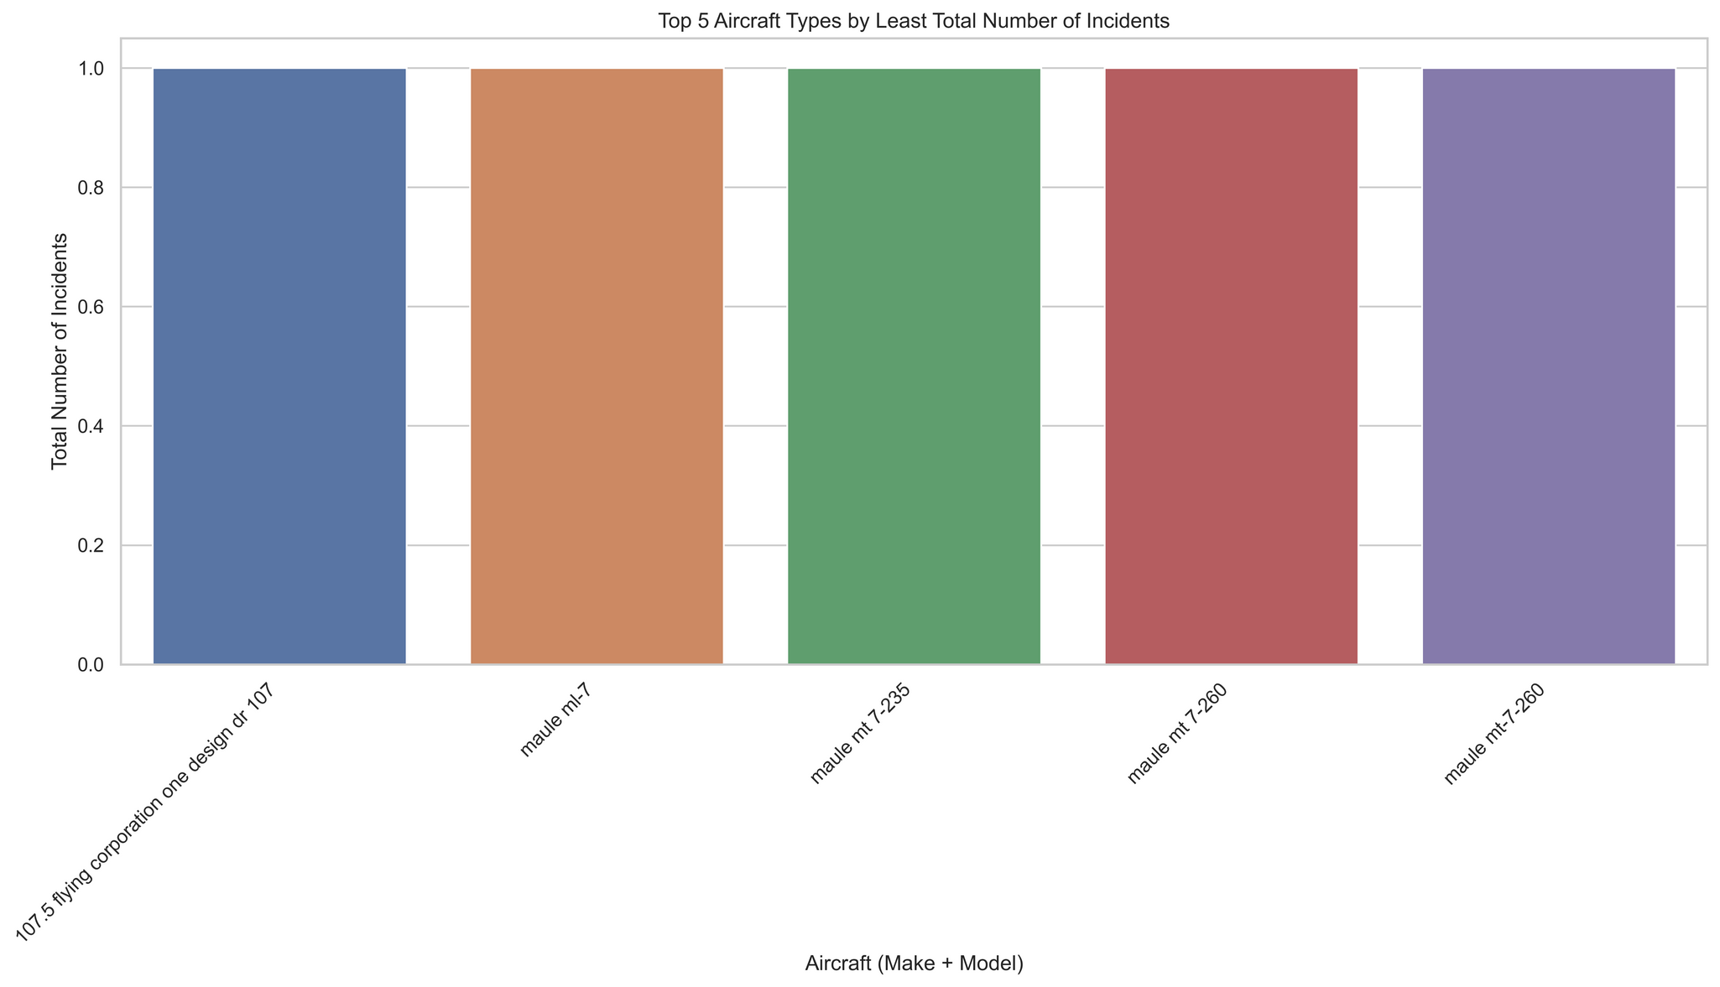
Top 5 Aircraft Types by Most Total Number of Incidents vs Top 5 Aircraft Types by Least Total Number of Incidents
The above bar graphs shows that models like Cessna 152 and Piper PA-28-140 report higher incidents, while Maule models report fewer, highlighting areas for deeper investigation into usage, maintenance, and design factors.

Slide 9
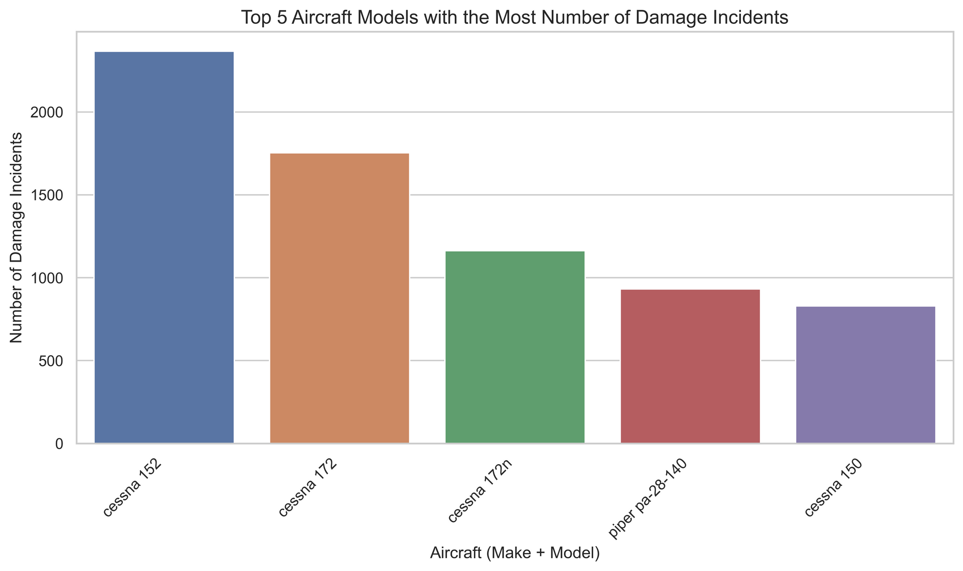
Top 5 Aircraft Models with the Most Number of Damage Incidents
Aircraft models with most damage incidents like the cesna 152, may not offer a viable option when it comes to resilience and safer options for starting the aviation business.

Slide 10
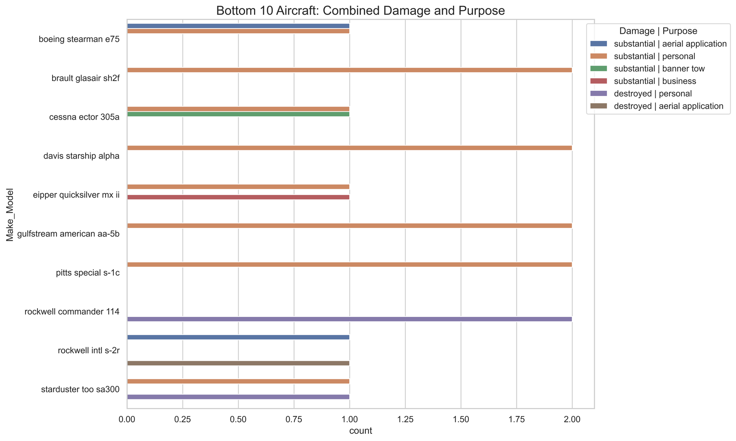
Bottom 10 Aircrafts: Combined Damage and Purpose
Analyzing damage types alongside flight purposes shows that some aircraft models face higher risks due to their operational roles, emphasizing the need for targeted risk management.

Slide 11
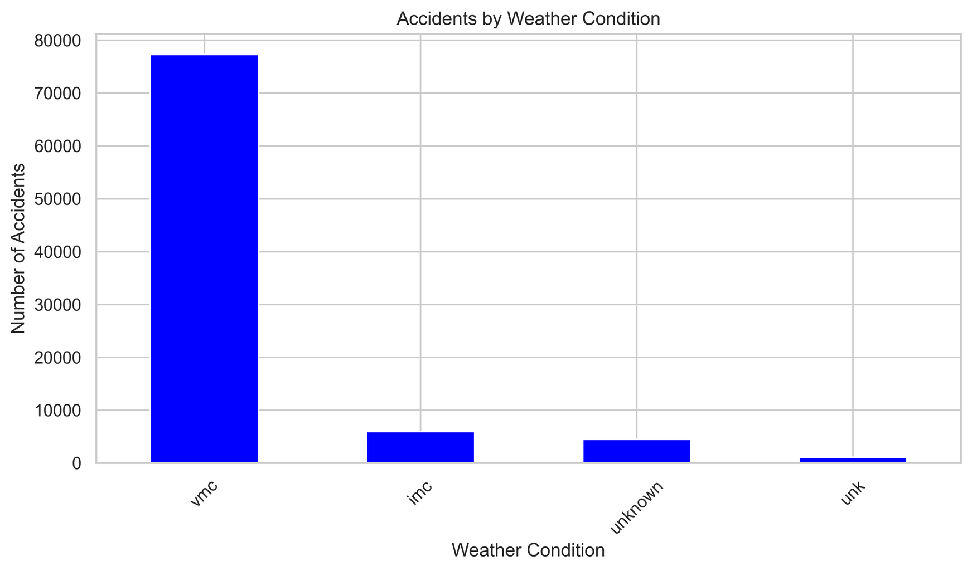
Accidents by Weather Condition
Accidents were higher when pilots relied on visual navigation (VMC) instead of instruments. In contrast, incidents involving instrument-based navigation were minimal.

Slide 12
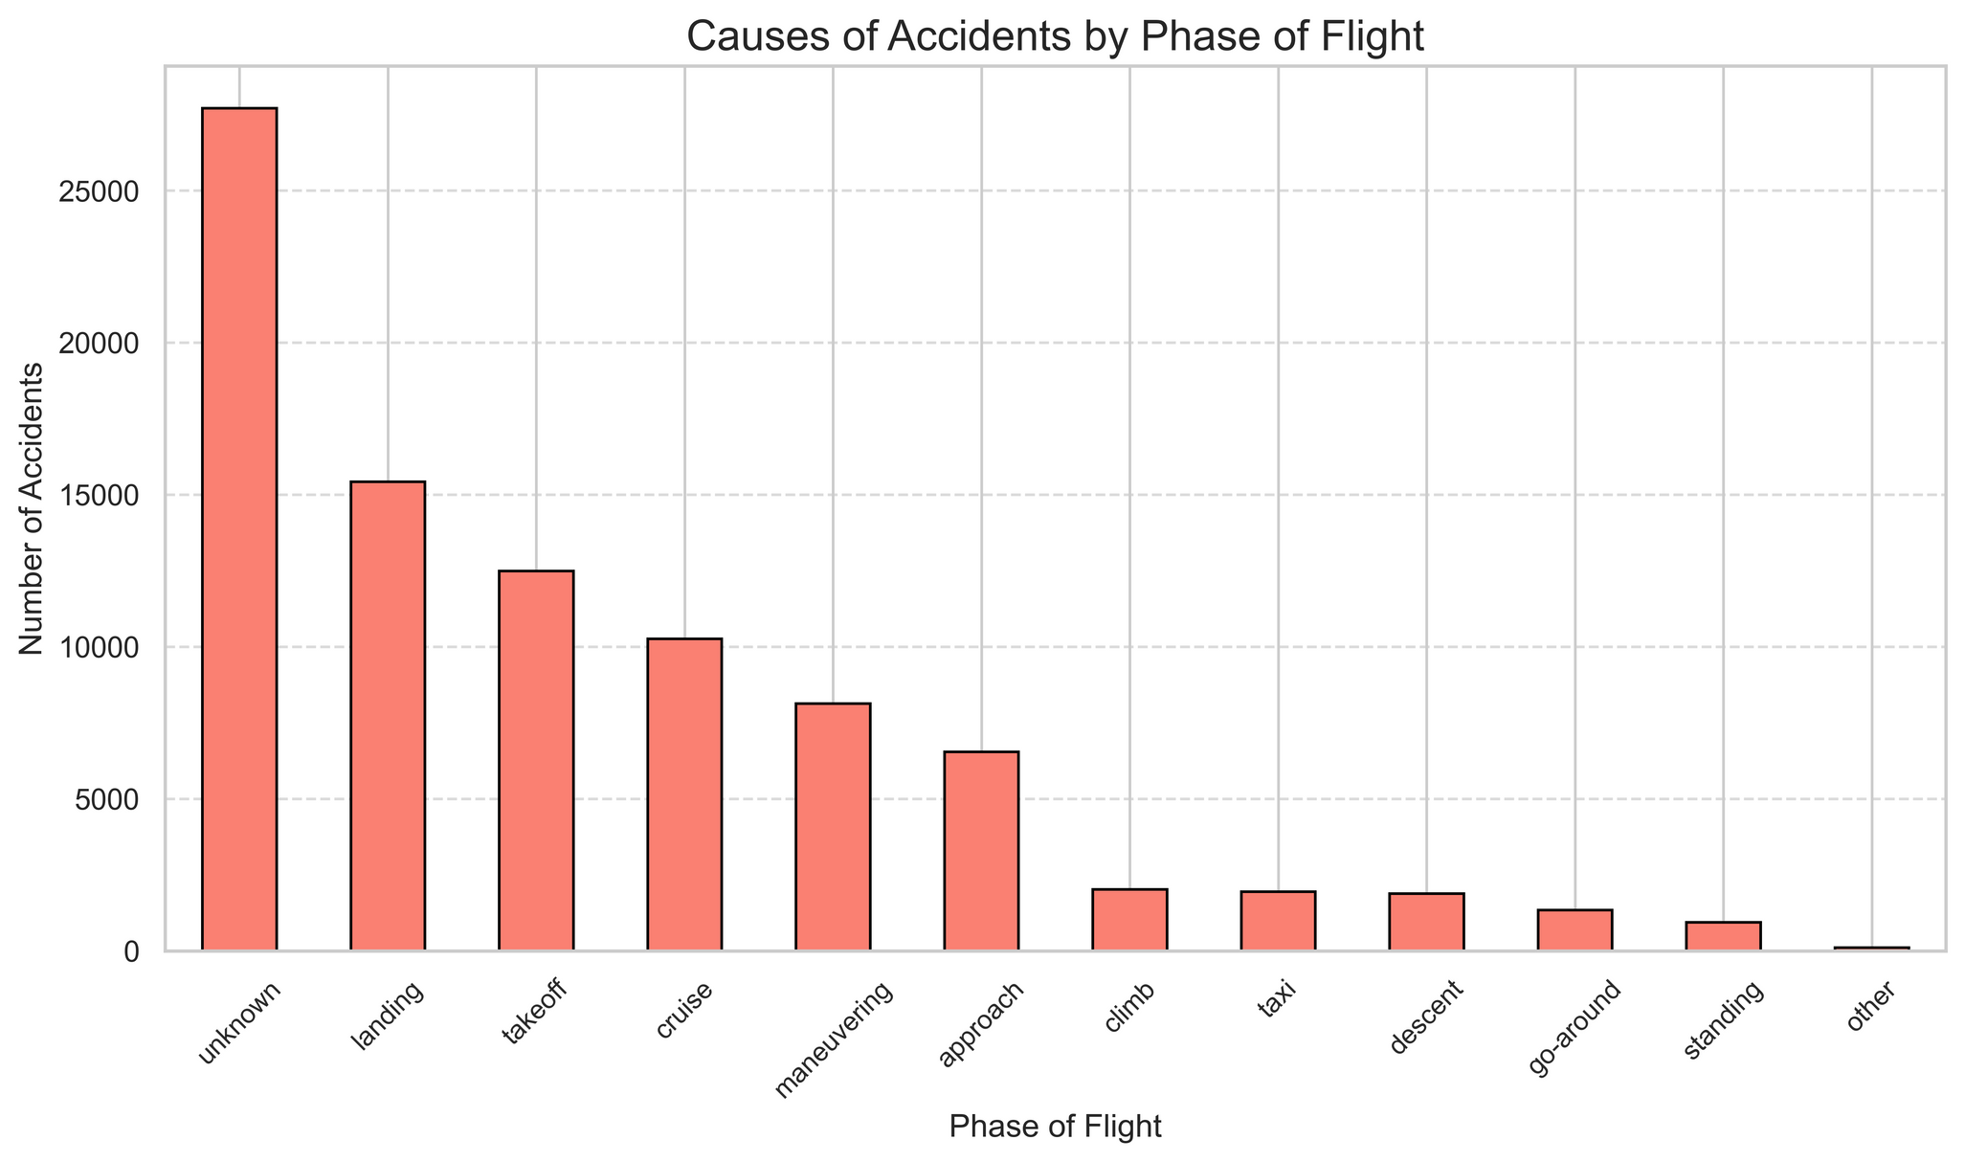
Causes of Accidents by Phase of Flight
Most accidents occur during landing, takeoff, cruise, maneuvering, and unknown phases, highlighting the need for enhanced safety measures during these critical stages.

Slide 13
RECOMMENDATIONS
Prioritize Safer Aircraft: Focus on models with lower fatal injuries and incident rates, like Maule MX-7-180 and One Design DR 107.
Select Resilient Models: Choose aircraft that mostly sustain minor damage, reducing repair costs and enhancing safety.
Consider Weather and Flight Phases: Prefer aircraft that perform well during critical phases like takeoff and landing, and in varying weather conditions.

Slide 14
NEXT STEPS
Conduct Detailed Risk Assessments for shortlisted aircraft models.
Engage with Manufacturers to gather maintenance and safety records.
Pilot Test Selected Aircraft under different conditions (weather, phases of flight).
Develop Training Programs focused on high-risk phases like takeoff and landing.
Establish Ongoing Monitoring to track incident and maintenance trends after acquisition.

Slide 15


THANK YOU
For any inquiries, please contact me at:
akinyimarilyn@gmail.com
UserName: Marilyn Akinyi

