Slide 1
Commodity Price Forecasting Using Multi-Market Financial Time Series Data
Group members
SAMWEL ONGECHI
Marilyn akinyi
Erick mauti
Lydiah Chumba
Rose miriti
Isaac onyango
RODGERS OTIENO
PRESENTED BY: GROUP 5
TM : GEORGE KAMUNDIA

Slide 2
Business Understanding
Volatility in commodity markets impacts global trade and investments
Forecasting helps producers, traders, and policymakers make informed decisions.
BUSINESS PROBLEM
Predicting commodity returns is particularly challenging due to:
Market volatility
Time-lagged effects
Dependencies across different financial instruments
How can we leverage time series data to predict commodity price movements?

Slide 3

Stakeholders
Commodity traders – optimize trading strategies
Investors –To manage portfolio risk
Policy makers and regulators – anticipate inflationary trends
Financial Analysts – provide data-driven forecasts

Slide 4
Objectives
To preprocess and integrate multi-market financial time series data for commodities.
To explore and analyze patterns, correlations, and volatility in commodity returns.
To develop predictive models for selected commodity prices and spreads.
To evaluate model accuracy and stability using appropriate performance metrics.
To generate insights that can support trading strategies and risk management.

Slide 5
Data Understanding
Sources: Kaggle (London Metal Exchange (LME), Japan Exchange Group (JPX), U.S. stock markets.
Data used: Train.csv, Target pairs and Train_labels.csv
Time horizon: Daily
Challenges: missing values, seasonality, volatility, external shocks

Slide 6
EXPLORATORY DATA ANALYSIS(EDA)
Understand the distributions of target variables and features.
Identify trends, patterns, and outliers in the data.
Explore relationships between features and targets, including correlations and potential predictive signals.
Visualize time series behaviors since this is a temporal dataset.
This step helps inform feature engineering, model selection, and further preprocessing decisions.

Slide 7
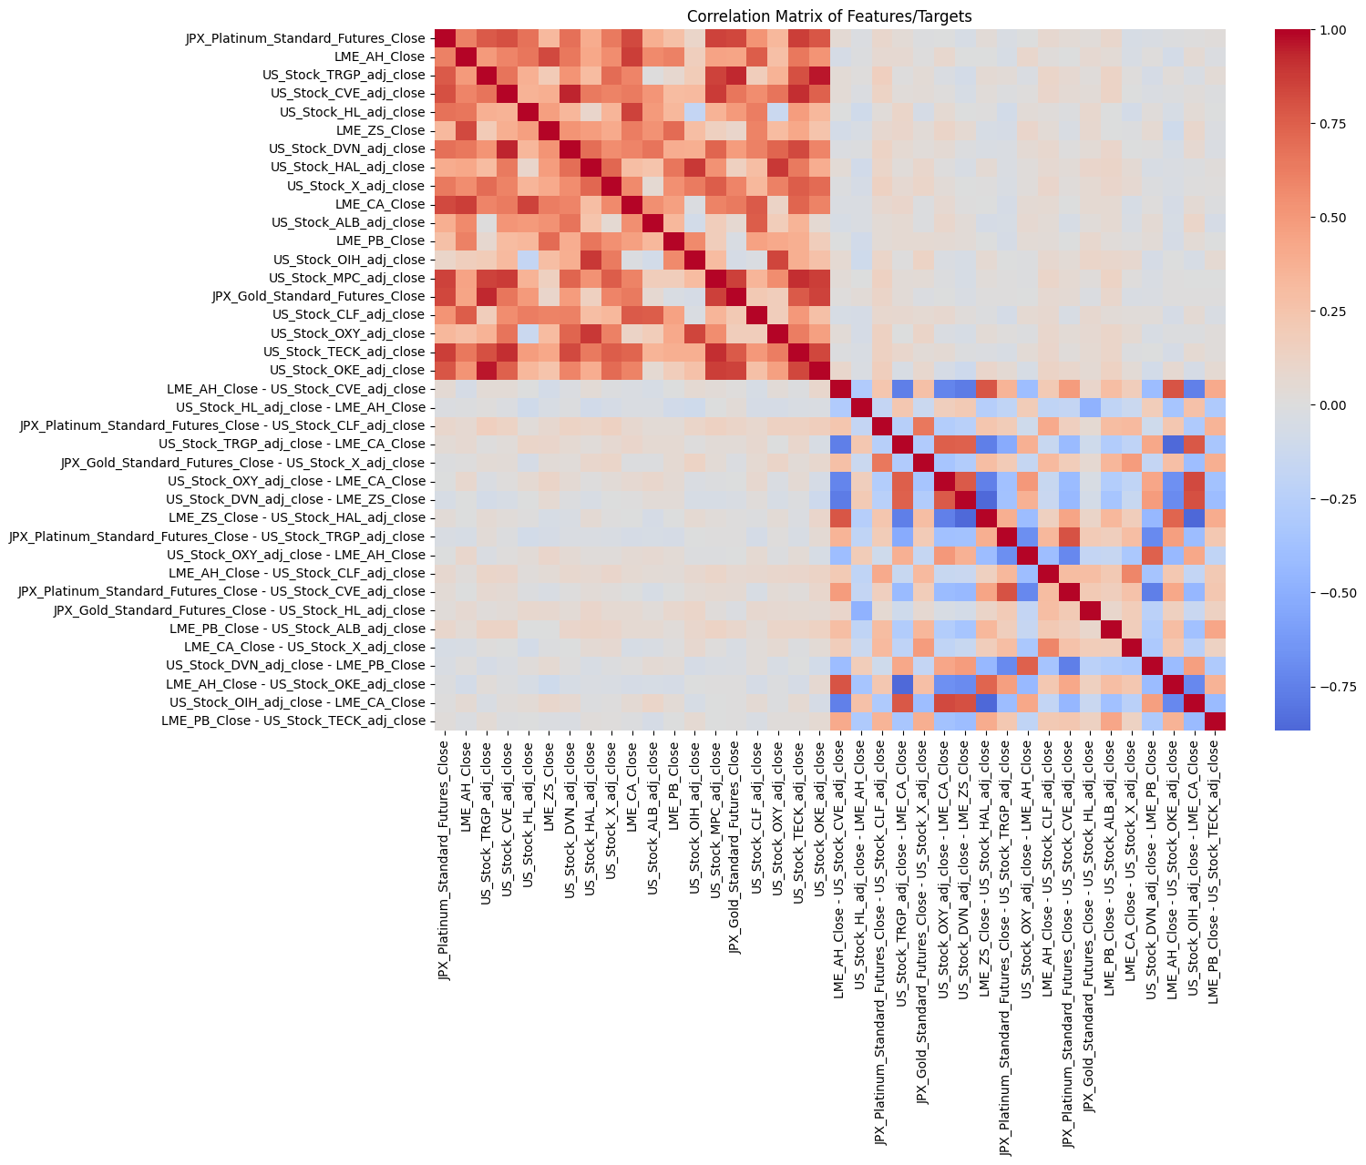
EDA CONT ‘D
Correlation Analysis

Slide 8
EDA CONT ‘D
Applied 0.9 correlation threshold to flag highly correlated pairs.
A total of 5 pairs exceeded this threshold, meaning they may introduce multicollinearity risks if included together in models.

Slide 9
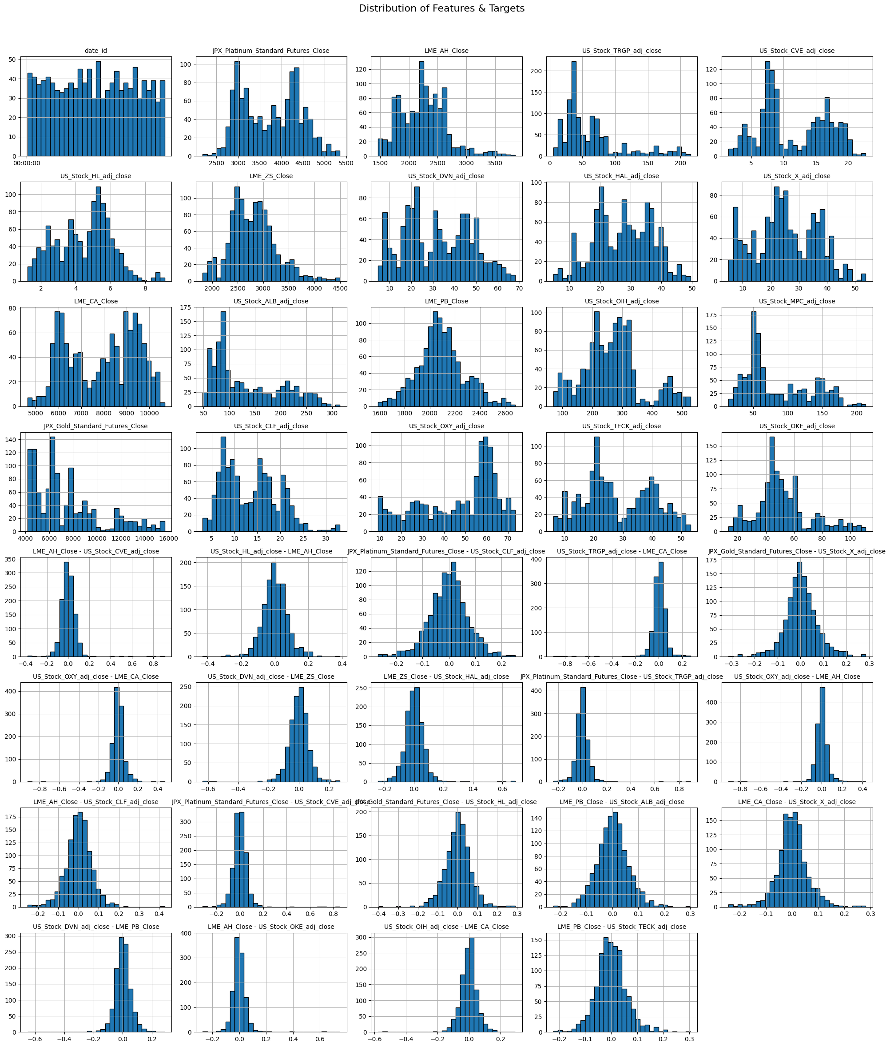
EDA CONT ‘D
DISTRIBUTION OF FEATURES AND TARGETS

Slide 10
EDA CONT ‘D
The histograms above illustrate the distributions of our merged dataset’s features and targets.
dataset combines skewed raw price distributions with nearly-normal return distributions.
To improve model performance, we should consider applying transformations to raw prices and using returns directly as predictors.

Slide 11
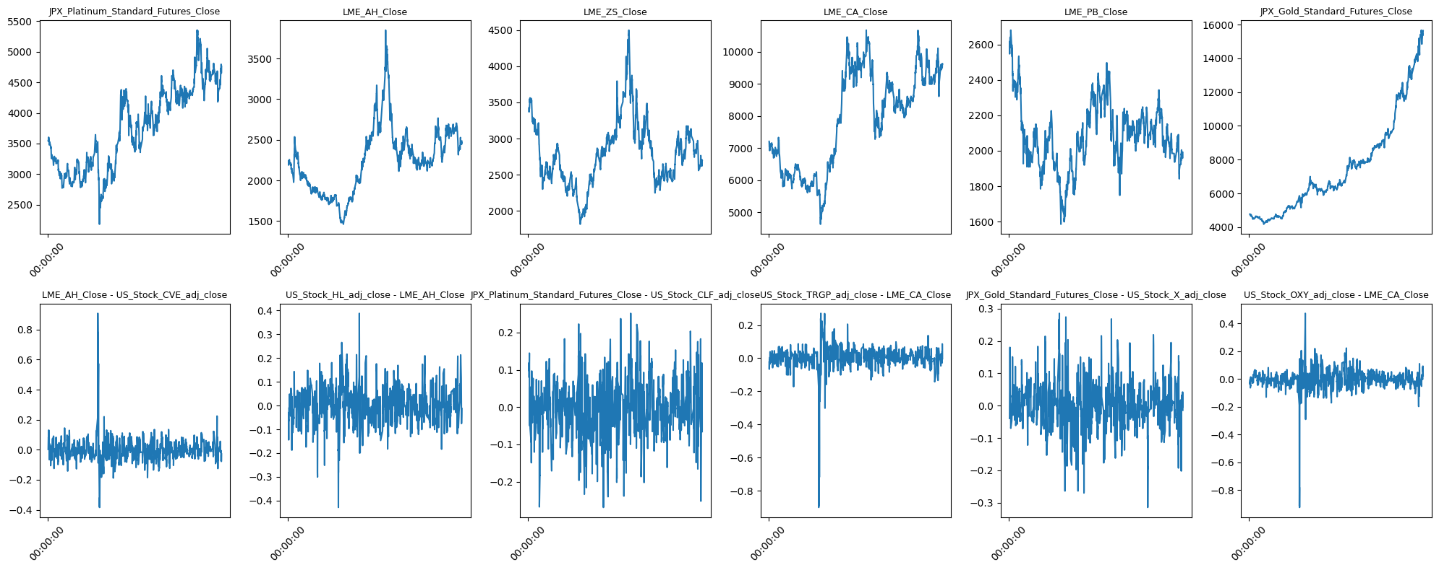
Target Trends Over Time
EDA CONT ‘D

Slide 12
Target Trends Over Time
Overall trend : To form the baseline for prediction.
Volatility: Indicates market risk and uncertainty which impacts model choice.
Seasonality/patterns : Provides insights for timing decisions, e.g when to buy/sell commodities.
Outliers: Could be caused by market shocks, policy changes, or data errors.
Forms the basis for data preprocessing and feature engineering

Slide 13

Data Preparation
Cleaning missing values & outliers
Checking for duplicates and data types
Normalization / scaling of variables
Mapping
Handling stationarity: differencing, log returns
Feature engineering: lags, rolling averages, volatility measures

Slide 14
Data Preprocessing and FEATURE Engineering
Stationary check
Spread calculations to create spread columns. These help us see how one asset is performing compared to another.
Create lag features for our dataset while avoiding data leakage

Slide 15
Modeling
BASELINE MODELS
Ridge & Lasso Regression
Linear Regression
Random Forest LightGBM
XGboost
ADVANCE MODELS
Gradient Boosting
ElasticNet
SVR
MLP Regressor

Slide 16
Evaluation
Mean Absolute Error (MAE): Average magnitude of prediction errors.
Root Mean Squared Error (RMSE): Measures error magnitude with greater penalty for larger deviations.
R-squared (R²): Proportion of variance explained by the model.
MAPE (Mean Absolute Percentage Error)
SMAPE (Symmetric MAPE)
Directional Accuracy: Percentage of correct predictions in the direction of price movement.

Slide 17
Evaluation baseline models

Slide 18
Evaluation baseline models cont’d
Ridge and Linear Regression achieved the highest combined score with directional accuracy of 0.72 and reasonable MAE/RMSE values.
Tree-based models performed well for most targets.
Lasso showed weaker performance on several targets, with very low directional accuracy for some folds.

Slide 19
Evaluation advanced models

Slide 20
Evaluation advanced cont’d
Gradient Boosting showed the strongest performance among this set, with an R² of 0.32 and directional accuracy of 0.71.
SVR and ElasticNet underperformed, with negative or near zero R² scores. SVR struggled with scalability, while ElasticNet failed to capture complex relationships in spread movements.
MLP Regressor performed poorly, with very high MAE/RMSE and strongly negative R².

Slide 21
TIME SERIES MODELS
SARIMA (Seasonal AutoRegressive Integrated Moving Average)
SARIMA + Ridge Hybrid

Slide 22
TIME SERIES MODEL EVALUATION
SARIMA alone produced relatively weak performance, with low directional accuracy and near-zero or negative R² on several targets.
The SARIMA + Ridge Hybrid consistently improved accuracy, reducing both MAE and RMSE while significantly boosting directional accuracy to 72 and R² of 42 compared to plain SARIMA.

Slide 23
COMBINED MODEL EVALUATION

Slide 24
COMBINED MODEL EVALUATION CONT’D
Best Model Ridge_Tuned achieved the highest CombinedScore, outperforming both untuned Ridge and advanced ensemble models.
Strong Baselines: Ridge and LinearRegression ranked closely behind, showing that linear methods remain competitive.
Hybrid Success: SARIMA+Ridge performed better than standalone SARIMA, proving that combining time-series modeling with machine learning improves results.
Tree-based Models: RandomForest and GradientBoosting showed strong but slightly weaker performance compared to tuned Ridge.
Weaker Models: ElasticNet, Lasso, and NaivePersistence underperformed significantly, while MLP collapsed with highly negative R².
SARIMA Alone: Bare SARIMA struggled, but adding Ridge correction significantly boosted its performance.

Slide 25
ENSEMBLE Modeling and evaluation
Selected the top 3 performing models based on a combination of R², MAE, and directional accuracy to do the ensemble modelling.

Slide 26
ENSEMBLE CONT’D
Best single model R²: 0.5504
Best ensemble R²: 0.7227
R² improvement: +0.1723
The ensemble outperforms individual models, providing more accurate predictions.

Slide 27
FEATURE IMPORTANCE

Slide 28
Recommendations
Go with the Ensemble-Weighted-Top3 Model
Energy Sector Features Matter Most
Markets Don’t Move in Isolation

Slide 29
Limitations
Market regimes change
The model is tuned for today’s conditions but markets evolve
Over-reliance on energy features might reduce accuracy in tech-led or defensive markets.
External shocks (wars, pandemics, policy changes)
Validation Gaps
Back tests are based on past data true future-proofing is untested.
Assumes markets remain liquid execution could fail during crises.

Slide 30
DEPLOYMENT
We deployed the Weighted Ensemble Method https://commodity-price-forecasting.streamlit.app/ as a price forecasting app.

Slide 31
NEXT STEP
Strengthen Validation Testing
Smarter Feature Engineering
Build a Monitoring System

