Slide 1
Commodity Price Forecasting Using Multi-Market Financial Time Series Data
Group members
SAMWEL ONGECHI
Marilyn akinyi
Erick mauti
Lydiah Chumba
Rose miriti
Isaac onyango
RODGERS OTIENO
PRESENTED BY: GROUP 5
TM : GEORGE KAMUNDIA

Slide 2
Business Understanding
Volatility in commodity markets impacts global trade and investments
Forecasting helps producers, traders, and policymakers make informed decisions
BUSINESS PROBLEM
Predicting commodity returns is particularly challenging due to:
Market volatility
Time-lagged effects
Dependencies across different financial instruments
How can we leverage time series data to predict commodity price movements?

Slide 3

Stakeholders
Commodity traders – optimize trading strategies
Investors –To manage portfolio risk
Policy makers and regulators – anticipate inflationary trends
Financial Analysts – provide data-driven forecasts

Slide 4
Objectives
To preprocess and integrate multi-market financial time series data for commodities.
To explore and analyze patterns, correlations, and volatility in commodity returns.
To develop predictive models for selected commodity prices and spreads.
To evaluate model accuracy and stability using appropriate performance metrics.
To generate insights that can support trading strategies and risk management.

Slide 5
Data Understanding
Sources: Kaggle (London Metal Exchange (LME), Japan Exchange Group (JPX), U.S. stock markets.
Target pairs and Train labels
Time horizon: Daily
Challenges: missing values, seasonality, volatility, external shocks

Slide 6
Visualizations (EDA)
Understand the distributions of target variables and features.
Identify trends, patterns, and outliers in the data.
Explore relationships between features and targets, including correlations and potential predictive signals.
Visualize time series behaviors since this is a temporal dataset.

Slide 7
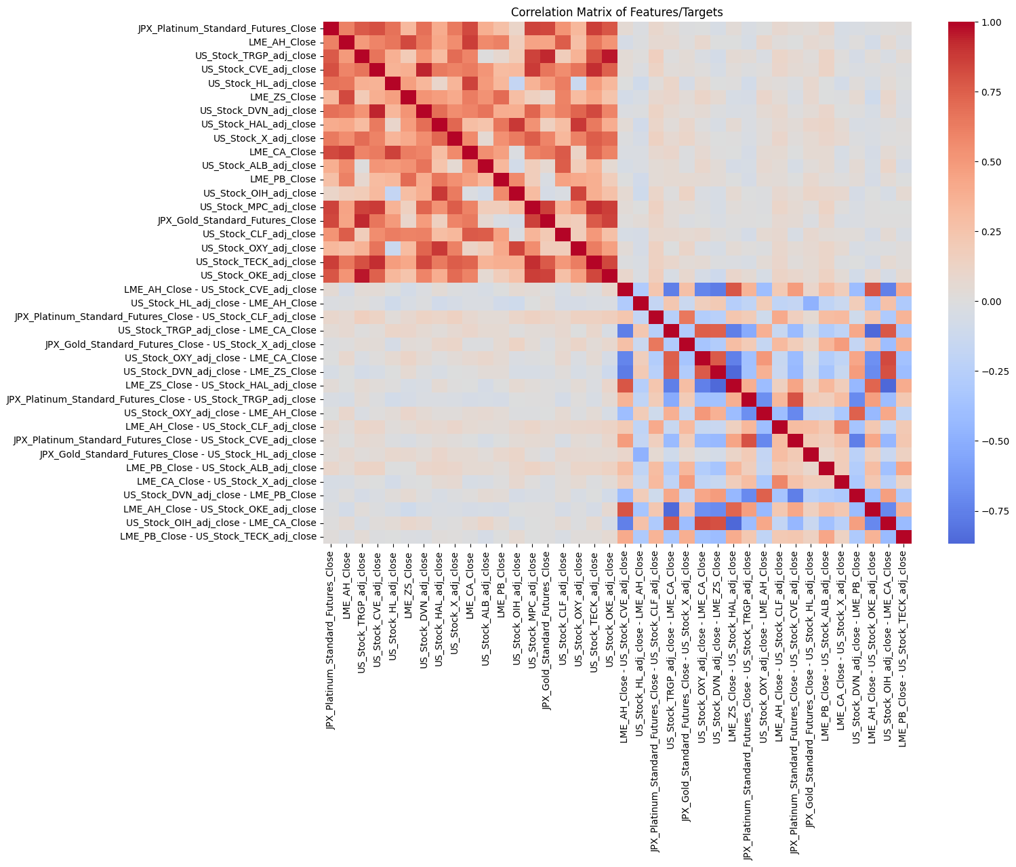
Visualizations (EDA) cont.….
Correlation Analysis

Slide 8
Visualizations (EDA) cont.….
Applied 0.9 correlation threshold to flag highly correlated pairs.
A total of 5 pairs exceeded this threshold, meaning they may introduce multicollinearity risks if included together in models.

Slide 9
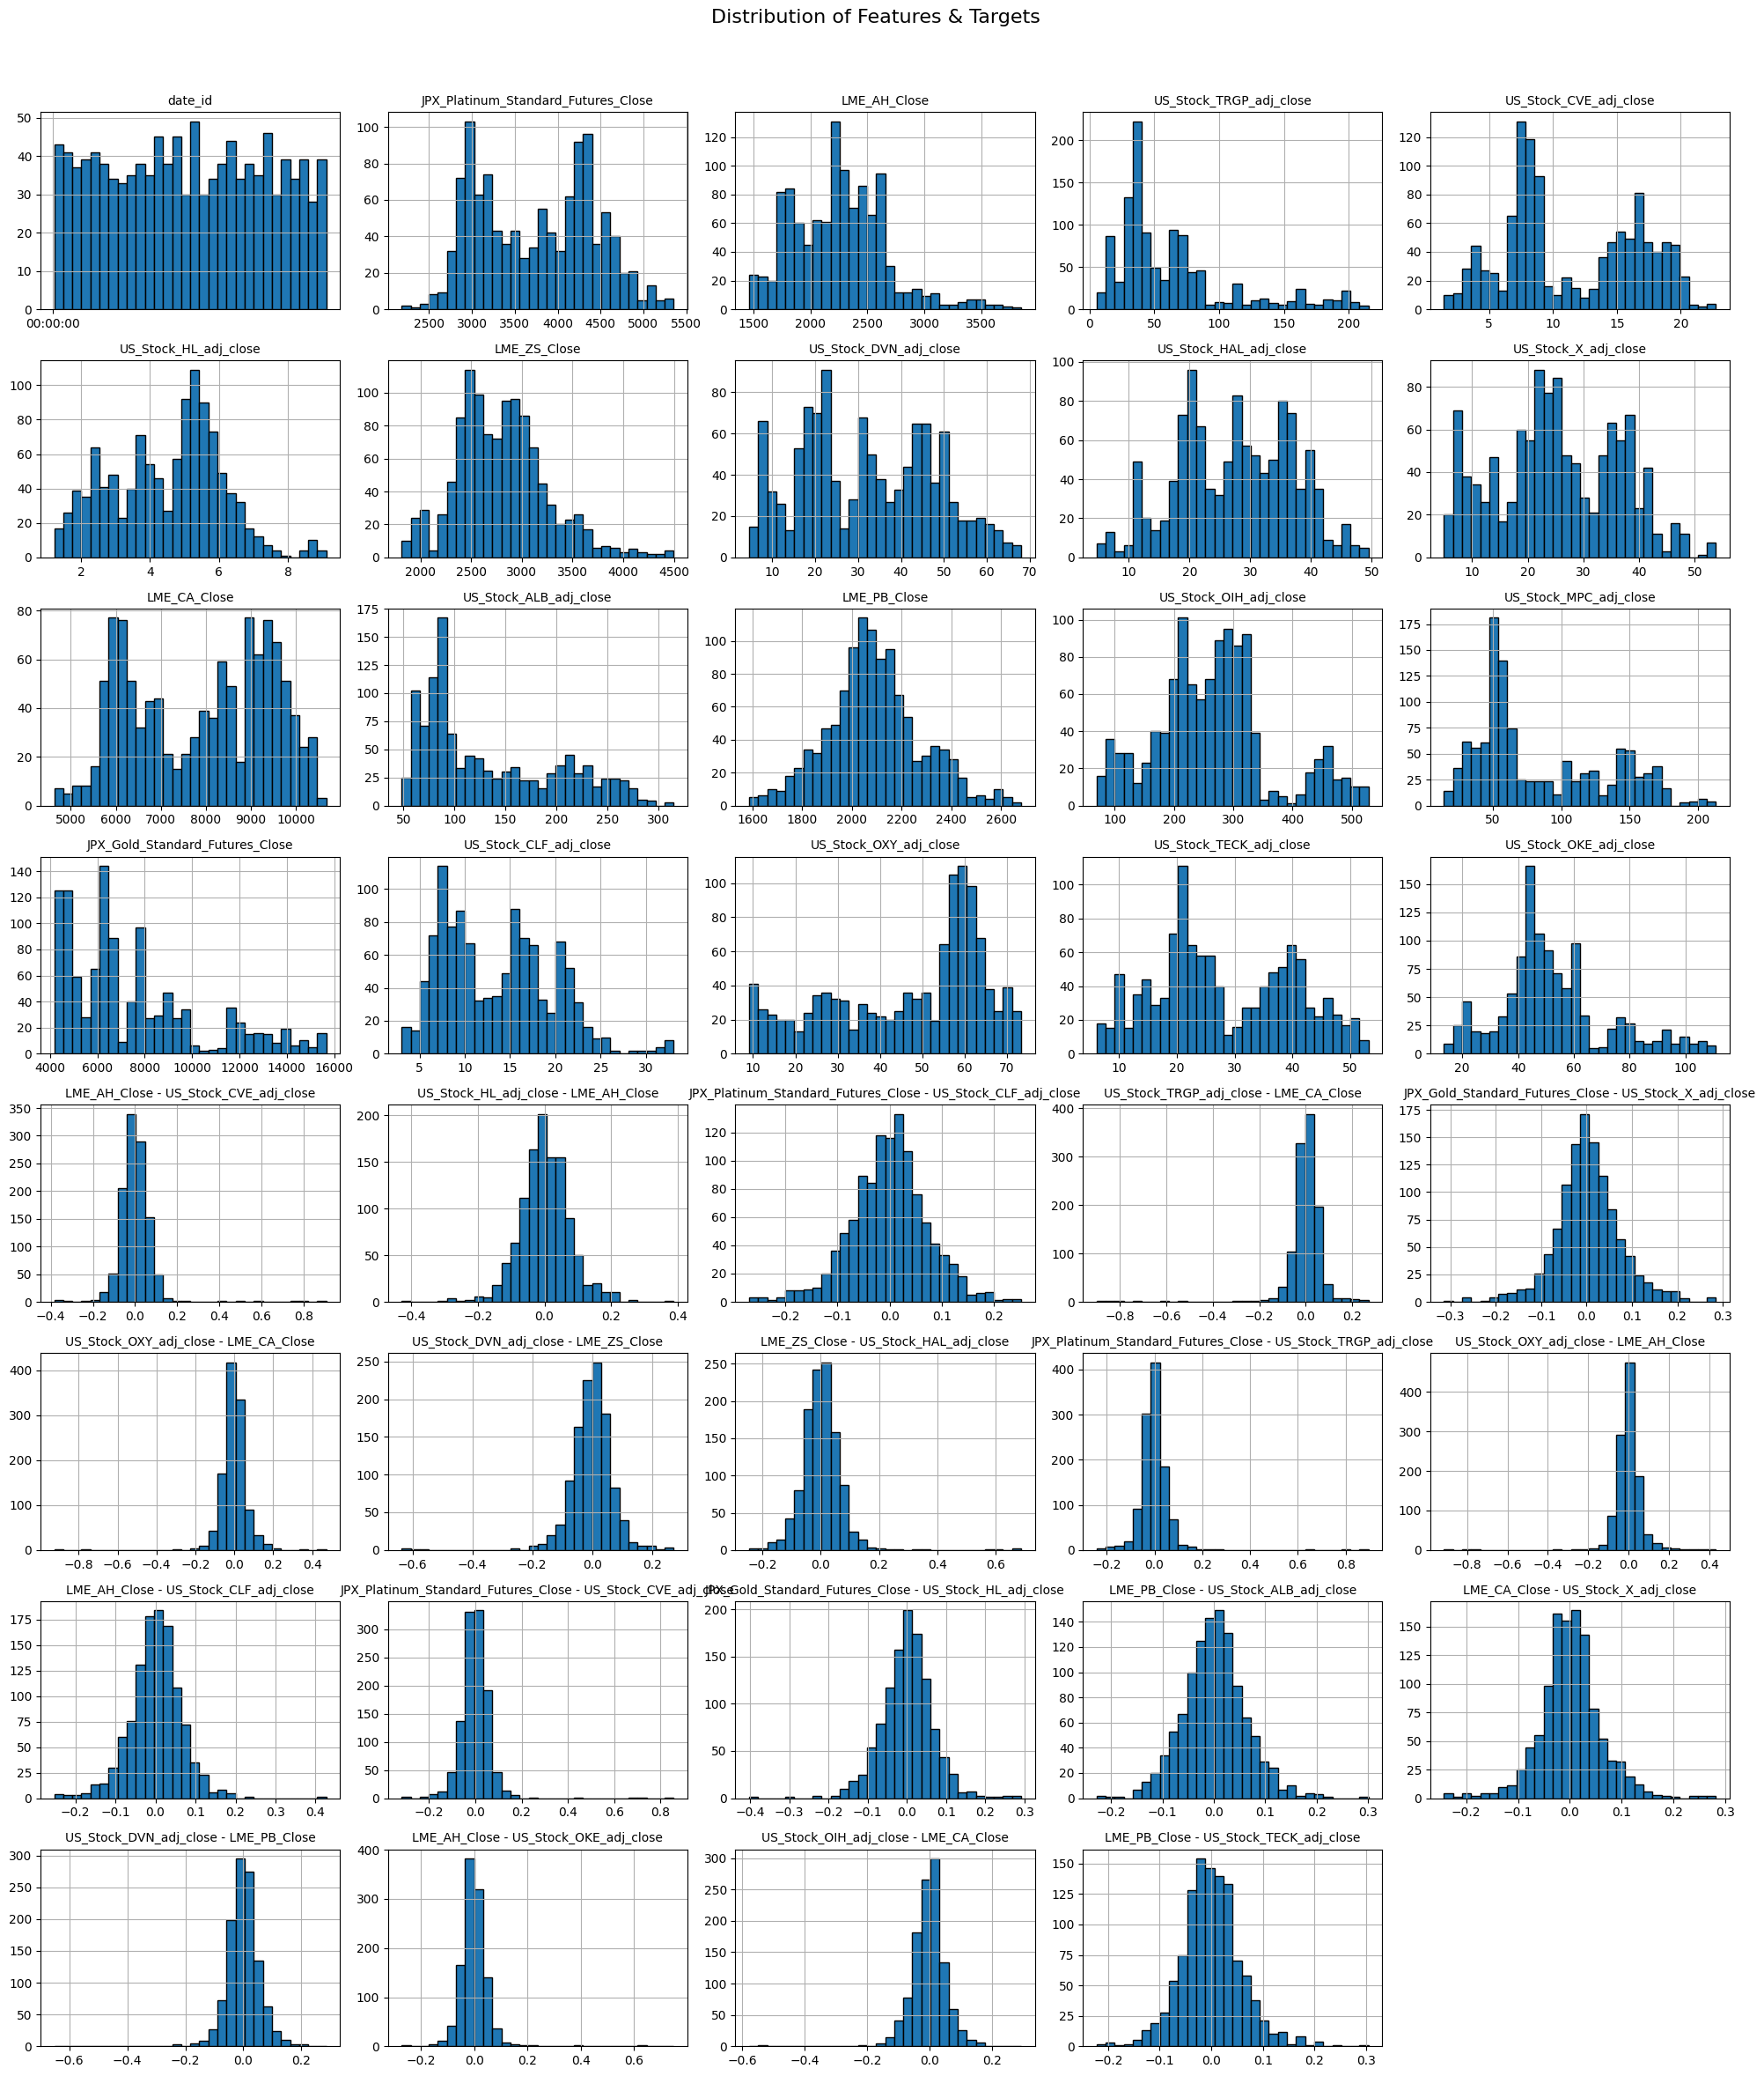

Slide 10
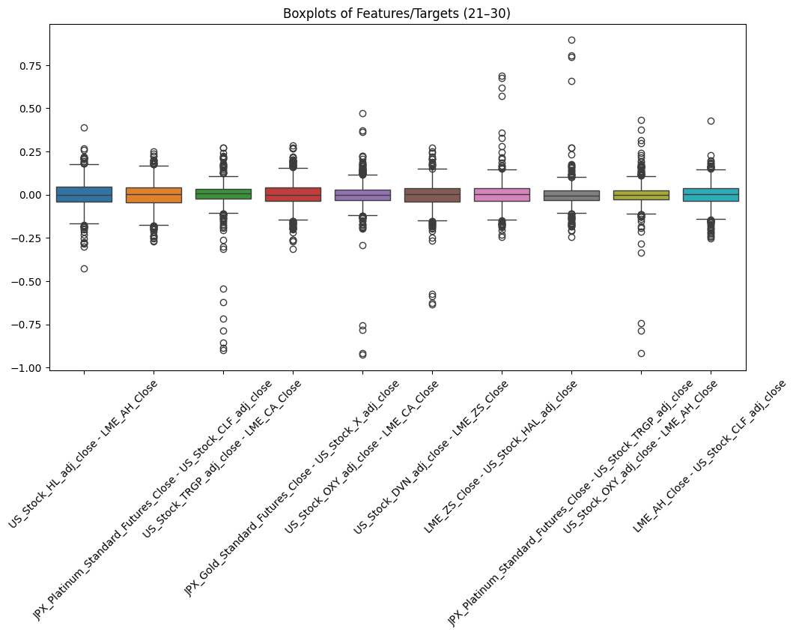
Boxplot of Features & Targets

Slide 11
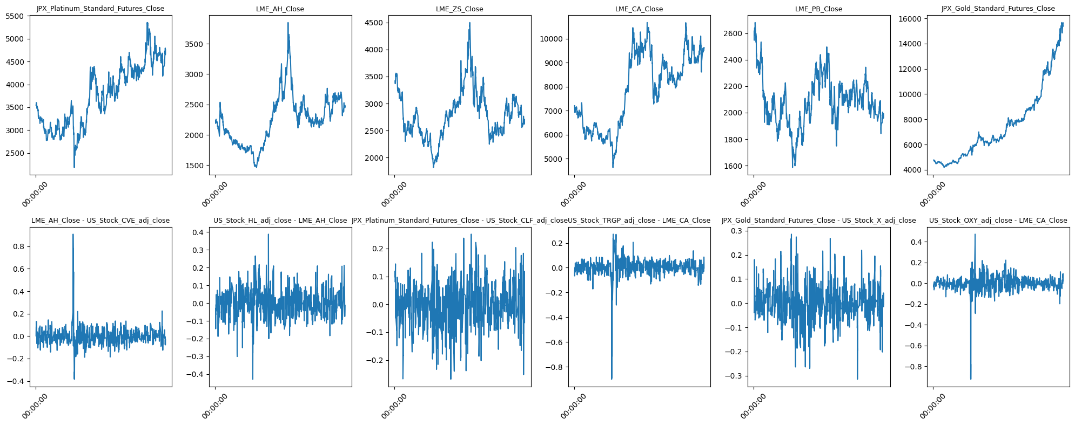
Target Trends Over Time
Notes:
Overall trend
Volatility
Seasonality/patterns
Outliers

Slide 12

Data Preparation
Cleaning missing values & outliers
Normalization / scaling of variables
Mapping
Handling stationarity: differencing, log returns
Feature engineering: lags, rolling averages, volatility measures

Slide 13
Modeling
BASELINE MODELS
Linear Regression
Random Forest
XGBoost
LightGBM
ADVANCE MODELS
Gradient Boosting
ElasticNet
SVR
MLP Regressor
TIME SERIES MODEL- SARIMA

Slide 14
Evaluation
Mean Absolute Error (MAE): Average magnitude of prediction errors.
Root Mean Squared Error (RMSE): Measures error magnitude with greater penalty for larger deviations.
R-squared (R²): Proportion of variance explained by the model.
MAPE (Mean Absolute Percentage Error)
SMAPE (Symmetric MAPE)
Directional Accuracy: Percentage of correct predictions in the direction of price movement.

Slide 15
Evaluation

Slide 16
Evaluation cont.…..

Slide 17
Evaluation cont.…
Best Model `Ridge Tuned` achieved the highest Combined Score, outperforming both untuned Ridge and advanced ensemble models.
-Strong Baselines: Ridge` and `LinearRegression` ranked closely behind, showing that linear methods remain competitive.
-Hybrid Success:`SARIMA+Ridge` performed better than standalone SARIMA, proving that combining time-series modeling with machine learning improves results.
Tree-based Models:`RandomForest` and `GradientBoosting` showed strong but slightly weaker performance compared to tuned Ridge.
Weaker Models:`ElasticNet`, `Lasso`, and `NaivePersistence` underperformed significantly, while `MLP` collapsed with highly negative R².
SARIMA Alone:Bare SARIMA struggled, but adding Ridge correction significantly boosted its performance.

Slide 18
ENSEMBLE MODELING

Slide 19
Evaluation cont.…
Best single model R²: 0.5504
Best ensemble R²: 0.7227
R² improvement: +0.1723
The ensemble outperforms individual models, providing more accurate predictions.

Slide 20
Feature importance

Slide 21
Recommendations
Go with the Ensemble-Weighted-Top3 Model
Energy Sector Features Matter Most
Markets Don’t Move in Isolation

Slide 22
NEXT STEP
Strengthen Validation Testing
Smarter Feature Engineering
Build a Monitoring System

Slide 23
Limitations
Market regimes change
The model is tuned for today’s conditions but markets evolve
Over-reliance on energy features might reduce accuracy in tech-led or defensive markets.
External shocks (wars, pandemics, policy changes)
Validation Gaps
Back tests are based on past data true future-proofing is untested.
Assumes markets remain liquid execution could fail during crises.

