Slide 1
Title: Introduction to HTML Tags
Subtitle: Understanding HTML Tags and Examples

Slide 2
What is HTML?
Definition:HTML (HyperText Markup Language) is the standard language used to create and design web pages. It structures content and describes the elements of a webpage.Purpose:Content Structuring: Defines the structure of a web page using tags and elements.Formatting: Provides basic formatting for text, images, and links.Navigation: Links different web pages together through hyperlinks.Integration: Supports embedding of multimedia and interactive elements.

Slide 3
Purpose:
Content Structuring: Defines the structure of a web page using tags and elements.
Formatting: Provides basic formatting for text, images, and links.Navigation: Links different web pages together through hyperlinks.
Integration: Supports embedding of multimedia and interactive elements.

Slide 4
HTML Syntax
<!DOCTYPE html> <html> <head> <title>Page Title</title> </head> <body> <h1>Main Heading</h1> <p>This is a paragraph.</p> </body> </html>

Slide 5
<!DOCTYPE html>: Declares the document type.
<html>: Root element of the HTML document.
<head>: Contains meta-information about the document.
<title>: Sets the document’s title.
<body>: Contains the visible content of the page.
<h1>: Represents a main heading.
<p>: Represents a paragraph.

Slide 6
HTML Heading Tags
Purpose:Headings define the structure of the content on a web page, creating a hierarchy of information.
<body> <h1>Main Heading</h1> <h2>Subheading Level 2</h2> <h3>Subheading Level 3</h3> <h4>Subheading Level 4</h4> <h5>Subheading Level 5</h5> <h6>Subheading Level 6</h6> </body>

Slide 7
Output
<h1>: Main Heading (Largest and most important)
<h2>: Subheading Level 2 (Smaller than <h1>)
<h3>: Subheading Level 3 (Smaller than <h2>)
<h4>: Subheading Level 4 (Smaller than <h3>)
<h5>: Subheading Level 5 (Smaller than <h4>)
<h6>: Subheading Level 6 (Smallest and least important)
<h1>: Main Heading (Largest and most important)<h2>: Subheading Level 2 (Smaller than <h1>)<h3>: Subheading Level 3 (Smaller than <h2>)<h4>: Subheading Level 4 (Smaller than <h3>)<h5>: Subheading Level 5 (Smaller than <h4>)<h6>: Subheading Level 6 (Smallest and least important)

Slide 8
HTML Paragraph Tag
<p>This is the first paragraph. It introduces the content and is separated from other paragraphs by space.</p>
Output: “This is the first paragraph. It introduces the content and is separated from other paragraphs by space.”

Slide 9
HTML Bold Text
<p>This is <strong>bold</strong> text.</p>
Output :
“This is bold text.”
The word “bold” is displayed in bold font.

Slide 10
Italic text
<p>This is an example of <i>italicized text</i> </p>
Output :
This is an example of italicized text using the <i> tag.

Slide 11
Subscripted text and superscripted text
<!DOCTYPE html>
<html>
<head>
<title>Subscript and Superscript Example</title>
</head>
<body> <p>Chemical formula: H<sub>2</sub>O</p>
<p>Mathematical exponent: E = mc<sup>2</sup></p>
</body>
</html>
Output :
Chemical formula: H₂O
mathematical exponent: E = mc²

Slide 12
More tags
MarkedTag <mark>
SmallTag<small>
Deleted Tag<delete>
InsertedTag<ins>
BreakTag<br>
Block quoteTag<blockquote>
QuotationTag<q>

Slide 13
ImaGe tag
<img src=https://via.placeholder.com/150 alt="Placeholder Image">
Explanation:<img>: The tag itself.src: Specifies the path to the image file.
In this example, it uses a URL to an image placeholde.
alt: Provides alternative text for the image if it cannot be displayed.

Slide 14
Table tag
<table>
<thead>
<tr> <th>Name</th>
<th>Subject</th>
<th>Grade</th>
</tr> </thead>
<tbody>
<tr>
<td>Alice</td>
<td>Mathematics</td>
<td>A</td> </tr>
<tr> <td>Bob</td> <td>Science</td> <td>B</td> </tr> <tr> <td>Charlie</td> <td>English</td> <td>A</td> </tr> </tbody> </table>

Slide 15
Output
Name | Subject | Grade
Alice | Mathematics | A
Bob | Science | B
Charlie | English | A

Slide 16
Ordered list
<ol>
<li>Apple</li>
<li>Banana</li>
<li>Cherry</li>
<li>Date</li>
</ol>
Output:The output will be a webpage with a heading “My Favorite Fruits” followed by a numbered list of fruits:
1.Apple
2.Banana
3.Cherry
4.Date

Slide 17
Un ordered list
<ul>
<li>Red</li>
<li>Blue</li>
<li>Green</li>
<li>Yellow</li>
</ul>
Output :
.Red
.Blue
.Green
.Yellow

Slide 18
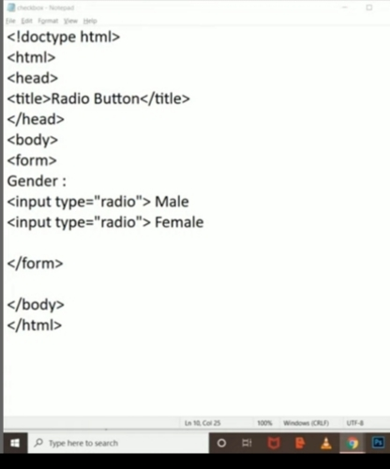
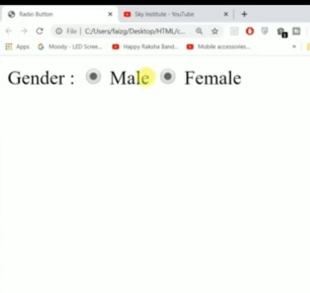
Radio button
Output

Slide 19
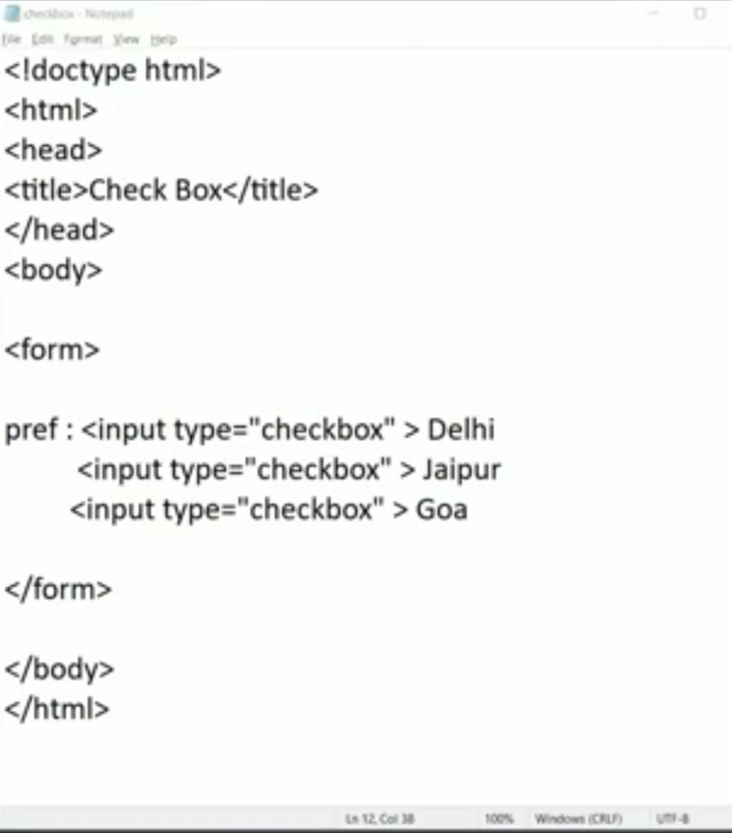
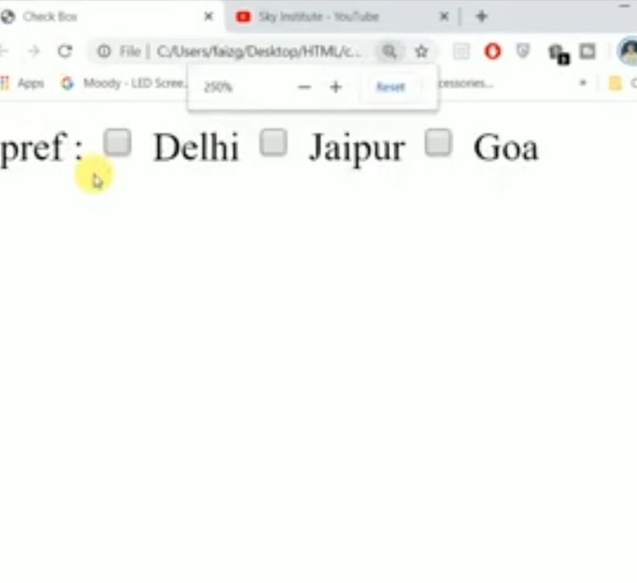
Check box
Output

Slide 20
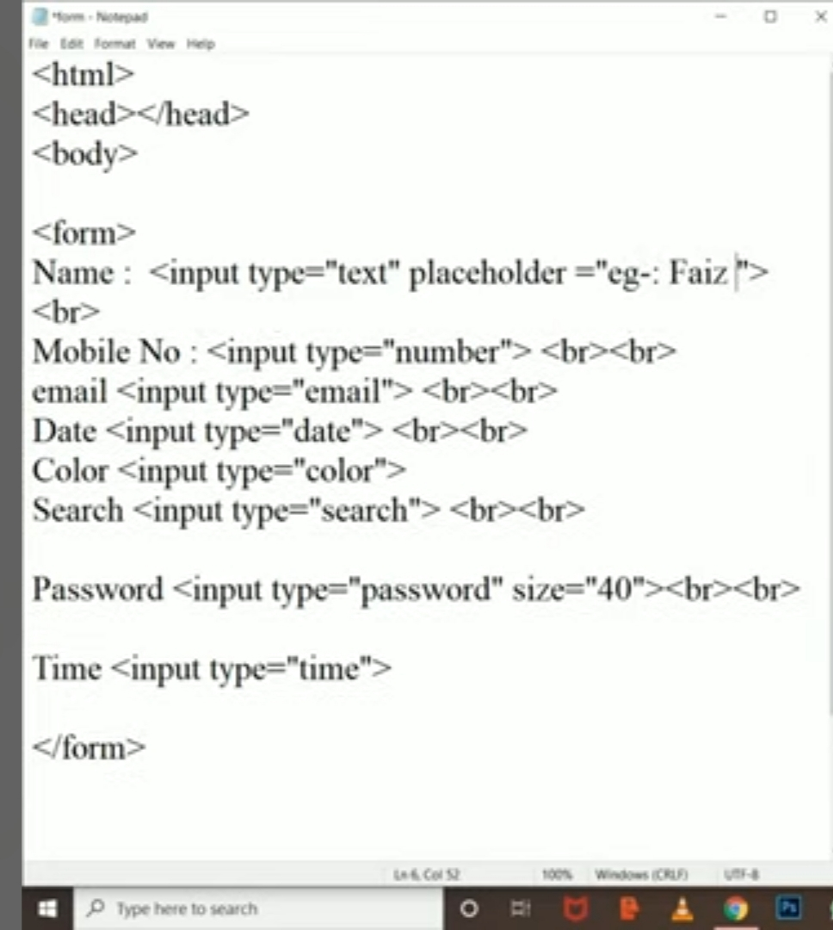
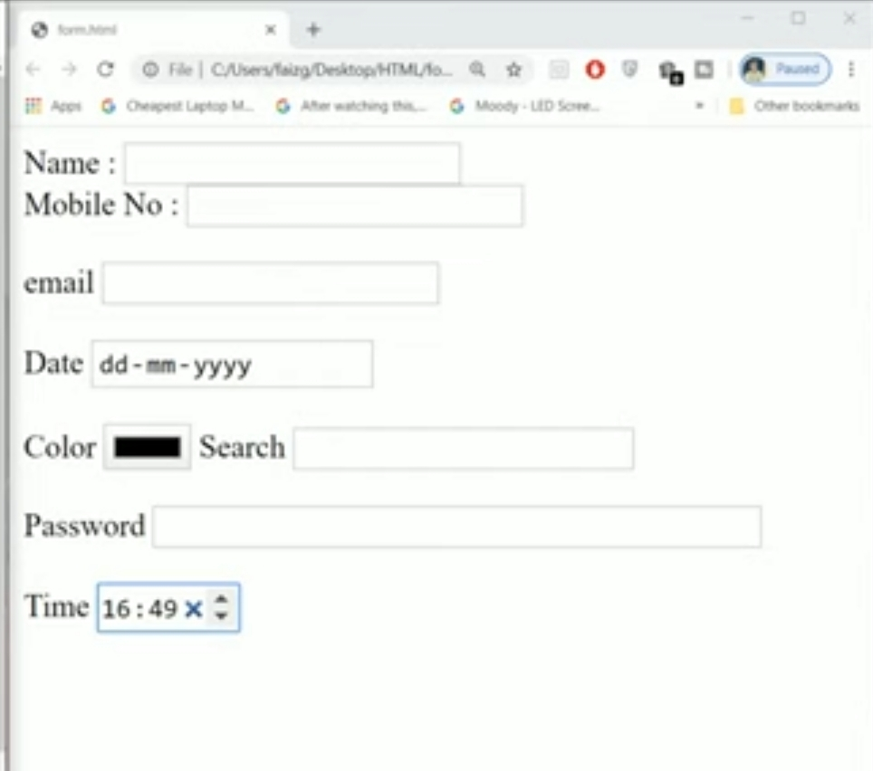
Input types
Output

