Slide 1
Example Project in html

Slide 2
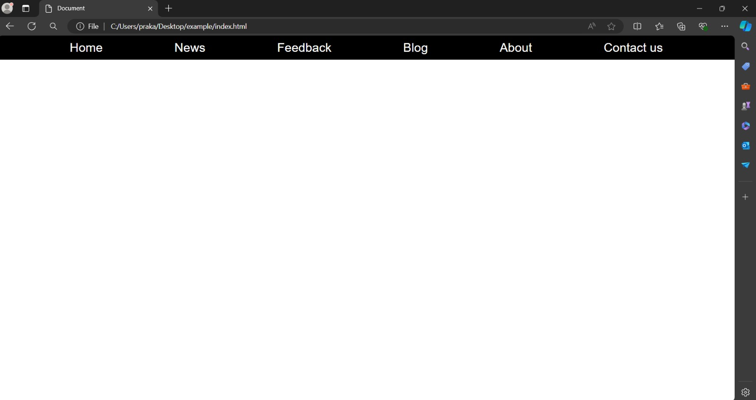
Example 1

Slide 3
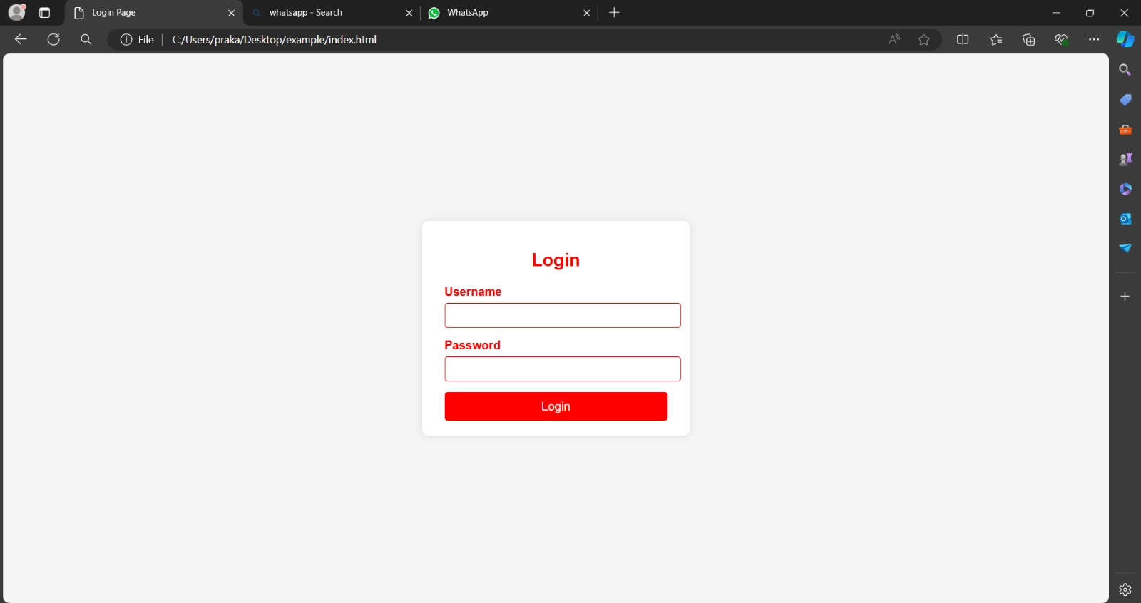
Example 2

