Slide 1
SPARK TUTORING · FULL STACK CHALLENGE
MARIN JURSIC · AUGUST 2026
A focused team
task tracker.
Clear ownership. Fast updates. Deliberate scope.
01
Notes:
Open with the outcome: a complete, intentionally small tracker that is easy to use and easy to review.
[Sources]
- Spark Tutoring Full Stack Developer - Task Tracker Challenge.pdf (provided brief)
- Spark Team Task Tracker README.md (project overview)

Slide 2
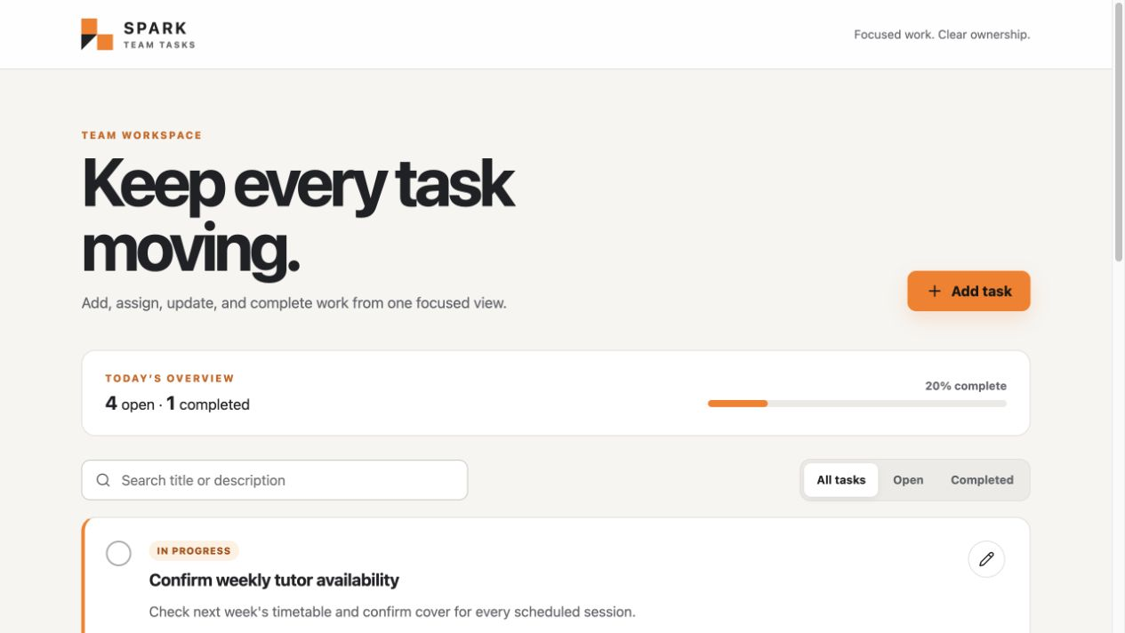
All four required actions share one focused view.
01
Add
Capture a clear title, description, and owner.
02
Edit
Update wording or reassign work in one dialog.
03
Assign
Choose from seeded example team members.
04
Complete
Toggle status in either direction without losing context.
02
Notes:
Walk through the four actions in order. The screenshot is from the browser-verified application, not a mockup. Mention search and status filters only after the required flow.
[Sources]
- Spark Tutoring Full Stack Developer - Task Tracker Challenge.pdf (required features)
- docs/assets/task-tracker-desktop.png (local browser QA capture)

Slide 3
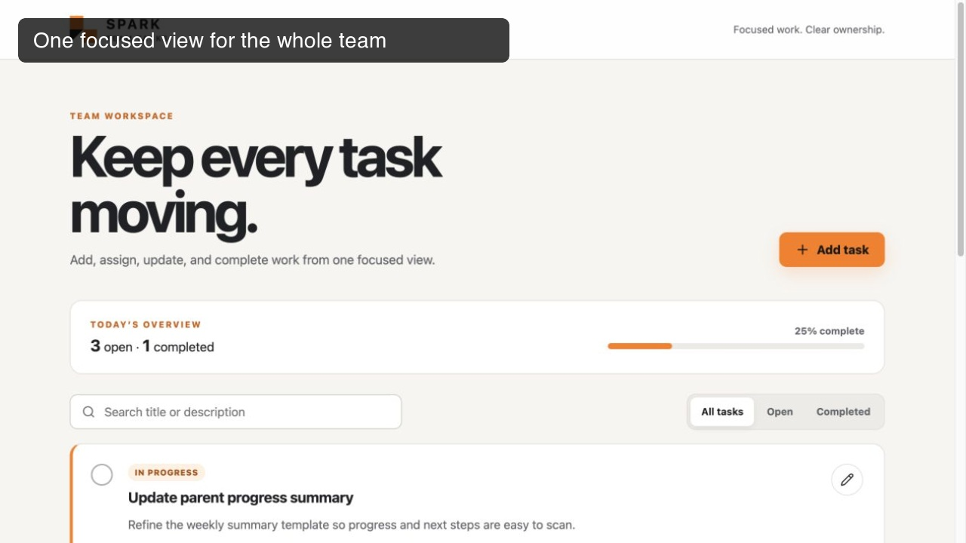
Play the complete 32-second task flow.
VIDEO PREVIEW · 00:32
03
Notes:
Play the embedded preview to show the required workflow in one concise sequence: add a task, assign an owner, edit and reassign it, mark it complete, then demonstrate search and status filtering.
[Sources]
- docs/assets/spark-task-tracker-demo.mp4 (local browser walkthrough, 32 seconds)
- tmp/presentation-video-update/capture-01-overview.jpg through capture-09-search-filter.jpg (browser captures)

Slide 4
Scope discipline keeps the product simple.
Included
Intentionally excluded
01
Persistent CRUD subset
01
Authentication
Create and update only - deletion was not requested.
A pretend login would add risk without a user requirement.
02
One practical bonus
02
Due dates and priority
Search and status filters improve daily use at low complexity.
Mentioned as optional, but not needed to prove the core flow.
03
Demo-ready data
03
Extra infrastructure
Four realistic users and tasks arrive through a reversible migration.
No speculative services, state library, or delete workflow.
04
Notes:
Explain the trade-off: quality is concentrated on the required workflow. Search/filter is the only chosen bonus because it delivers immediate value without expanding the data model.
[Sources]
- Spark Tutoring Full Stack Developer - Task Tracker Challenge.pdf (required and bonus features)
- README.md (deliberate trade-offs)

Slide 5
Clear boundaries keep changes local.
Each layer has one job, and every boundary is replaceable without rewriting the rest.
React UI
API service
Django REST
ORM + data
01
02
03
04
Accessible interaction
and responsive views
Typed transport and
error translation
Validation and
use-case coordination
SQLite by default;
PostgreSQL by config
PostgreSQL support is configuration, not a second code path.
05
Notes:
Move left to right. React renders; the API service owns HTTP; Django REST validates and coordinates; the ORM persists. Call out the SQLite/PostgreSQL choice as review convenience, not architectural compromise.
[Sources]
- frontend/src (application source)
- backend/tasks and backend/config (application source)
- README.md (architecture and technology choices)

Slide 6
Quality is visible at every layer.
The same fast checks run locally and in GitHub Actions, supported by hands-on browser QA.
12
3
2
backend tests
frontend tests
verified viewports
Models, validation, filtering, assignment, editing, and status changes.
Required task content, actions, search, and filter interactions.
Desktop and mobile flows, including the responsive edit dialog.
0 browser console warnings or errors in the verified workflow
06
Notes:
Use the numbers as evidence, not decoration. The backend tests cover every required behavior. The browser pass exercised add, edit, assign, complete/incomplete, search, filters, and responsive layout with a clean console.
[Sources]
- backend/tasks/tests (12 passing tests)
- frontend/src/components/*.test.tsx (3 passing tests)
- .github/workflows/ci.yml (automated checks)
- Local browser QA run on 2026-08-07

Slide 7
SUBMISSION HANDOFF
Ready to review
in minutes.
Run
Review
Walk through
Install, migrate, and start
with the documented commands.
README, focused source,
and automated CI checks.
Prepared 2–5 minute Loom,
plus the embedded app preview.
07
Notes:
Close on review readiness. The repository is self-contained, the setup path is short, and the Loom script keeps the video within the requested time.
[Sources]
- README.md (setup and review path)
- docs/LOOM_SCRIPT.md (2-5 minute walkthrough)
- output/presentation/Spark-Task-Tracker-Walkthrough.pptx

