Slide 1
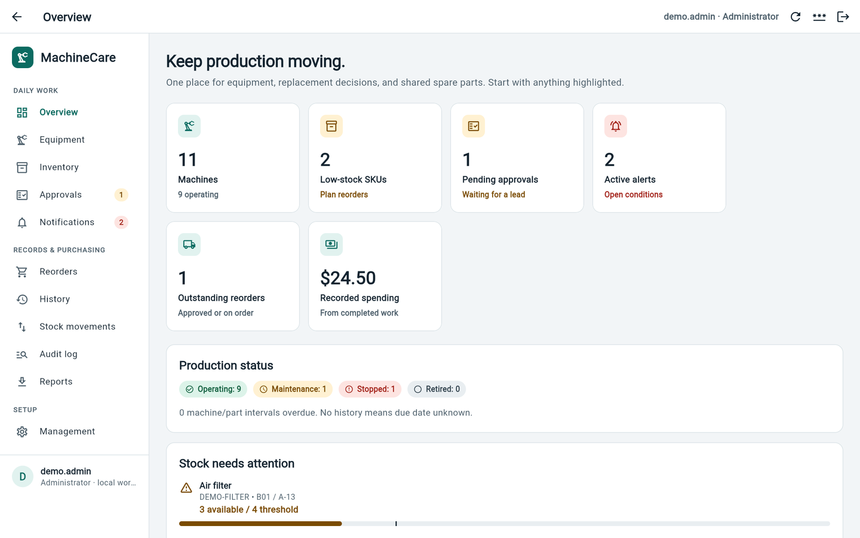
MachineCare
MANAGER REVIEW · 19 OCTOBER 2026
Equipment, spare parts and every replacement in one traceable record
Working local pilot for DIMM press and AOI lines
Walkthrough of the app as it runs today
What still stands between the pilot and production
Ask: approve a one-line validation pilot
Notes:
Open with the purpose: MachineCare connects machines, shared spare parts and each replacement so we can answer what was replaced, where, by whom, with which part and at what cost. Today it is a working local pilot on this laptop, not a company-wide production system. The screenshots in this deck come from the real application running on a demonstration copy of the data. The ask at the end is a supervised one-line validation pilot.

Slide 2



Three questions maintenance must answer quickly
WHY THIS MATTERS
Which machine?
What do we have?
What happened?
Building › line › station › machine, with the parts each machine type is compatible with.
Physical, reserved and available stock for shared spares, and low-stock alerts before a line waits on a part.
Who replaced which part, when, where, why, and at what cost, recorded at the moment the work is completed.
One workflow: Request → Review → Reserve stock → Complete → Traceable history
Notes:
These are intended benefits, not measured savings. Today this information is spread across people, paper and spreadsheets. The pilot should measure three things: traceability of replacements, stock accuracy, and how easy the app is for operators.

Slide 3
A complete working pilot, not a mock-up
WHAT EXISTS TODAY
11
3
11
20
screens
roles
machines
catalog parts
Overview to Reports
Admin · Lead · Technician
6 DIMM + 3 AOI + 2 others
with real DIMM/AOI references
Built with
Verified by automated tests
Flutter web front end (works on desktop, tablet, phone)
Python API using only the standard library
SQLite database with 7 ordered schema migrations
Optional background worker: checks, backups, email
140 backend tests: permissions, stock, workflows, security, backups
45 Flutter widget tests: screens, roles, forms, layouts
Static analysis: no issues found
Notes:
Everything shown in the walkthrough works end to end in the browser. Test counts are from a run on 19 October 2026 against disposable databases. Tests prove the rules behave; they do not replace a signed-in acceptance session with real users, which is still on the production list.

Slide 4
Every configured line: two DIMM presses and one AOI
PRODUCTION MODEL
B01 / L01
DIMM press 1
DIMM press 2
AOI · TM robot cell
10
DIMM part references
7
AOI component references
B01 / L02
DIMM press 1
DIMM press 2
AOI · TM robot cell
B03 / L02
DIMM press 1
DIMM press 2
AOI · TM robot cell
6 DIMM + 3 AOI
+ existing ACOS station and conveyor = 11 equipment records
Part names, manufacturers, model numbers and quantities per machine were supplied by maintenance (see appendix). New asset tags, stations and statuses are placeholders until a physical survey.
Notes:
Three lines are configured: B01/L01, B01/L02 and B03/L02. Each has two DIMM presses and one AOI, which gives six DIMMs and three AOIs. The existing ACOS station and conveyor were kept, giving 11 equipment records. Part references are real; asset tags and stations for the newly added machines are placeholders.

Slide 5
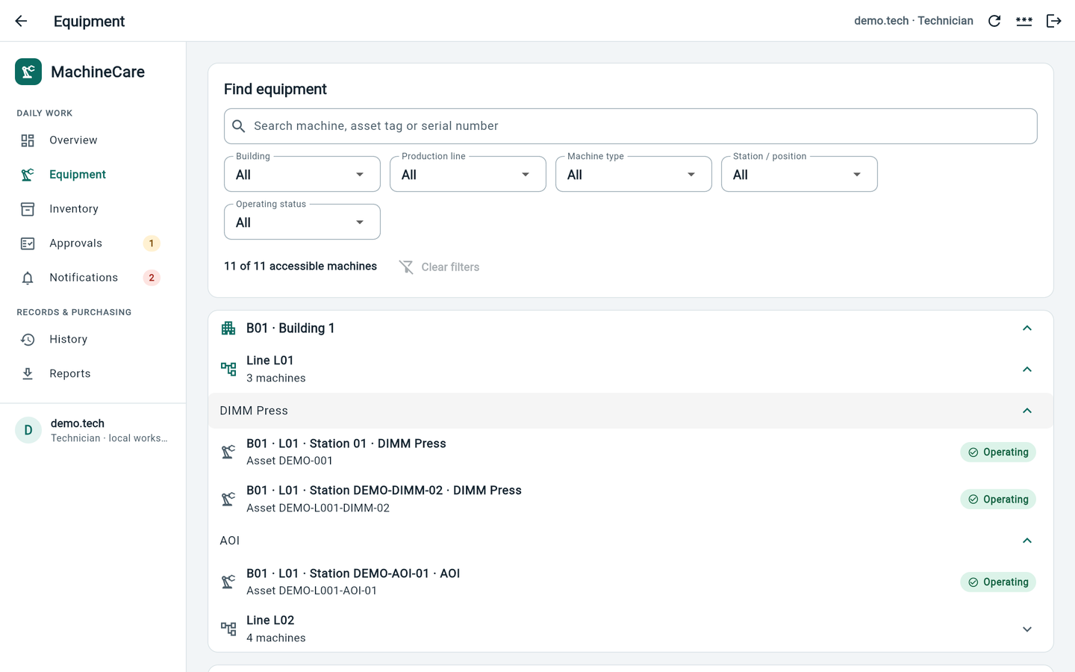
Three roles, enforced on the server
WHO DOES WHAT
Capability | Admin | Lead | Tech
View assigned machines and history | ✓ | ✓ | ✓
Request a replacement; complete own work | ✓ | ✓ | ✓
Review early work, complete others' work | ✓ | ✓ | –
Catalog, stock receipts and adjustments | ✓ | ✓ | –
Purchasing, audit log, stock ledger, exports | ✓ | ✓ | –
Accounts, access, buildings and lines, backups | ✓ | – | –
Technician view: no Management, Reorders, Audit or Stock screens
Technicians see a shorter menu, and only the lines they are assigned to. Hiding buttons is not the protection: the server checks every action.
Notes:
Administrator: accounts, access, plant structure, system configuration and backups. Lead: runs operations, including the catalog, stock, purchasing, approvals and audit, but can never edit accounts. Technician: works on assigned machines and can complete or cancel only their own work. Machine access is scoped by building and line, and moves check both the source and the destination line.

Slide 6
The overview puts today's exceptions first
WALKTHROUGH 1 · OVERVIEW
Start with what needs attention
1
Attention cards
Turn amber or red when action is needed; click one to jump to that page
2
Production status
Operating, maintenance, stopped and retired, each with colour and icon
3
Stock needs attention
Parts at or below their reorder level, with a stock bar
Demo database · illustrative values
Notes:
This is the landing page after sign-in. Point at the counters, then the production status chips, then the low-stock list. In the demo, the solenoid valve shows 8 available against a threshold of 10. These numbers come from the demo copy, not from real stock.

Slide 7
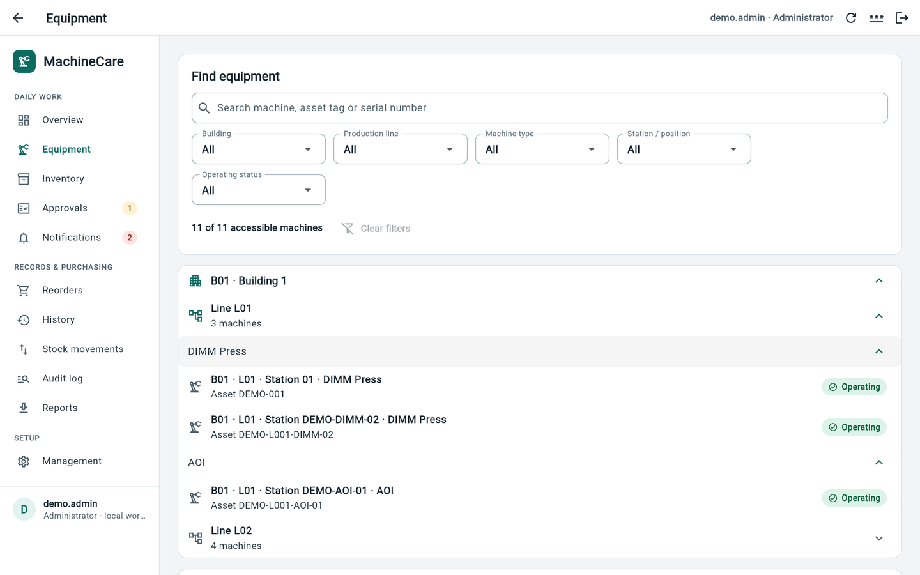
Find the line, then the machine
WALKTHROUGH 2 · EQUIPMENT
Navigate the plant
1
Building › line › type
Expandable tree; each machine shows station, asset tag and status
2
Search and filters
By asset tag, serial, building, line, type, station and status
3
Scoped
Each user only sees the buildings and lines they are assigned
Demo database · illustrative values
Notes:
Expand B01, then L01: two DIMM presses and one AOI. Open a machine to see its compatible parts and request a replacement. Leads and administrators can register, edit, move or retire machines inside their scope.

Slide 8
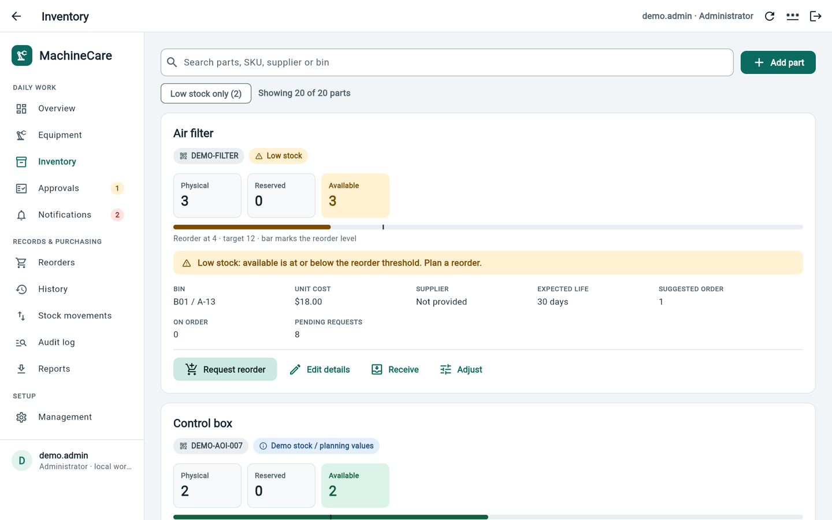
Shared spare parts with honest labels
WALKTHROUGH 3 · INVENTORY
Every part shows
1
Physical · reserved · available
Three clear tiles plus a bar marking the reorder level
2
Real references kept
Manufacturer, model or serial, and quantity per machine
3
Demo values flagged
A blue tag marks stock, prices, bins and intervals as placeholders
Demo database · illustrative values
Notes:
Example: the AOI control box shows VEVOR and the supplied serial number. The tag 'Demo stock / planning values' means the opening stock, $0 price, bin and 365-day interval are placeholders. Receive, adjust and reorder are available to leads and administrators; adjustments need a reason and cannot consume reserved stock.

Slide 9
From request to an auditable replacement
WALKTHROUGH 4 · MAINTENANCE FLOW
01
02
03
04
05
Request
Review
Reserve
Complete
Record
Technician picks machine and compatible part
Early work needs an explanation and lead review
Approval holds stock without deducting it
One atomic stock deduction, at completion
History and ledger keep who, where, cost
Approval reserves stock. Only completion deducts physical inventory. Cancelling never deducts.
If someone else completes or cancels your request, you are notified. The history keeps both the original requester and the person who did the work.
Notes:
This is the heart of the system. A normal request is approved immediately and reserves stock. If the same part on the same machine is replaced before its expected life, the technician must explain why and a lead reviews it. A pending early request reserves nothing. Completion deducts stock exactly once, creates the history record and releases the reservation. If completion fails, the reservation stays.

Slide 10
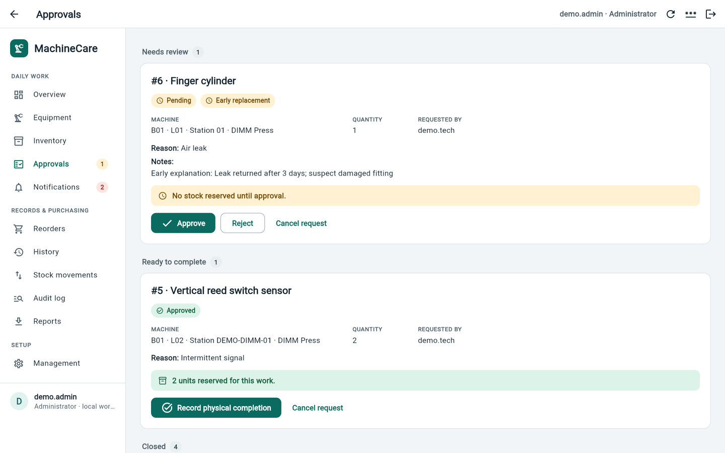
Review early work before anyone records completion
WALKTHROUGH 5 · APPROVALS
Grouped by what to do next
1
#6 Pending · early
Finger cylinder: the technician's explanation is shown for the lead
2
#5 Approved
2 reed switches reserved; ready to record physical completion
3
#4 Completed
Locked; it now appears in History and Stock movements
Demo database · illustrative values
Notes:
Request 6 is an early replacement: the leak came back after three days. A lead can approve or reject it with a comment, but cannot approve their own request. Request 5 is approved and holds two units in reserve. Record physical completion only after the work is actually done.

Slide 11
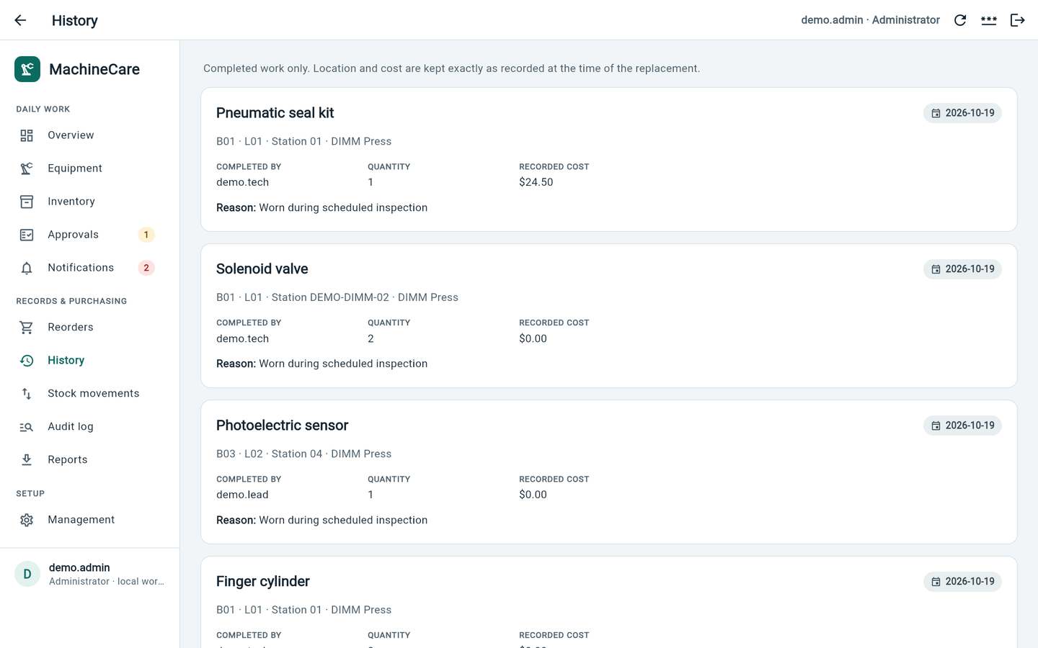
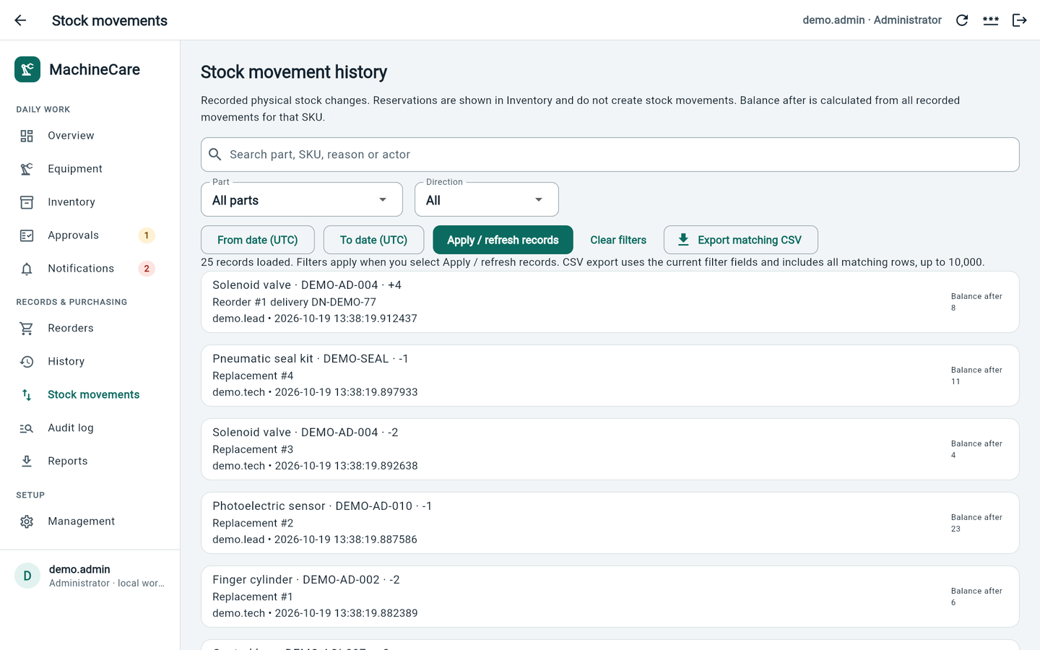
History and stock movements explain every change
WALKTHROUGH 6 · TRACEABILITY
History Part, machine location, who, when, quantity and cost, kept as a snapshot even if the machine later moves or the price changes
Stock movements Every receipt, adjustment and deduction with actor, reason and running balance. Filters and CSV export
Notes:
History shows completed work only. Because location and cost are snapshots, older records stay correct when things change later. The stock ledger is append-only: nothing is overwritten, and corrections are new, explained entries. Recorded costs of $0 are the unknown-price placeholders.

Slide 12
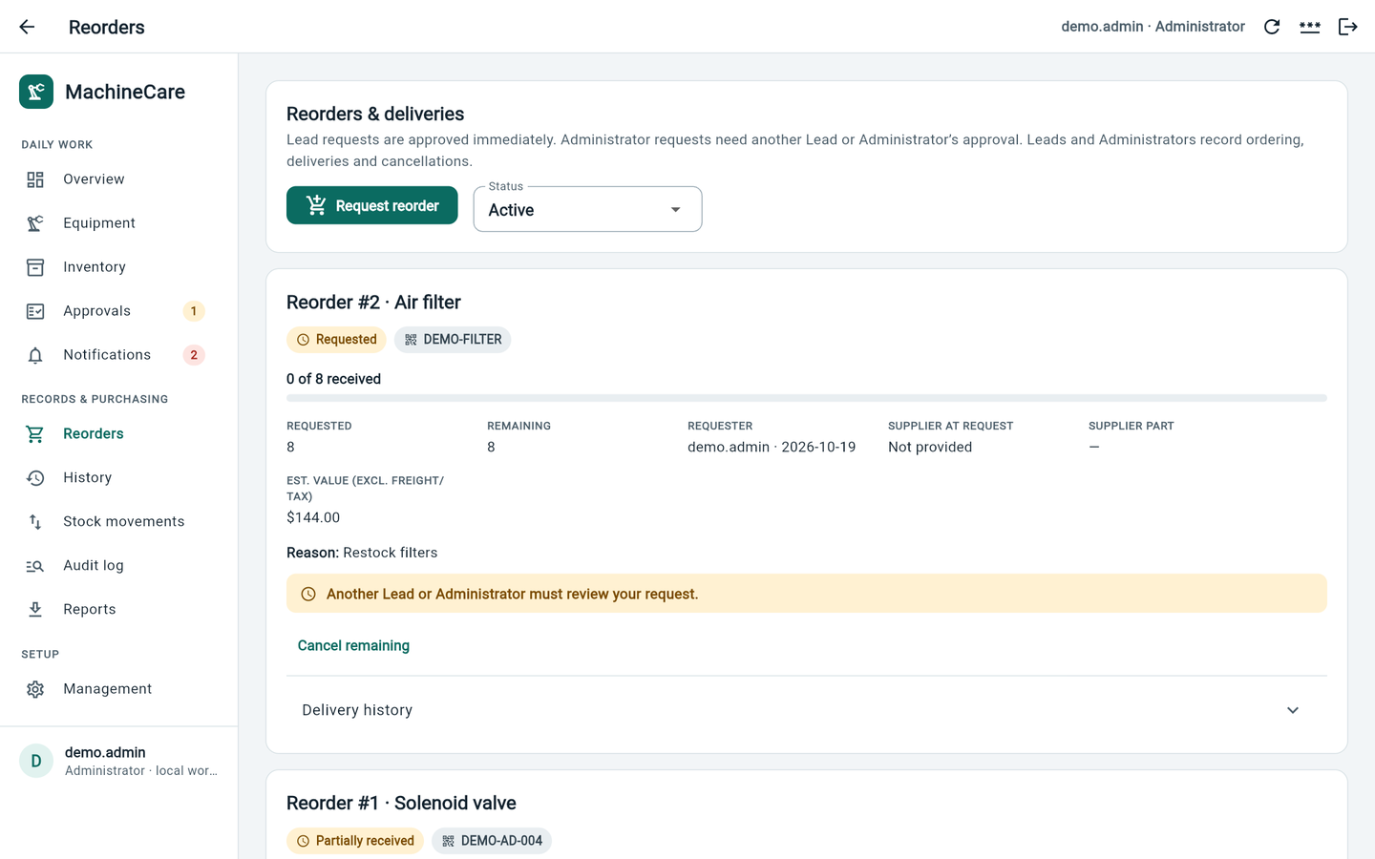
Ordering is tracked, but only receipts add stock
WALKTHROUGH 7 · PURCHASING
Request › order › receive
1
Approval policy
Lead requests start approved; Admin requests need another manager
2
Partial deliveries
#1 solenoid: 10 ordered, 4 received on DN-DEMO-77, 6 still open
3
Built-in protection
Duplicate delivery references and over-receipts are rejected
Demo database · illustrative values
Notes:
Supplier ordering itself is still manual: the app records the PO reference but does not send anything to a supplier or ERP. Cancelling an open balance keeps what was already received.

Slide 13
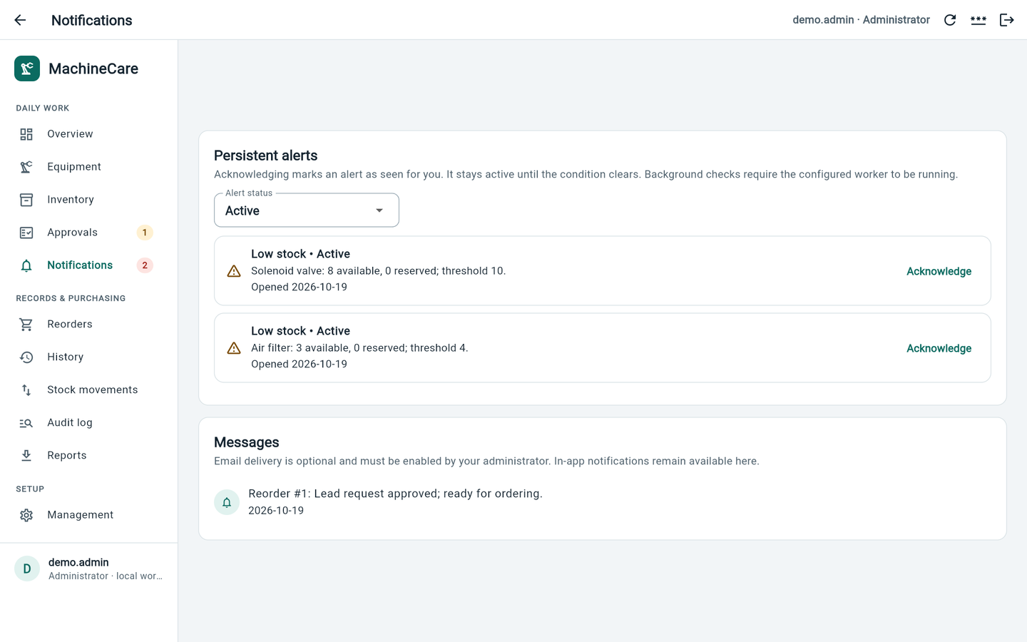
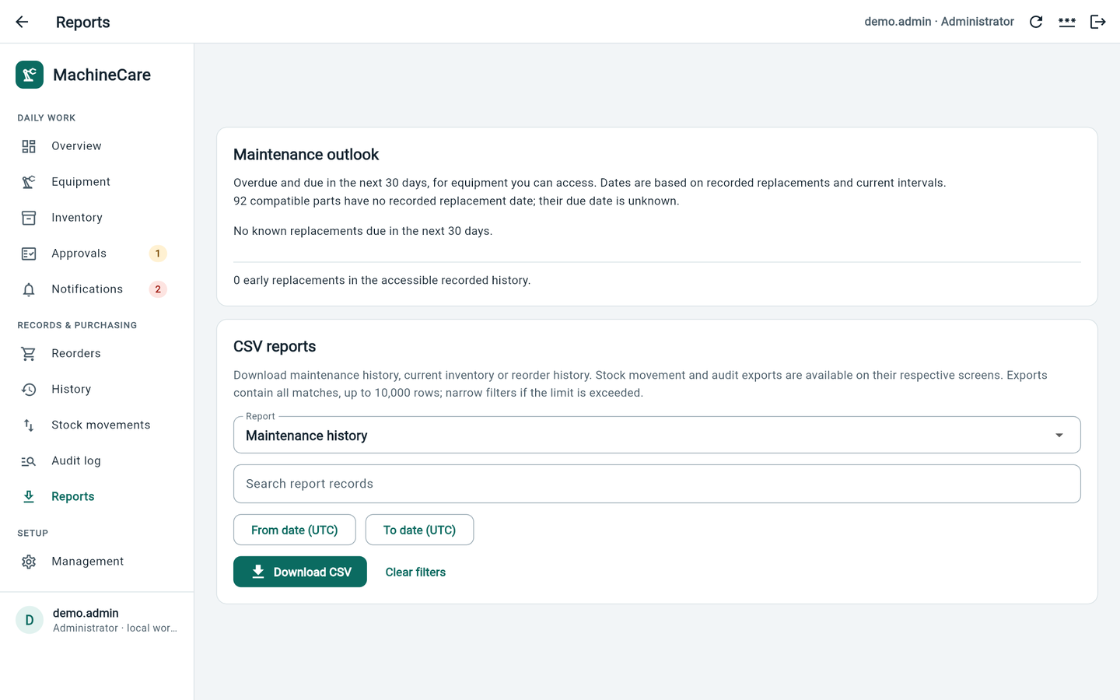
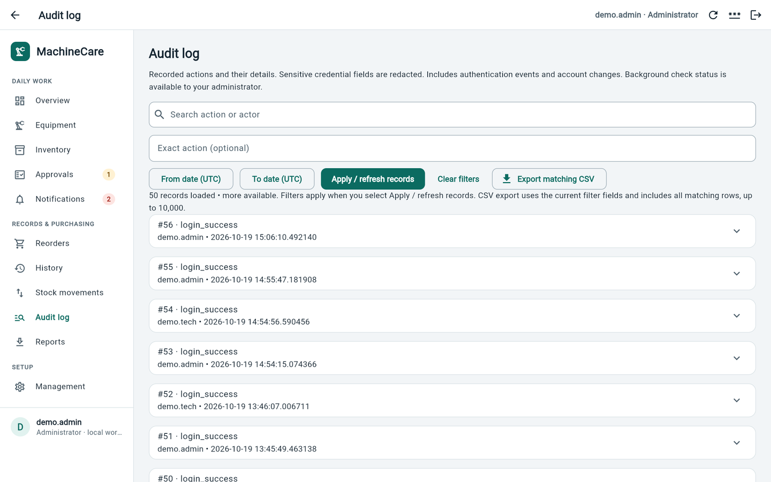
Alerts, reports and a full audit trail
WALKTHROUGH 8 · OVERSIGHT
Persistent alerts
Low stock, shortfalls and overdue intervals stay open until the condition clears
Reports and CSV
Maintenance outlook, early-replacement counts, exports protected against spreadsheet formulas
Audit log
Logins, account changes, approvals and orders. Passwords are never recorded
Notes:
Alerts are re-evaluated whenever someone uses the app, or continuously if the optional background worker is running. Email notification is built in but switched off: it needs an approved mail server and explicit authorization. Administrators also have a system-status view for background jobs.

Slide 14






Safeguards that are already working
BUILT IN FROM DAY ONE
Secure sign-in
Server-side permissions
No double counting
Hashed passwords, 8-hour sessions, forced first change, lockout after repeated failures
Every action checks role and building/line scope
Atomic transactions, duplicate-submit keys, edit-conflict detection
Safe exports
Verified backups
Local only
Permission checked, passwords redacted, formula injection blocked
Integrity-checked copies; recovery always uses a new file
Bound to this laptop (loopback); not exposed to the company network
Notes:
These protections are tested automatically. They are a strong base, but an engineering review is not an independent security assessment, which is still a production gate.

Slide 15



Features are done; operations and data are not
PRODUCTION READINESS
Done
Core workflows: equipment, inventory, approvals, history, purchasing, alerts, reports, audit
Done
Role permissions, data integrity, backups and recovery tooling, automated tests
Partial
Background worker and email: built and tested, not switched on or configured
Partial
Operational data: part references real; stock, prices, bins, intervals, asset tags are demo
Missing
Production hosting: HTTPS server, company sign-in, monitoring, supported runtime
Missing
Independent security review and signed-in user acceptance for all roles
Missing
Four business rules not yet decided (multi-bin, backdating, emergency work, corrections)
Notes:
This is the honest summary. The software features a maintenance team needs are built and tested. What is missing is mostly not code: verified data, an approved hosting setup, company identity and security sign-off, operations ownership, and four business-rule decisions only management can make.

Slide 16
Release gates, owners and evidence
WHAT'S MISSING
Gate | Still missing | Owner | Evidence of done
Operational data | Real stock counts, bins, prices, suppliers, intervals, asset tags | Maintenance lead | Signed inventory and equipment review
AOI identification | TM robot model, unknown makers, nameplate check | Maintenance lead | Verified component list
Hosting | Production web server, HTTPS, upgrade and rollback plan | IT + engineering | Reviewed staging deployment
Runtime | Python 3.10 out of support since 1 Oct 2026; Flutter SDK review | Engineering | Approved versions, tests re-run
Identity and security | SSO/MFA decision, service account, file permissions, secrets | IT / security | Independent security assessment
Backups | Scheduled, encrypted, off-host; recovery targets | IT / operations | Restore drill on a separate host
Operations | Auto-start, monitoring, logs, patching, support | IT / operations | Runbook and restart tests
User acceptance | All roles in Chrome, CSV in Excel, accessibility, load | Maintenance + eng. | Signed acceptance, no critical defects
Email (optional) | Mail server, recipients, send authorization | IT + business | Monitored test sends
Notes:
These are acceptance gates, not a delivery date. Each needs an owner and evidence. The most urgent technical item is the Python runtime: version 3.10 reached end of support on 1 October 2026, so production must use a supported version and the tests must be re-run on it. The current built-in Python web server is fine for a local pilot but is documented as unsuitable for production.

Slide 17
Four business rules to agree before building
DECISIONS NEEDED
Multi-bin stock
Backdated work
If one part sits in several bins, which bin is reserved and used, and how are transfers recorded?
Can completion be recorded for an earlier date? How far back, in which time zone, and who approves?
Emergency work
Corrections
Who can override stock or approval checks in a breakdown, and what is the deadline for review afterwards?
How is a wrong record reversed, and what happens to stock, history and orders? Today nothing is ever deleted.
Notes:
These were deliberately not built on guesswork, because each one changes stock, history and approvals. Options: agree the rules and build them, or explicitly leave them out of the first release.

Slide 18
A staged path from demo to adoption
PROPOSED ROLLOUT
1
2
3
4
NOW
NEXT
THEN
RELEASE
Manager review
One-line pilot
Harden
Go live
Walkthrough on the demo copy; agree owners and success measures
Count real stock for one line; replace demo values; train users
Supported runtime, hosting design, security review, backup policy
User acceptance sign-off, monitored service, support owner
Move to the next stage when the current one meets its agreed acceptance criteria. No calendar dates are promised here.
Notes:
Suggested pilot measures: share of replacements recorded with full traceability, stock-count accuracy against a physical count for the pilot line, and operator feedback on usability. Agree these before promising savings or a launch date.

Slide 19
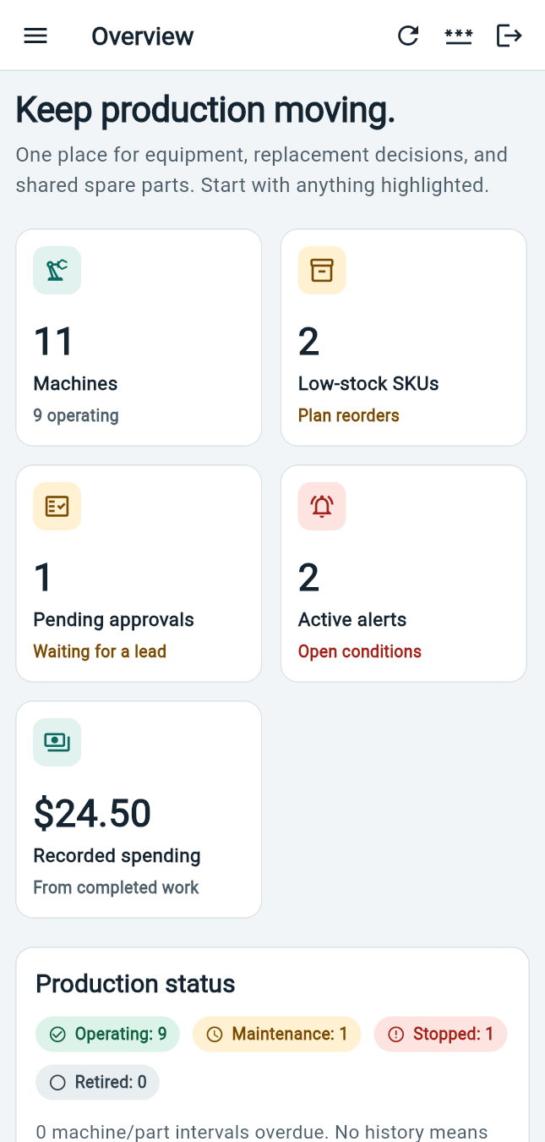
Approve a focused validation pilot
THE DECISION
1
Choose one validated line
Where we count real stock and run the full workflow
2
Name a data owner and an IT reviewer
Maintenance and IT/security owners for the production gates
3
Agree acceptance measures
Traceability, stock accuracy and operator usability
Also works on a phone
A working local pilot today. A controlled release after validation.
Notes:
Close with three concrete requests. Do not commit to a production date until the gates have owners and scope.

Slide 20
DIMM press component reference
APPENDIX A
Component | Manufacturer | Supplied identifier | Per DIMM
Load cell | Delta Transducers | Serial 2511231 (not a part number) | 5
Finger cylinder | Airtac | HFD12X50 | 4
Vertical cylinder | Airtac | HLQ12X50S | 5
Solenoid valve | Airtac | 7V110-6 | 10
Tray cylinder | Airtac | TCL25X20S | 2
Tray clamp cylinder | Unknown | HLS16X20SAS | 4
Finger reed switch sensor | Airtac | DMSH A11DW | 8
Vertical reed switch sensor | Airtac | D-M98W | 10
Flag sensor | Panasonic | PM-T45 | 8
Photoelectric sensor | Panasonic | CX-441 | 12
Notes:
References exactly as supplied by maintenance. Spare quantities in the demo are illustrative and separate from installed quantities.

Slide 21
AOI component reference
APPENDIX B
Component | Manufacturer | Supplied identifier | Per AOI
TM robot | TM (as supplied) | Model not supplied | 1
Small light curtain | PILZ | PSEN op113H-s-30-030 | 4
Large light curtain | PILZ | PESN op113H-s-30-075 | 2
PLC PNOZ m bo.1 | PILZ | Ident-772104 | 1
Tower light | Unknown | ASTLF-110-4-5FT-CM | 2
Switching power supply | Unknown | s-120-24 | 1
Control box | VEVOR | Serial 240108586510146 | 1
Notes:
Identifiers kept verbatim pending nameplate confirmation. Catalog entries for safety components are not an inspection or certification.

