Slide 1

Locating Fermi Surface with SVM and Logistic Regression
Presented by YANG Yuting and TU Hao Chen

Slide 2

Introduction
METHOD
RESULTS

Slide 3
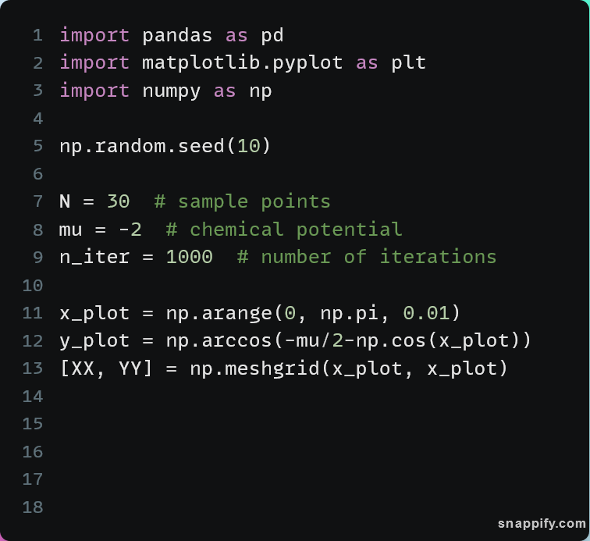
Python Codes
Import necessary libraries
Define parameters

Slide 4
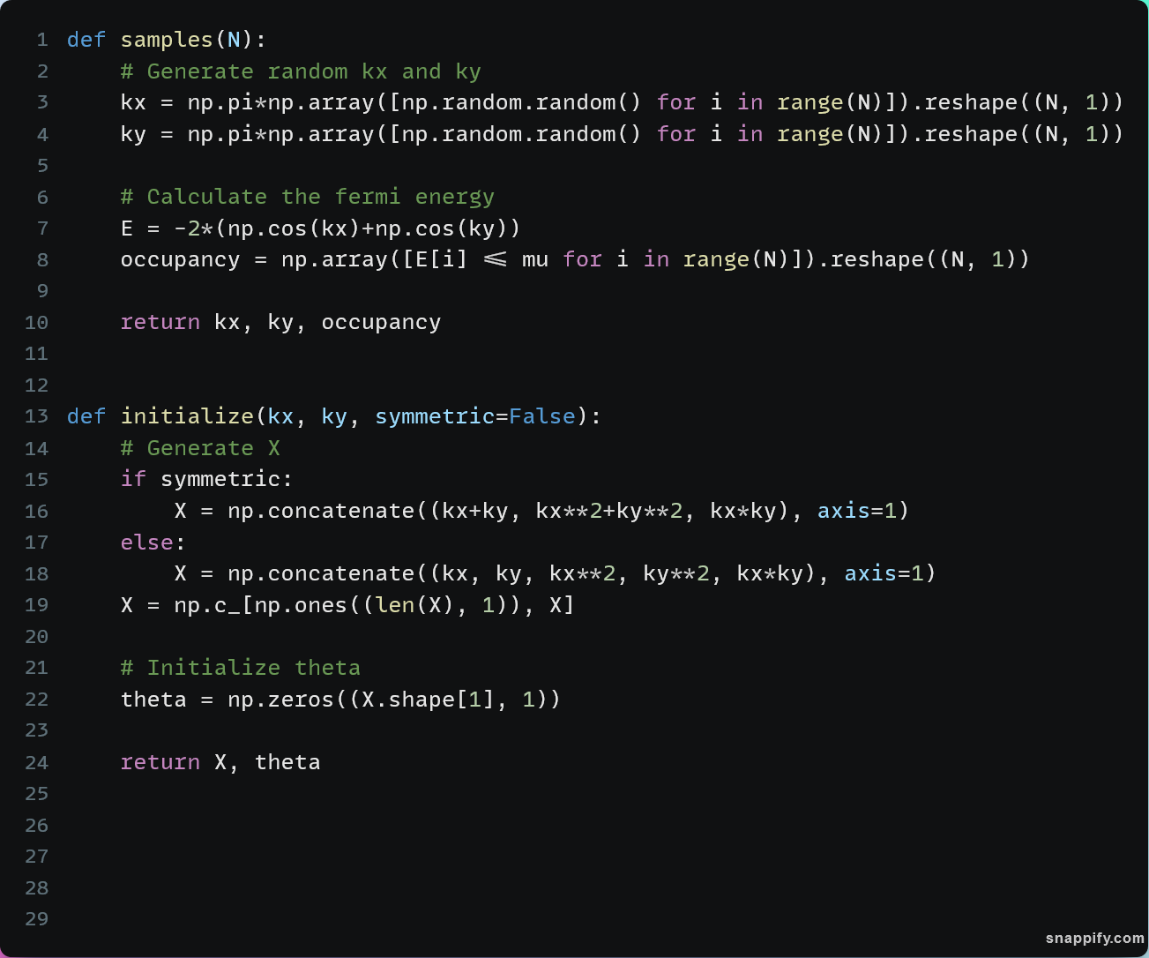
Functions
X θ Y
N
samples
initialize
kx ky occupancy

Slide 5
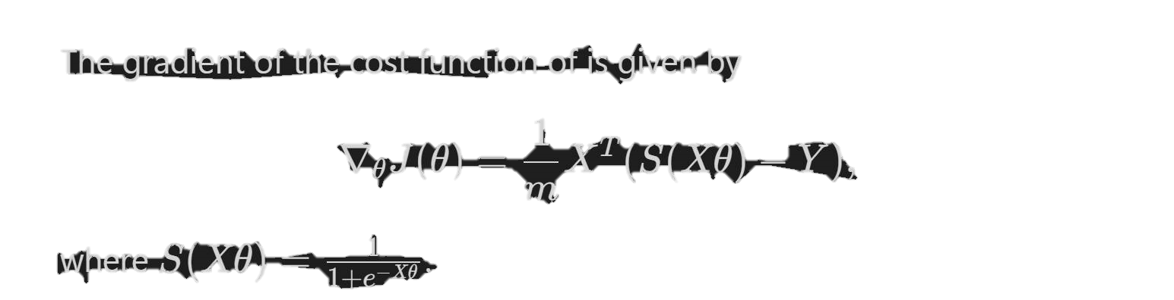
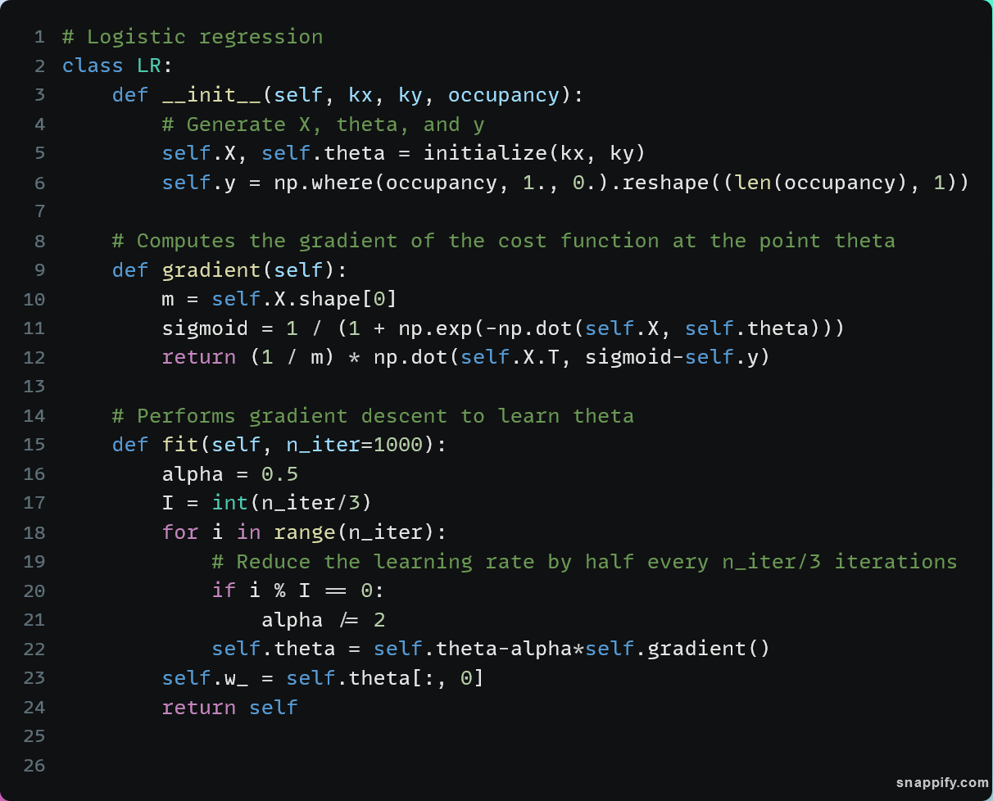
Classes

Slide 6
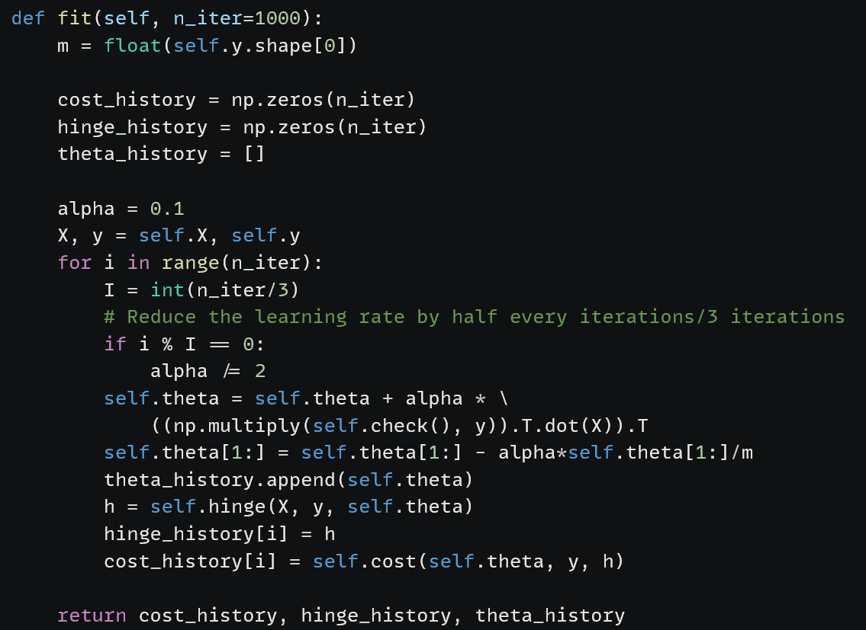
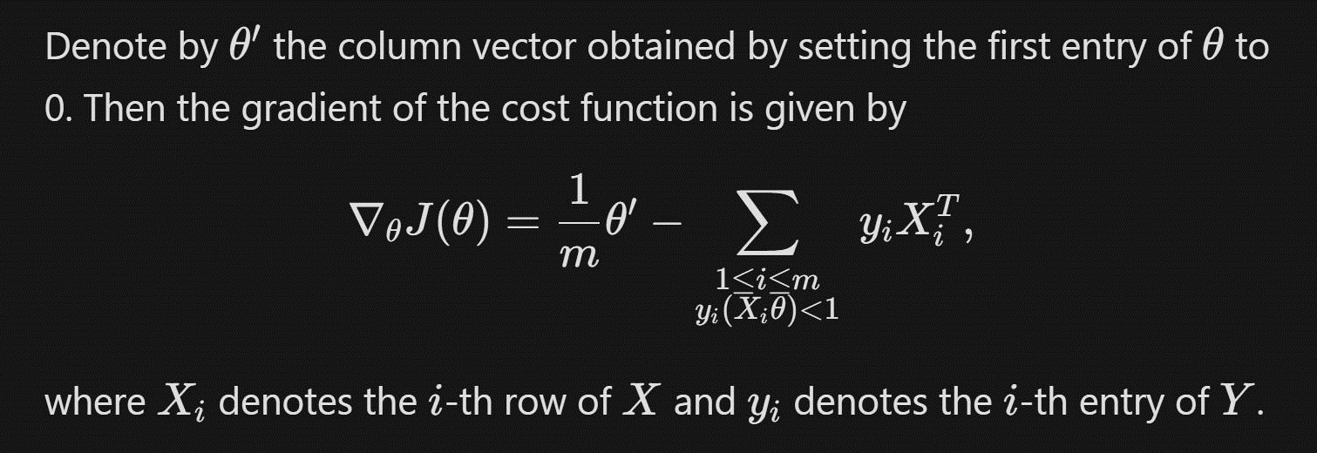
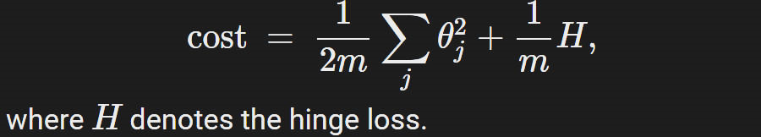
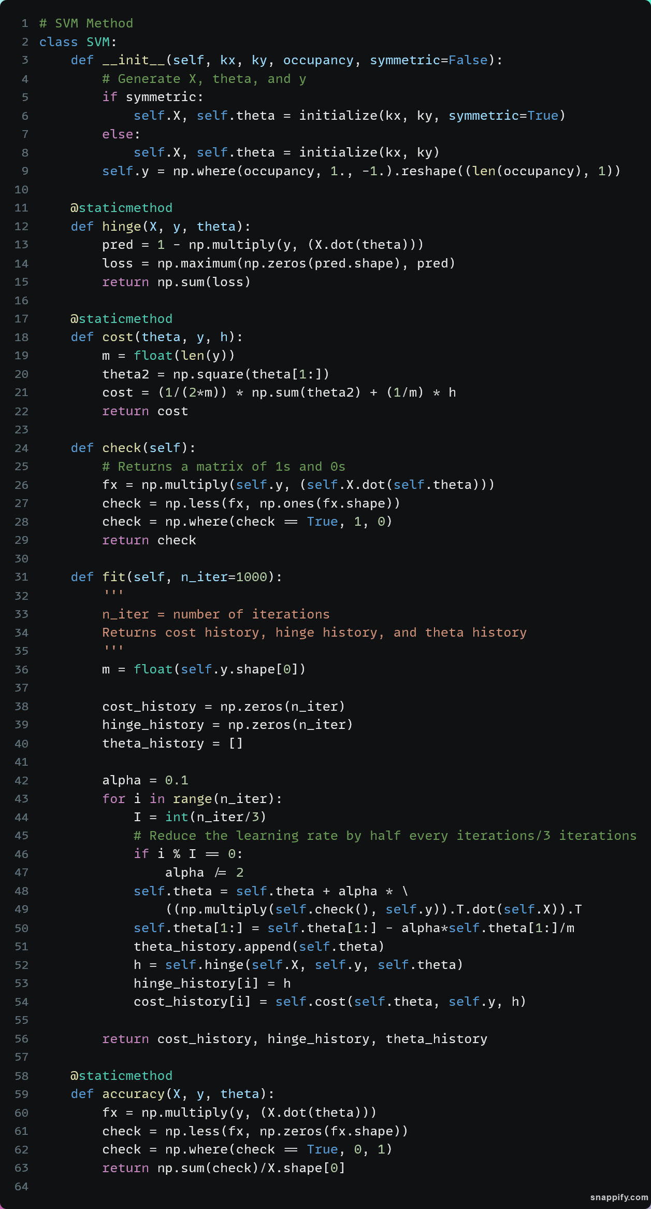

Implementation
Check this condition

Slide 7
Classes
Calculate y_{i}Xθ
Less than 0 ?
True -> 0, False ->1
Sum all and take average
y_{i}Xθ<0
Xθ=0

Slide 8
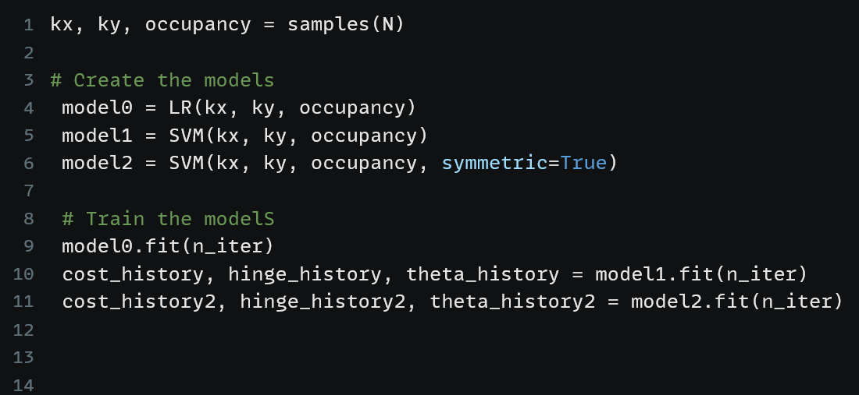
Training
Create samples
Create models
Train the models

Slide 9
Introduction
METHOD
RESULTS

Slide 10
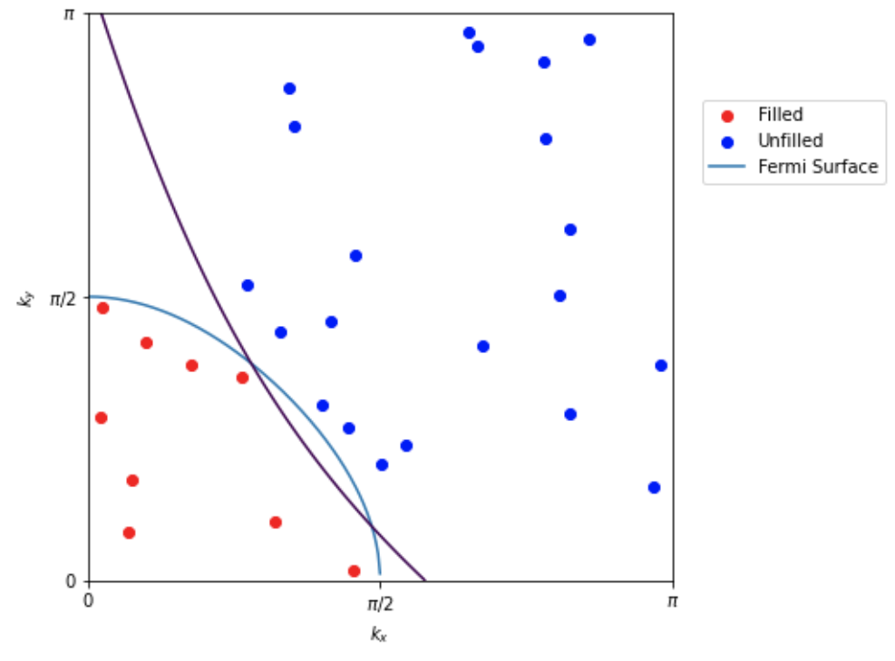
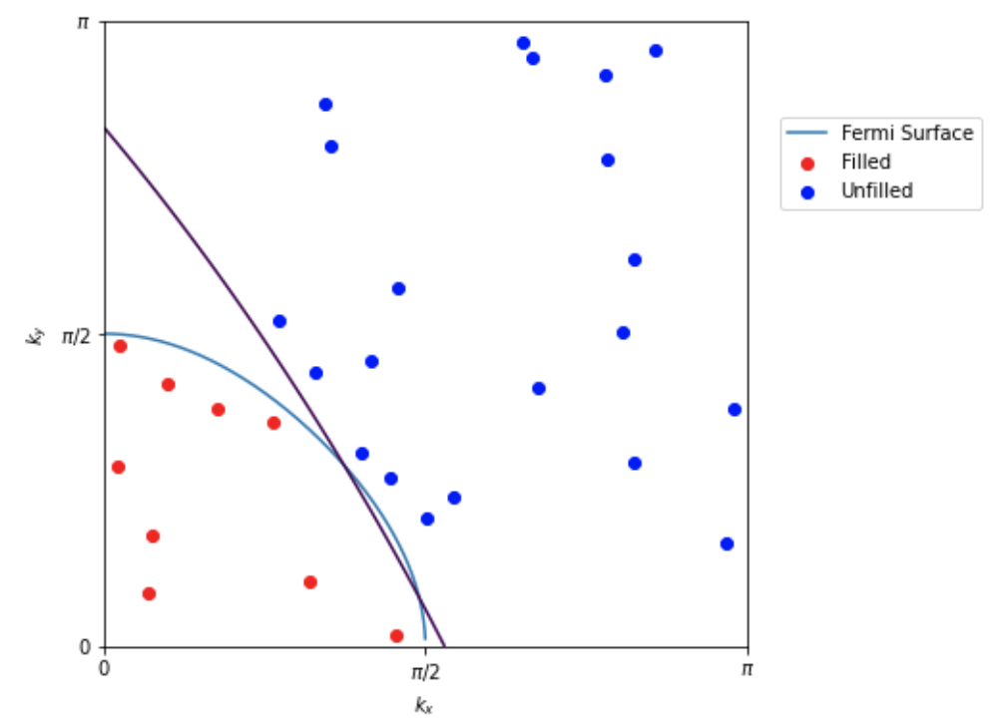
Results for N=30
Logistic regression SVM
SIMILAR
Cost:
0.18

Slide 11
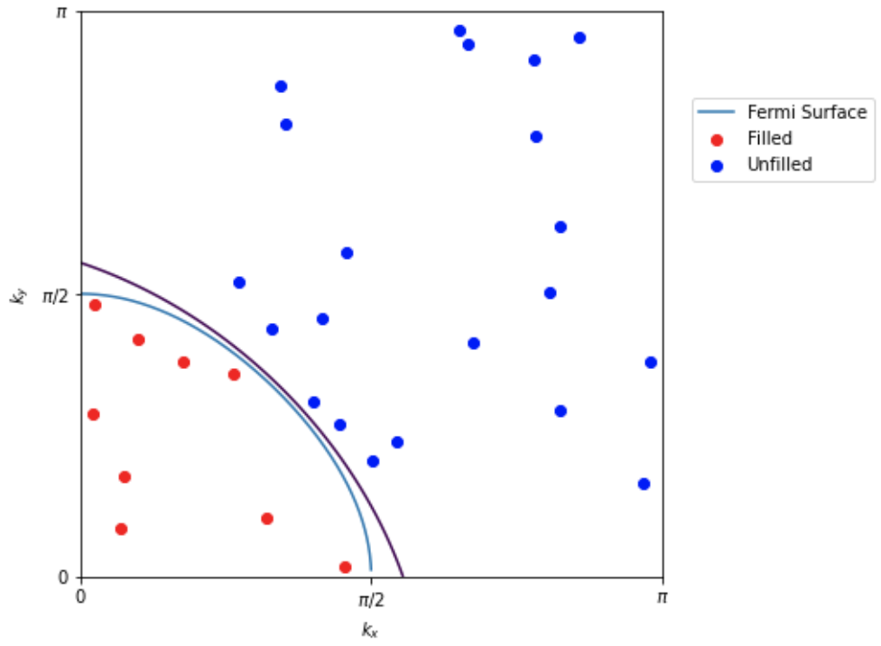
Symmetric Features
ROBUST
Cost:
0.18
Cost:
0.20

Slide 12
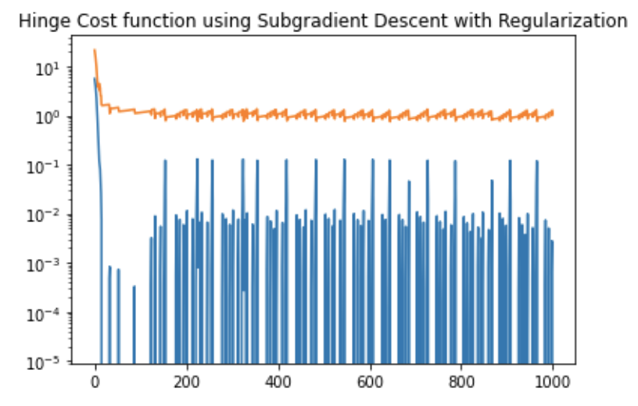
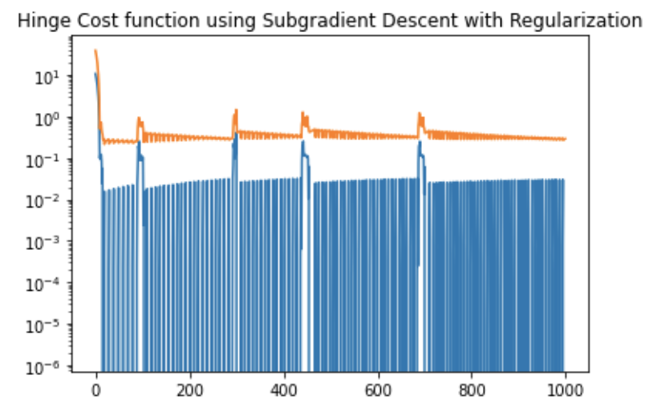
Testing Forecastability: Hinge Cost
Asymmetric Symmetric
CONSISTENT

Slide 13
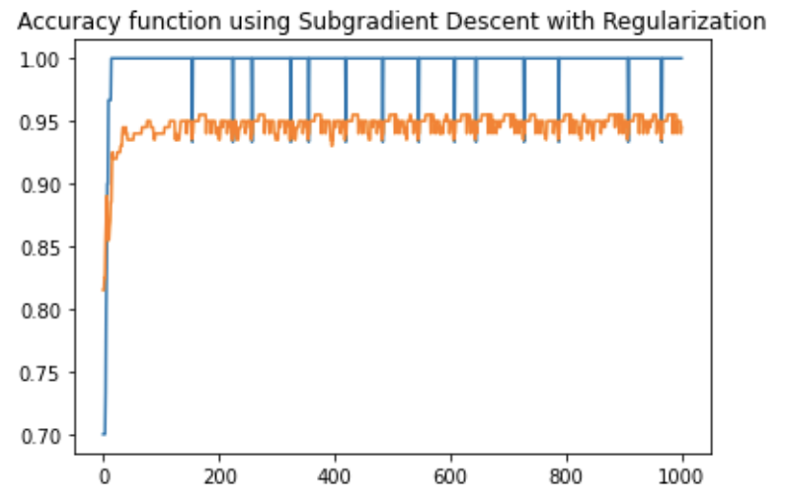
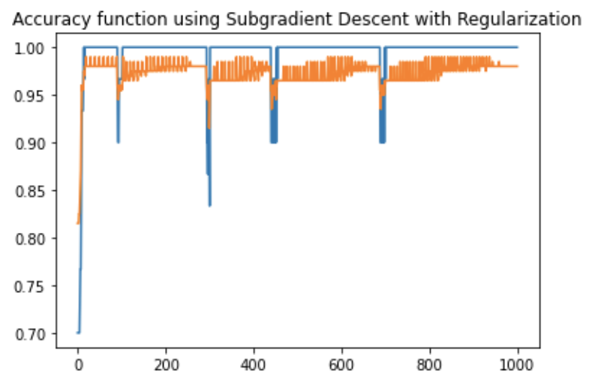
Testing Forecastability: Accuracy
Asymmetric Symmetric
ACCURATE

Slide 14
Advantages of Using X₂
Increase robustness
Forecast more accurately
Reduce overfitting
Cost less memory storage

Slide 15
THANKS FOR LISTENING!

