Slide 1


Classification of 2D Ising Model Phases Using Neural Network
Presented by YANG Yuting and Wang Yiyan (Group 5)
Notes:
Good afternoon everyone! Today I am going to present on the topic of classifying the phases of a 2D Ising model using neural networks. The presentation is divided into two sections:

Slide 2

METHOD
RESULTS
Notes:
method and results. In the method section, I will discuss the various steps involved in preparing the data, building the neural network, and training it using gradient descent.

Slide 3
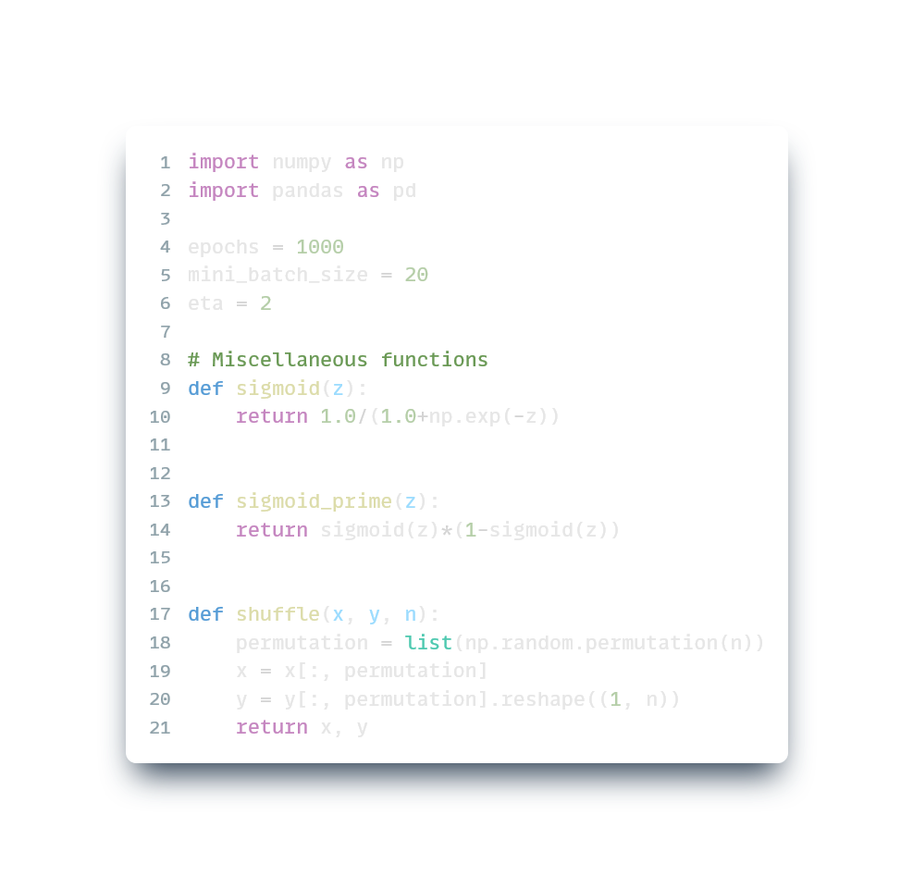
Python Codes
Import necessary libraries
Define hyperparameters
Notes:
To begin with, we import necessary libraries like numpy and pandas as usual. Then we define our hyperparameters, including the number of epochs, mini-batch size, and learning rate. We also define some useful functions, such as sigmoid and sigmoid_prime, which calculate the sigmoid activation function and its derivative respectively. Additionally, we have the shuffle function, which randomly shuffles the input data.

Slide 4
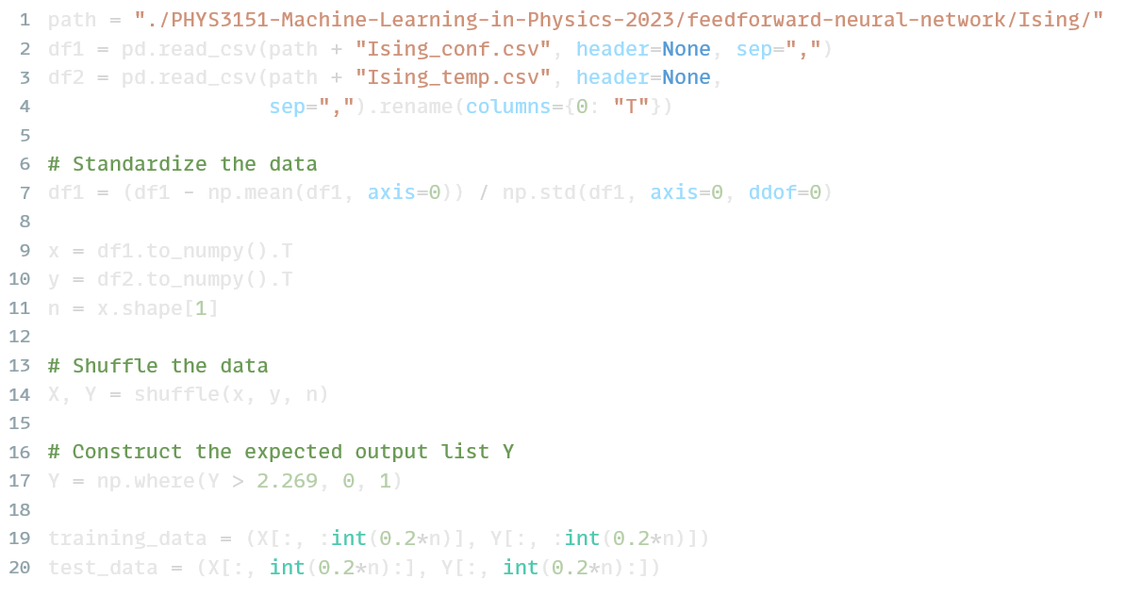



Read data
Standardization
X
100 $×$ 5000
0.2 0.8
Y
1 $×$ 5000
(Binary)
Training Testing
Notes:
Next, we prepare the training and testing data sets. We first load the data from files, then standardise it by subtracting column-wise means and dividing by column-wise standard deviations. This step can prevent our weighted sums from being too large or too small, thus helping to avoid the saturation of neurons. Next, we randomly shuffle the data sets. After that we turn the expected output y into binary based on the critical temperature. Finally, we split the data into training and testing sets.

Slide 5
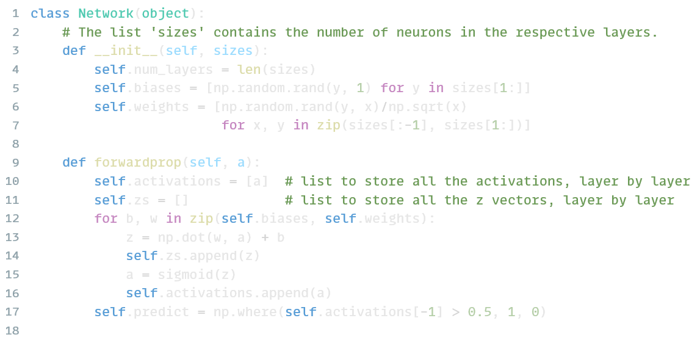


Class
[100, 2, 1]
2 $×$ (100+1)
1 $×$ (2+1)
…
Notes:
Now let me introduce the Network class, which defines the structure of the neural network. The class is initialised with a list of integers representing the number of neurons in each layer. Based on this list, we then initialise the biases and weights using random values. We also define a method called forwardprop which performs forward propagation through the layers of the network, storing the activations and z values along the way.

Slide 6
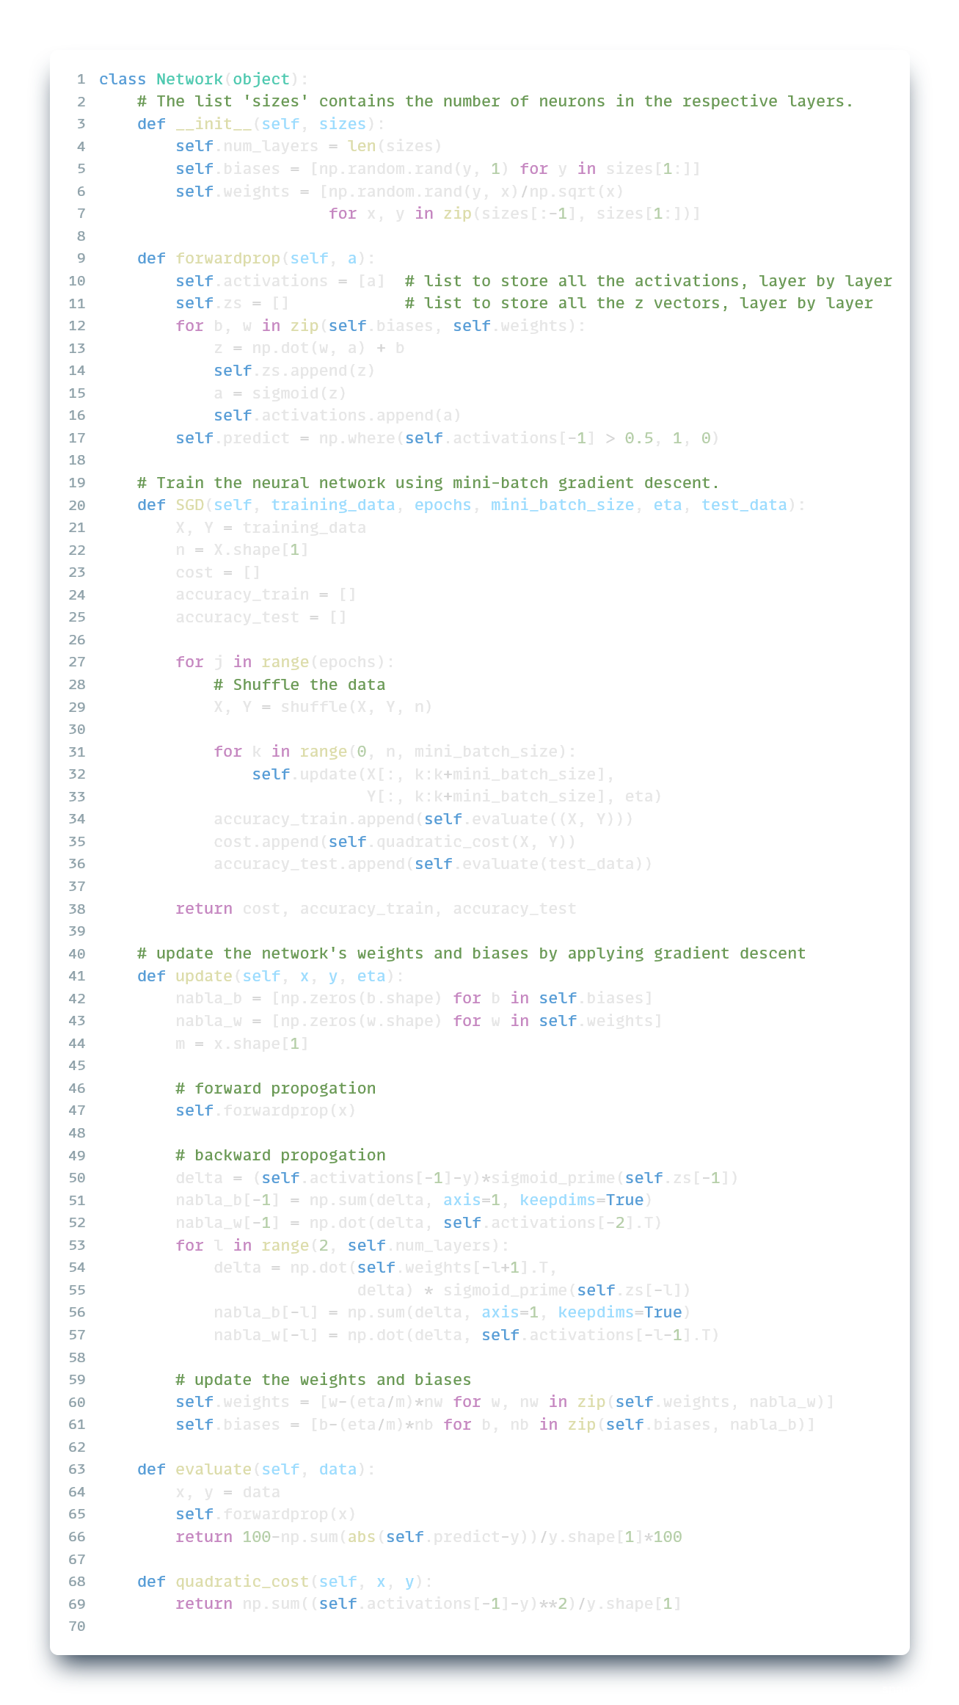
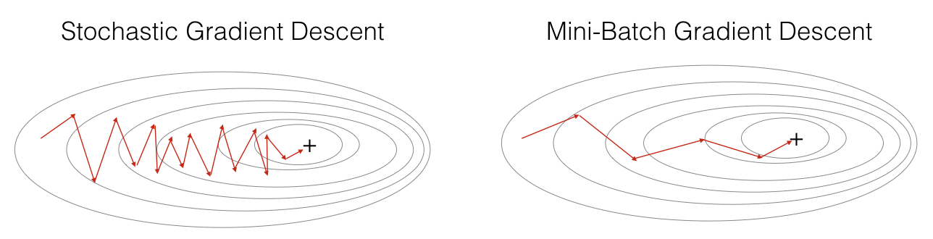
X
Y
m
Update per m=1 example
Update per m=20 examples
Notes:
To train the neural network, we first divide the training set into mini-batches of size m. One of the primary benefits of doing so is that it allows for smoother convergence. As shown in the figure, using mini-batch produces a less zigzag path. That's because it averages out some of the noise in the gradient estimates obtained from individual data points. Furthermore, mini-batch gradient descent can reduce computation time, as it processes multiple data points concurrently.

Slide 7
…
Notes:
For each mini-batch, we first perform forward propagation and then backward propagation, updating the weights and biases of the network based on the gradient of the cost function with respect to them.

Slide 8
Notes:
Finally, to evaluate the performance of our neural network, we define the accuracy function and the quadratic cost function.

Slide 9
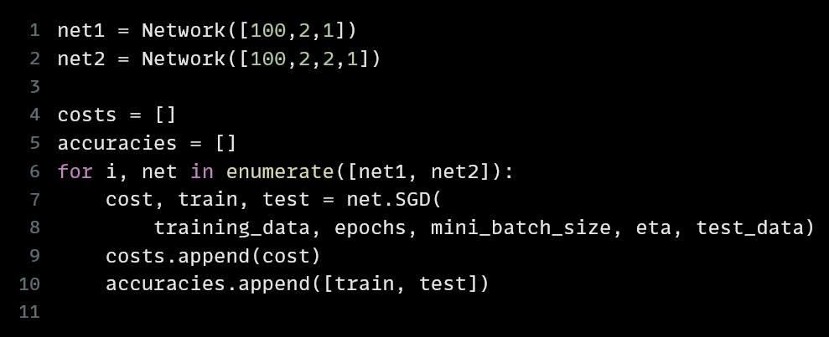
Training
Notes:
Now we construct two neural networks, one with one hidden layer, and the other with two hidden layers. After that, we train the networks by calling the SGD method. The cost and accuracy are stored for later comparison.

Slide 10
METHOD
RESULTS
Notes:
Next, Wang Yiyan will discuss our results. Welcome!

Slide 11
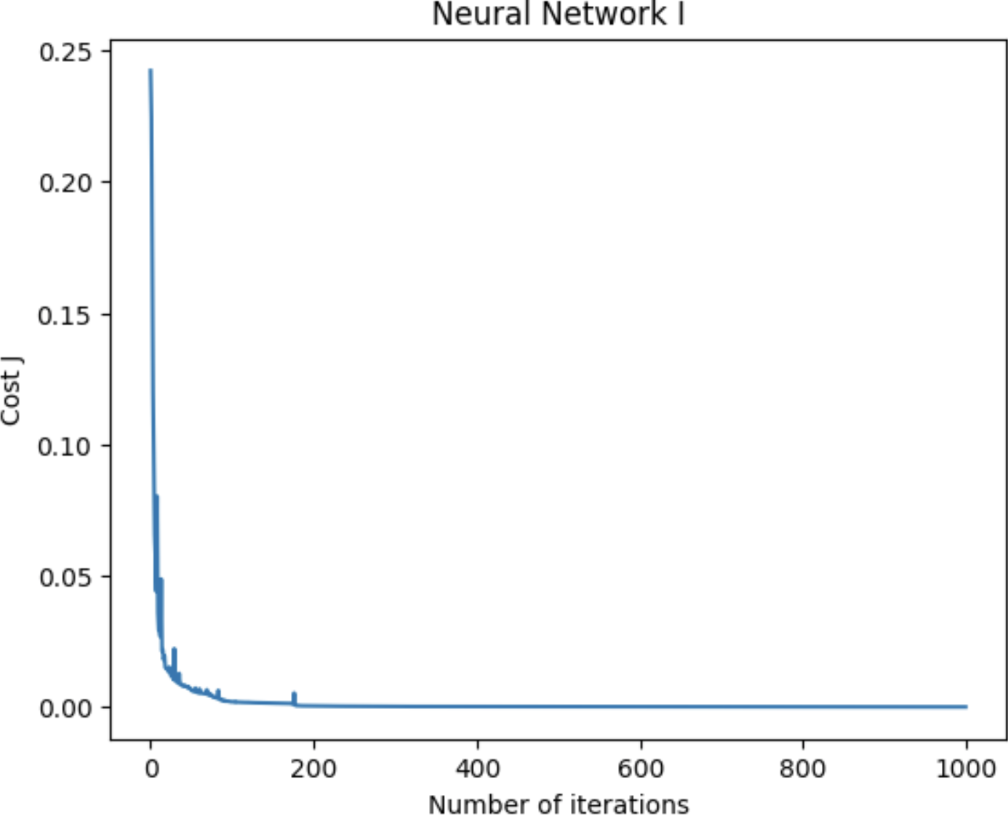
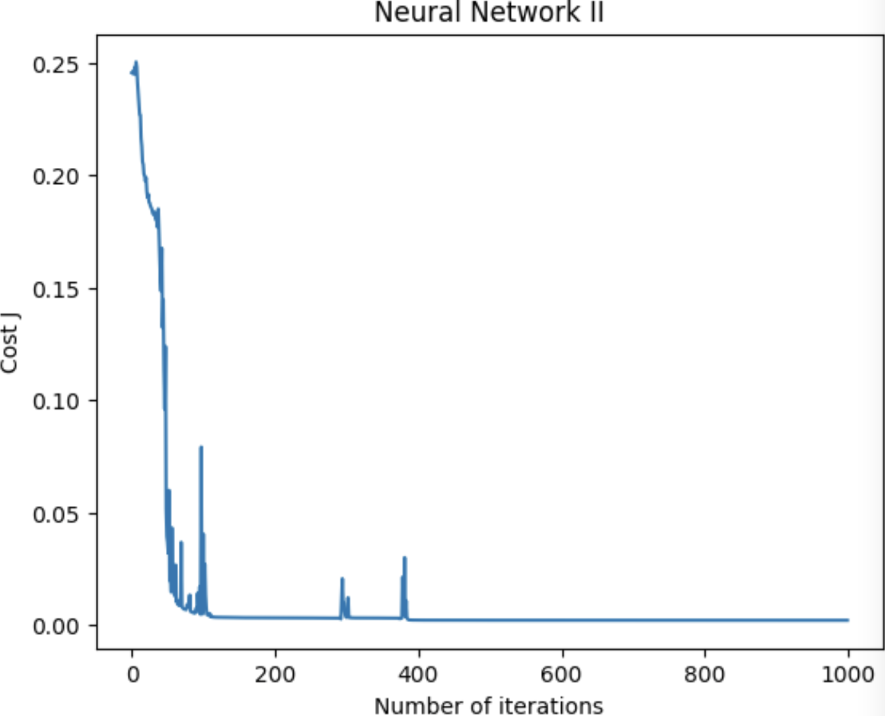
Training Cost
Smooth curve
Rapid decrease
Break point
Small changes at odd data
Acute changes at odd data

Slide 12
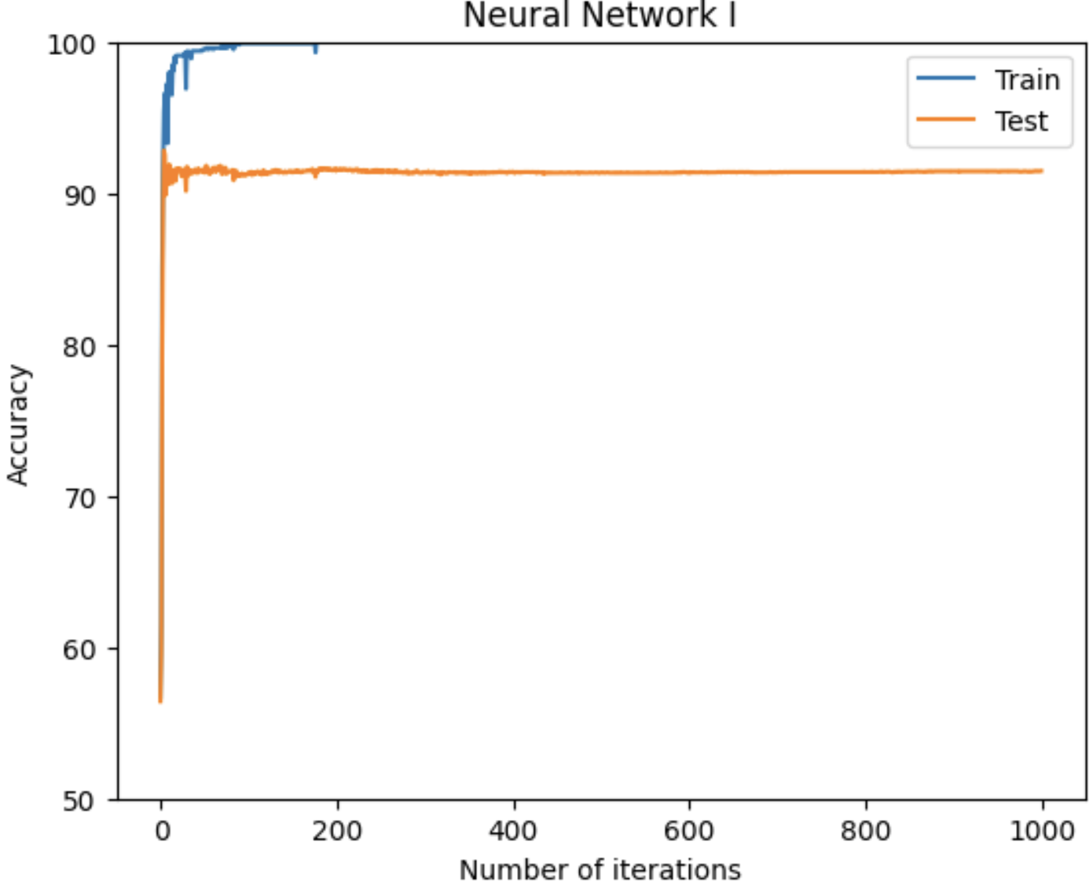
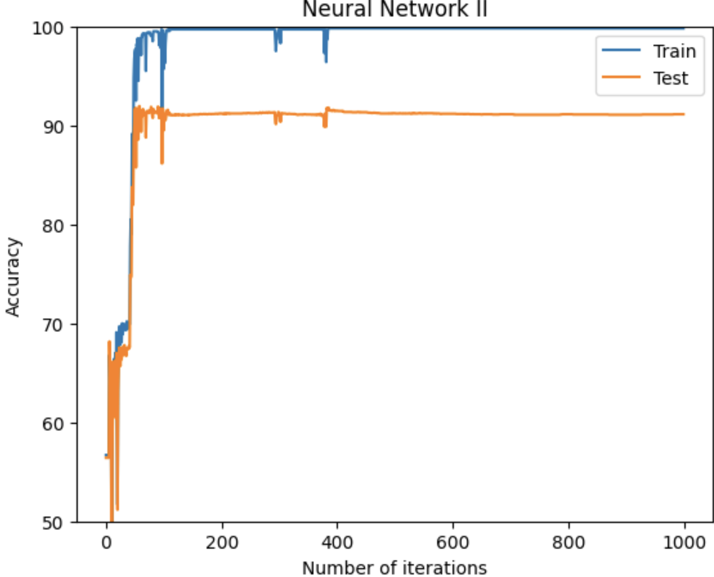
Accuracies
More stable
Small difference between training and testing
Sensitive to odd data
Less iterations needed to attain high accuracy
More iterations needed to learn
Cost:
0.20

Slide 13
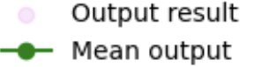
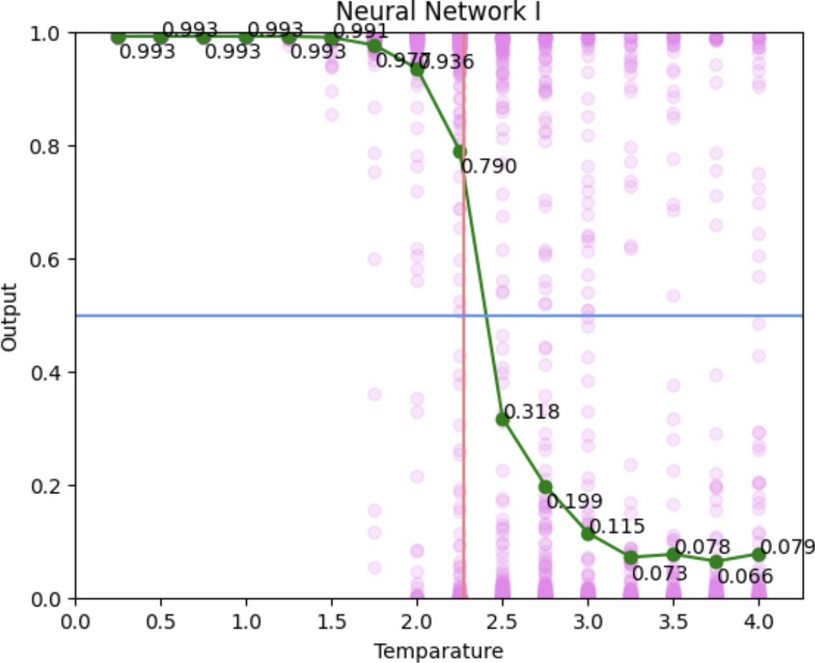
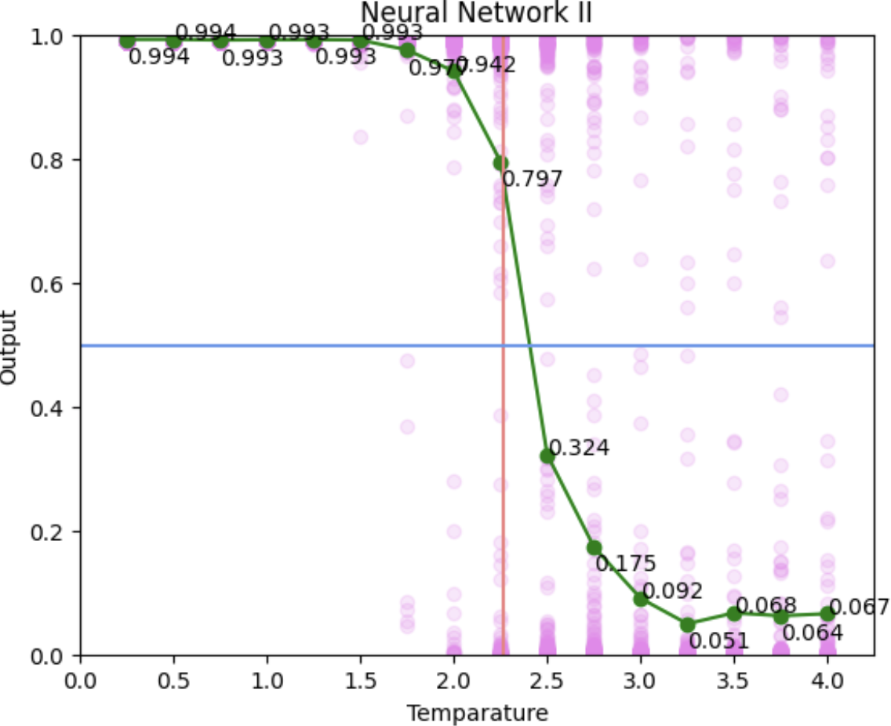
Model Evaluation
Result > 0.5 classified as ordered state
higher mean at ordered states
0.5
0.5
Result < 0.5
Classified as disordered state
Lower mean at disordered states
2.269
2.269

Slide 14
Comparison
Both models can classify states of the Ising model accurately.
Model I
(100 , 2 , 1)
A faster decrease in cost
Less running time to attain high accuracy
Less steps in forward/backward propagation
Less memory usage
Model II
(100 , 2 , 2 , 1)
Slower convergence at first
Sensitive to more exquisite patterns
More discernable results

Slide 15
THANKS FOR LISTENING!

