Slide 1
Assessment of protein preparations
The contactome of amino acids forming H-bonds
Adrià Fernández, Luis Jordà, Marina Miñarro

Slide 2
Context of our project
From X-ray diffraction
(or NMR)
to a reliable structural model
AMBIGUITIES
Positions of hydrogen atoms have to be predicted
Orientations of some amino acid side chains
Lack of information from the physiologic environment: pH, saline concentrations, interactions with water…
The inclusion of water molecules is not always helpful
Role fulfilled by protein preparation and energy minimization steps

Slide 3
Aims of the project
Provide support to the protein preparation step in order to avoid wrong (or large) energy minimization steps
Evaluate the results of protein preparations according to an heuristic approach
Test our own algorithm and propose future improvements

Slide 4
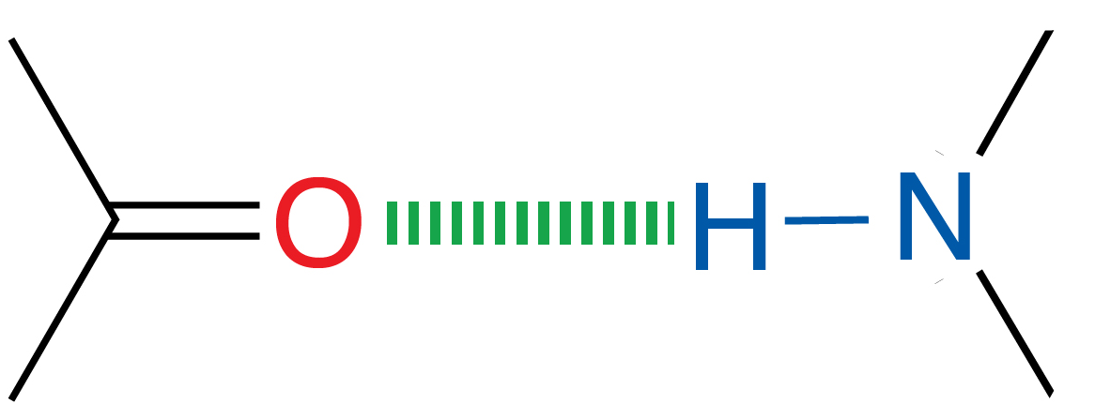
Following an heuristic approach
Based on hydrogen bond distances in some amino acid side chains to solve ambiguity.
The presence of an energetically significant hydrogen bond can be inferred when a probable donor and acceptor are within 3.5 Å of each other ^{[1]}.
2.2 – 4.0 Å ^{[1]}
¹ An Introduction to Hydrogen Bonding (Jeffrey, George A.). Michael J. Minch, Journal of Chemical Education 1999 76 (6), 759

Slide 5
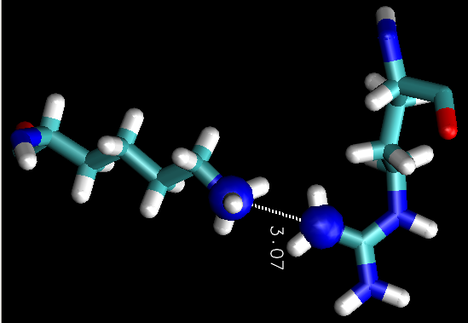
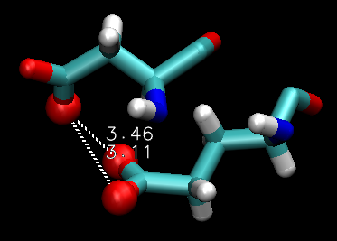
Following an heuristic approach (1)
Positively charged residues (Arg, Lys and His) remain protonated unless the side chain is directly within H-bond distance of another positive residue, in which case one of them may be neutral.
Negatively charged residues (Asp and Glu) remain deprotonated unless the side chain is directly within H-bond distance of another negative residue, in which case one of them may be neutral.

Slide 6
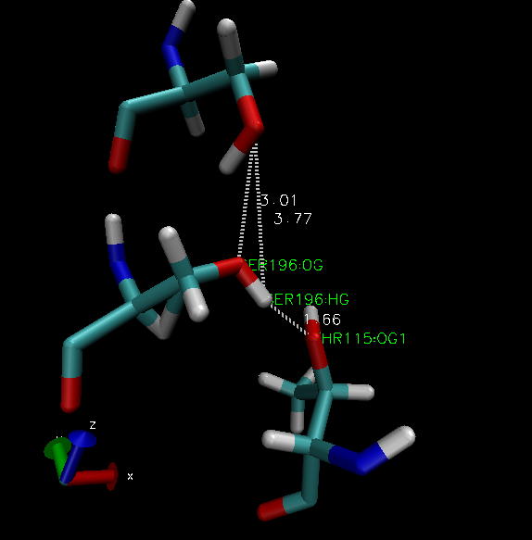
Following an heuristic approach (2)
3) Amino acids having a hydroxyl group (Ser, Thr and Tyr) can act as both H-bond acceptors and as H-bond donors, but they can only be one of each.

Slide 7
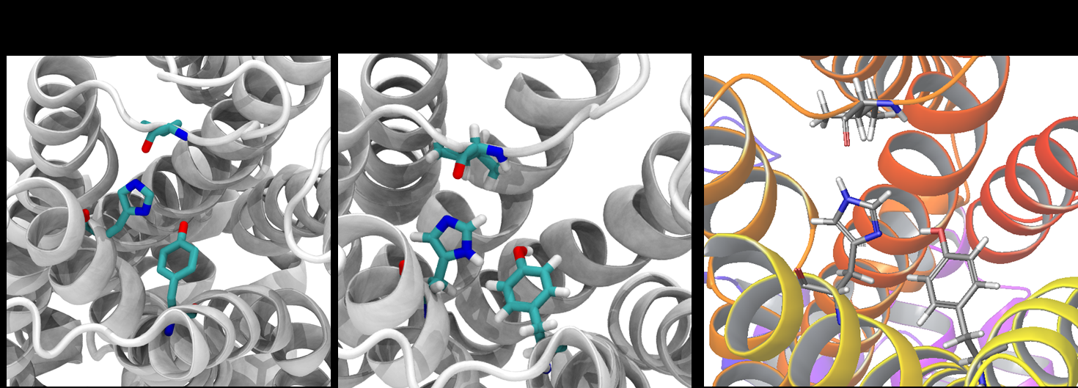
Following an heuristic approach (3)
4) Histidine should be protonated in one of its two nitrogen atoms (ND1 or NE2) or in both of them only when significant H-bond acceptors are found, and deprotonated when significant H-bond donors are found.

Slide 8
Code
Contactome creation
Contactome checking
Playing with the data
Atomatically by calling the contactome function
Pandas.Dataframe tools + Contactome methods

Slide 9
Contactome Creation
1) Iterating through the DataFrame.
Protein preparation DataFrame
If an aa of interest is found, it creates a Aa _wiki object with the chain, resid and protonation name (resname)
2) Creating the contactome for each amino acid (aa).
Aa_wiki object
2.1 – Looking if the aa has a potential donor atom. If yes, it takes all the potential acceptor atoms* in the cutoff distance**
2.2 – Looking if the aa has a potential acceptor atom. If yes, it takes all the potential donor atoms* in the cutoff distance**
2.3 – Return a dictionary: key -> tuple with the aminaocid atom information
value-> np.array with information of the hit
Contactome object
3) Pile up the dictionary.
When finishing the iteration…
pandas.DataFrame.Contactome object creation

Slide 10
Assessing charge clashes
For each carboxyl group of Asp and Glu (negatively charged) in the contactome, capture any other carboxyl groups from Asp and Glu within 3.5 Å (default cutoff).
Discard the clash only if there is an ‘exogenous’ cation stabilizing the area (i.e, within 3.5 Å of both carboxyl groups).
Apply the steps 1 and 2 for the complementary case of groups of positively charged amino acids (Lys, Arg and His) and ‘exogenous’ anions.
Report found clashes.

Slide 11
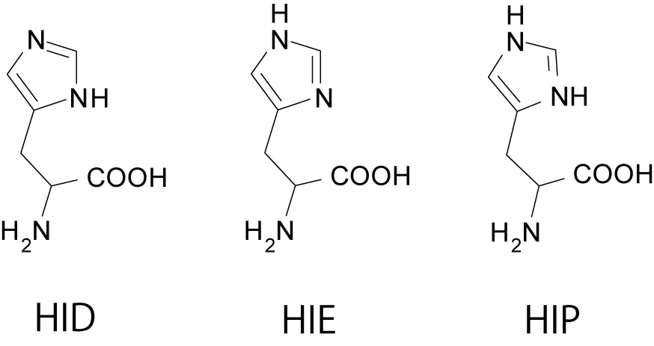
Histidine detection
We Look for…
Donors
Acceptors
Donors
Acceptors
+
Histidine: HIP, HID, HIE
ND1
ND1a
ND1d
NE2
NE2a
NE2d

Slide 12
Histidine detection
Contactome
His_test()
His_judge()
For each posible donor/acceptor group in each Histidine check if there is any donor/acceptor within 3.5 Å (default cutoff)
Objective: Creation of an array used in the his_judge function → (ND1a , ND1d, NE2a, NE2d)
If we do not have any result: array.append(False)
If we have one hit: check hit’s environment
In the surroundings of the hit we only have the histidine: array.append(bond distance)
In the surroundings we have more than one residue:
Histidine in first position and:
More than 0.5 Å than the following hit: array.append(bond distance)
Less than 0.5 Å than the following hit: array.append(1000)
Histidine not in first position and:
More than 0.5 Å than the following hit: array.append(5000)
Less than 0.5 Å than the following hit: array.append(1000)
If we have more than one hit: check environment for every hit
Creation of a decision array and store all the values and select minimum for the final array

Slide 13
Histidine decision
+
Contactome
His_test()
His_judge()
(ND1a , ND1d, NE2a, NE2d)
Takes the smallest bond distance for both atoms (independently)
If both are donors: HIP ; If just one is donor: HID(ND1d) or HIE(NE2d) ; If both are acceptors: the smallest bond distance wins.
If there are only information for one atom, the smallest bond will decide the outcome.
If there are only one outcome information for one of the atoms, this atom will have preference in draw cases (ex: if both are acceptors).
If there are the same distance for both outcomes, both outcomes are considered in the result.

Slide 14
Results: Statistics
20 pdb tested
7 cases of charge clashes
40 histidine cases
Precision: 86%
Precision: 67,7%

Slide 15
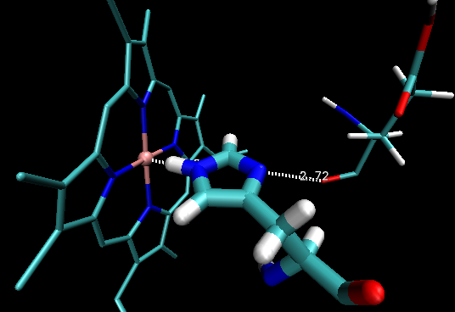
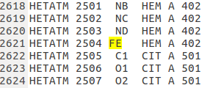
Problems and posible future improvements
Contactome do not take into account ligands
The detection system of Histidine protonation is not 100% accurate. We can improve it by taking into account the interaction angles.
Not prepared to deal with Dummy Atoms (O,N)
Better if contactome could be created from pqr file instead of the PrepData variable.
Notes:
S'equivoca perquè detecta algun oxigen acceptor però que no està en línia recta ni molt menys amb l'hipotètic H que diu que li falta
D'aquests casos només he reportat com a FP els més exagerats
Els que no eren tan exagerats els he donat per bons (TP) tot i que tampoc tinguessin orientació bona
També les aigües fan que s'equivoqui força, però la majoria dels casos amb aigua també els he tractat com a TP perquè les aigües solien estar ben orientades
Jo concluiria que si en l'algoritme es tinguessin en compte el rang de valors d'angles que són factibles, s'afinaria molt més

