Slide 1
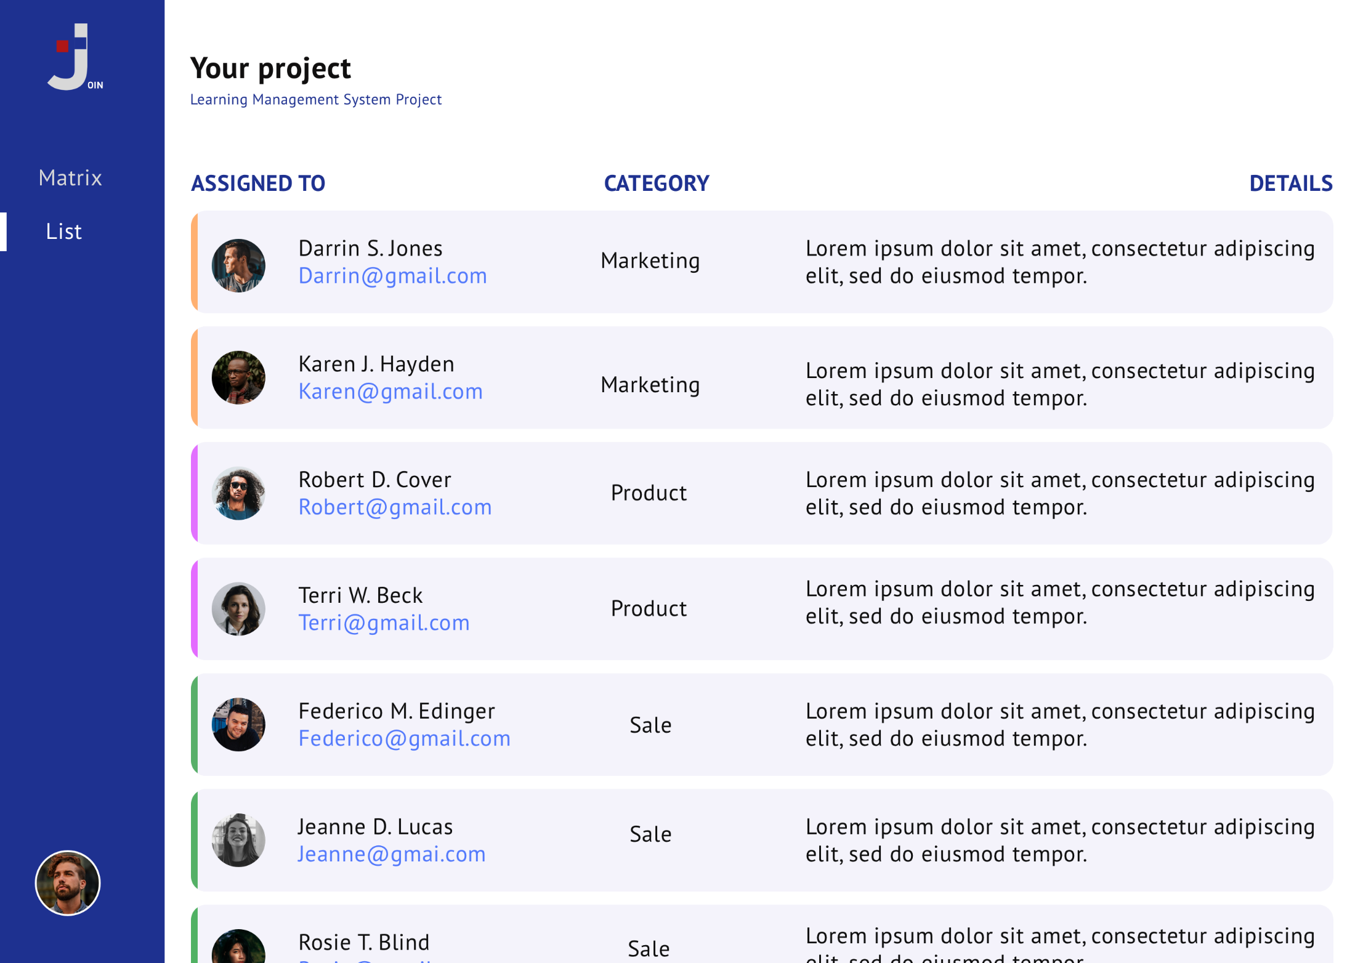
Backlog
Board
Backlog
Add Task
Help

Slide 2
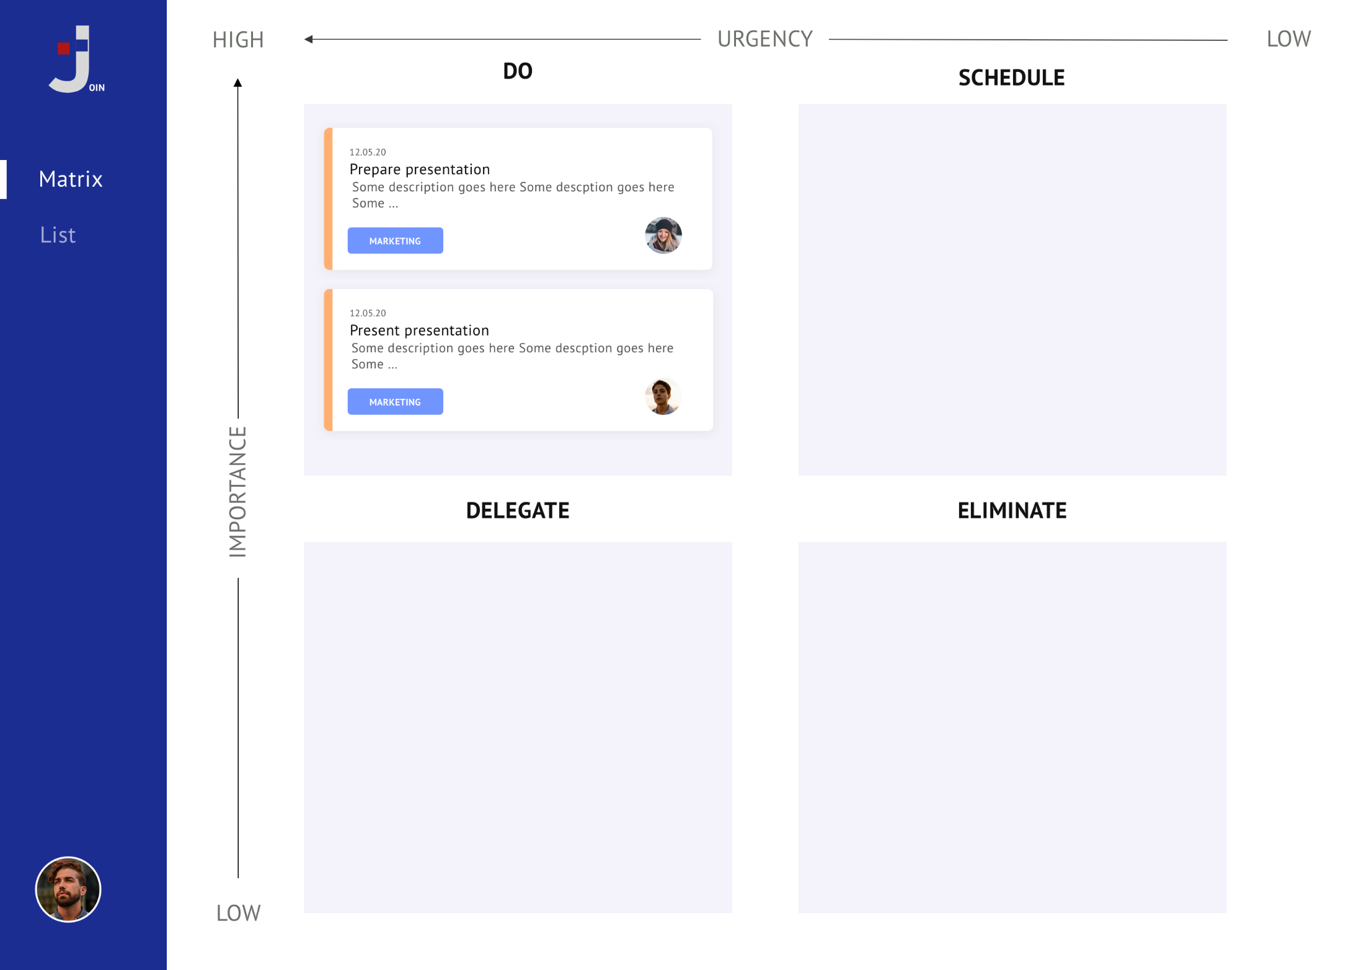
TO DO
IN PROGRESS
TESTING
DONE
Board
Backlog
Add Task
Help

Slide 3
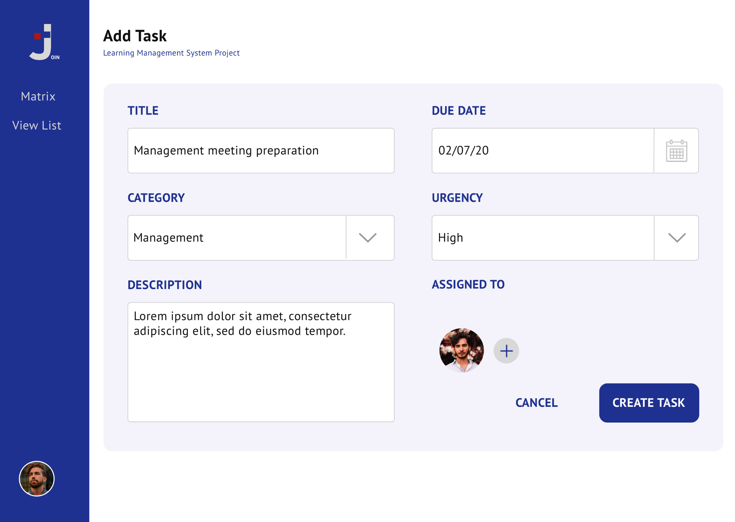
Board
Backlog
Add Task
Help

