Slide 1
happiness_report
File created on: 07/05/2024 16:32:09

Slide 2


Slide 3
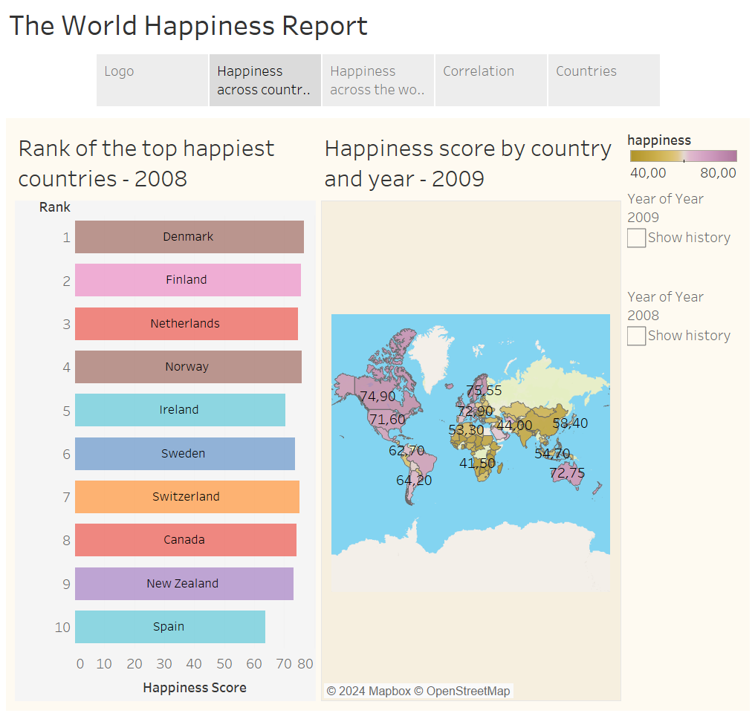

Slide 4
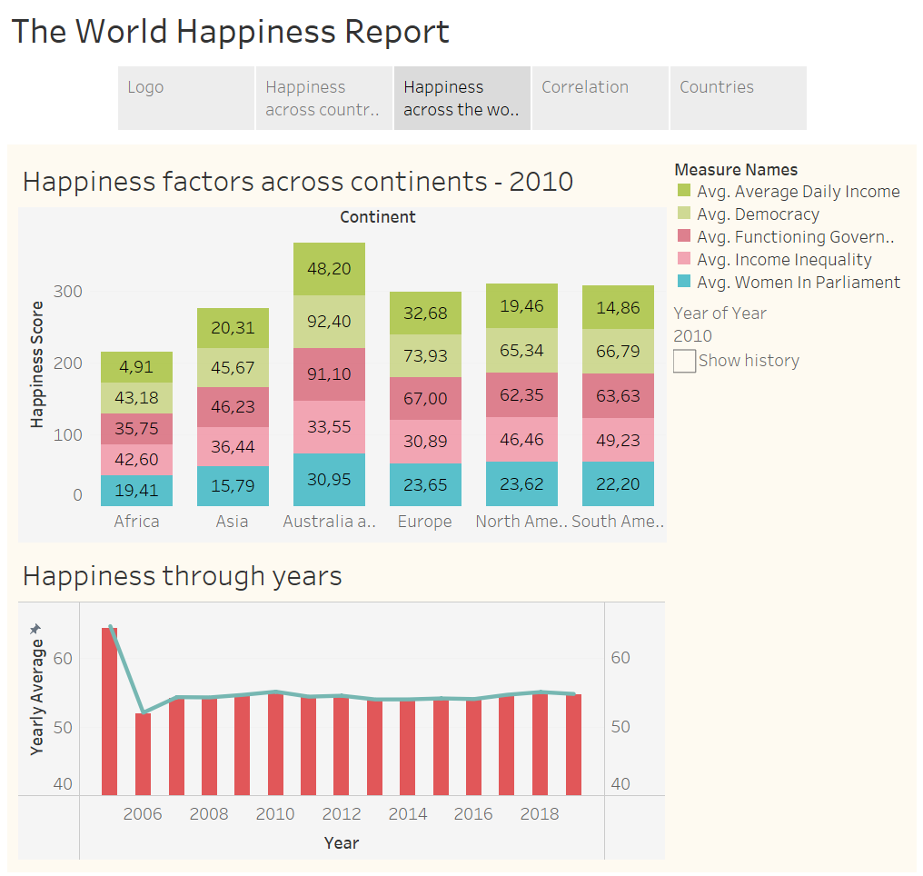

Slide 5
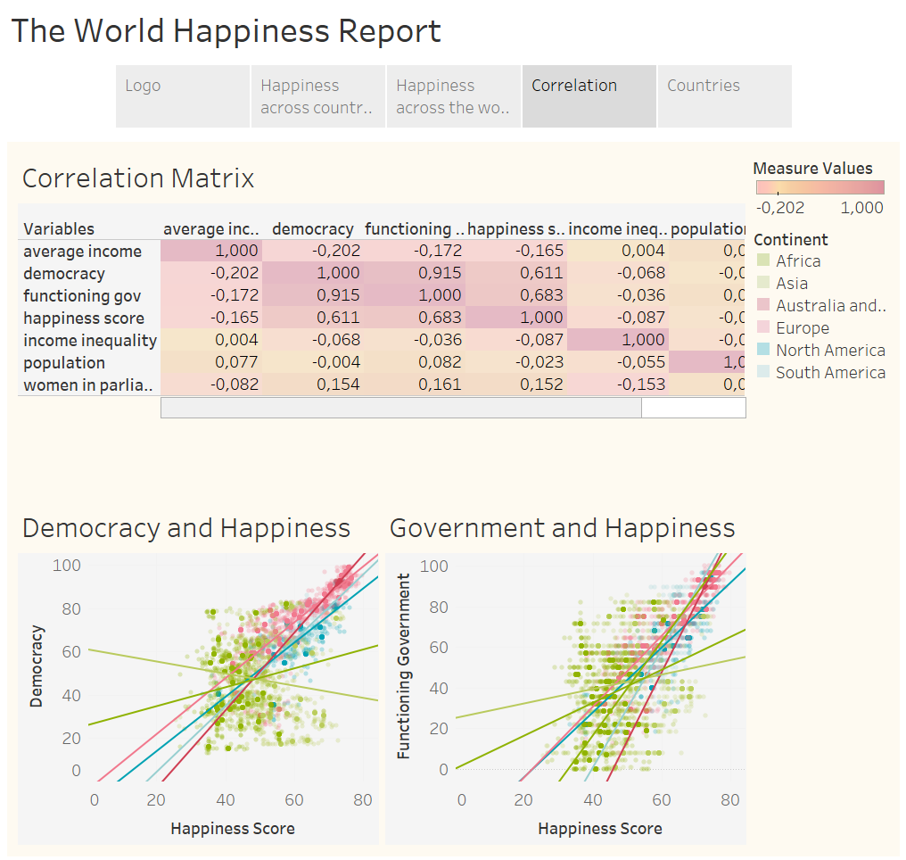

Slide 6
