Slide 1


Slide 2

CSS Cascading Style Sheet
CSS describes how HTML elements are to be displayed on screen.
Notes:
The term cascading derives from the fact that multiple style sheets can be applied to the same Web page.

Slide 3
CSS Cascading Style Sheet
Styles define how to display HTML elements (font face, size, color, alignment, …etc.)
Styles are normally stored in Style Sheets.
The term cascading derives from the fact that multiple style sheets can be applied to the same Web page.
Due to CSS, all HTML presentation tags and attributes are deprecated, e.g. font, center, etc.

Slide 4

Founder Håkon Wium Lie
Late 1994

Slide 5

Separate Structure & Presentation
Ease of maintenance

Slide 6
CSS Features
Provides precise control over margins, line spacing, element placement, colors, font faces, and font sizes.
Removes the need to re-type HTML style tags each time a new style is needed.
Ensures every user sees the same view regardless of the ways in which the browser's size and colors are configured.
Provides the ability to change the overall look of a Web page or even an entire site by changing a single style sheet.

Slide 7
CSS Versions
Cascading Style Sheets 1 (CSS1)
Features: Fonts, Colors, Alignment, Spacing
Cascading Style Sheets 2 (CSS2-CSS2.1)
Features: Layout, Positioning… (CSS-P)
Cascading Style Sheets 3 (CSS 3)
Features: Effect, Sizing…

Slide 8
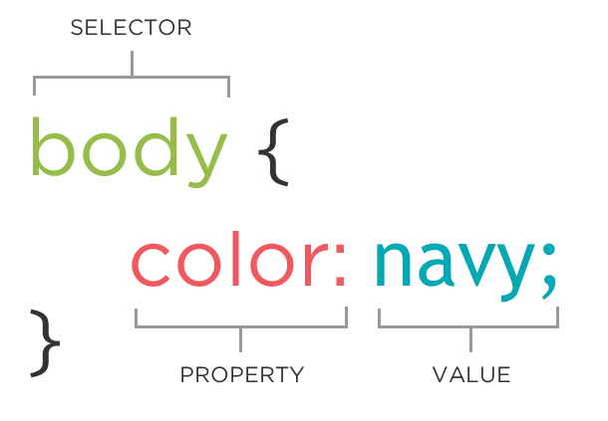
CSS SYNTAX

Slide 9
Page
Inline
Style Tag
External
Link
Import
Cascading Style Rules
Import Vs. Link
Notes:
<STYLE TYPE="text/css"> H1 { color: blue }
H2 { color: red}
</STYLE>
<link type="text/css" href="style.css“ rel="stylesheet" >
<STYLE TYPE="text/css">
@import url(“styles1.css”);
@import url(“style2.css”);
</STYLE>
<P STYLE="color: red; font-family: ‘Ariel‘ ">
This paragraph is styled in red with the Ariel font, if available.
</P>
http://www.stevesouders.com/blog/2009/04/09/dont-use-import/

Slide 10
Inline
ID
Class
Element
SELECTORS
SIMPLE

Slide 11
https://www.w3schools.com/cssref/css_selectors.asp
Pseudo-classes (:hover , :active , etc.)
Combinators & Multiple Selector (, & space & < & + & ~)
Universal Selector (*)
Attributes Selector [attr|=val] [attr^=val] [attr$=val] [attr*=val] [attr~=val]
Pseudo-elements (::after , ::before , ::first-letter)
SELECTORS
OTHER

Slide 12
Grouping
Grouping selectors is done by separating each selector with a comma to give the same properties to several selectors without having to repeat.
Example: h1 { font-family: “sans-serif “}
h2 { font-family: “sans-serif” }
h3 { font-family: “sans-serif “}
is equivalent to: h1, h2, h3 { font-family: “sans-serif” }

Slide 13
https://www.w3schools.com/cssref
Color
Background and Borders
Basic Box
Text
Text Decoration
Fonts
Writing Modes
Table
Lists and Counters
Basic User Interface
Paged Media
Generated Content
ATTRIBUTES
Notes:
Background-position (image with double images) –(sprites)

Slide 14
Keywords
Physical Measurement
Screen Measurement
Relative Measurement
Color Codes
Fonts (multivalues)
Functional Notations
Thin, Thick, Large
Inch (in), Point (pt), cm, mm
Pixels (px)
% , em (1.0em default size)
red., green , #rrggbb
Rgb(r,g,b) , url(“http://www.google.com”)
Helvitica, sans-serif
Short Hand
p { border: 5px solid red; }
VALUES

Slide 15
Specificity
Order
!important
Cascading Style Rules
Notes:
<STYLE TYPE="text/css"> H1 { color: blue }
H2 { color: red}
</STYLE>
http://www.stevesouders.com/blog/2009/04/09/dont-use-import/

Slide 16
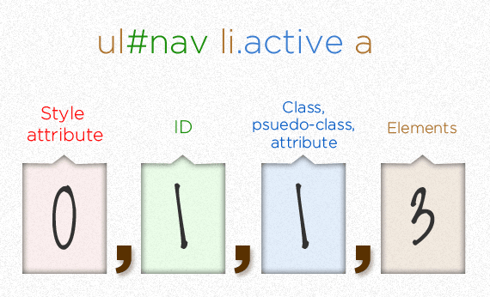
Specificity

Slide 17

!important

Slide 18
Cascading Order
“Cascading ” reflects the way styles are applied to the elements in a document, because style declarations cascade down to elements from many origins.
Styles will be applied to HTML in the following order:
1. Browser default
2. External style sheet
3. Internal style sheet (in head)
4. Inline style

Slide 19
Order
If the Specificity is the same, order of classes declaration make the last declaration has the highest priority.

Slide 20
Page Strongest
Default Weak
User Strong
External Stronger
Cascading Style
CSS Reset
Notes:
User : Internet options => accessibility
Link media=“Print”

Slide 21
Inheriting Style Rules
<div>
<p>
Data
</p>
</div>
Paragraph inherits the styles that can be inherited from the div.
Notes:
<STYLE TYPE="text/css"> H1 { color: blue }
H2 { color: red}
</STYLE>
http://www.stevesouders.com/blog/2009/04/09/dont-use-import/

Slide 22
BOX Model
Left
Top
Border
Data
Padding
H
Right
Total Height
W
Margin
Bottom
Total Width
Notes:
Margin : 0 auto; to center

Slide 23
Vertical Margin Collapse
Data
Horizontal Margin
Data
Data
Data

Slide 24
Display Vs. Visibility
Data1
Data 2
Data 3
Data1
Data 3
Data1
Data 3
Display None for second element
Visibility hidden for second element
Display Block
Data1
Data 2
Data 3
Display Inline or Inline-block
Notes:
Display : inline => width not applied
Display inline-block =>with applied

Slide 25
Static
Fixed
Relative
Absolute
Inherit
Z-Index
Positioning & Layout
Notes:
If there a container with position different than static the inner block will behave differently when you select absolute position it will calculate absolute position from the container not the screen.

Slide 26
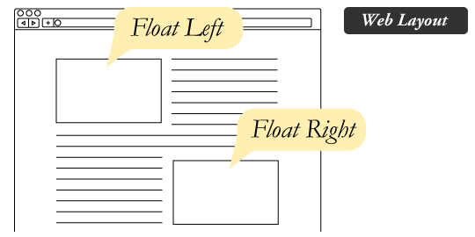
float : left;
float : right;
float : none;
clear : both;
clear : left;
clear : right;
Floating Elements

Slide 27

Text Styling
Serif
Times New Roman
Sans-serif
Arial
Cursive
Fantasy
Monospace
Comic Sans
Impact
Courier New
Notes:
body
{
font-family: Arial, Helvitica, sans-serief;
}

Slide 28

Text Styling
text-indent
letter-spacing
word-spacing
text-decoration
text-align
text-transform
vertical-align
line-height
Notes:
body
{
font-family: Arial, Helvitica, sans-serief;
}

Slide 29


Font Awesome
Notes:
https://jigsaw.w3.org/css-validator/ to validate your css

Slide 30





Slide 31
Questions ???

