Slide 1




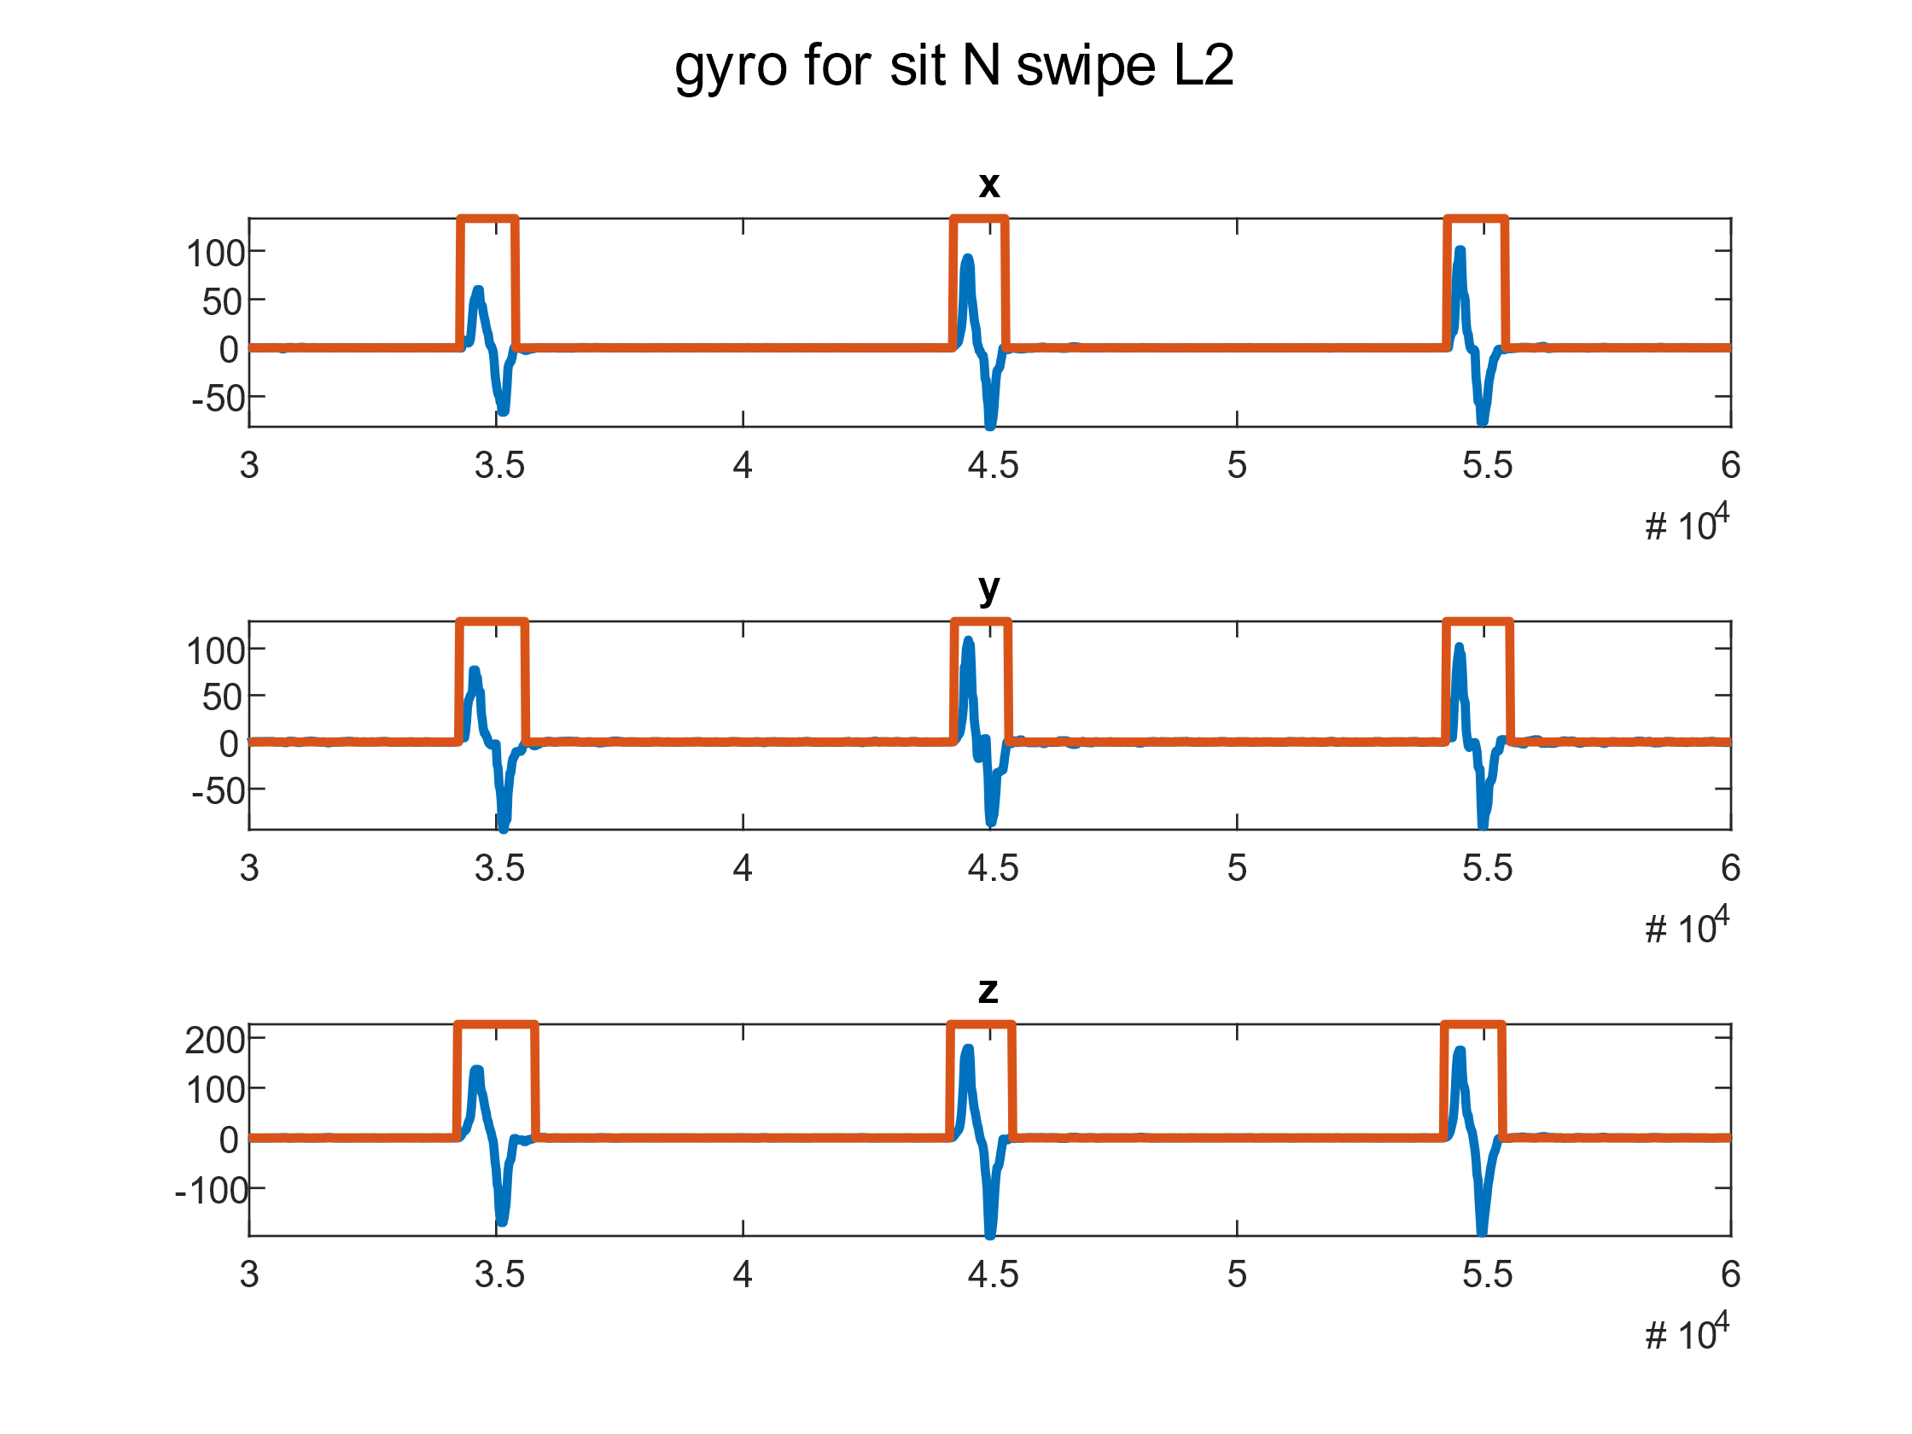
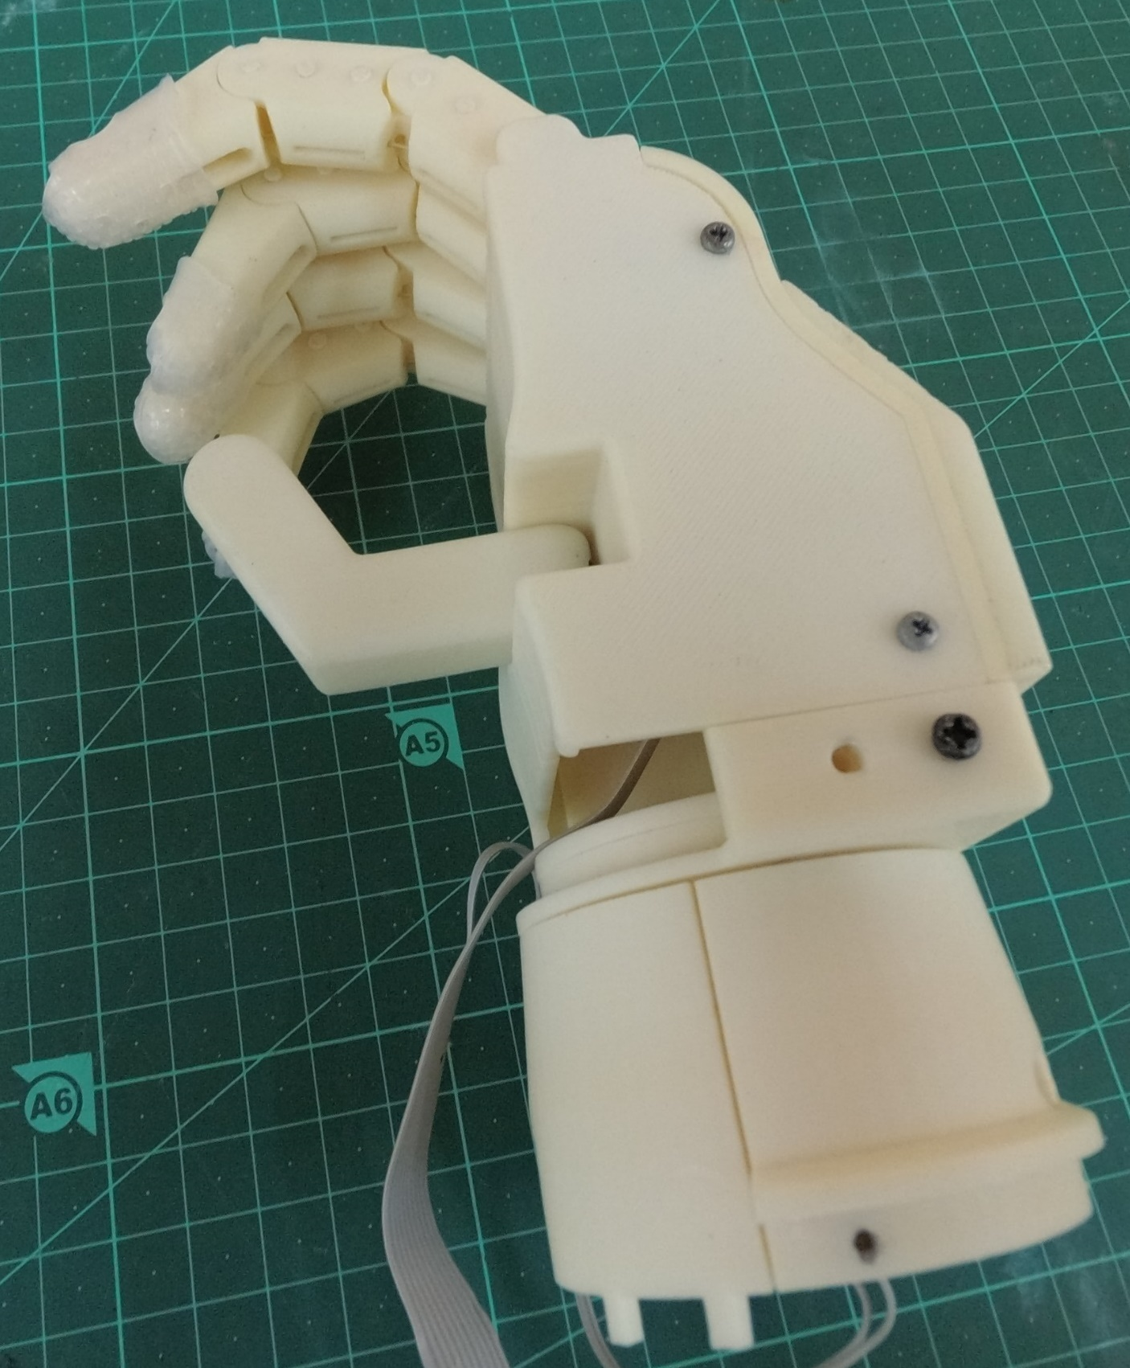
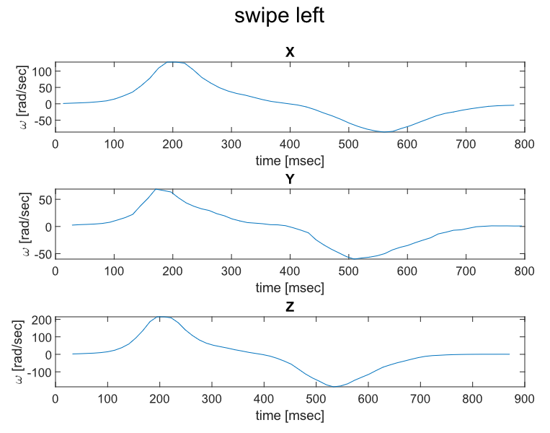
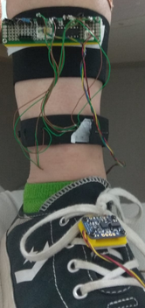
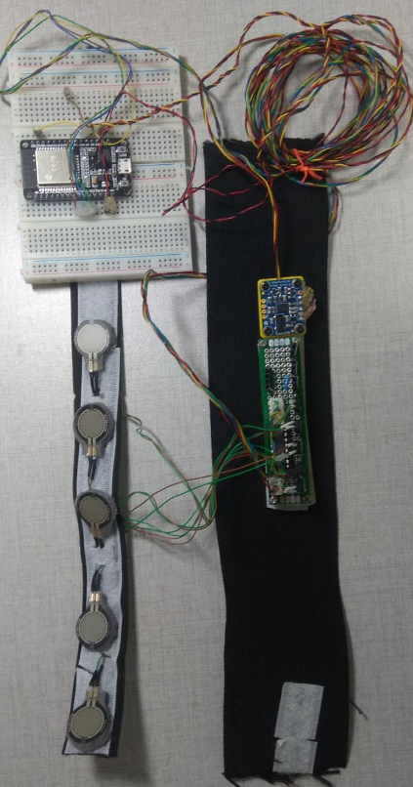
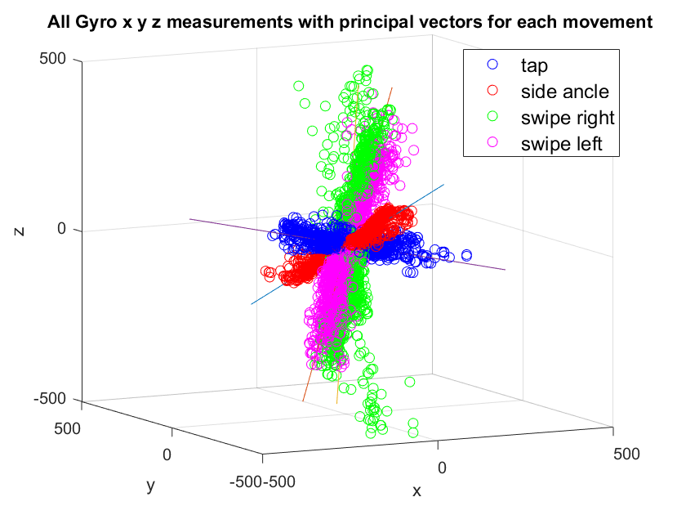
Signal and Image Processing Lab
User Interface Design for Low Cost 3D Printed Prosthetic Hand
Yahel Solomon and Marina Mearkovich, Supervised by Shunit Polinsky
In collaboration with Haifa 3D
Introduction
Chosen Solution
Classification
Day to day life aspects impaired by hand loss. Such as daily activities, social activities and work.
Thus the need for a practical, reliable & intuitive hand prosthesis arises.
The following users' needs are yet to be addressed by the current available solutions
- Short training period
Reliability and steady grip
Light weight
- low-cost
- Controlling grip force
A 3D printed prosthetic hand was designed to meet these needs
Our system reads the ankle orientation and muscles movements around it
FSR - pressure sensor that get data from the muscles
IMU - orientation and acceleration sensor. For our purpose we used mainly the fused gyro data which is an angular velocity.
Template matching method was chosen for the purpose of classification due to the pattern exhibited by the gyro measurements
Movements were extracted to create average templates of each movement at each axis:
Movements were aligned and clipped to create average templates of each axis for each movement:
PCA analysis was used to extract 3D principle vectors for each movement
The principle vectors were used as weights applied to highlight the difference in the patterns.
Classification is based on the highest movement-template correlation
FSRs
Controller
Prosthetic hand
IMU
Pre Processing
Classifier
Marking movements to create average templates
Block Diagram
Implementation
A custom-made band was assembled for data acquisition:
IMU located on foot and read movements signals.
FSR’s located above ankle and read muscle pressure signals.
Low Cost 3D Printed Prosthetic Hand designed by Shunit
Prosthetic hand control
Average template of swipe with 3 channels –x,y,z
Most available Electromechanical prosthetic hands are based on surface EMG which still introduces some challenges:
Noisy signal & unstable control
use of the residual limb muscles, which may cause phantom pain and unreliable signal.
System on leg
System layout
Goals
Control of Electromechanical prosthetic hand through signals acquired from the foot:
- Setting up a sensor system
Collecting data
Classification of at least three gestures
Data acquisition
3D plot of all data with the first principle vector of each movement
Arduino code was written to implement data acquisition and synchronize all sensors to produce measurements at approximately 50 [Hz] rate.
A series of measurements was conducted for 4 movements - Tap, Swipe Left & right & side ankle flexion.
Raw data was filtered using a median filter and resampled to a constant sample rate.
Challenges
Future Work
Choosing short, different and intuitive movements
Choosing classification method
Implement robust acquisition system – wiring, choosing components, design on PCB
Improving classifier
Implement real time on-board algorithm
Test with real user to measure algorithm success and user’s satisfaction.
June 2020
Notes:
לשנות גרפים

