Slide 1
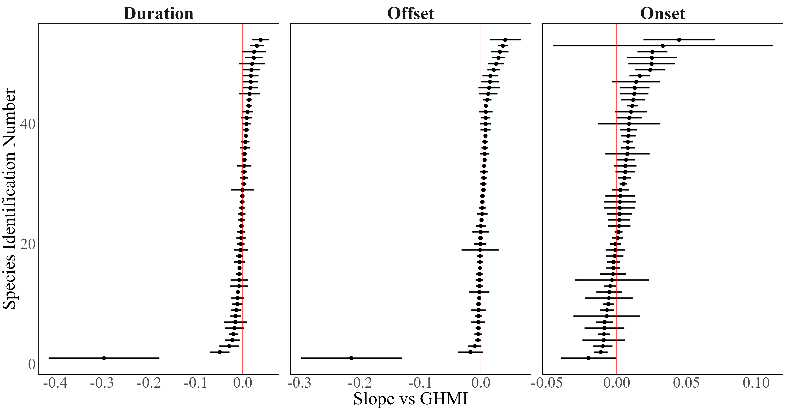
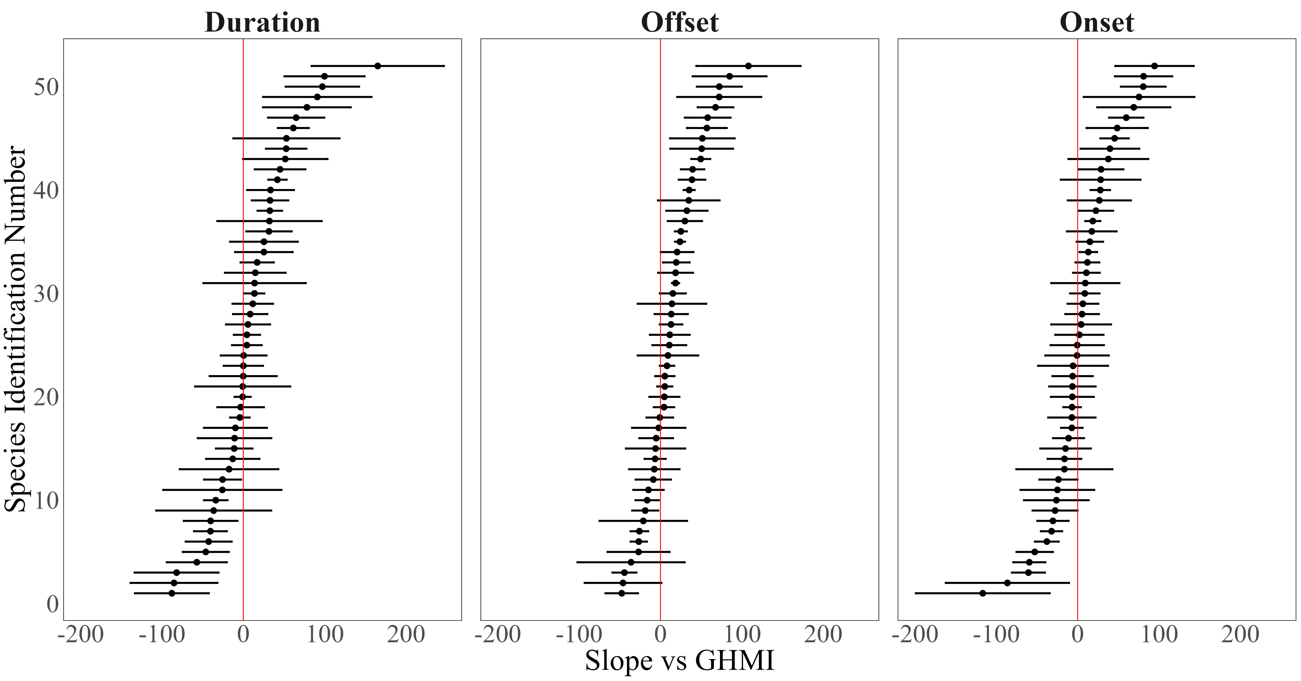
A)
Effect of population density on phenology
B)
Effect of anthropogenic modification on phenology

