Slide 1
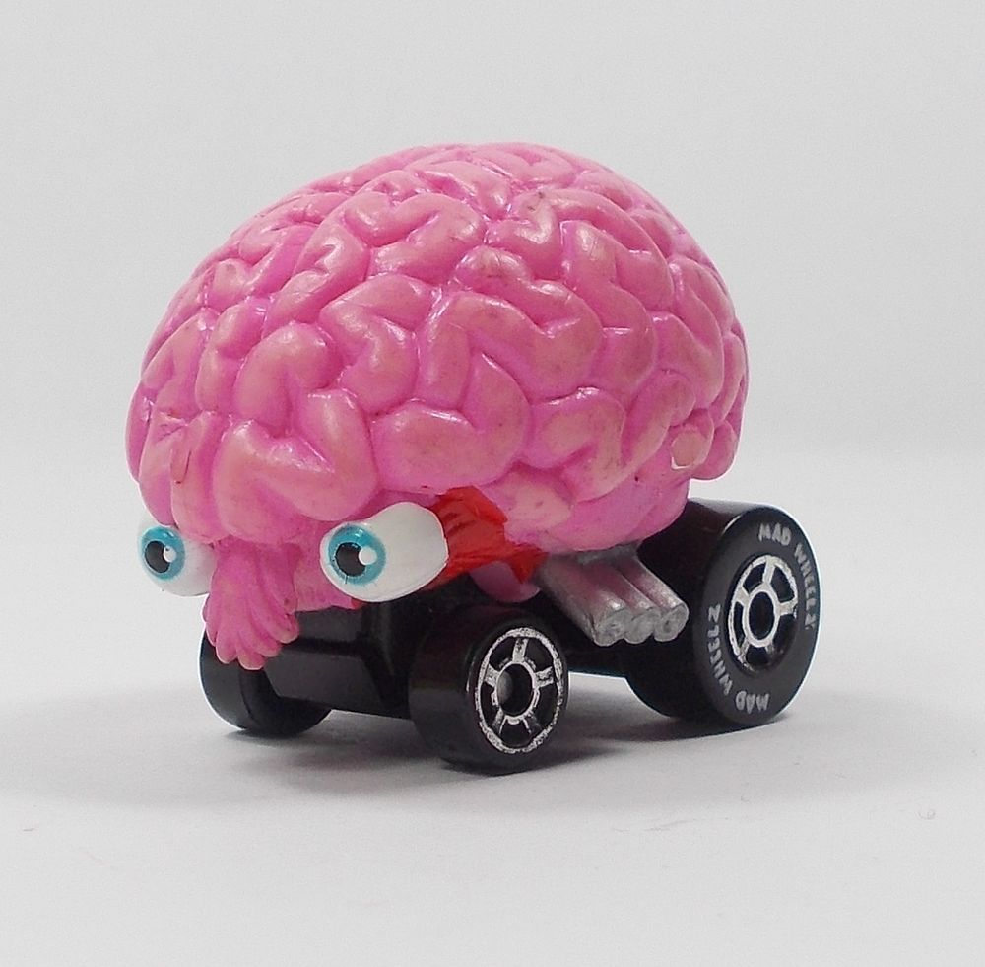
H2020 : APS Autopilot cars for roads in Serbia
Type of funding scheme: STREP
Work programme topics addressed:
Internet of Things - ICT-27-2018-2020
Name of the coordinating person:
Miroslav Misljenovic, Marina Nikolic
E-mail:
mr12260@alas.matf.bg.ac.rs
mr12095@alas.matf.bg.ac.rs

Slide 2
Participants:
Miroslav Misljenovic | MATF | Serbia
Marina Nikolic | RT-RK | Serbia
Milos Stojanovic | EED | Serbia
Djordje Pesic | OBLO | Serbia
Jovan Petrovic | TTTECH | Austria

Slide 3
About project… WHY?
Serbia…
So hard to drive…
Holes on the roads
Inadequate marking
Poor lighting of individual sections
How to automatize something that unpredictable?
Current technologies
Recognize only quality and unimpaired signalling
Impossible to apply in Serbia

Slide 4
About project… HOW?
An idea struck in our minds…
Adapt autopilot software for roads in serbia
and implement it on vehicles imported from korea
We want to be better…
Improving the system for identifying and avoiding holes and other road damages
Improving the system for side-line following, in straight driving, curves and turning
Improving the system for distance measuring and speed optimisation

Slide 5
About project… FOR WHO?
We want
More people driving autopilot cars!
More importantly we want…
More people driving!!!
Give chance to…
Blind and visually impaired people
People with disabilities
Safety first:
One test saves on life!
Testing… and more testing…

Slide 6
Progress beyond the state-of-the-art
Many researches have been conducted…
Not one applicable on roads like the ones in Serbia…
Here we go beyond state of the art!
TESLA:
Most advanced technologies
In top 5 selling autopilot cars
Remarkable properties of cars with autopilot
But…
Unreliable and dangerous even on more quality roads then the ones in serbia.
Keep good properties, but correct the flaws.

Slide 7
Work packages - table
Work package No | Work package title | Type of activity | Lead partic no. | Lead partic. short name | Person-months | Start month | End month
WP0 | Project management | MGT | 2 | RT-RK | 48 | M1 | M21
WP1 | Generating use cases | RTD | 1 | MATF | 8 | M2 | M3
WP2 | Import vehicles from South Korea | RTD | 5 | TTTECH | 4 | M4 | M5
WP3 | Obtain software from Tesla | RTD | 3 | EED | 8 | M4 | M5
WP4 | Detailed study on road conditions in Serbia | RTD | 5 | TTTECH | 70 | M6 | M12
WP5 | Software implementation | RTD | 1 | MATF | 160 | M10 | M18
WP6 | Testing | RTD | 4 | OBLO | 50 | M13 | M19
WP7 | Dissemination | DEM | 2 | RT-RK | 24 | M13 | M24
 | TOTAL |  |  |  | 372

Slide 8
Work packages - Gantt chart
 | Months
 | 01 | 02 | 03 | 04 | 05 | 06 | 07 | 08 | 09 | 10 | 11 | 12 | 13 | 14 | 15 | 16 | 17 | 18 | 19 | 20 | 21 | 22 | 23 | 24
WP0 Project management
WP1 Generating use cases
WP2 Import vehicles from South Korea
WP3 Obtain software from Tesla
WP4 Detailed study on road conditions in Serbia
WP5 Software implementation
WP6 Testing
WP7 Dissemination

Slide 9
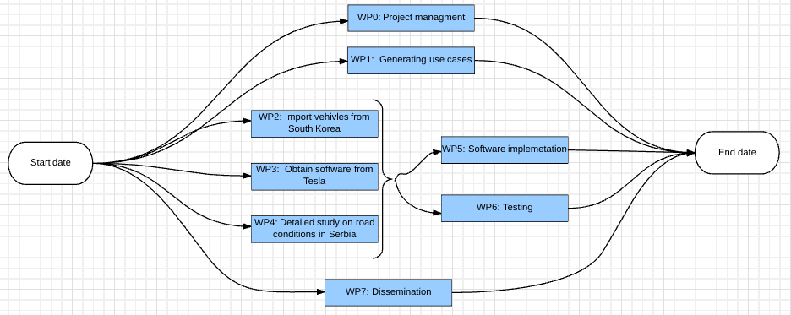
Work packages – Pert chart

Slide 10
Deliverables
Del. no. | Deliverable name | WP no. | Nature | Dissemi-nation level | Delivery date (proj. month)
D0.1 | Progress report for the three months of work | 0 | R | PU | M3
D0.2 | Progress report for the nine months of work | 0 | R | PU | M9
D0.3 | Progress report for the fifteen months of work | 0 | R | PU | M15
D0.4 | Progress report of whole project | 0 | R | PU | M24
D1 | Documentation of use cases | 1 | R | CO | M4
D2 | Confirmation on import success | 2 | R | PP | M6
D3 | Confirmation on Tesla’s software receiving success | 3 | R | PP | M6

Slide 11
Deliverables
Del. no. | Deliverable name | WP no. | Nature | Dissemi-nation level | Delivery date (proj. month)
D4 | Report on detailed study on Serbian roads | 4 | R | CO | M13
D5.1 | Documented code | 5 | R | CO | M14
D5.2 | Final version of software implementation | 5 | P | CO | M18
D6.1 | Documented testing procedures | 6 | R | CO | M14
D6.2 | Report on testing results | 6 | R | PU | M20
D7.1 | Number of participants at automotive seminars and sessions | 7 | D | PU | M24
D7.2 | Number of car shows organized | 7 | D | PU | M24
D7.3 | Number of arcticles in international car magazines | 7 | D | PU | M24

Slide 12
Milestones
Milestone number | Milestone name | Work package(s) involved | Expected date | Means of verification
M0.1 | Checking on optimization of the reporting processes involved in the project (deadlines) | WP0 | M6
M0.2 | Checking on optimization of the control processes involved in the project | WP0 | M12
M0.3 | Checking on optimizing finances of the project | WP0 | M12
M1.1 | Checking on opinion of beneficiaries on the need for the generated applications | WP1 | M3
M1.2 | Checking on opinion of beneficiaries about the functionalities provided | WP1 | M4
M2.1 | Checking if imports are done in arranged deadlines | WP2 | M5
M2.2 | Checking if needed licences are obtained | WP2 | M5
M3.1 | Checking if needed licences are obtained | WP3 | M5
M4.1 | Checking if list of all possible problems on Serbian roads is made properly | WP4 | M13

Slide 13
Milestones
Milestone number | Milestone name | Work package(s) involved | Expected date | Means of verification
M5.1 | Checking on system for damage recognition | WP5 | M18 | System can detect and avoid road damages off any size and types.
M5.2 | Checking on system for side-line following | WP5 | M18 | System can maintain required distance from each side-line in straight driving and in both left and right curves and turning.
M5.3 | Checking on system for car distance | WP5 | M18 | System can measure distance from both cars in front and behind and optimize speed to keep it constant.
M5.4 | Checking if software covers statistically significant number of different road issues | WP5 | M18
M6.1 | Checking if test cases are developed according to the needs of the beneficiary industry | WP6 | M13
M6.2 | Checking if all 12 test combinations passed successfully. | WP6 | M20
M7.1 | Checking on number of papers presented at most famous international car magazines | WP7 | M24 | Number must match plan: one per each month dissemination is done, 8 in total
M7.2 | Checking on number of participants at automotive seminars and sessions | WP7 | M24 | Number must match plan: one of each kind, in each dissemination section, 4 participations in total

Slide 14
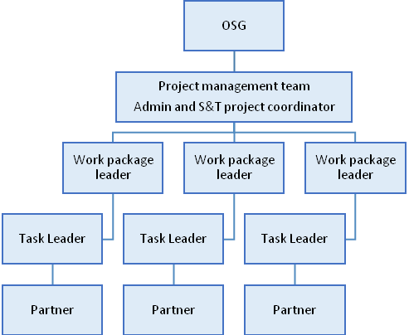
Management structure

Slide 15
Resources
Some expences:
Import expenses estimated on E260K
Licence obtaining resources estimated on E100K
Software implementation resources estimated on E200K
Testing equipment resources estimated on E350K
Overall: 4.000.000,00 euro

Slide 16
Impact and dissemination
Positive impact on the economy of all car producers
Strong impact on each partner
People with disabilities will drive
Commercial and scientific impact
Posting an example to other countries, Europe-wide
Dissemination is planed through
Sessions and seminars
Car shows
Media: local TV and radio stations, international car magazines, ...

Slide 17
Ethical issues
No direct ethical, legal, social and safety issues
Just in case, we will form:
Ethical committee
Because:
There is no right way to do a wrong thing…
Harold S. Kushner

Slide 18

Thank You For Your Attention !!!

