Slide 1
FMCG Marketing Analytics
Postgraduate Diploma in Data Science
Project Scope:
Marina Nikon

Slide 2
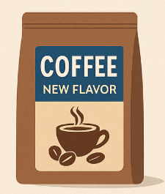

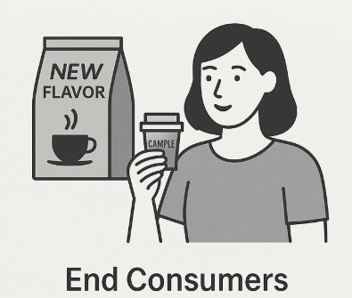
Background
The company launched a new flavor variant of coffee brand
in January 2023. The marketing campaign was executed for
their Channel Partners and end consumers before the
product launch
For Channel Partners, the company introduced the product and reward system through SMS, email and call.
For end consumers, product samples were given and initial opinion was understood through primary market research.

Slide 3


Objective
To identify which Channel partners responded and who to target first in the next planned campaign (EDA/Modeling)
To identify the most effective communication channel/s for them
The objective of the study is
To analyze the responses collected from end consumers and see if minor tweaks can be done to improve the product

Slide 4
Objective
To identify which Channel partners responded and who to target first in the next planned campaign (EDA/Modeling)
To identify the
most effective communication channel/s for them
The objective of the study
To analyze the responses collected from end consumers and see if minor tweaks can be done to improve the product

Slide 5
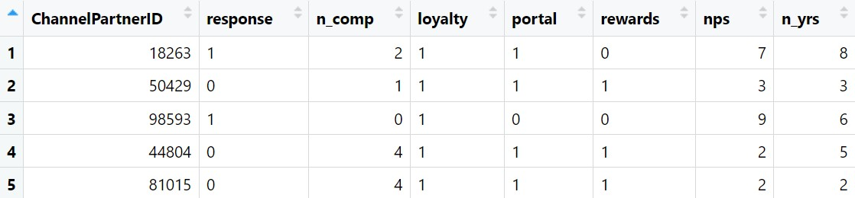
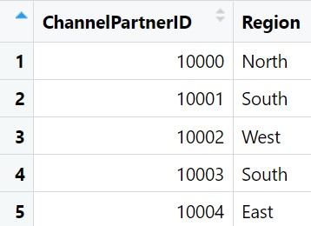
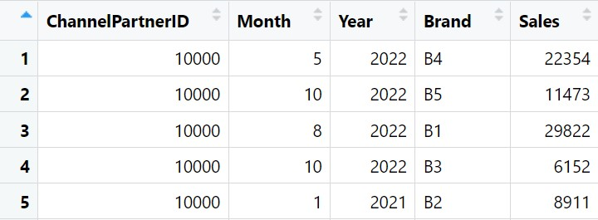
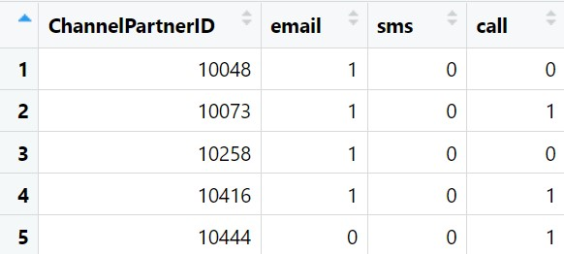
Data Snapshots
Campaign Response
Transaction Data
Region
Campaign
Details

Slide 6
Flowchart
Phase 1 is all about creating master data using 4 CSV files.
Phase 2 is about data analysis using graphs, tables etc (EDA)
Phase 3 is about developing a model using Binary Logistic Regression(using final master data- 1228 rows and 20+ variables))
Phase 4 is about using ML methods and compare with Binary Logistic Regression
Phase 5 is about text mining of consumer feedback data

Slide 7
Flowchart of all 5 Phases
Phase 1
Data preparation
Load and merge raw data
Final master data created
Phase 2
Exploratory Data Analysis
Understand variable distributions
Identify trends using plots/tables/charts
Phase 3
Binary Logistic Regression
Dependent and Significant Variables
Text Pre-Processing
Explore relationship between predictors and response
Derived variables
Phase 5
Text Analytics
Multicollinearity
Phase 4
ML Methods
Model Performance
Naïve Bayes
Decision Tree
Random Forest
Four Methods Comparison
Word Cloud
Sentiment Analysis

Slide 8
Flowchart of all 5 phases UDALAT
Phase 1 Data preparation
Load and merge raw data
Phase 2 Exploratory data analysis
Understand variable distributions
Final master data created
Identify trends using plots/tables/charts
Explore relationship between predictors and response
derived variables
Phase 4
Load and merge raw data
Phase 5
Understand variable distributions
Final master data created
Identify trends using plots/tables/charts
Explore relationship between predictors and response

Slide 9
Flowchart of all 5 phases UDLAT
Phase 1 Data preparation
Load and merge raw data
Final master data created
Phase 2 Exploratory data analysis
derived variables

Slide 10
List of derived variables (Phase 1)
TotalSales2021
Total sales in 2021 for each Channel Partner
TotalSales2022
Total sales in 2022 for each Channel Partner
B1_sales2022
Brand B1 sales in 2022 for each Channel Partner
B1_contribution2022
Brand B1 contribution to total sales in 2022
Buying_Frequency_2022
Number of unique months of purchase in 2022
Brand_Engagement_2022
Number of unique brands purchase in 2022
Buying_Frequency_B1_2022
Buying Frequency for brand B1 in 2022 by each Channel Partner
Active_Last_Q
Active in the last quarter (Yes/No) by each Channel Partner
Active_Last_Q_B1
Active in last quarter (Yes/No) for brand B1 by each Channel Partner

Slide 11
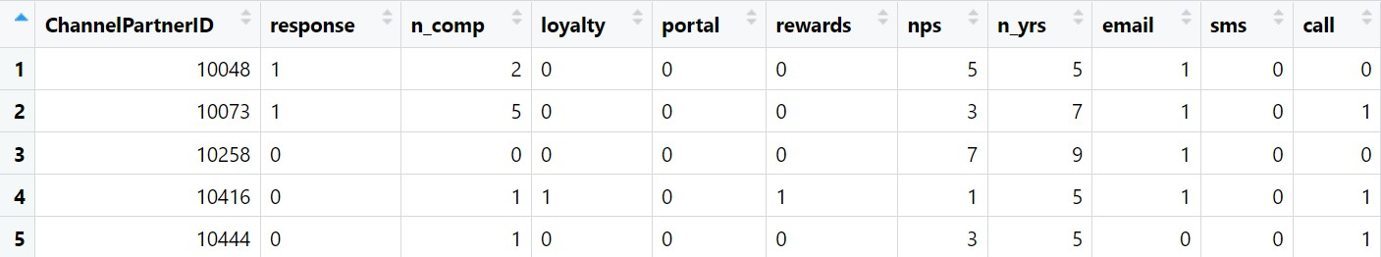
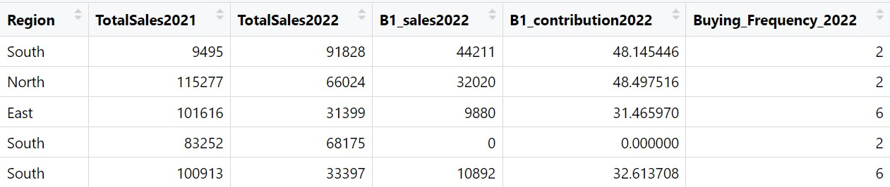
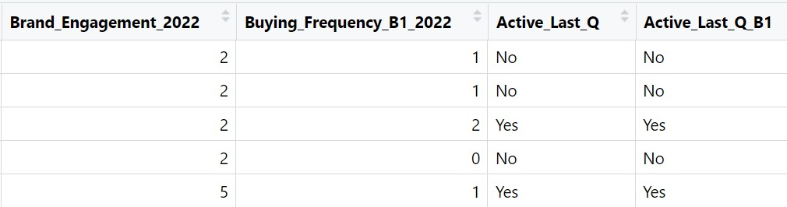
Snapshot of final master data (Phase1)

Slide 12
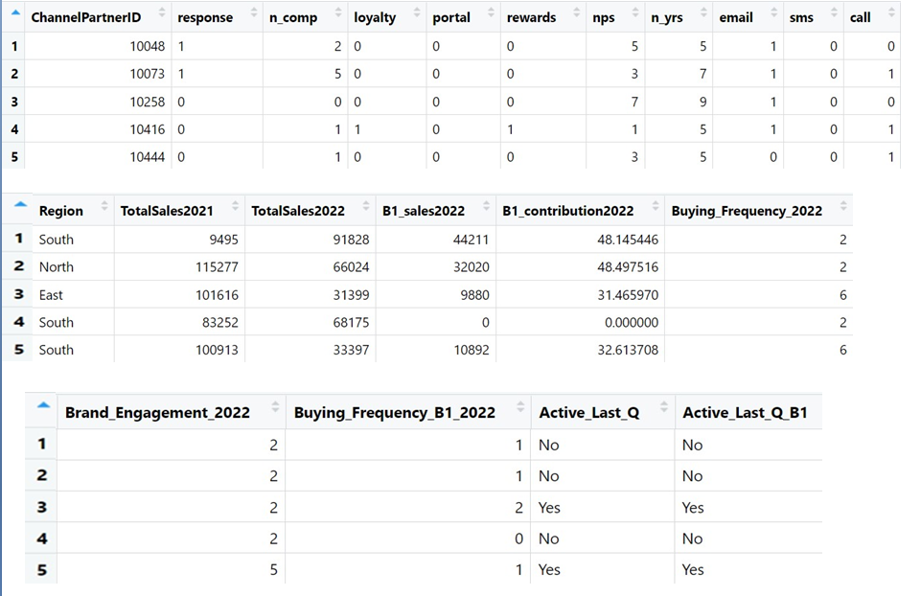
Phase1- snapshot of final master data
After merging the data and deriving variables
the final dataset was obtain.

Slide 13
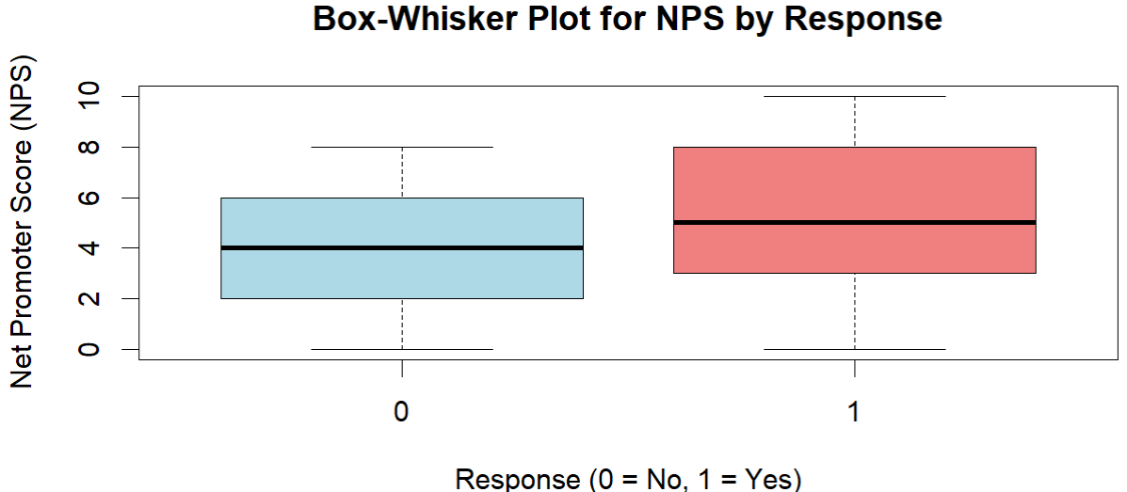
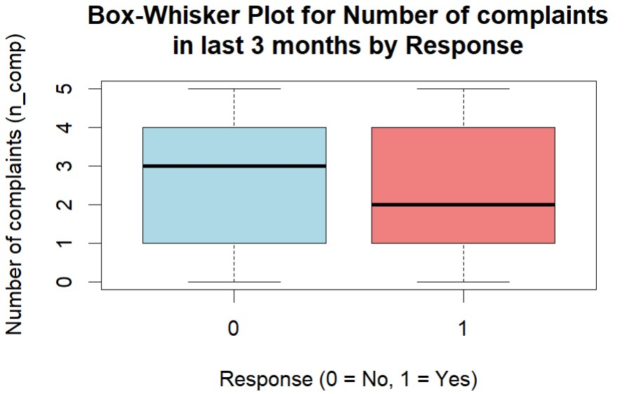
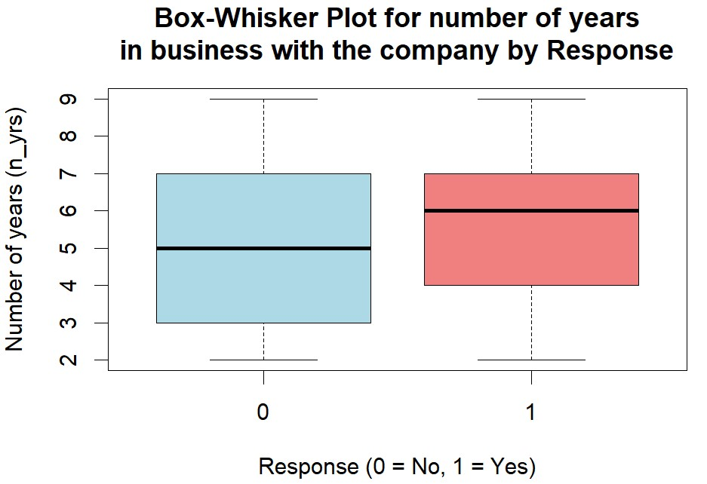
Tables/graphs with interpretations (Phase 2)
The box-whisker plot shows that the median
change in NPS is slightly higher for those who
responded 'Yes', indicating that partners who
responded to the campaign are more
satisfied / loyal.
The median change in n_comp in last 3 months
is higher for responses 'No' than for 'Yes',
indicating that the partners who did not respond
to the campaign tend to have more complaints.
The median change in n_yrs in business with the
company is slightly higher for response 'Yes' than
for 'No', indicating that long-term partners are
more likely to respond to the campaign.

Slide 14
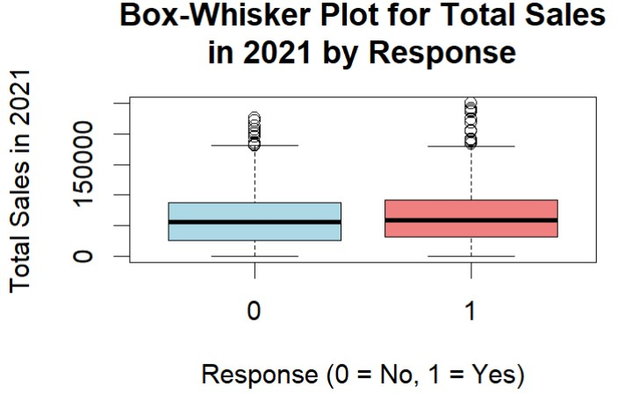
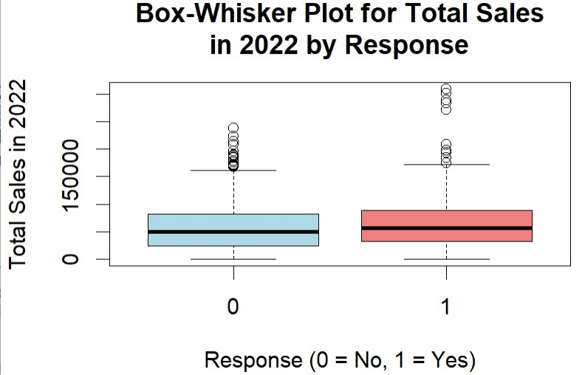
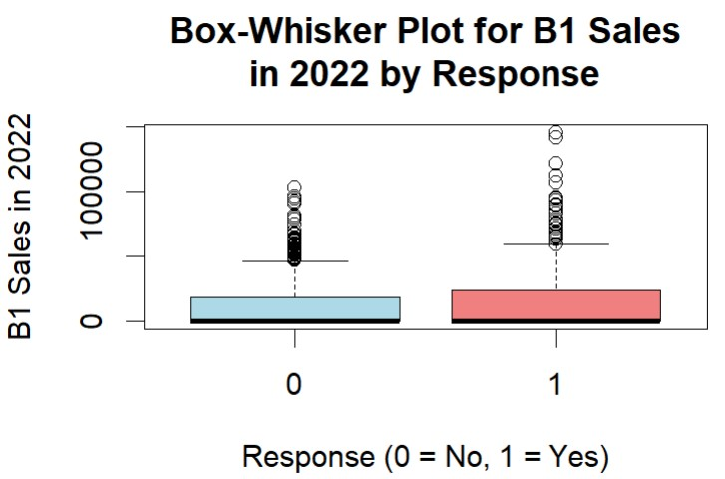
The median in Total Sales both in 2021 and 2022
is slightly higher for response 'Yes' than for 'No',
but this median difference is not clearly noted.
Both response groups are highly positively skewed
and include a significant number of outliers,
meaning that some partners sold more then the
others.
The median in B1 Sales in 2022 is very close to
zero for both response groups, indicating that a
large number of the channel partners had little or
no B1 sales. Both response groups are extremely
positively skewed and include a significant
number of outliers, meaning that some partners
have very high B1sales compared to majority.
It looks that response "Yes" has higher outliers,
than response "No".

Slide 15
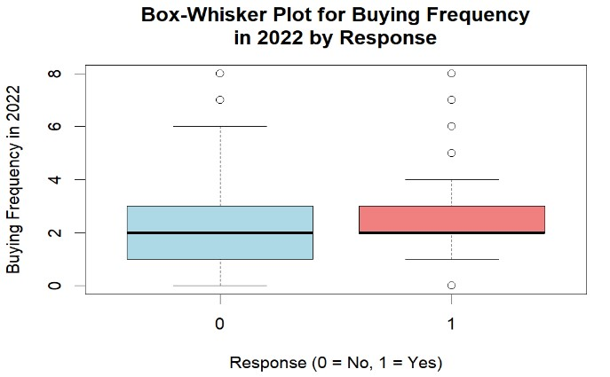
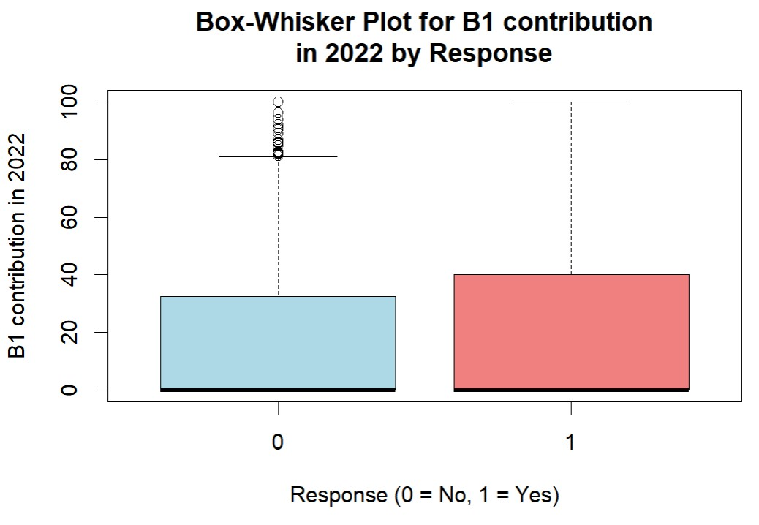
The median for B1 contribution in 2022 is very close to zero, indicating that a large number of the channel
partners had little or no B1 contribution. Both response
groups are extremely positively skewed. Response
"No" include a significant number of outliers.
The median for buying frequency is
similar for both response groups, it
suggests that, on average, the buying
frequency does not differ significantly
between these two response groups.
Both groups have a few high-value
outliers (above 6 purchases),
indicating that some channel partners
made significantly more purchases
then the majority. The spread of
buying frequency is nearly identical
for both responses.

Slide 16
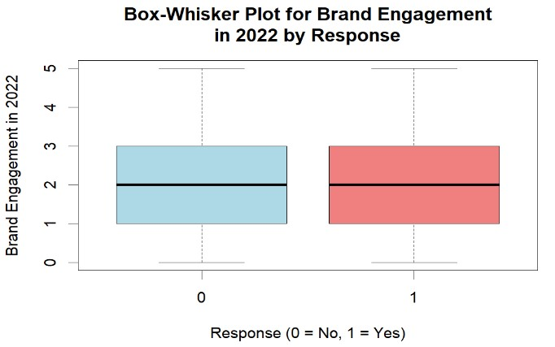
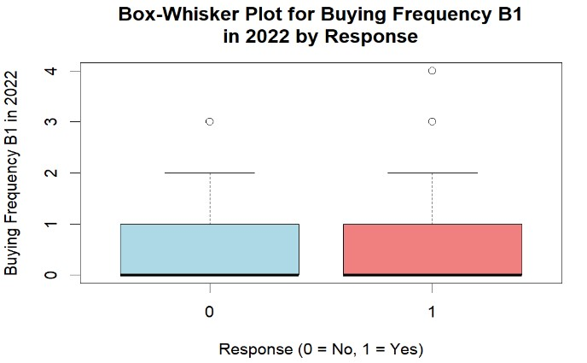
The box-whisker plot shows that the
median change in Brand Engagement
looks symmetrically for both response
groups.
The median in Buying Frequency B1
is very close to zero, indicating that a
large number of the channel partners
ad bought little or no at all of B1.
Both response groups are distributed
Symmetrically and extremely
positively skewed.
Overall, B1-related performance was
low across all channel partners.
Most partners had little to no B1 sales
or contribution. However, both
response groups included a few
significant outliers, indicating that a
small subset of partners drove
disproportionately high B1 sales or
contributions. This suggests that:
Campaign response did not strongly
differentiate B1 behavior on average.

Slide 17
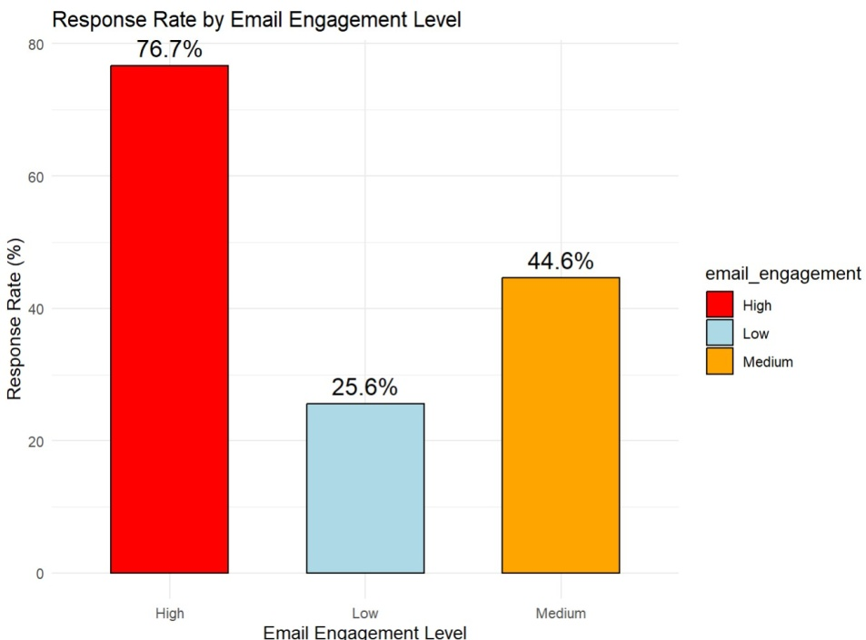
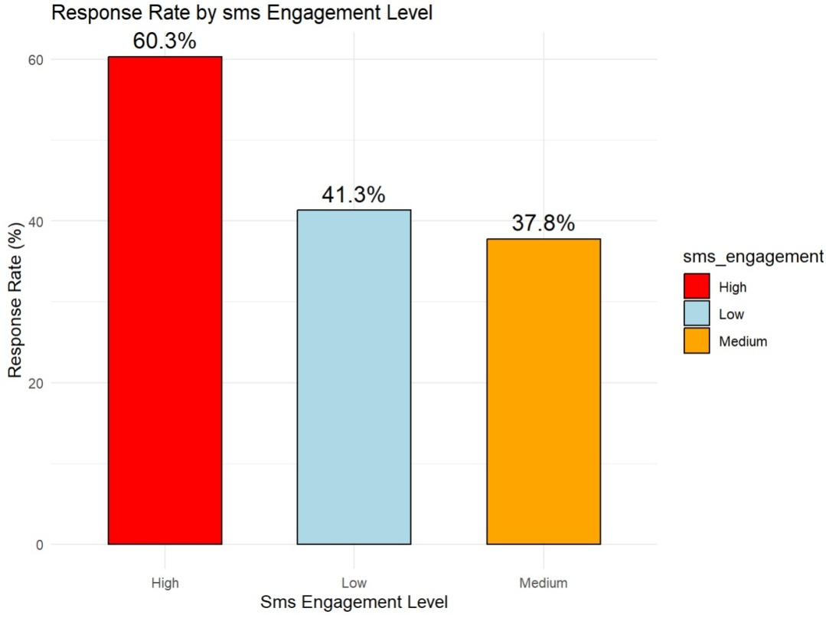
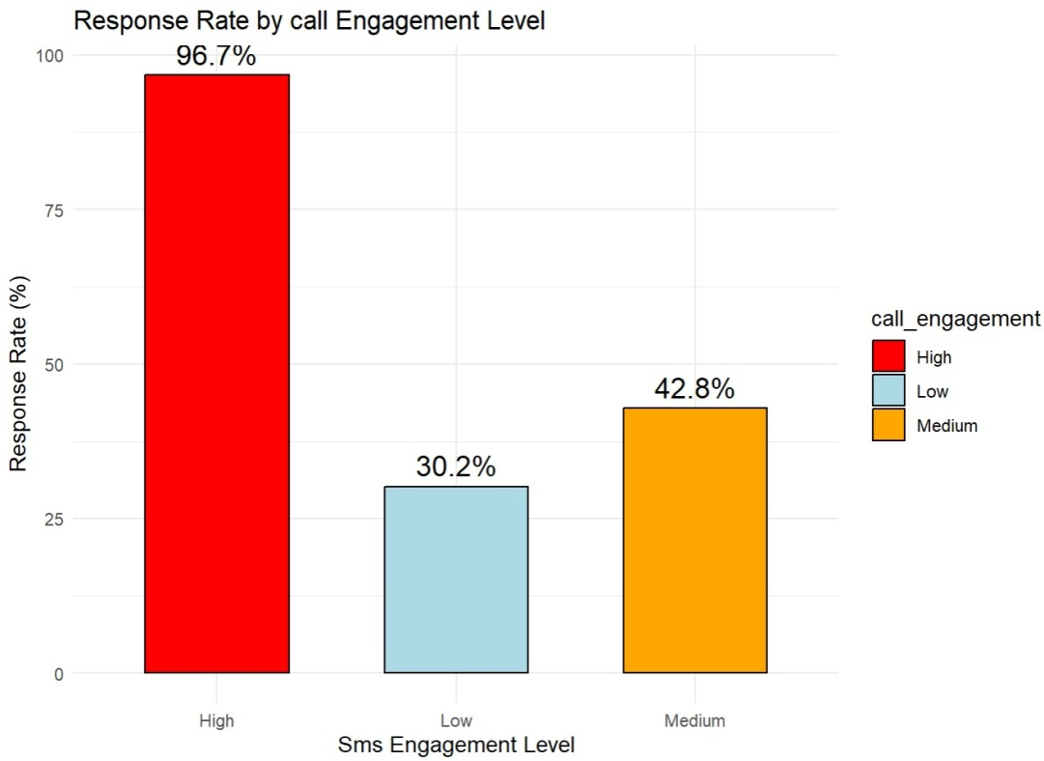
Bar chart of Response Rate and Chi-Square Test (Phase2)
Email p-value < 2.2e-16 – Significant
relationship
SMS p-value = 0.00523 - No strong
relationship
Call p-value < 2.2e-16 – Significant
relationship
Higher email and call engagement are
strongly associated with higher
Response Rates

Slide 18
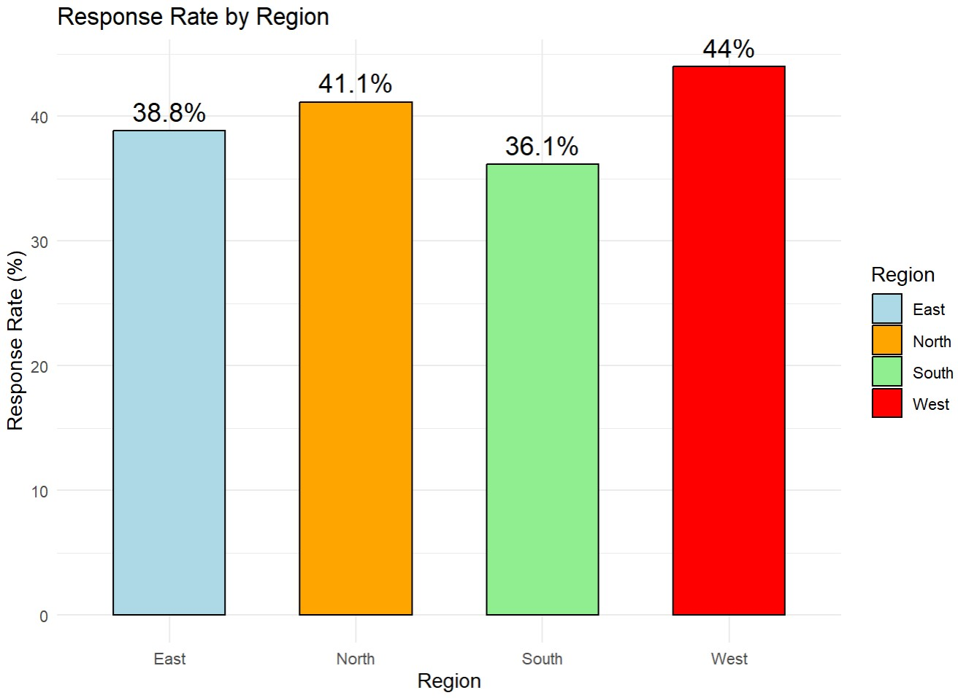
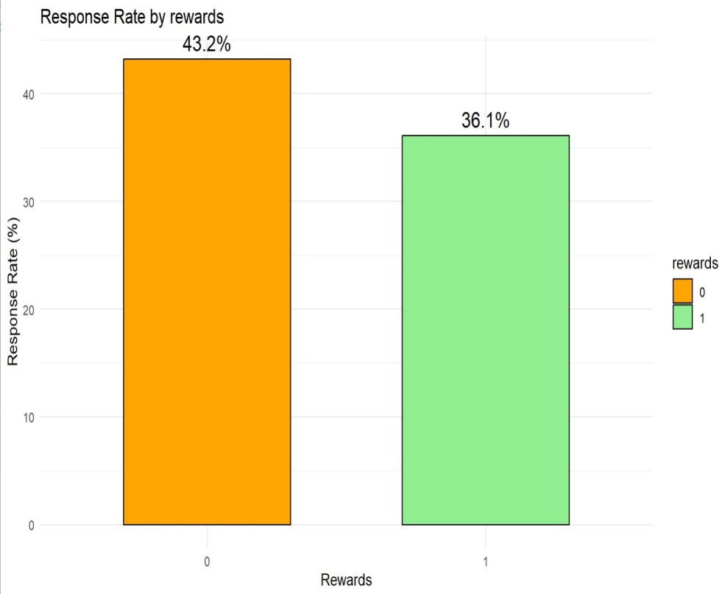
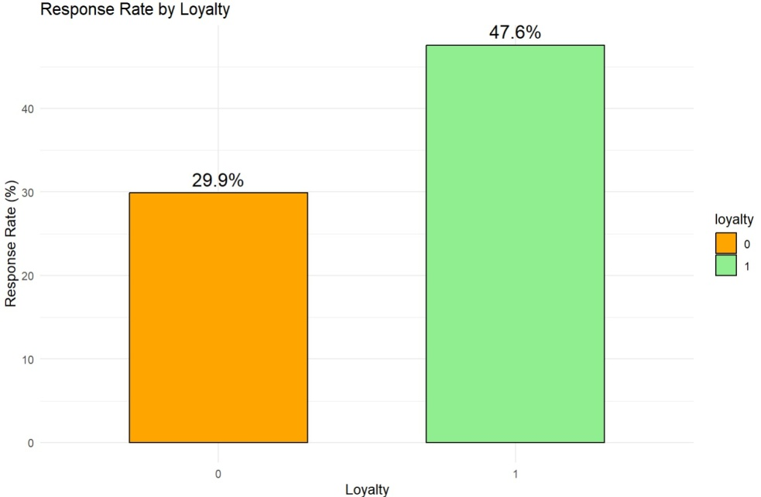
Region p-value = 0.2595 - No strong relationship
Loyalty p-value = 5.614e-10 - Significant relationship
Rewards p-value = 0.01356 - Strong relationship
Response Rate varies not significantly
by region
Higher RR has partners who are
members of loyalty program. This
suggests that loyal partners are more
engaged and responsive.
Unrewarded partners have higher RR.
This suggests that partners, who did
not redeem reward points responded
more frequently .

Slide 19
Region p-value = 0.2595 - No strong relationship
Loyalty p-value = 5.614e-10 - Significant relationship
Rewards p-value = 0.01356 - Strong relationship
Response Rate varies not significantly
by region
Higher RR has partners who are members of
loyalty program. This suggests that loyal
partners are more engaged and responsive.
Unrewarded partners have higher RR.
This suggests that partners, who did not
redeem reward points responded more
frequently .

Slide 20
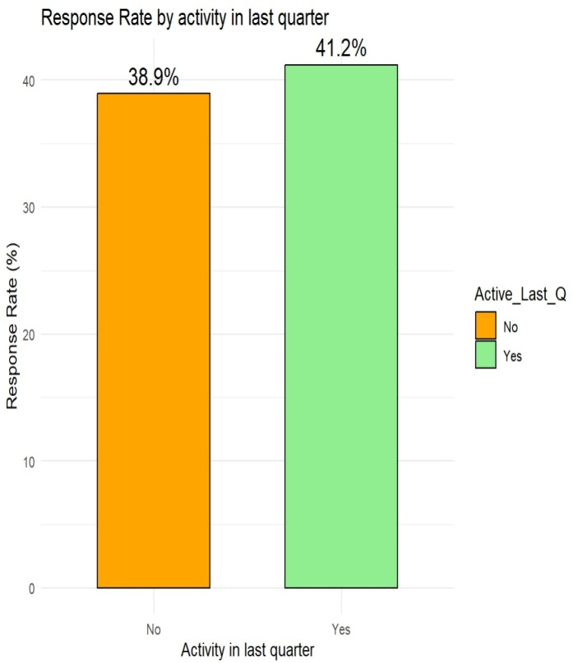
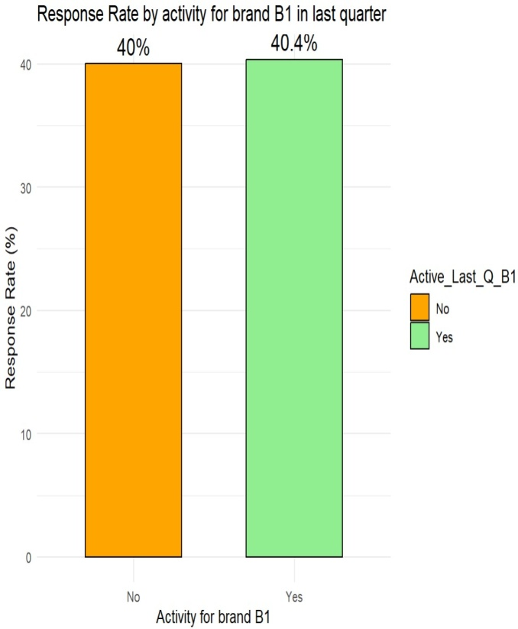
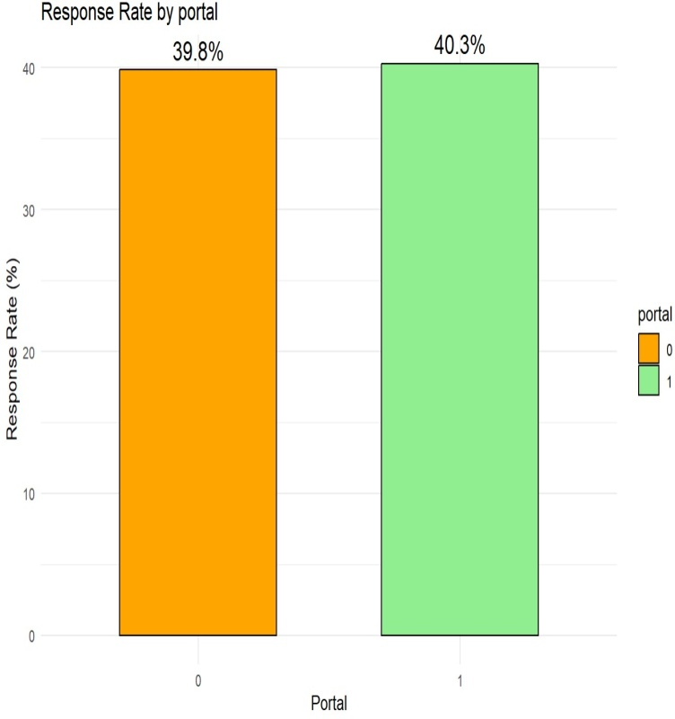
Activity on web portal p-value = 0.9173 - no strong relationship
Activity last quarter p-value = 0.449 - no strong relationship
Activity last quarter for B1p-value = 1 - no strong relationship
The web portal usage does not significantly impact RR. Percentage of activity and
non-activity is almost equal between active and non active partners.
Partners who are members of the loyalty program and those who have not redeemed
rewards show significantly higher response rates, indicating that loyalty and
unused benefits strongly drive engagement. Communication channels also play
a key role—email and especially phone calls are highly effective, with a strong
statistical relationship to response. In contrast, SMS has a weaker impact.
Other factors like region, web portal usage, recent activity, and B1 brand activity
show minimal or no influence on response behavior, both in terms of response
rates and statistical significance.

Slide 21
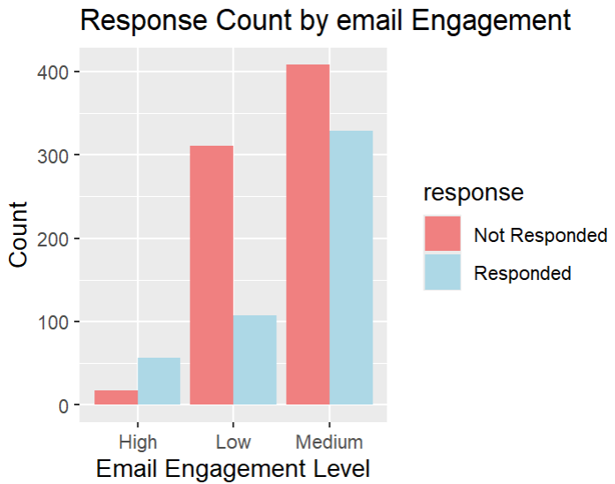
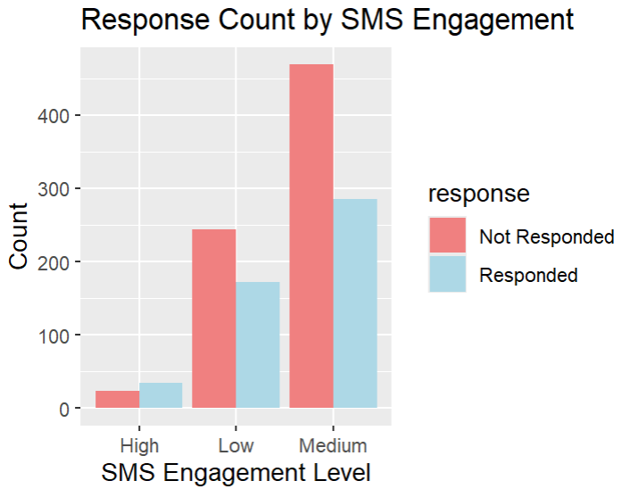
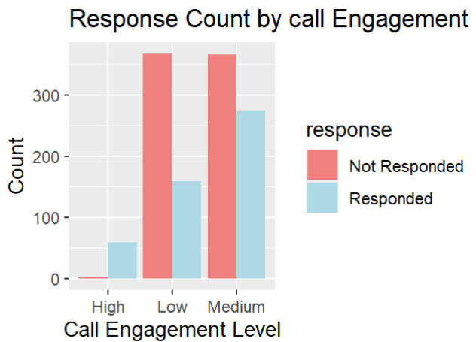
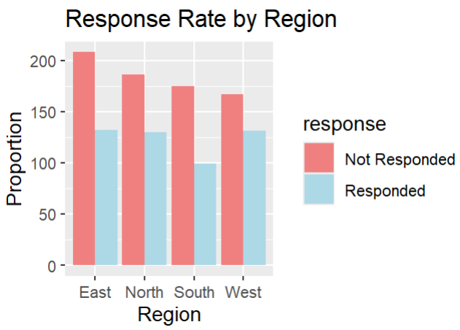
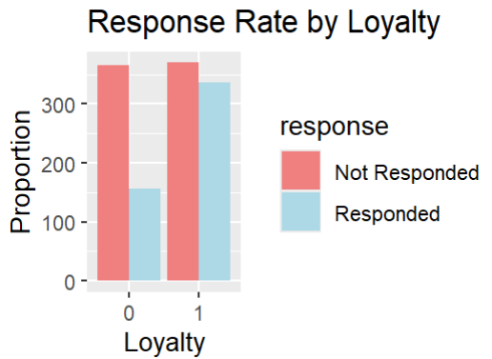
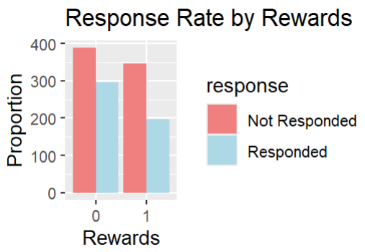

Slide 22
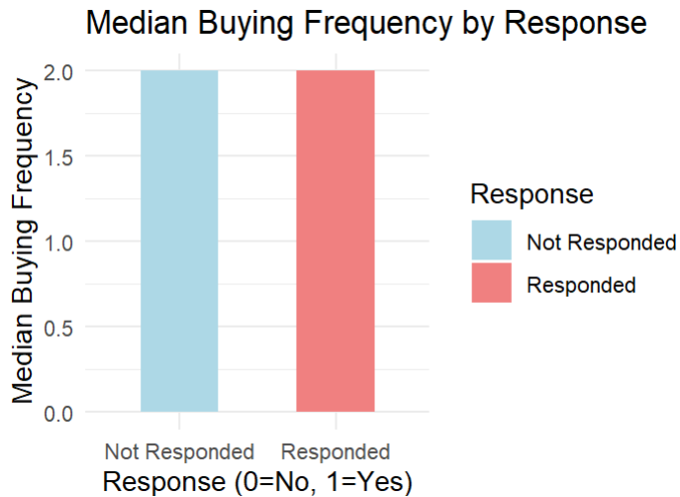
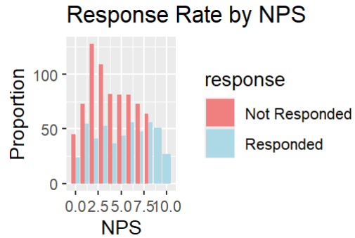
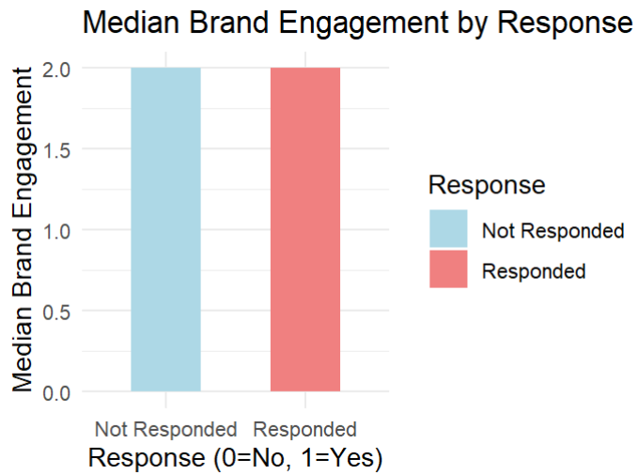

Slide 23
Brief Intro
Logistic Regression is a statistical classification algorithm that models the probability of a binary outcome using a logistic function. It assumes a linear relationship input features and the log-odds of the target variable. Known for its interpretability and between efficiency, logistic regression performs well on linearly separable data and is a common baseline for classification tasks.
In this project, Logistic Regression is used to predict the likelihood of a channel partner responding based on variables like loyalty, engagement, and sales history, providing a clear understanding of feature influence through model coefficients.
The Naïve Bayes method is a probabilistic classification algorithm based on Bayes’ Theorem with a strong (naïve) assumption of independence between predictors. It is particularly effective for high-dimensional data and is known for its simplicity, speed, and performance on classification tasks.
In the context of this project, Naïve Bayes is used to model the likelihood of a channel partner responding based on input features such as loyalty, engagement levels, and past sales performance. Despite its simplicity, Naïve Bayes often delivers competitive accuracy, especially when predictor variables contribute independently to the outcome.

Slide 24
Response (dependent variable)
n_comp
Loyalty
Portal
Rewards
Nps
n_yrs
Region
TotalSales2021
TotalSales2022
B1_sales2022
B1_contribution2022
Buying_Frequency_2022
Brand_Engagement_2022
Buying_Frequency_B1_2022
Active_Last_Q
Active_Last_Q_B1
email_engagement
sms_engagement
call_engagement

Slide 25
Response (dependent variable)
n_comp
Loyalty
Portal
Rewards
Nps
n_yrs
Region
TotalSales2021
TotalSales2022
B1_sales2022
B1_contribution2022
Buying_Frequency_2022
Brand_Engagement_2022
Buying_Frequency_B1_2022
Active_Last_Q
Active_Last_Q_B1
email_engagement
sms_engagement
call_engagement

Slide 26
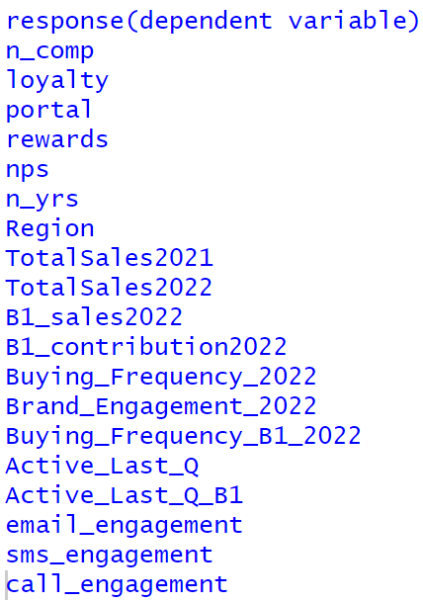
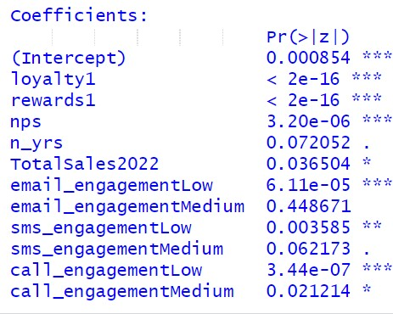
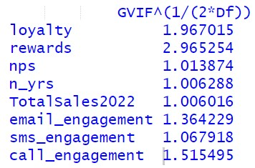
Binary Logistic Regression (Phase 3)
Final model coefficients
Define Y and list all X variables
Variance Inflation Factor (VIF)

Slide 27
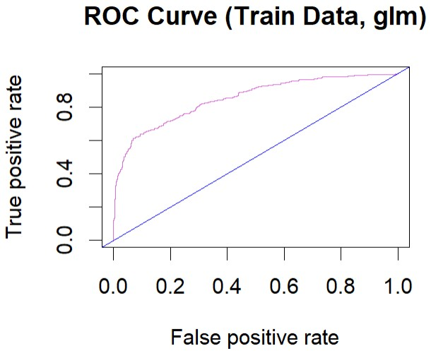
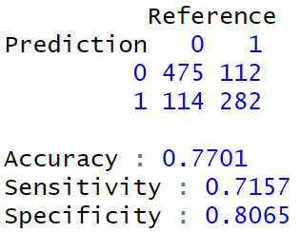
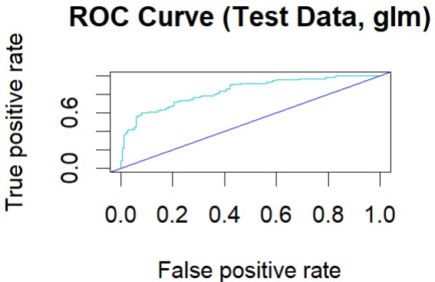
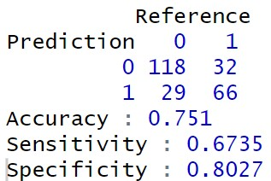
Confusion matrix for train data
0.8492886
Confusion matrix for test data
0.835277

Slide 28
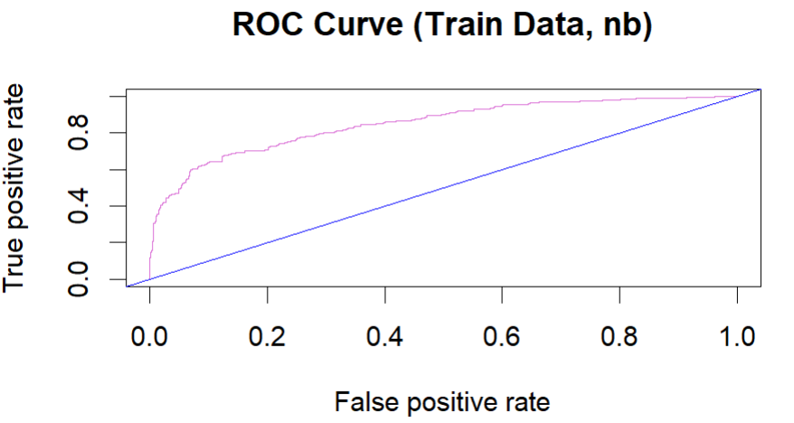
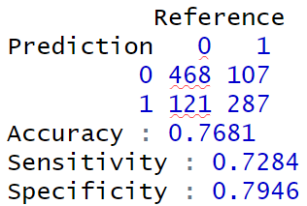
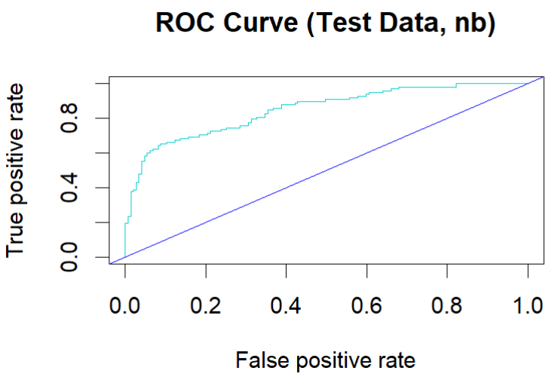
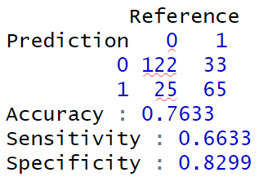
Naïve Bayes Method (Phase 4)
Confusion matrix for train data
0.8491938
Confusion matrix for test data
0.8420103

Slide 29
Brief Intro
A Decision Tree is a non-parametric supervised learning algorithm that splits data into branches based on feature values to arrive at a decision. It models data by recursively dividing it into subsets, making decisions at each node based on the most informative feature. Easy to interpret and visualize, decision trees handle both numerical and categorical data well.
In this project, the Decision Tree algorithm captures complex interactions among features such as partner loyalty, engagement, and sales trends, making it a powerful tool for uncovering decision rules that lead to partner responses.
Random Forest is an ensemble learning method that constructs multiple decision trees during training and outputs the mode of their predictions for classification tasks. It combines the power of bagging and feature randomness to improve generalization and reduce overfitting. Known for its robustness and high accuracy, Random Forest is well-suited for handling noisy or high-dimensional datasets, still making accurate predictions even when the data isn't perfect.
In this project, Random Forest leverages diverse features—including loyalty scores, engagement metrics, and past performance—to model partner response behavior with improved reliability and resilience to overfitting compared to a single decision tree.

Slide 30
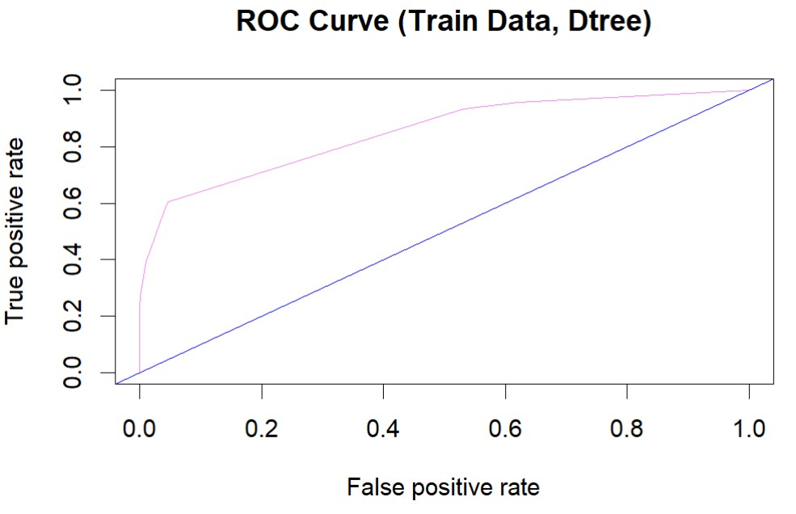



Decision Tree Method (Phase 4)
Confusion matrix for train data
0.850256
Confusion matrix for test data
0.8173678

Slide 31


Random Forest Method (Phase 4)
Variable Importance

Slide 32




Random Forest Method (Phase 4)
Confusion matrix for train data
1
0.850256
Confusion matrix for test data
0.8190337

Slide 33


Slide 34



Text Mining of Consumer Feedback Data
Sample Size : 74

Slide 35


Sentiment successfully captures emotional tone. Positive and negative responses are sharply differentiated by their emotional content.
The majority of responses are neutral, suggesting that most respondents provided informative comments, possibly without strong emotion.
Negative sentiment is relatively low but clearly indicating dissatisfaction that should be addressing.
The positive sentiment number suggests a healthy number of satisfied users.

Slide 36

Final Summary
Logistic Regression was selected as the optimal model due to its strong AUC, balanced accuracy and sensitivity, and high business interpretability.
Although Naïve Bayes achieved the highest AUC, it relies on strong Independence assumption, which can lead to less reliable probability estimates and reduced interpretability.
Random Forest and Decision Tree provided slightly higher accuracy but lower sensitivity (weaker at identifying responders).

Slide 37
· Loyalty membership, unredeemed rewards, and direct communication (emails/SMS) are the most influential factors in predicting higher response rates.
· Higher NPS and longer business relationships are associated with better responsiveness.
· Sales-related metrics have limited but supportive predictive power.
· Region, web activity, and SMS engagement have minimal influence.
Strategic Focus
Prioritize loyalty members and non-reward redeemers
Use calls and emails for stronger engagement
Deprioritize low-impact factors (portal, region, B1 activity)

Slide 38
[Text]
[Text]
[Text]
[Text]
[Text]
[Text]

