Slide 1
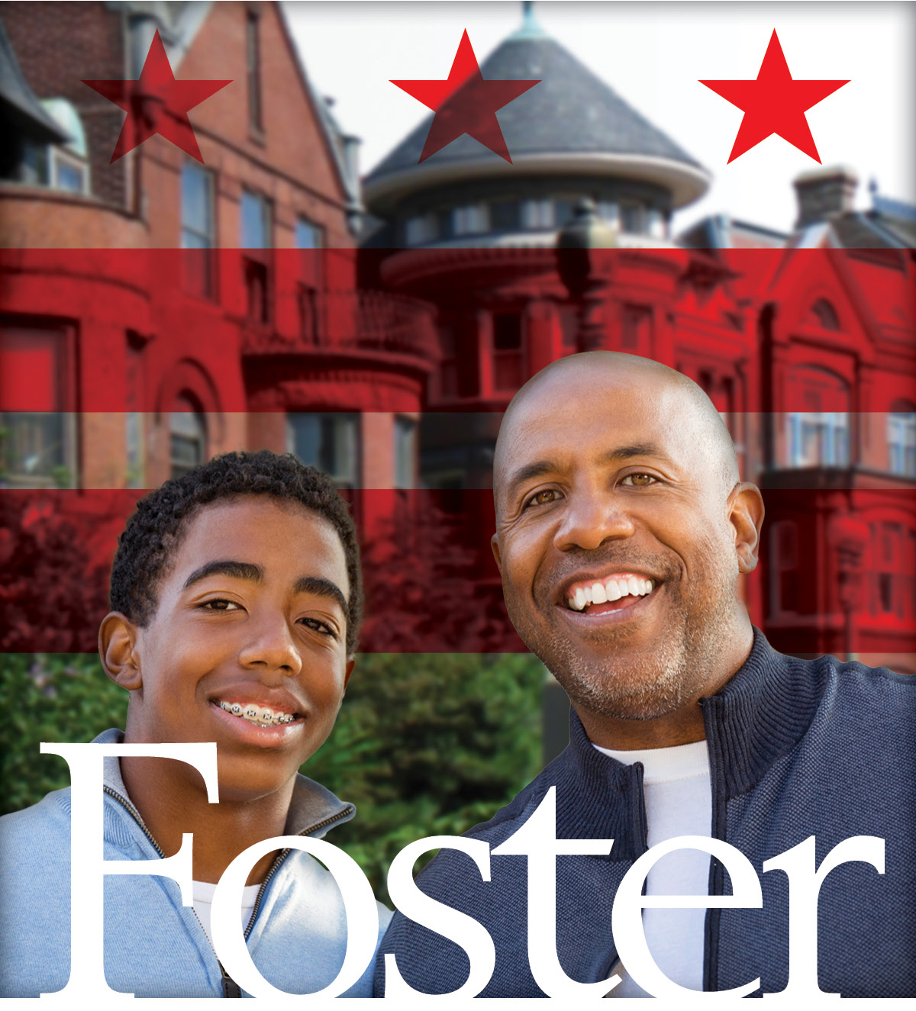
General
Foster Care Recruitment:
Orientation
Session

Slide 2
Purpose
The orientation meeting is designed to provide prospective individuals/families with information on the criteria of becoming a resource parent in the District of Columbia for children in foster care. We hope by providing you this overview, that includes sharing the philosophy of the agency, demographics on youth in foster care, key terminology, the support and resources offered, testimony by a current resource parent, and the overall process from training to licensure to placement of a child in your home, that you will be able to make an informed decision and complete an application to begin the process of becoming a foster/adoptive resource parent.

Slide 3
CFSA Notice of Non-Discrimination
D.C. Human Rights Act of 1977 Concerning all Children, Youth, Adults, and Employees Engaged in Care, Services, and/or Resources Available through the CFSA
In accordance with the D.C. Human Rights Act of 1977, as amended, D.C. Official Code § 2-1401.01 et seq., the Child and Family Services Agency (CFSA) does not discriminate on the basis of actual or perceived: race, color, religion, national origin, sex, age, marital status, personal appearance, sexual orientation, gender identity or expression, familial status, family responsibilities, political affiliation, disability, or place of residence or business.
.

Slide 4
Terminology
NOTE: You may hear the terms foster parent and resource parent used interchangeably in this presentation.
The term “resource parent” is typically used to broadly refer to any adult who is currently functioning as – or is in the process of becoming – a kinship caregiver, foster parent, respite provider, legal guardian, or child-specific adoptive parent. All resource parents complete a minimum of 30 pre-service training hours and a licensing process that ensures their preparation to safely care for a child in their home.

Slide 5
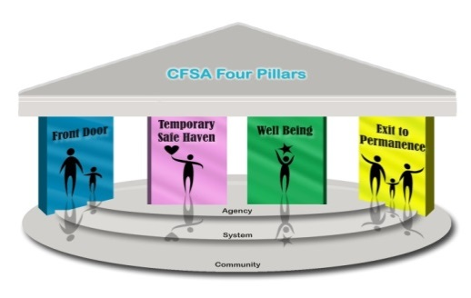
Child and Family Services Agency
The District’s Child and Family Services Agency (CFSA) is the local public organization authorized to protect child victims of abuse and neglect. Our mission is to improve the safety, permanence, and wellbeing of abused and neglected children and youth up to age 21. CFSA’s 4 Pillars are the foundation for improved performance and guide policy and practice for the child welfare system.

Slide 6
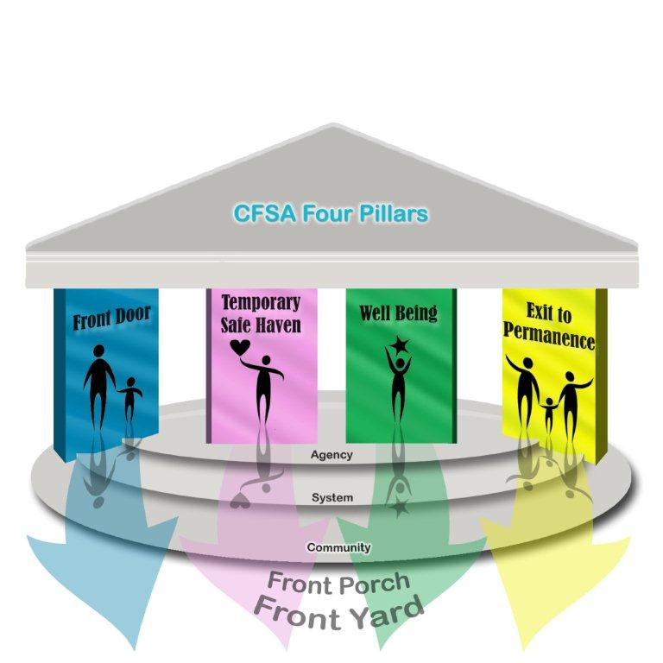
Four Pillars Agenda: Values-Based
Every child exits care as quickly as possible for a safe, supportive family or life-long connection. Older youth have skills for successful adulthood.
Children grow up best with their families. We remove children only when necessary to keep them safe.
Foster care is temporary. We start planning for permanence the day a child enters care.
Every child is entitled to a nurturing environment that supports healthy growth and development, good physical and mental health, and academic achievement.

Slide 7
DC Foster Care: Citywide Snapshot
CFSA understands from our experience, and research confirms, that children develop best and have the easiest transitions into a foster home when they remain close to their birth families, their friends, their community. As of March 12, 2020, there were 740 District children and teens (aged 0-20) under the custody of CFSA residing in foster care.
Gender Race/ Ethnicity Ages of Children
49% Female 86% Black/African American 28% 1-5
51% Male 9% Hispanic 26% 6-11
1% Asian 22% 12-16 3% White 24% 17-20 1% American Indian
.

Slide 8
Public Agency Adoption
Adoption through a public agency differs from adoption through a private agency or through a private attorney in several ways:
Children in foster care with a goal of adoption are not yet legally free for adoption. Legally freeing a child for adoption can be subject to a lengthy court process. Therefore all adoptive parents will foster the child for some amount of time before the adoption is finalized in court.
Infants and toddlers are generally not available, older youth are available.
Because we encourage shared parenting, and because children may maintain direct contact with birth family members, you are likely to meet and work with the birth family.
Adopting from a public system is low in cost and the agency provides comprehensive pre-adoption training and post-adoption services, including a monthly financial stipend.

Slide 9
Pathways to Adoption
CFSA generally has between 50 to 60 children and youth in need of an adoptive home. Most are African American. As of March 12, 2020, 85 percent of available youth are ages 12 to 20. 15 percent are ages 6 to 11. Less than 1 percent are age five or younger. There are two pathways to adopting a child through a public agency:
Foster to Adopt: A prospective parent becomes licensed and serves as a foster parent. When no kinship resources are located, the foster parent then has priority to adopt the child in his/her home if and when the child’s goal becomes adoption.
Child-Specific Adoption: A prospective parent becomes interested in a specific child available for adoption, through one of the channels CFSA uses to promote adoption or through direct recruitment. This person becomes licensed as a foster parent so CFSA can make a pre-adoptive placement of the specific child in his/her home.
To see children available for adoption from CFSA, visit: www.adoptuskids.org or ww.adoptionstogether.org/adopting/adopt-an-older-child/heart-gallery

Slide 10
Who are the Children in Foster Care?
All children in foster care have experienced some level of trauma. Removal from home is traumatic, children are removed from a familiar place to an unknown environment and may lead to difficulty trusting adults.
20% are removed due to abuse (physical, emotional, and sexual abuse)
80% are removed due to neglect (physical, emotional, educational, medical)
75% of the children come into care from Wards 5 (19%) 7 (24%) and 8 (32%)
50% of the children are not only removed from their family, but are removed from their community
100% of the children and teens want to be in a nurturing and supportive environment

Slide 11
What is Shared Parenting?
Shared parenting” is an active, supportive relationship between birth parents and foster parents that is aimed at minimizing loss and trauma, easing a child’s adjustment to foster care, and expediting permanency.
Shared parenting usually starts with an Icebreaker – a facilitated, in-person conversation so everyone can get to know each other.
When a child is newly placed in the resource home, consultation with biological parents or family members can be key to understanding the child.
Children in foster care take comfort in knowing that their birth and resource parents are working together and there’s no need to feel divided loyalty.
Even when the birth parent is not available for shared parenting conversations, maintaining connections with other family members can be an important bridge for the child in a time of transition.
Notes:
Shared parenting is a team approach that emphasizes listening, learning, sharing information, collaborating and making joint decisions. The team relies on birth parents’ knowledge of their children and family, and foster parents’ knowledge about parenting. When birth and foster parents team with each other, children see adults who care about them working together on their behalf.
Participation in shared parenting is expected and, to some degree, unavoidable while fostering. Even if the birth parent is not available, typically the child will maintain a relationship with other family members. The child may attend school with siblings, may play on a sports team with cousins, and is likely to have ongoing communication with the birth family by cell phone or through social media accounts.

Slide 12
The Five Competencies of Resource Parents
Protect and nurture children - keep them safe and cared for.
Meet children’s developmental needs and delays - support their emotional, social, physical, educational or other needs.
Support children’s relationships with their birth families (mother, father, siblings, others relatives) - help them build positive relationships with their birth parents and other persons important to them.
Connect children to relationships that are safe, nurturing, and intended to last a lifetime (preferably with their parents but, if that is not possible, then with relatives, or adoption by this family or another family).
Work as a member of our professional team - meet with social workers and others to support the children and their families.

Slide 13
Support for Resource Parents & Children
Sample supports for Resource Parents:
Monthly Board & Care Payment
Daycare Vouchers
In-person and online training
Respite Care
Support worker
Telephone
Support Line
Sample supports for Children:
Educational Specialists
Mental Health Coordinator
Nursing Care Services
Tutors and Mentors
Teen Services: career specialist, pre-college counseling, financial counseling
Emergency mobile stabilization service for children experiencing an emotional or mental health crisis.
Monthly Stipend
Respite
Services for Teens
FPSW
Training
Daycare

Slide 14
The Foster Parent Support Unit
CFSA’s Foster Parent Support Unit (FPSU) provides on-going support to licensed foster family providers with the goal of retaining them as viable long-term placement resources. Two key ways this is done are:
FPSU social workers are assigned to serve as the support worker for foster parents and help by assisting them as they navigate the licensing and foster care experience as long as they are serving as foster parents.
Respite via BOND are foster parent support models based on the “extended family” concept where a “Squad Leader” provides peer support services, including occasional respite care, and support to four to ten other foster parents caring for children in “satellite homes” that are part of the support network.

Slide 15
Presentation
Resource Parent
Foster Care Alumni

Slide 16
The Licensing Process
Attend the orientation session at CFSA
Determine your eligibility to foster
Compete the “At-Home Consultation” with your assigned Recruiter and register for pre-service training
Complete 30 hours of pre-service training
Participate in the home study process
Submit required documentation and clearances

Slide 17
At-Home Consultation Meeting
Preliminary assessment of home/apt and Chapter 60 Regulations requirements.
Assess the available of the individual/family’ time and support.
Register to upcoming pre-service training.

Slide 18
Criteria to Become a Resource Parent
Be at least 21 years of age
Can be single, married with or without children in the home
Live in the District of Columbia
Have enough income to meet the reasonable living needs of their family without relying on foster care board and care payments. (CFSA uses the current year’s Federal Poverty Index based on household size to evaluate the sufficiency of income.)
No record of child abuse/neglect
Be in good physical and mental health
Have enough space in your home or apartment for children to sleep separately from adults and opposite sex if they are over the age of 5
Have the time and ability to provide good care, guidance, and support to children and teens

Slide 19
Pre-Service Training
CFSA uses the New Generation-Parent Resources for Information Development and Education (NG-PRIDE) curriculum for the 30-hour pre-service training which includes six in-person sessions and four on-line clusters. Topics include:
Introduction to the Licensing Process
Roles and relationships in foster care
The importance of the foster child’s family and the foster child’s relationship
Developmental needs of children in foster care
Awareness of cultural and religious differences
Managing behaviors and discipline techniques
Child abuse and neglect, including prevention, reporting, investigation, and services
Supportive services available in the community
Self-awareness, communication skills, problem solving
Preparation for fostering

Slide 20

Pre-Service Class Schedules
Offered monthly throughout the year, except December
Classes last six weeks, one day per week
Weekday classes vary by month but include Mondays, Tuesdays, and Wednesdays from 6:30 – 9:30 pm and all day Saturdays
Attendance at all in-person sessions is mandatory
On-line cluster sessions must be completed before the next in-person session

Slide 21
DCMR Chapter 60 Regulations
Chapter 60 contains the regulations that determine what is needed to foster children in the District of Columbia. They can be found online at: https://cfsa.dc.gov/sites/default/files/dc/sites/cfsa/publication/attachments/foster_home.pdf
For example:
Traditional Foster Parents may not be licensed with a one bedroom home
Bedrooms must be at least 70 sq. feet for one child; 100 sq. feet for two children; 150 sq. feet for three children
Bedrooms must have two forms of egress (e.g., door and window), no bars allowed on bedroom windows
Boys and girls must have separate bedrooms after age 5; a child older than 18 months cannot share a room with an adult
Adult roommates/tenants will be required to participate in the home study process

Slide 22

Home Study Assessment
Must be completed within 100 days of pre-service start date
Includes a minimum of 2-4 home visits
Includes an assessment of the physical space
All persons in the home must be interviewed - this provides the licensing worker with a biography of you and your family, answers questions in reference to your abilities, resources and willingness to foster, and helps to determine if fostering is right for you

Slide 23
Inspections and Other Requirements
A fire inspection of the applicant’s residence
Lead-based paint inspection for homes accepting children age five (5) years old and under
The lead inspection is at no cost to the property owner or lease holder
If the home fails the inspection, the property owner is responsible for lead abatement at his/her own cost
Once cited, abatement is required or the homeowner will be fined
Deciding to not move forward with foster care licensing does not eliminate the requirement for lead abatement
First Aid and CPR certification for the resource parents
Medical examinations for all persons in the household, including children

Slide 24

Background Clearances
All persons that are 18 years old or older that reside in the home must complete the necessary clearances.
FBI background check
Local police: clearances are needed from each state or jurisdiction in which you have resided from the time you were 18 years old
Child Protection Register clearances
NOTE. Resource parents must identify Backup Childcare Providers during the licensing process. These backup providers must complete the same clearances listed above.

Slide 25
After licensing, then what…
You will meet with your team members:
Resource Parent Support Worker
Re-licensing worker
And you will receive the Resource Parent Handbook, also accessible at https://cfsa.dc.gov/page/foster-parents
When a child is placed with you, you will meet:
The child’s assigned social worker
A network of partners to support you and your family
The interdisciplinary team: (i.e., attorneys, GALs, therapist).
And you will begin to receive the monthly board and care payment

Slide 26

Placing Children in Your Home
The CFSA Placement Division:
Will only call parents licensed as foster/adoptive parents for placement
Will furnish as much information as we have available on the child at the time of placement
Record all placement acceptance and denial calls

Slide 27
Next Steps
Review the application to determine if you meet the requirements
If you are eligible, complete all sections of the application
Review your application with the facilitator
Completed an application, schedule with the recruiter the at-home consultation meeting.
Registration for training is done during the “at-home consultation”
Please, immediately speak to a facilitator before completing the application if the following applies to you:
If there are any concerns, questions or clarifications that are needed
You have taken foster parent training previously

Slide 28

Questions

