Slide 1
Database structure

Slide 2
Visitor
int | id
String | name
String | surname
String | fathersname
DateTime | birthDate
int | age
Visit
int | id
DateTime | timestamp
int | currentStep
Visitor | visitor
Doctor | doctor
Volunteer | translator
FormData | formData
Result | result
Volunteer
int | id
String | name
String | surname
String | role
String | login
String | pwd
String | device
Doctor
int | id
String | name
String | surname
String | fathersname
String | field
FormData
int | id
List<Question> | questions
List<Answer> | answers
Question
int | id
String | question
String | type
Answer
int | id
String | answer
Phrase
int | id
String | phrase
Result
int | id
String | text

Slide 3
Detailes

Slide 4
details
Visit.currentStep | 0 : visit created (visit has timestamp, visitor, visitor in hospital building 1: visit has doctor (the doctor was assigned to visitor/visit) 2: visit has filled form (visitor has filled form) 3: visit has result (visitor attended doctor and received prescription)
911 | No such login or pwd not correct
912 | No data to show (no visiotrs to show)
913 | Runtime exception (waited too long)
914 | Smth. Went wrong try later

Slide 5
Splashpage

Slide 6
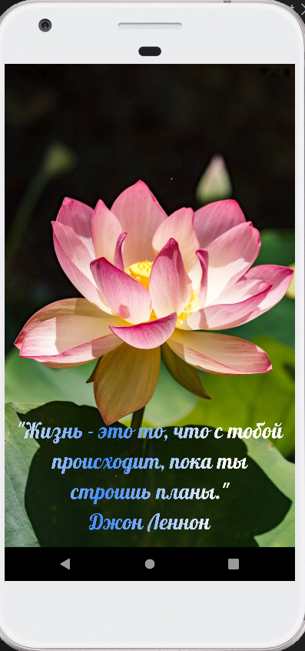
SplashPage: lotusmedi.com/getRandom
lotusmedi.com/getRandom
If fails runtime exception: 913
Then front will show any saved phrase
lotusmedi.com/getRandom
Output Fields:
String phraseofTheDay (phrase with author)
lotusmedi.com/getRandom
Input fields: n/a

Slide 7
Login Page

Slide 8
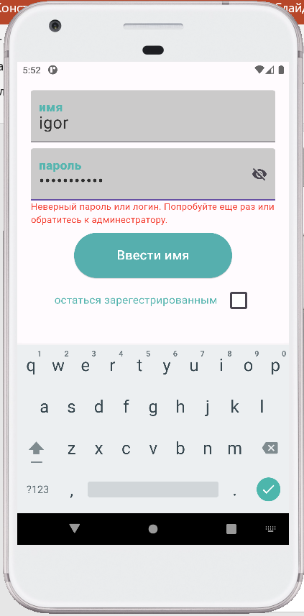
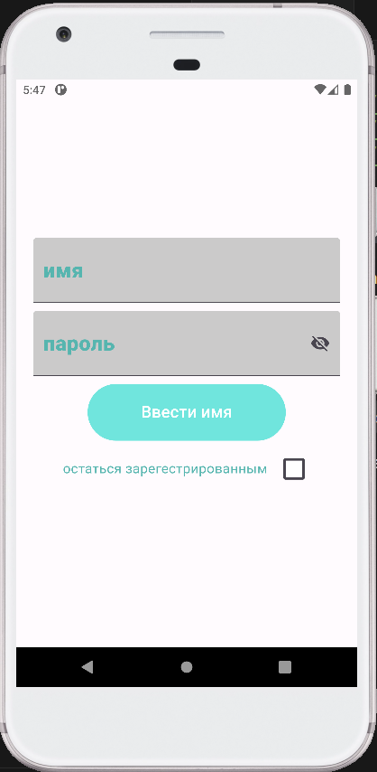
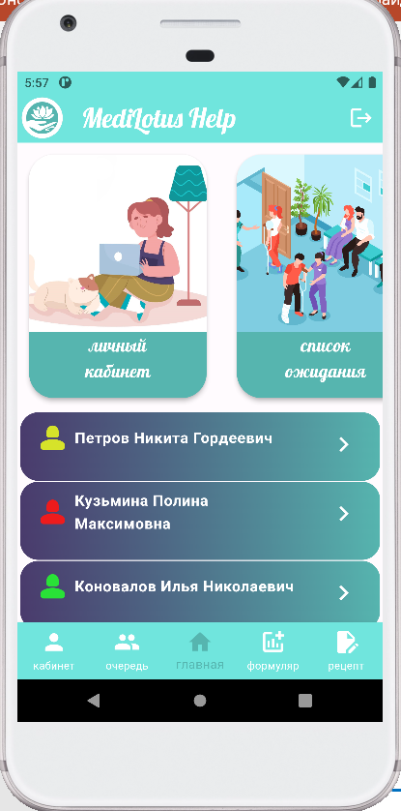
Вход в систему: lotusmedi.com/login?user=***pwd=***
If not possible: 911
lotusmedi.com/login?user=***pwd=***
Reply if error: 911
lotusmedi.com/login?user=***pwd=***
Input fields:
String user
String pwd
lotusmedi.com/login?user=***pwd=***
Reply if ok: 200

Slide 9
Home Page

Slide 10
Homepage: lotusmedi.com/getVisitors if no data to show 912
lotusmedi.com/getVisits
Reply if no data to show = no visitors: 912
lotusmedi.com/getVisits
Reply if data available output: List<Visit> visits
Отсортировынны 1-10 : первые 10 на заполнение формы currentState = 1
11-20: первые 10 на прием к врачу= выписку рецепта currentState = 2
21-30: последние 10 завершенны
currentState = 3
lotusmedi.com/getVisits
Input fields: n/a

Slide 11
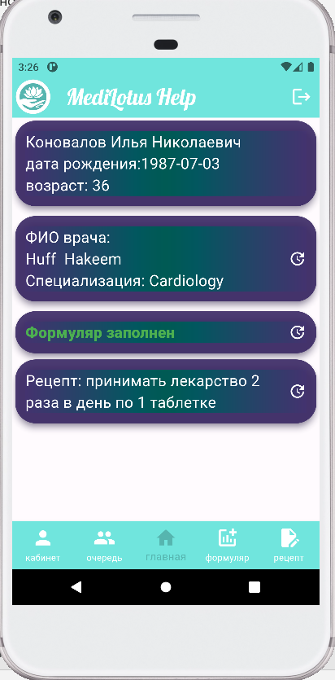
User details Page (preview): lotusmedi.com/getVisit?visitId=***
If not possible: 911
lotusmedi.com/getVisit?visitId=***
Reply if data available output:
Visit chosenVisit:
+Visitor visitor; +Doctor doctor;
+FormData formData;
+Result result;
If not exist then null;
lotusmedi.com/getVisit?visitId=***
Input fields:
Int visitId

Slide 12
Visitor Detailed Info

Slide 13
User details Page (modify if available change Doctor) updateVisit?visitId=***newDoctorId=***
If smth went wrong try later:914
lotusmedi.com/ updateVisit?visitId=***newDoctorId=***
If smth went wrong try later:
914
lotusmedi.com/updateVisit?visitId=***newDoctorId=***
Reply if ok: 200
lotusmedi.com/updateVisit?visitId=***newDoctorId=***
Input fields:
Int visitId
Int newDoctor

Slide 14
User details Page (modify if available change filled Form) lotusmedi.com/updateForm?formData=***
If smth went wrong try later:914
lotusmedi.com/ updateForm?formData=***
If smth went wrong try later:
914
lotusmedi.com/updateForm?formData=***
Reply if ok: 200
lotusmedi.com/updateForm?formData=***
Input fields:
Int formData

Slide 15
User details Page (modify if available change Result): lotusmedi.com/updatePrescription?resultId=***
If smth went wrong try later:914
lotusmedi.com/updatePrescription?resultId=***
If smth went wrong try later:
914
lotusmedi.com/updatePrescription?resultId=***
Reply if ok: 200
lotusmedi.com/updatePrescription?resultId=***
Input fields:
Int result

Slide 16
Ochered

Slide 17
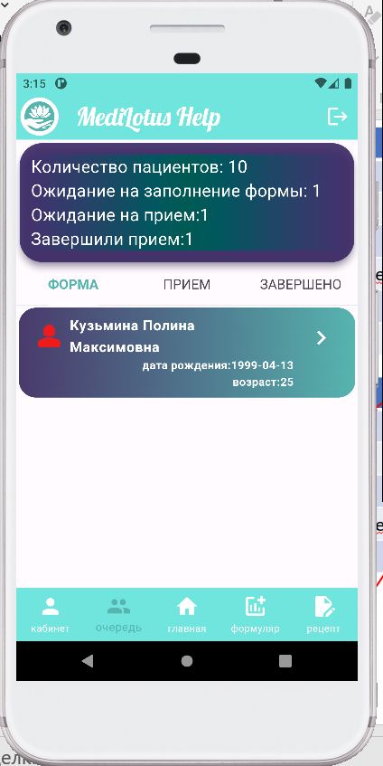
Page: Очередь (Overview)
lotusmedi.com/review
Reply if data available output:
List<int> data:
data[0] visits.length data[1] visits.currentStep = 1 .length
data[2] visits.currentStep = 2 .length
data[3] visits.currentStep = 3 .length
If not exist then 0;
lotusmedi.com/overview
Input: n/a

Slide 18
Page: Очередь (Sorted: form, appointment, finished )
lotusmedi.com/form
Reply if data available output:
List<Visit> visits:
Visits that have visit.currentStep = 1
If not exist then 0;
lotusmedi.com/form
Input: n/a
lotusmedi.com/ form
Reply if data available output:
List<Visit> visits:
Visits that have visit.currentStep = 2
If not exist then 0;
lotusmedi.com/finished
Input: n/a
lotusmedi.com/ finished
Reply if data available output:
List<Visit> visits:
Visits that have visit.currentStep = 3
If not exist then 0;
lotusmedi.com/form
Input: n/a

Slide 19
Lichnii Kabinet

Slide 20
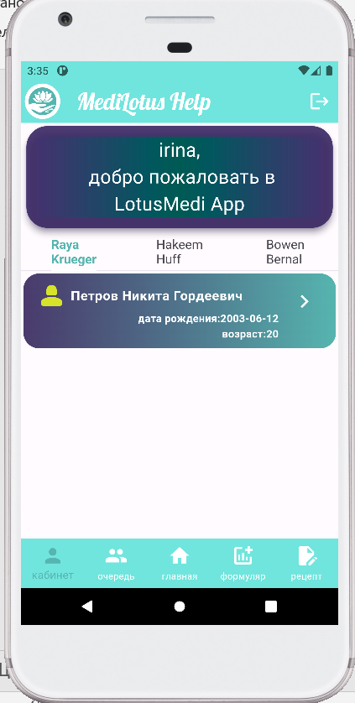
Page:
If not possible: 911
lotusmedi.com/getVisits
Reply if no data to show = no visitors: 912
lotusmedi.com/getVisits
Reply if data available output: List<Visit> visitsByDoctor
Отсортировынны 1-10 : первые 10 на заполнение формы currentState = 1
11-20: первые 10 на прием к врачу= выписку рецепта currentState = 2
21-30: последние 10 завершенны
currentState = 3
lotusmedi.com/getUsersByDoctor
Input fields : n/a

Slide 21
Assign doctor & fill FormData

Slide 22
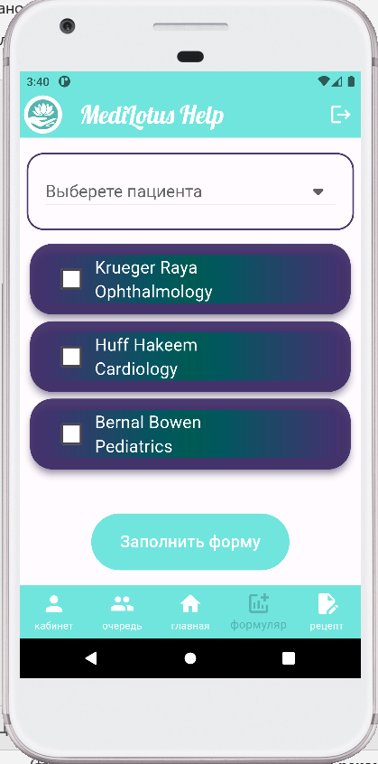
lotusmedi.com/overview?staus=0
Reply if ok: 200
lotusmedi.com/overview?staus=0
Input fields : n/a
lotusmedi.com/overview?staus=0
If smth went wrong try later:
914
lotusmedi.com/getDoctors
Input fields : n/a
lotusmedi.com/ saveVisitDoctor?visitId=***doctorId=***
Reply if ok: 200
lotusmedi.com/ saveVisitDoctor?visitId=***doctorId=***
If smth went wrong try later:
914
lotusmedi.com/setVisitDoctor?visitId=***doctorId=***
Input fields:
Int visitId
Int doctorId
lotusmedi.com/getDoctors
Reply if data available output: List<Doctors> doctors

Slide 23
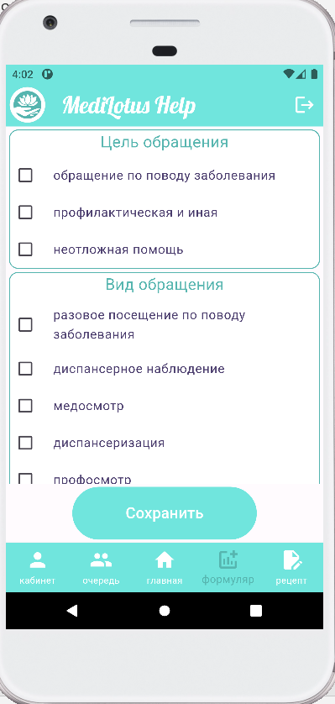
lotusmedi.com/getFormData
Input fields : n/a
lotusmedi.com/ getFormData
Reply if ok:
FormData formData
lotusmedi.com/ getFormData
If smth went wrong try later:
914
lotusmedi.com/ setVisitFormData?visitId=***
Reply if ok: 200
lotusmedi.com/setVisitFormData?visitId=***
Input fields:
Int visitId
lotusmedi.com/ setVisitFormData?visitId=***
If smth went wrong try later:
914

Slide 24
Write prescription

Slide 25
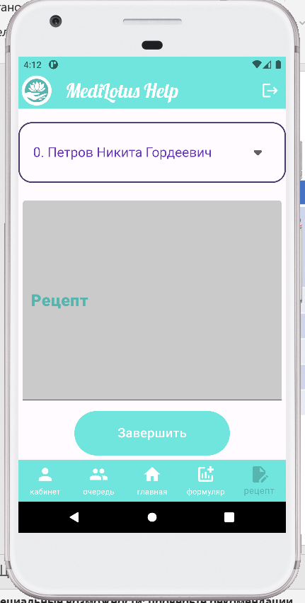
lotusmedi.com/overview?staus=2
Input fields : n/a
lotusmedi.com/overview?staus=0
Reply if ok: 200
lotusmedi.com/overview?staus=0
If smth went wrong try later:
914
lotusmedi.com/ setVisitFormData?visitId=***
Reply if ok: 200
lotusmedi.com/setVisitResult?visitId=***resultTxt=***
Input fields:
Int visitId
String resultTxt
lotusmedi.com/ setVisitFormData?visitId=***
If smth went wrong try later:
914

