Slide 1
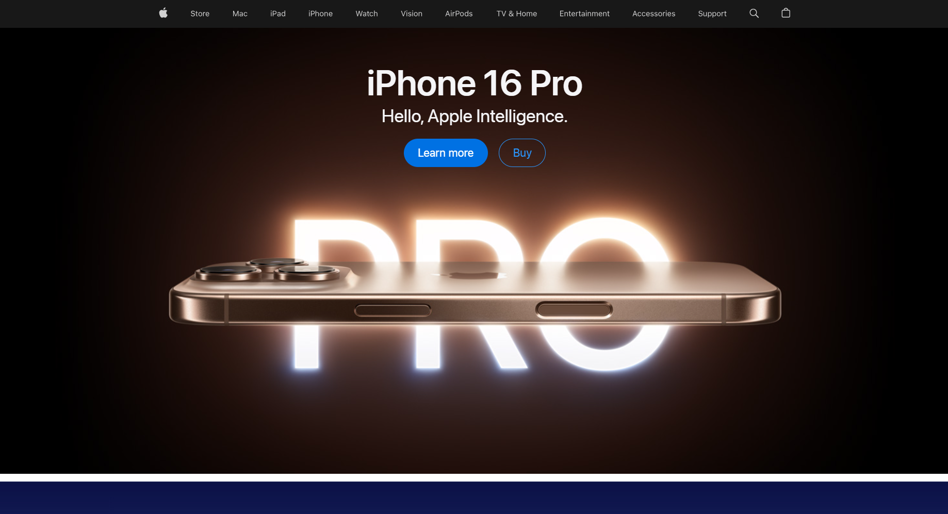
https://www.apple.com

