Slide 1
Random Recipe Picker
Marina Saitgareeva (New York, USA)
CS50’s Introduction to Programming with Python course by Harvard

Slide 2
agenda
INTRODUCTION 3
RECIPE PDF EXAMPLE 4
PARAMETERS FOR RECIPE SEARCH 5
DESCRIPTION OF DIET TYPE 6
MAIN FUNCTIONS 7
PROCESS AND RESULT 8-9

Slide 3

Introduction
This Final project is done as a part of the CS50’s Introduction to Programming with Python course by Harvard:
Random Recipe Picker based on the preferred diet type, meal type, ingredients, and maximum cooking time.
All recipes are from Spoonacular API.
If you like Random Recipe, you will be able to save it in a PDF file.

Slide 4
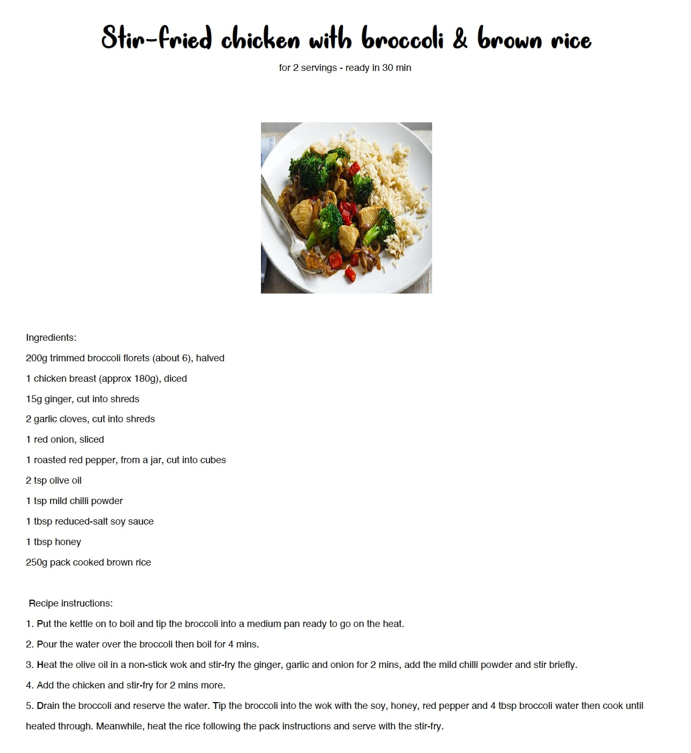
Recipe PDF Example
2023
Random Recipe Picker
4

Slide 5
Parameters for Recipe Search
Diet type: "None", "Gluten Free", "Ketogenic", "Vegetarian", "Lacto-Vegetarian", "Ovo-Vegetarian", "Vegan", "Pescetarian", "Paleo", "Primal", "Low FODMAP", "Whole30”.
Meal type: "none", "main course", "side dish", "dessert", "appetizer", "salad", "bread", "breakfast", "soup", "beverage", "sauce", "marinade", "fingerfood", "snack", "drink”.
Ingredients.
The maximum time in minutes it should take to prepare and cook the recipe.

Slide 6
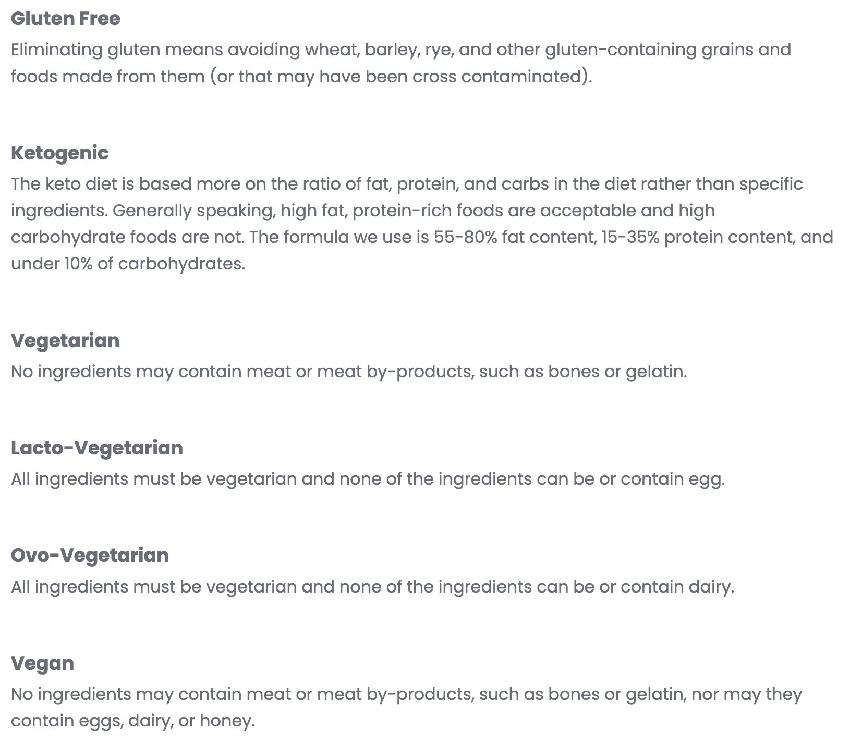
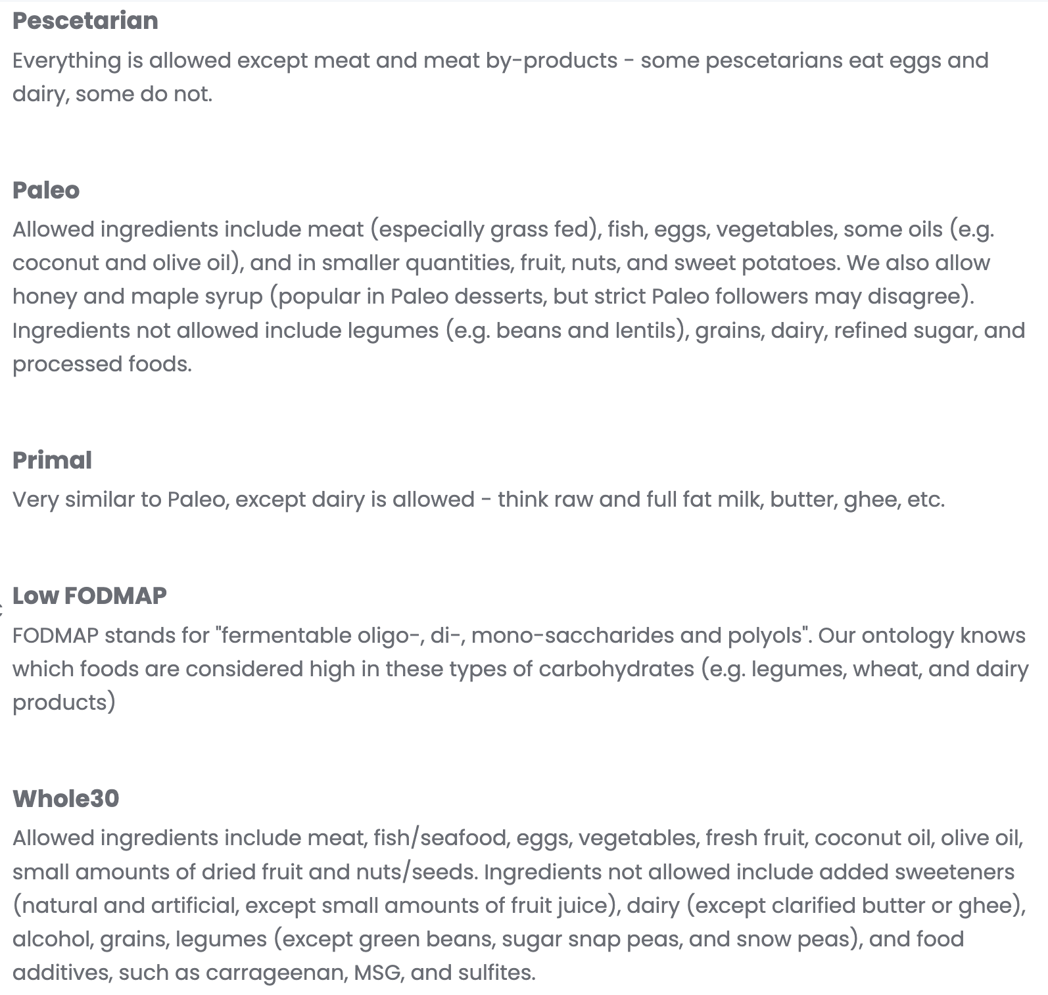
Description of Diet Type

Slide 7
Main functions
Get Recipes from API based on the diet, meal type, ingredients, max ready time, and number.
get_diet
Ask the user to "Select diet type".
get_meal_type
Ask the user to "Select meal type".
def get_ingredients
Ask the user "A comma-separated list of ingredients that the recipes should contain".
Ask the user "The maximum time in minutes it should take to prepare and cook the recipe".
get_recipes
get_max_ready_time
get_random_recipe
get_recipe_instructions
save_recipe_in_pdf
Get the Recipe instructions from API based on the recipe's ID.
Get the Recipe from the Recipes list based on the random number.
Ask if the user wants to save Random Recipe. Create and save PDF with the Recipe.

Slide 8
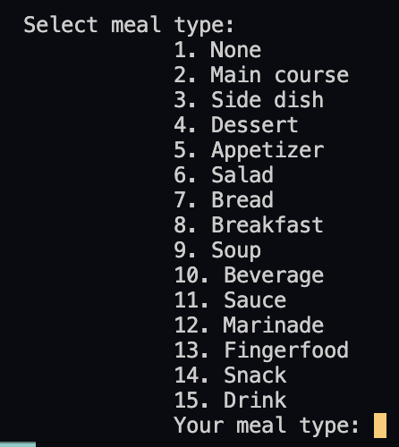
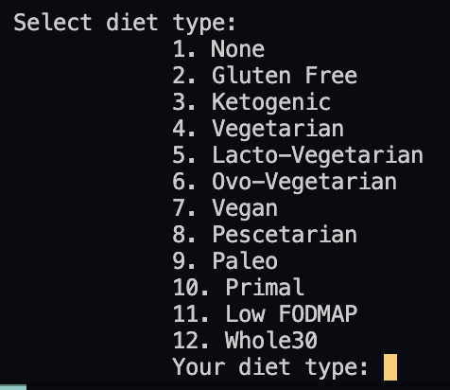
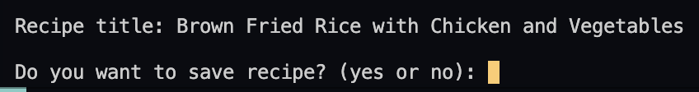
Process
2023
Random Recipe Picker
8

Slide 9

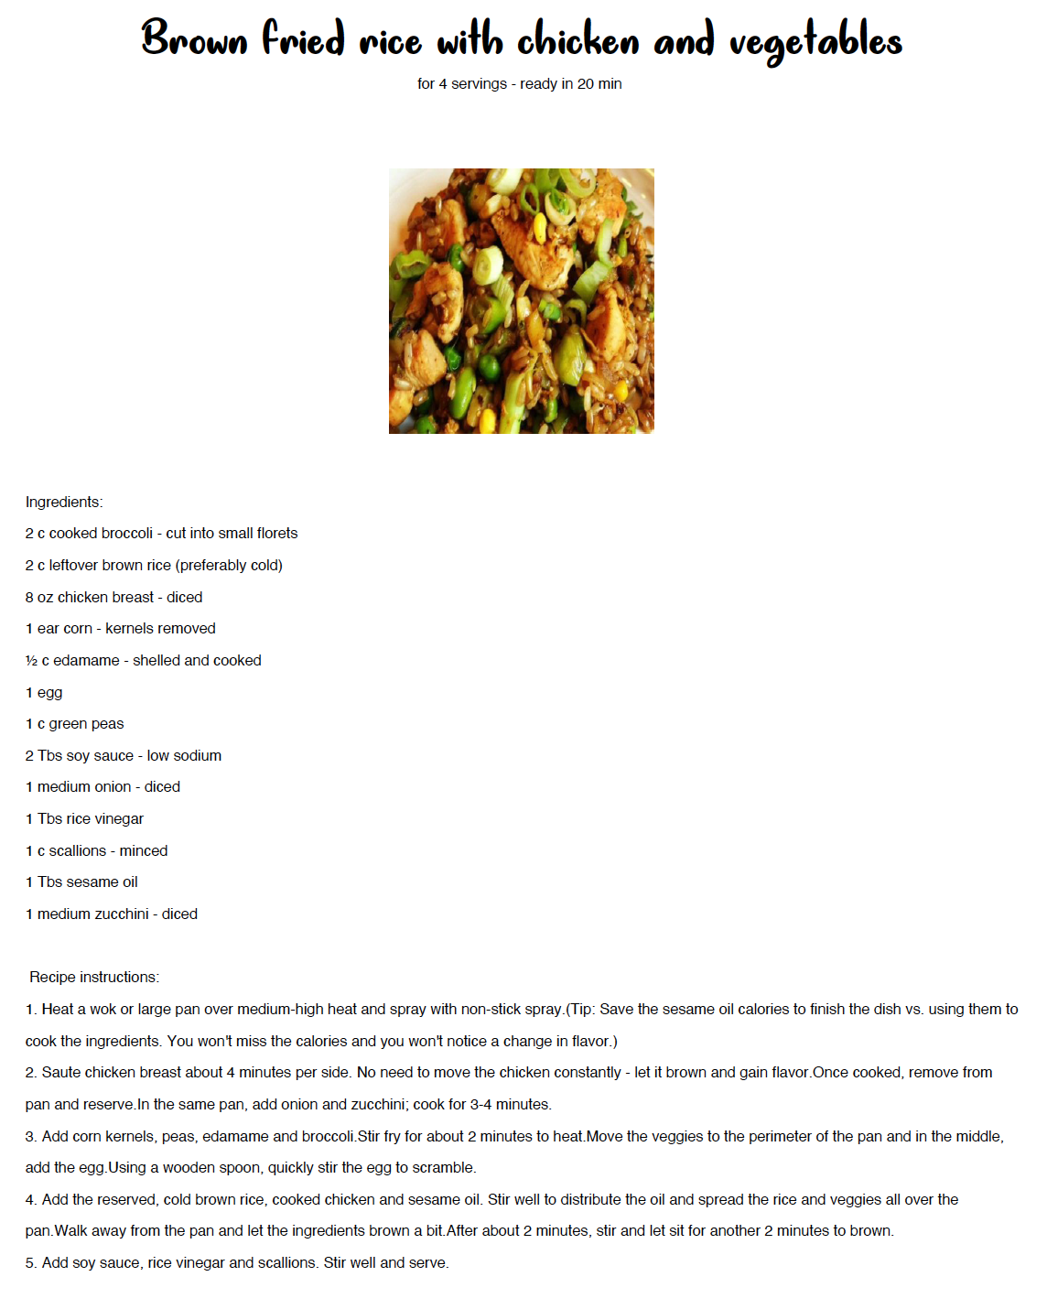
Result

Slide 10
thank you
Marina Saitgareeva
4006761ms@gmail.com
https://github.com/MarinaSaitgareeva

