Slide 1
Breast Cancer Screening Inequalities in England
A health-equity analysis, with a local focus on Hampshire & Isle of Wight
Marina Volkaert
Sources: OHID Fingertips (indicator 94063) · Health Equity Evidence Centre practice-level IMD · NHS ODS · NHS BSP-S02 standard

Slide 2
The business question
Breast screening saves lives by catching cancer early, but is it reaching everyone equally?
Women in more deprived areas are known to attend less. If true, the people who could gain most are gaining least.
This project asks, using open national data:
Why it matters to me
This project matters to me because I lost someone very close to an aggressive breast cancer. It is why I want to use data to help improve community wellbeing and reduce health inequalities.
1
Does screening coverage fall as deprivation rises, and is any gap real, not chance?
2
Does the same pattern hold locally, within Hampshire & Isle of Wight?
3
Which specific practices should a local team target first?
Breast Screening Inequalities · Marina Volkaert · Data: OHID Fingertips 2024

Slide 3
Data & method
1 - Source & clean
2 - Join deprivation
3 - Group & measure
4 - Test & target
OHID Fingertips breast screening coverage (indicator 94063), women 53–70, 2024. Filtered to ~6,170 GP practices; one clean year.
Joined each practice to its deprivation score (HEEC practice-level IMD, 2024) on NHS practice code — an inner join keeping fully-matched practices.
Ranked practices into five deprivation groups; coverage pooled by women (population-weighted), not averaged percentages.
95% confidence intervals to prove the gradient is real; localised to Hampshire & IoW via the NHS ODS practice list; ranked priority practices.
Tools: Python: pandas for data cleaning & joining, NumPy for confidence intervals, matplotlib for charts
Breast Screening Inequalities · Marina Volkaert · Data: OHID Fingertips 2024

Slide 4
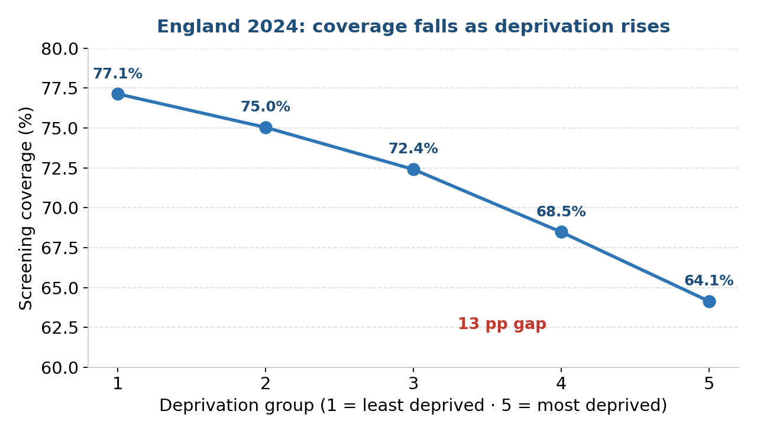
Finding 1: a clear national gradient
Coverage falls at every step,
77.1% in the least deprived fifth → 64.1% in the most deprived.
A 13 percentage-point gap.
The 95% confidence intervals are ~0.1% wide and never overlap, therefore this gradient is real, not chance.
Breast Screening Inequalities · Marina Volkaert · Data: OHID Fingertips 2024

Slide 5
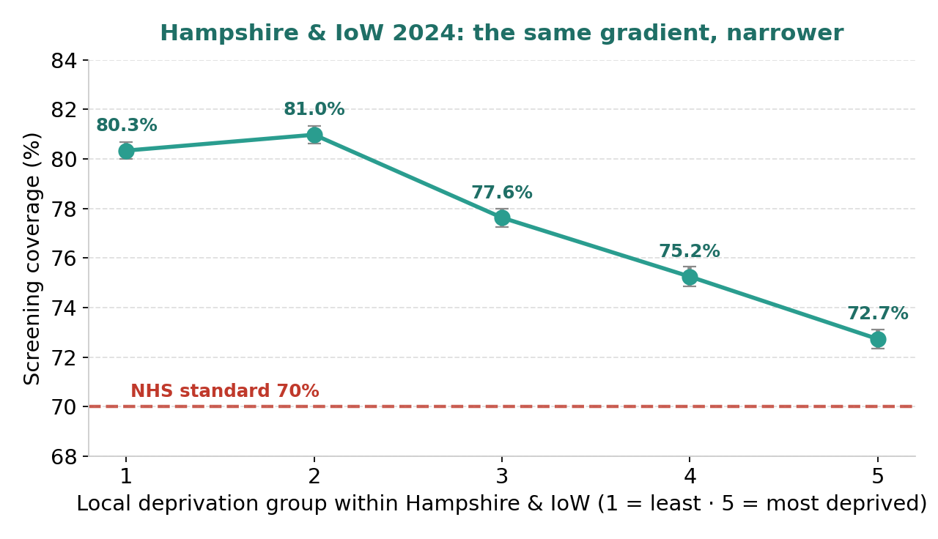
Finding 2: it holds locally too
The same inequality appears within Hampshire & IoW,
though narrower (~8 pp), as expected in a more affluent area.
Every group average sits above the 70% standard —
yet that average hides 10 individual practices below it.
Averages reassure; individual practices reveal where to act.
Breast Screening Inequalities · Marina Volkaert · Data: OHID Fingertips 2024

Slide 6
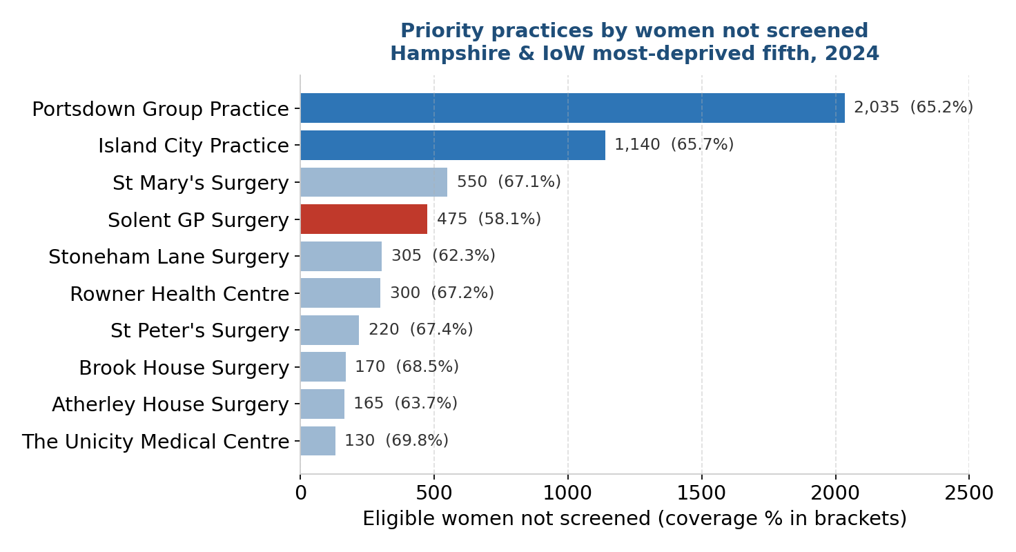
Where to act first
Ranked by women missed
Two large deprived practices dominate:
Portsdown (2,035 women) and
Island City (1,140)
Together, it represents more than 3,000 women unscreened.
Solent (58.1%) is the most acute rate: the lowest coverage of any practice.
Lifting just the top four to the 70% standard would screen ≈600 more women
(283 + 142 + 49 + 134 = the gap each needs to reach 70%).
Breast Screening Inequalities · Marina Volkaert · Data: OHID Fingertips 2024

Slide 7
Why coverage may be lower
The data shows where the gap is, not why. Published evidence points to barriers that cluster with deprivation:
Time & work
Travel & childcare
Awareness & trust
Population churn
Lost pay or no cover for daytime appointments
Harder to reach a clinic
Lower awareness, fear, or stigma; language barriers
Invitations sent to out-of-date addresses
Stated as possibilities from the literature, not conclusions from this dataset (area-level data cannot explain individual behaviour).
Breast Screening Inequalities · Marina Volkaert · Data: OHID Fingertips 2024

Slide 8
Recommendation
Target the priority practices, matching each action to a likely barrier:
Mobile screening units: Site vans at Portsdown & Island City in familiar places (supermarkets, community centres) to removes travel & time barriers.
Extended-hours appointments: Evenings and weekends for women who lose pay attending in the day.
Community outreach & reminders: Through these practices, in relevant languages to builds awareness and trust.
Address-data cleaning: At high-churn practices, so invitations reach.
Breast Screening Inequalities · Marina Volkaert · Data: OHID Fingertips 2024

Slide 9
Limitations & data ethics
Coverage is a 3-year measure, so it lags recent change.
Deprivation is modelled at practice level (HEEC interpolated IMD) and describes areas, not individuals — findings are not claims about any single woman (ecological fallacy).
16 practices (0.3%) were excluded for missing deprivation or screening data; a few figures are suppressed for small numbers.
All data is open and aggregate — no patient-level or personal data used.
Breast Screening Inequalities · Marina Volkaert · Data: OHID Fingertips 2024

Slide 10
From two open files to a targeted, evidence-based recommendation
Skills demonstrated: data sourcing & cleaning - joining datasets on keys - population-weighted rates - confidence intervals - national vs local analysis - turning analysis into a prioritised recommendation - clear visual communication
Coded in Python with AI support as a learning aid, while actively building my own coding fluency.
Full code & notebook: GitHub · Marina Volkaert

