Slide 1
FRAUDULENT & NONCOMPLIANT AIRBNB LISTINGS ACROSS NYC
A BOROUGH-LEVEL AND FEATURE ANALYSIS
Marina Herrera & Angelina Ramola

Slide 2
RESEARCH PROBLEM
Can New York City fraudulent Airbnb listings be distinguished through their measurable listing features?
FRAUDULENT OR NON-COMPLIANT LISTINGS INCLUDE:
Housing/code violations
Improper multi-listing by hosts
Illegal conversions

Slide 3
EXECUTIVE SUMMARY:
Tested for significance between NYC boroughs and fraudulent listings. Found borough has a measurable effect on fraud prevalence.
Bronx had the highest percentage of fraudulent listings (54.6%), while Staten Island had the lowest (5.8%), relative to borough size and listing volume.
Conducted Welch’s ANOVA to test if boroughs differ significantly in average prices.
Found boroughs with higher fraud percentages also had higher average prices.
Bronx again stood out, with $186 as the average price.
Applied Logistic Regression to measure the effect of listing features on fraud risk.
Regression provided quantifiable insights into which predictors are most relevant to fraud detection.

Slide 4

WHY IT MATTERS
1
2
3
PROTECT GUESTS
PLATFORM REPUTATION
REGULATORY COMPLIANCE

Slide 5
DATASETS OVERVIEW
AIRBNB OPEN DATA
10.5M
49K
Housing Maintenance Code Violations
From NYC Open Date

Slide 6
DATA CLEANING & PREPARATION
Dropped rows missing latitude/longitude
Rounded coordinates to 4 decimals (~11 meters)
Spatial matching on rounded coordinates
Binary 0/1 variable for fraud_flag

Slide 7
STATISTICAL/PREDICTIVE METHODS
CHI-SQUARE
WELCH’S ANOVA
LOGISTIC REGRESSION
TEST FOR CATEGORICAL ASSOCIATION BETWEEN BOROUGH AND FRAUD
QUANTIFY PREDICTOR EFFECTS, BUILD FRAUD DETECTION MODEL
TEST FOR DIFFERENCE IN MEAN LISTING PRICES

Slide 8
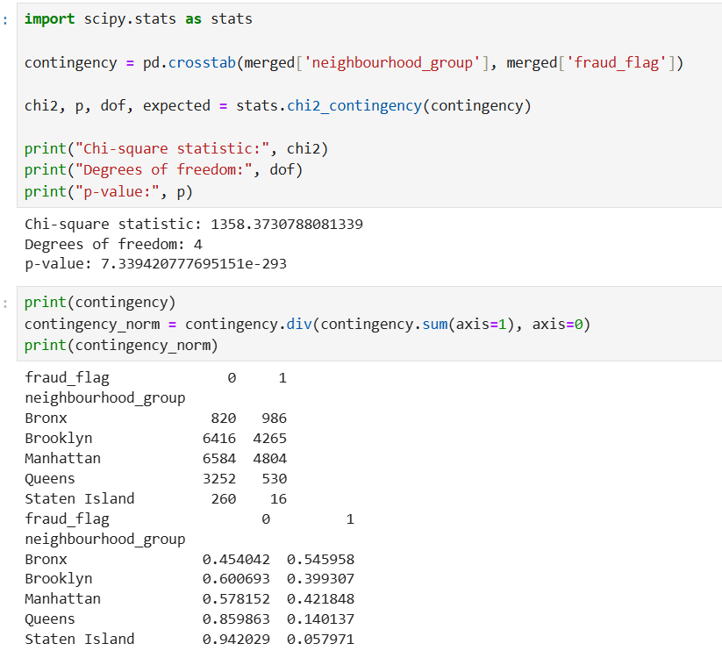
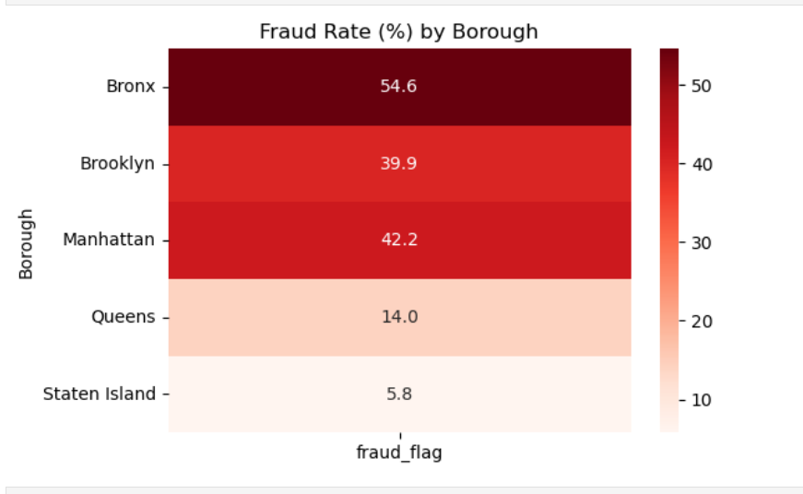
CHI-SQUARE
H0: FRAUD OCCURRENCE IS INDEPENDENT OF BOROUGH
HA: FRAUD OCCURRENCE IS NOT INDEPENDENT OF BOROUGH

Slide 9
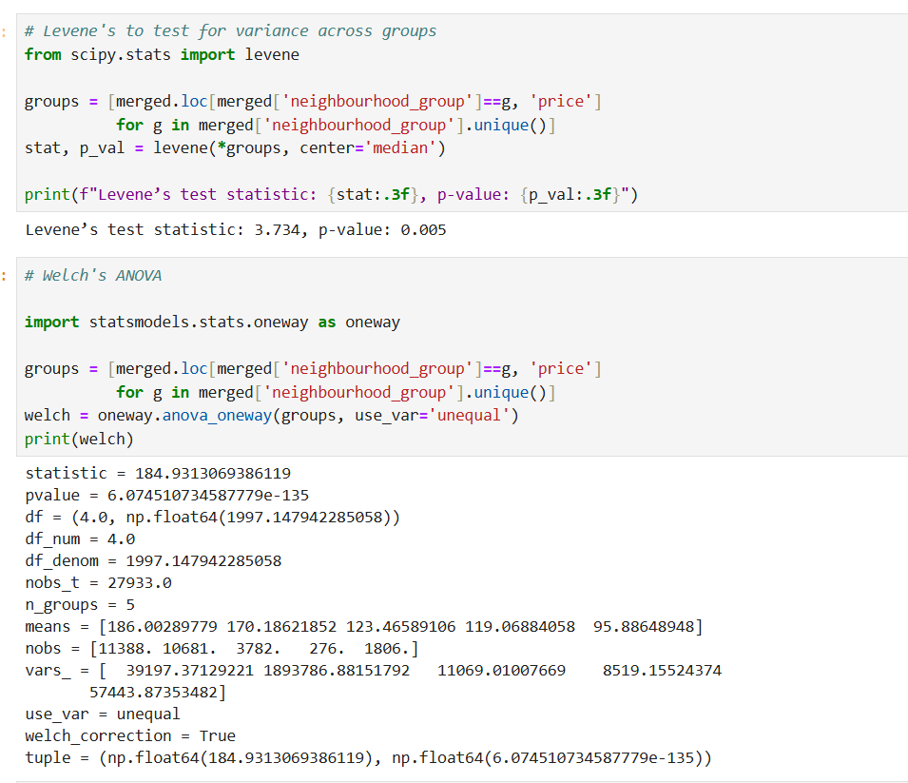
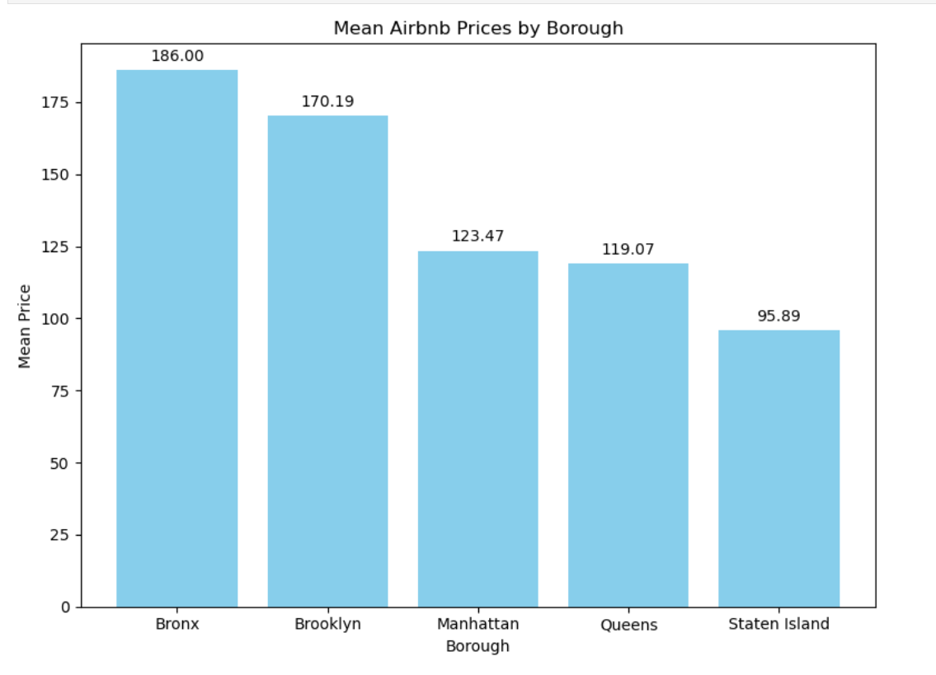
WELCH’S ANOVA
H0: BOROUGHS DO NOT DIFFER SIGNIFICANTLY IN AVERAGE PRICES
HA: AT LEAST ONE GROUP DIFFERS IN MEAN PRICE

Slide 10
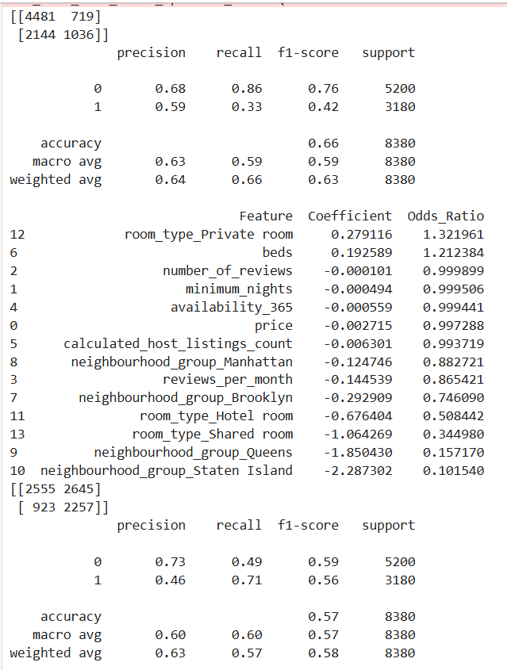
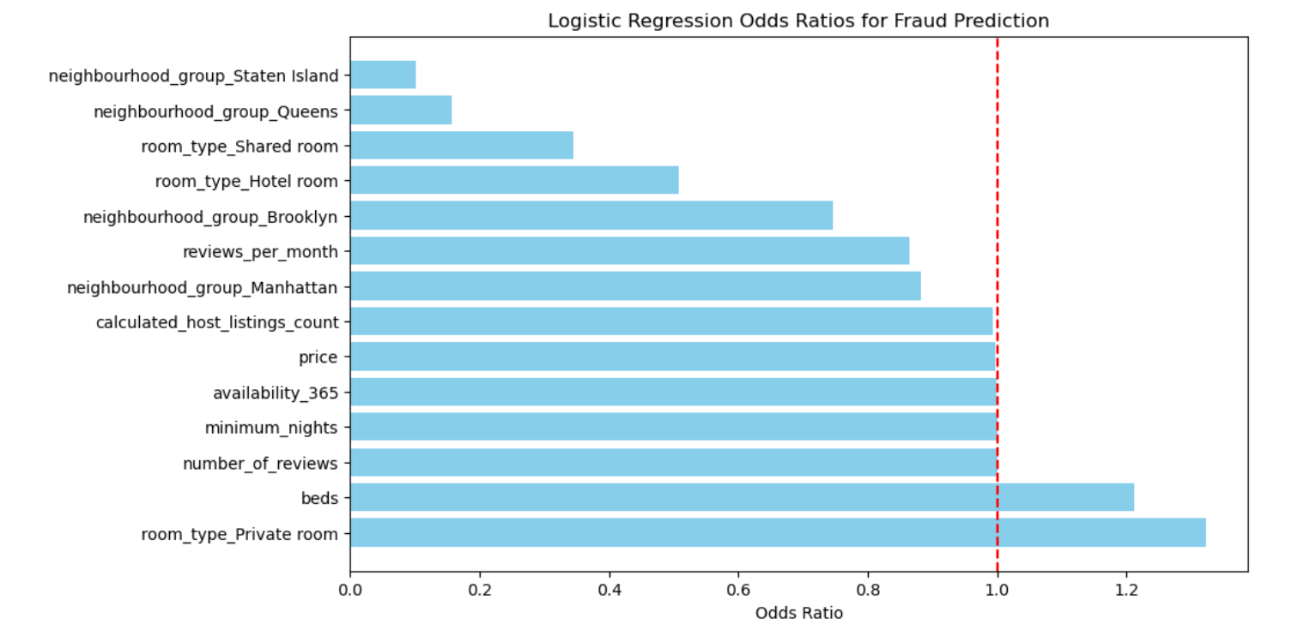
LOGISTIC REGRESSION

Slide 11
CONCLUSIONS:
Fraud listings disproportionately concentrated in Bronx
Fraud listings have fewer reviews and lower prices, likely to be private rooms
Listings in Queens & Staten Island and/or hotel and private rooms have more reviews and less likely to be fraud
Challenges:
Data preparation
Trial and error with tests
Large dataset management
Violation of equal variance

Slide 12
THANKS!
Please keep this slide for attribution

