Slide 1

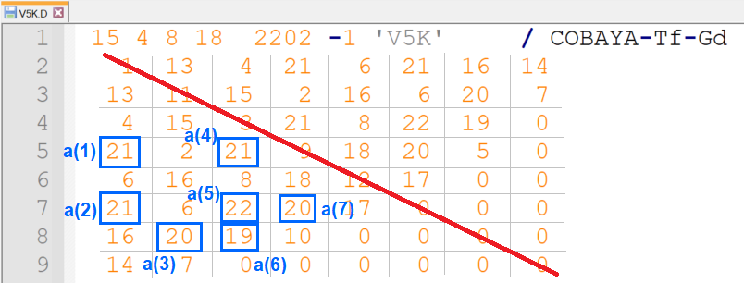
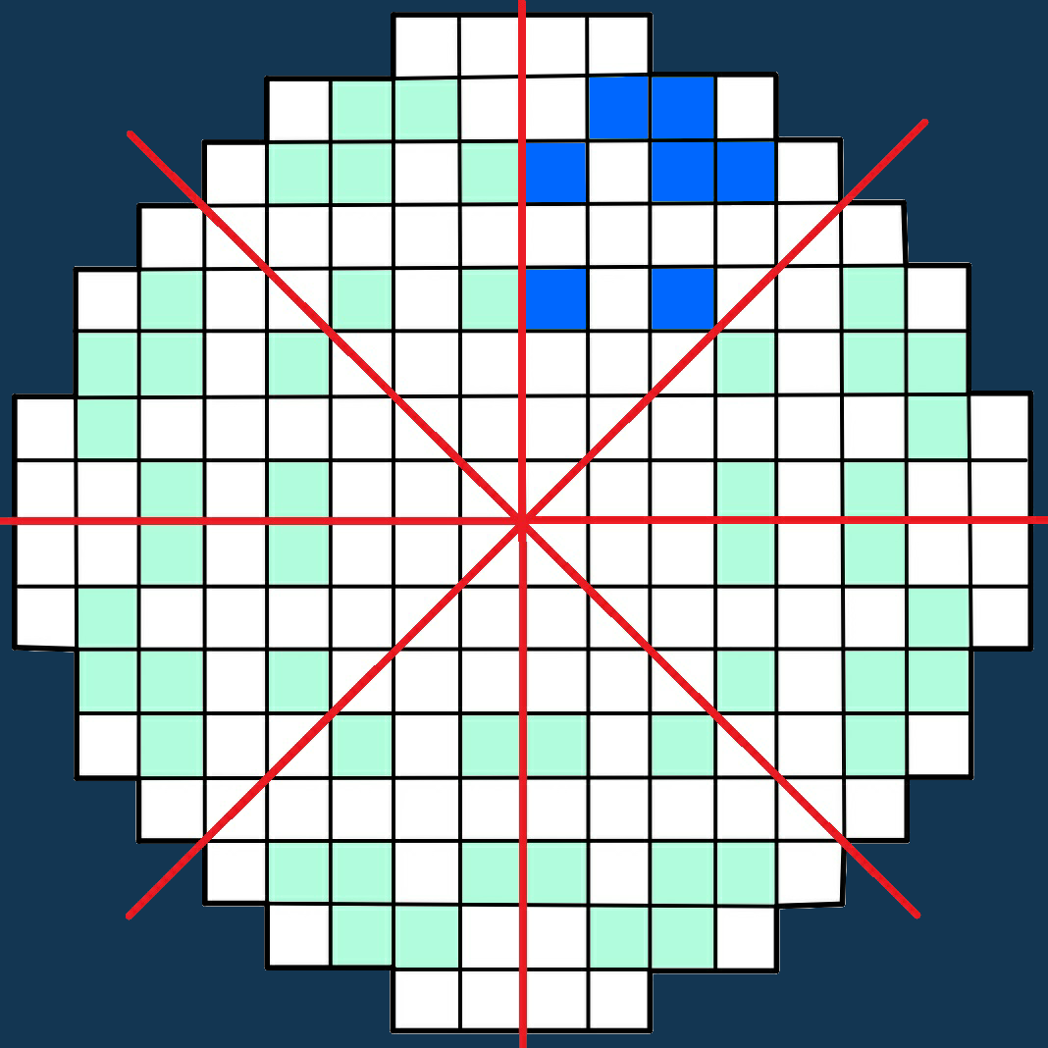
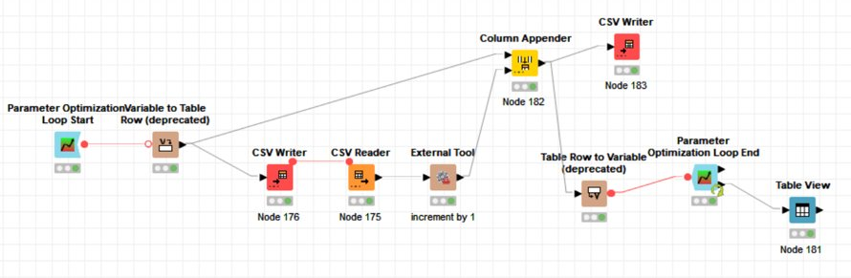



Fresh fuel reloading optimization for a PWR Westinghouse nuclear plant of 1000 MWe
Fresh fuel reloading optimization
7 different locations on each 1/8 of the core
Use of 4 different fresh fuel elements
Use of the simulator called SEANAP – COBAYA (2D).
Analysis of the data through different optimization methods.
Several factors will determine which fuel combination adapts best based on our optimized parameters. The optimization techniques follow to acquire the maximum burnup, the adaptation to radial potential limits and
the minimal power peaking.
Methodology
SEANAP FUNCTIONAL SCHEME
Objective
Fuel reloading data
refuel
fueldat
prewim
MARIA
16384 possible combinations of fresh elements to place
delfin
presam/
premel/melon
cobpat
COBAYA
KNIME
Minimum computational costs
Optimized results
Using Optimization Techniques
Genetic algorithms
Random search
Bayesian method
Hill climbing
Techniques should follow an objective function based on what parameters are crutial to determine the best reloading configuration
Knime receives the Cobaya data and, using techniques based on iteration and machine learning, returns the optimal value for the objective function used.
f(Burnup, power peaks, power and burn up distribution) = burnup∙w_{q} – |Fa – 1.70|∙w_{p} - |Fdh -1.60|∙w_{p} – dst_powers∙w_{p} – dst_quenod
Methodology​ | Objective Function​ | Burn-up ​ | Peak F-ele​ | Peak FdH​ | Power distribution​ | Burn-nod distribution​ | a(1) | a(2) | a(3) | a(4) | a(5) | a(6) | a(7)
Original | 5,5184 | 11,6886 | 1,4 | 1,52 | 0,2936 | 3,2624 | 21 | 21 | 20 | 21 | 22 | 19 | 20
Brute Force​ | 5,5575​ | 11,8012​ | 1,38​ | 1,513​ | 0,2981​ | 3,2624​ | 20 | 22 | 19 | 20 | 22 | 19 | 20
Random Search​ | 3,3527​ | 11,7442​ | 1.483​ | 1.631​ | 0.3108​ | 3,3433​ | 19 | 20 | 20 | 21 | 21 | 21 | 19
Hill Climbing​ | 5,5575​ | 11,8012​ | 1,38​ | 1,513​ | 0,2981​ | 3,2624​ | 20 | 22 | 19 | 20 | 22 | 19 | 20
Bayesian Method​ | 3,608​ | 11,6471​ | 1,47​ | 1,591​ | 0,3256​ | 3,3732​ | 20 | 21 | 22 | 20 | 21 | 19 | 20
Genetic Algorithms​ | 5,5187​ | 11,6627​ | 1,359​ | 1,511​ | 0,292​ | 3,2243​ | 21 | 22 | 20 | 21 | 22 | 19 | 20
IGUAL QUE EL ORIGINAL

