Slide 1
Hearthstone Sentimental analysis and NLP

Slide 2
Agenda
Introduction
Small game introduction
Hypothesis testing
Tableau
Sentimental Analysis of cards flavor text
NLP of cards text

Slide 3
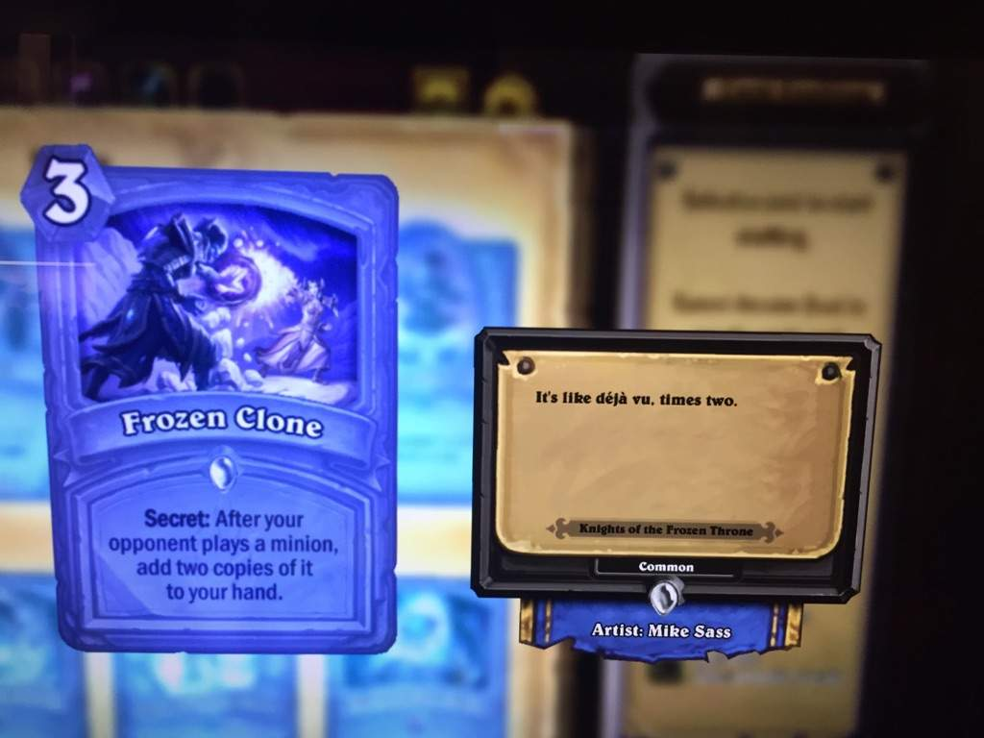
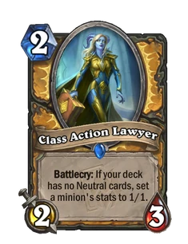
Hearthstone
Set within the Warcraft universe, Hearthstone is a digital-only, turn-based collectible card game which pits two opponents against each other. Players select a hero from one of eleven classes. All classes have unique cards and abilities, known as hero powers.
Flavor text is supplementary text displayed in the Collection, for each collectible card and hero. Almost always comical in nature, flavor text serves no game purpose and is not seen outside the Collection.
Text: This is the most important part of the card. The text describes the card's effect or effects. It might include instructions for summoning minions, dealing damage, healing, drawing cards, or applying other buffs or debuffs.

Slide 4
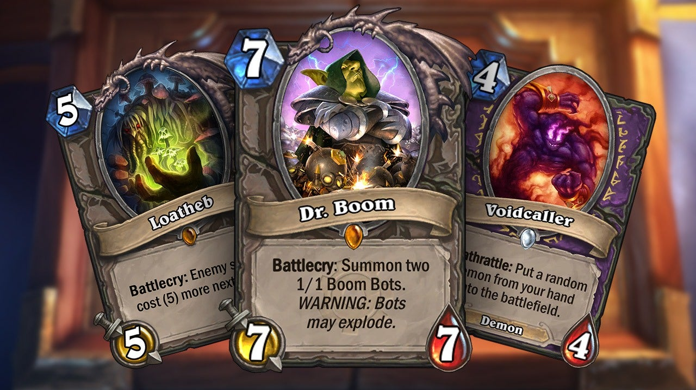
Data set from from Kaggle.
Before cleaning – 2819 cards
After data cleaning – 1014 cards

Slide 5
Hypothesis testing
The average attack of legendary minions is different from common minions.
Null Hypothesis (H0): μ_attack(legendary) = μ_attack(common). Legendary cards attack value is equal to common cards attack value.
Alternative Hypothesis (H1): μ_attack(legendary) ≠ μ_attack(common). Legendary cards attack value is different from common cards attack value
Result:
Test for Attack - Statistic: 10.035844391402186, P-value: 1.914019599904708e-19
Reject the null hypothesis. Legendary cards attack value is different from common cards attack value

Slide 6
Hypothesis: The distribution of card types (MINION, SPELL, etc.) varies across different sets.
Null Hypothesis (H0): The distribution of card types is the same across all sets.
Alternative Hypothesis (H1): The distribution of card types is different across sets.
Result:
Chi-square Statistic: 75.80704812741477, P-value: 2.792079596827584e-07
Reject the null hypothesis. The distribution of card types is different across sets.

Slide 7
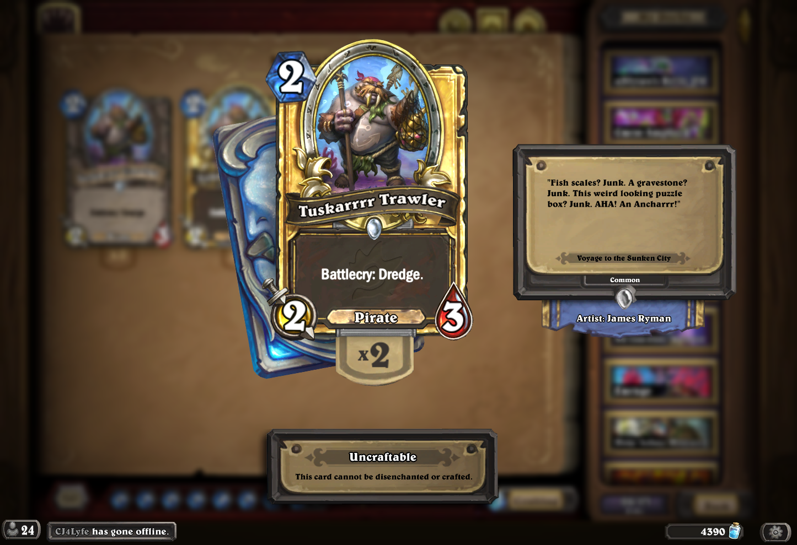
Cards flavor sentimental analysis

Slide 8
Why NLP?
The purpose of the text NLP analysis:
to gain insights into Hearthstone cards' characteristics, including their effects, abilities, sentiments, and player perceptions
to understand the gameplay mechanics, strategic implications, and player preferences associated with different cards in the game
It helps enhance our understanding of Hearthstone gameplay and can inform strategic decision-making for players, game developers, and enthusiasts alike.

Slide 9
NLP of cards text
Class analysis:
Group 0: Card abilities like summoning minions and modifying costs of cards.
Group 1: cards with “Battlecry” in description of the card, activating specific abilities
Group 2: cards with demons, debuff and buffs.
Group 3: cards related to drawing cards, reducing costs, or summoning specific entities.
Group 4: cards dealing damage and specific actions.
Group 5: Contains cards with effects triggered by specific events or conditions such as opponent actions or friendly minion deaths, allowing players to adapt their strategy based on the evolving game state in Hearthstone.

Slide 10
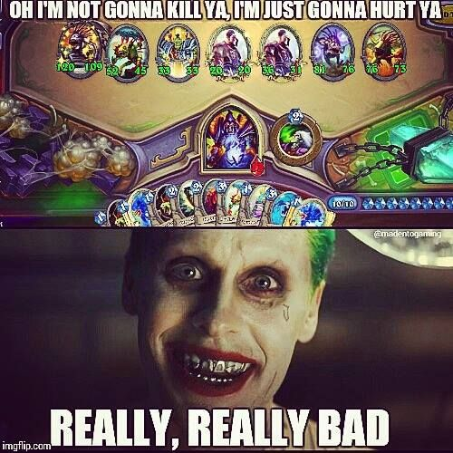
Thank you

