Slide 1
MarineGEO CPOP Data Viz
July, 2018

Slide 2
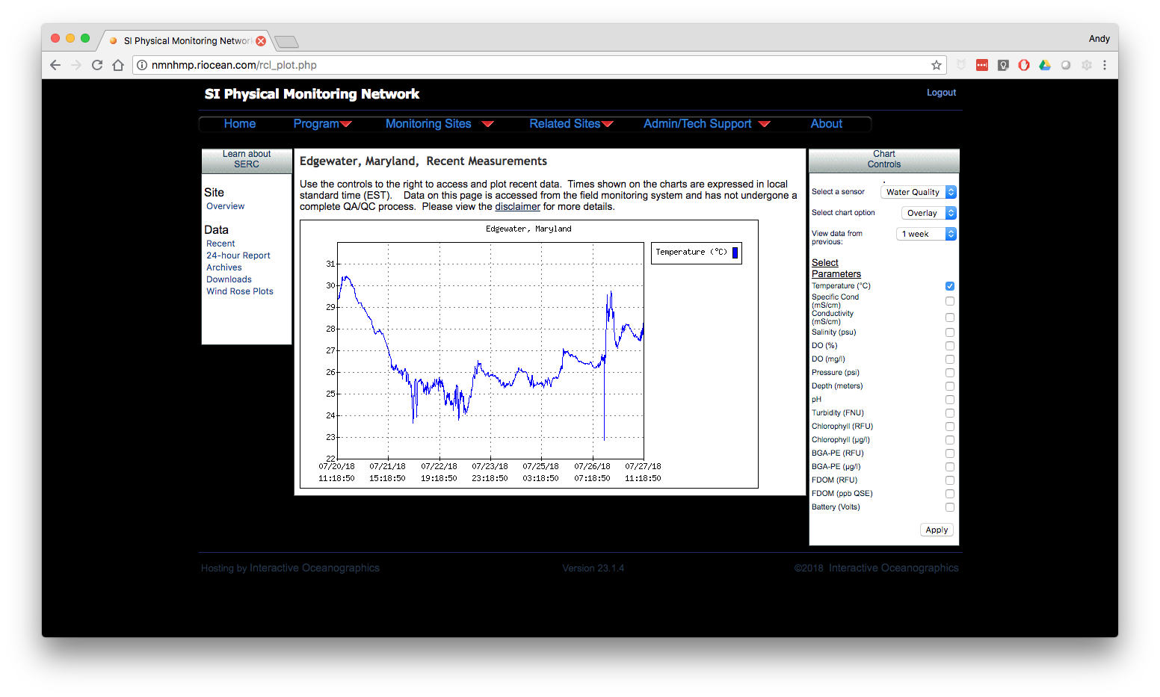
Notes:
Real time data
Multiple Sites
Sensors
Multiparms on a single figure

Slide 3
Serverless CPOP data visualization
Cron (task scheduler – windows?)
csv files available via a url (dropbox public file)
github pages (marinegeo.github.io)
D3 (javascript library)

Slide 4
CRON task
R or BASH
d3.csv(dbx_url, function (data) {
// do stuff with the csv
}
LoggerNet
CSV
SI Domain
marinegeo.github.io
'https://dl.dropboxusercontent.com/s/li1ciysypwc44t2/random_dice_generator.csv?dl=0'

Slide 5
Demo time
Python script that simulates rolling two dice
After each set of rolls,
appends results to a csv file
sleeps for 2 seconds between rolls
CSV file is shared on dropbox public URL
Website - D3 pulls in csv file on page load
table
plots

Slide 6
Start rolling dice….. `python random/random_dice.py`
https://marinegeo.github.io/cpop-viz-demo/

Slide 7
Water Quality Visualizations
SERC
2017-03-11 -> 2017-03-31
~ 20 days (5k rows)
Data from 2017_Water_Quality_RAW_SERC.csv
slider example
multi-params example
Note: sourcing csv file on github not dropbox

Slide 8
Issues
LF vs CRLF line endings
line feed (unix) vs carriage return (windows) to separate rows
Variable names with spaces (not sure about dashes)
Unable to use javascript dot notation
Null data values
currently null data is: NA
need to figure out if D3 has a recommend format or
possibly catch exceptions

