Slide 1


Fruit Freshness Analyzer
Tier 1
Benjamin LaCount II

Slide 2
The Problem
What real-world problem are you solving?
  A large portion of fresh fruit in US homes spoils before being eaten, making it a top source of household food waste.
Who cares about this problem?
  Consumers (households) who lose money, and anyone concerned with food waste and its environmental impact.
Why is it important?
  This wastes billions of dollars annually, costs families money, and contributes significantly to food in landfills.

Slide 3
A Solution
What will your system do?
  It will analyze a photo of a fruit and estimate the number of days remaining before it spoils.
How will it solve the problem?
  It gives consumers a clear, actionable "use by" timeline and provides smart storage tips (like the banana skin turning black in the fridge) to help them prioritize and consume fruit before it goes bad.
One sentence description:
  A computer vision tool that predicts a fruit's remaining shelf-life and provides storage tips from a single photo and whether the fruit is stored in the pantry or a fridge.

Slide 4
Technical Approach
CV Technique: Image Classification
Model: ResNet50 (pre-trained on ImageNet)
Framework: PyTorch
Why this approach?
ResNet50 is a powerful, proven architecture for classification. Using a pre-trained model (transfer learning) will help us achieve high accuracy on our specialized fruit dataset quickly.

Slide 5
Dataset & Preprocessing
CV Model Training Data (FruitVision):
  Source: A public dataset: "FruitVision" hosted on Mendeley Data.
  Size: 81,000+ augmented images of 5 different fruit types.
  Labels: "Fresh," "Rotten," and “Formalin-Infused” (pre-labeled).
Spoilage Timeline Data (FoodKeeper):
  Source: USDA "FoodKeeper" Dataset (data.gov).
  Usage: Provides the ground-truth spoilage timelines (e.g., "Apples: 1-2 months refrigerated"), keyword maps, and contextual storage tips.

Slide 6
Live Demonstration
Live Demonstration Video Link: https://drive.google.com/file/d/1AkD2KIRTfIUj1XUDlbkfthTKK1Al7yK-/view?usp=sharing
GitHub Repository Link: https://github.com/MarineMaaan/ITAI-1378-Midterm_FruitFreshnessTimer

Slide 7
Results
Primary Metric: Classification Accuracy (correctly identifying "fresh" vs. "rotten").
  Target: 85-90% accuracy on the test dataset.
  Result: >98% accuracy on the test dataset.
Secondary Metrics: Inference speed (processing time per image).
  Target: <1 second inference time.
  Result: <1 second inference time.

Slide 8
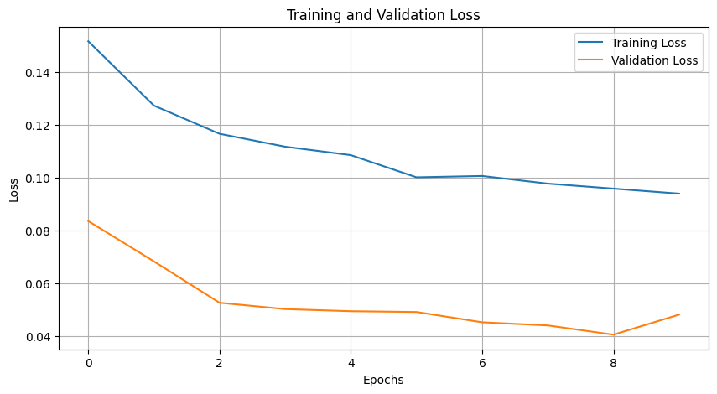

Slide 9
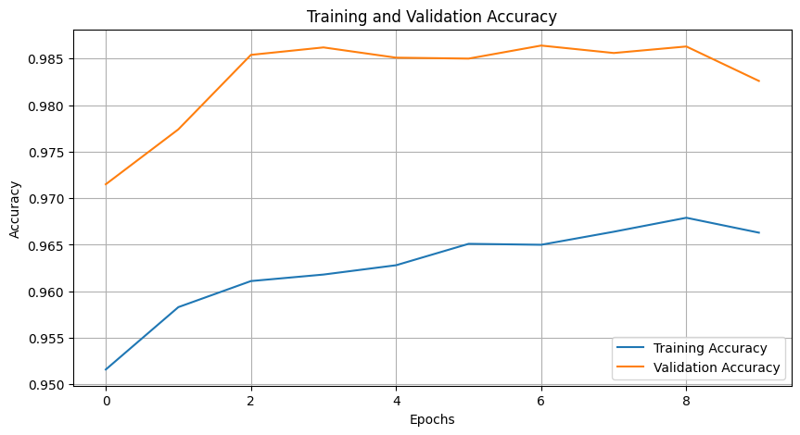

Slide 10
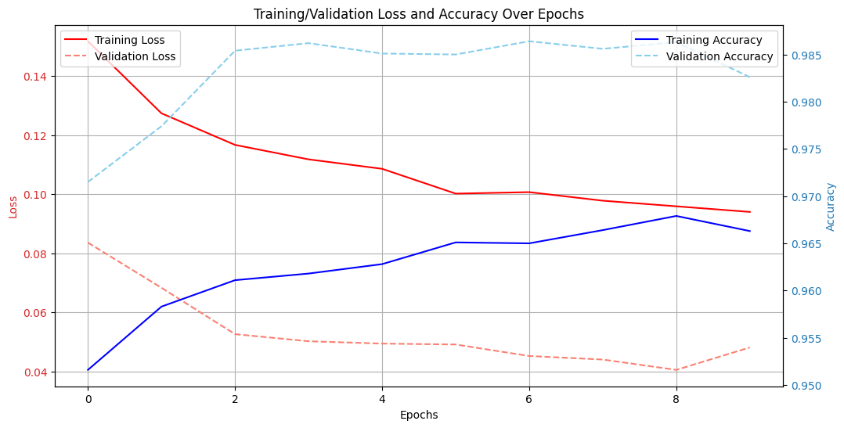

Slide 11
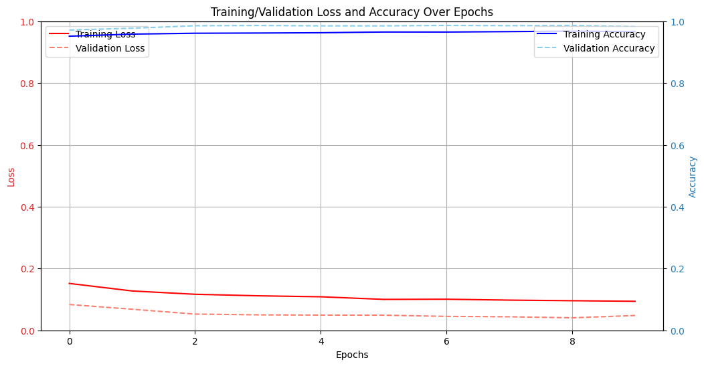

Slide 12
Key Learnings
Using a pre-trained model and transfer learning helped achieve high accuracy on our specialized fruit dataset quickly.
Using a pre-trained model, however, still doesn’t guarantee acceptable results “out-of-the-box”.
Additionally, I also became familiar with Gradio and Streamlit throughout the execution of this project.

Slide 13
Future Work
I would expand the options of fruits as much as possible from the five we are limited to today.
Additionally, I would seek a larger dataset that contains images of fruits in different settings, instead of just a plain background.

Slide 14
Acknowledgements
Thank you, Professor, my awesome team, and the AI tools I used throughout this project to assist in development.
THANK YOU! Questions?

