Slide 1

Successful people do
thing that other
would never do!
German entrepreneur
Winter 2022

Slide 2



A German company founded in 2015 with the goal of connecting Croatian manufacturers with large German retail chains.
We deliver more than 30 food and non food products under retailers or discounters brand name, and over 20 products of our own brands on the German market and other markets where German retail chains are located.
We cooperate only with manufacturers who have the relevant certificates and standards (IFS, BRC Food, Kosher, HALAL) and who produce according
to EU legislation and standards.
We respect all the rules of conduct of large retail chains and we know all the
processes of sales and procurement, logistics.
We know all the elements necessary for successful business with our partners (quality, competitive price, possibility of delivery, environmental protection, ecological packaging).
We specialize in private labels, our own brands and the brands of our partners.
We prepare, educate and advise our partners for trading with the most demanding customers, and provide our partners with tenders as well as
effectively filling them out

Slide 3


Our partners show us more and more trust from year to year
2021.
2020.
We belive that we are able to meet your needs as well!
2018.
2017.
2016.
Income:
120.000,00€
1,5 M €
27 M €
39 M €
48 M €

Slide 4










Our references :

Slide 5

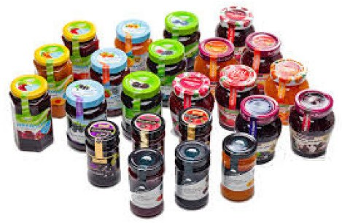
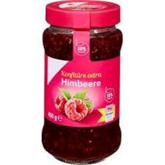
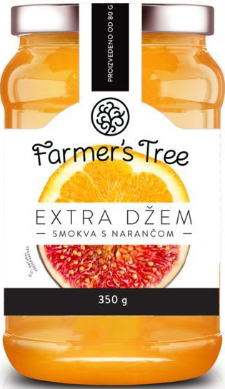
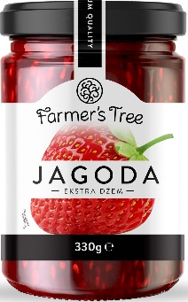
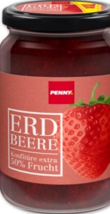
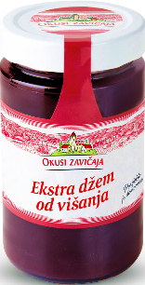
Brand Ambssador in co-ownership of companies
Croatia
www.nutrifit-food.hr
Production of jams, fruit spreads and compotes

Slide 6






Our partners:
Spain
www.delafruit.com
Croatia
www.nutrifit-food.hr
Croatia
www.klara.hr
Bosnia and Herzegovina
www.barpeh.com
Bosnia and Herzegovina
www.mljekara-livno.ba
Croatia
www.drpigley.hr
Croatia
www.zvijezda.hr
Cocoa processor and one of the leaders
in the region, in the production of creams and spreads from hazelnuts and cocoa. The production is IFS certified. The tradition of quality was con- firmed by the estab- lishment of an effective Quality Management System according to the requirements of the ISO 9001: 2000
standard in 2003, and by the reaffirmation of the compliance of the System in 2006.
A new modern, auto- mated cream spread factory began oper- ations in September 2001.
• the largest producer of hard cheese in Bosnia and Herzegovina
•buys over 10 million litres of milk per year
•produces over 1.000 tons of dairy products
•works with more than 350 subcontractors
•maintains the tradition of organised cheese production which started in 1885
• International certificates:
•ISO9001:2015 - quality management system
•HACCAP - Hazard Analysis and Critical Control Point is an internationally recognized system for reducing the risk of safety hazards in food
•IFS - International Food Standard
•Halal Certificate
The largest specialized Croatian producer of greaves and lard.
We are proud owners of many gold medals won for the quality and design of packaging at international fairs and awards.
Dr.Pigley products are present on shelves and refrigerators around the world and are sold by numerous international individual stores, supermarket chains as well as wholesalers.
We have IFS certification
Zvijezda is the largest producer of edible oils in Croatia and the only producer of
margarine, mayonnaise and mayonnaise-based products.
It follows world trends and develops new products accordingly.
It offers consumers a quality, modernly equipped and eco-
nomically standardized product. Consumers have been regaining confidence by buying Zvijezda’s products for more than 103 years.
We are a global organisation with Head- quarters in La Selva del Camp (Tarragona) and a factory in Chile, special- ized in the development and co-manufacturing of purees, smoothies, juices and nectars in pouch and bottle format for private label and distributors.
Unique in the EU in the production of HPP Technology, without preservatives and any additives (100% fruits and vegetables). They have all relevant pro- duction certificates: IFS,
BRC Food, ORGANIC, APPC/ HACCP, FDA, KOSHER, SE- DEX, AIB INTERNATIONAL, HALAL and 5S.
Thanks to its business and professional past as well as rich expe- rience in production, Nutrifit Food is a factory built on a solid foundation of fruit pro- duction and processing (jams, fruit spreads, jams and compotes, fruit fillings, thermo- stable jams and fruit in its own juice). It is the largest processing of its kind in the region. The production is IFS certified and operates according to ISO 9001 and 2000 standards.
The Zagreb bakery KLARA PC has a tradition since 1952. Croatian company dealing with industrial production and sale of bread, pastries and baked goods.
KLARA products can be found in all stores in Croatia and in almost all shopping centers and stores in Bosnia and Herzegovina, Slovenia, Serbia, Great Britain and Ireland.
The central production plant in Zagreb produces more than 150,000 units of a wide variety of baked goods every day, which are delivered daily to over 2,000 delivery points via its own distribution.
Constant investments in new technologies and knowledge of employees allow us to produce and offer all types of bakery products according to the needs of different markets.
KLARA PC have an IFS certificate

Slide 7
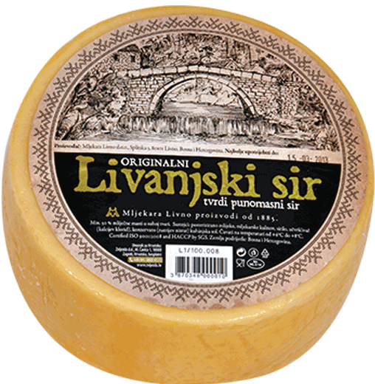
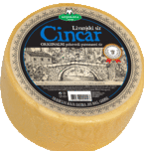

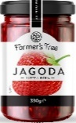
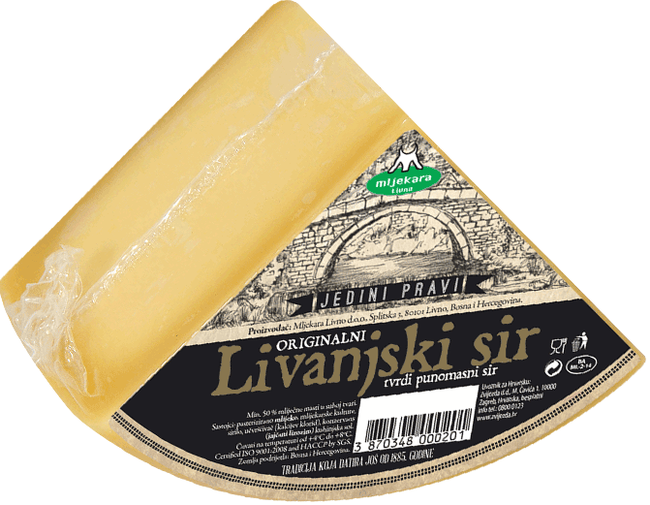
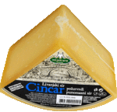
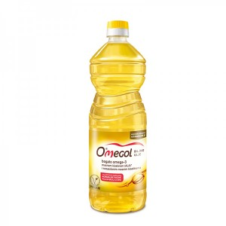
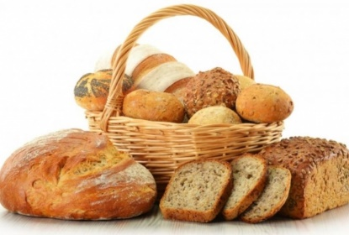



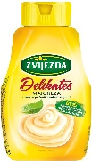
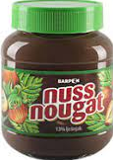
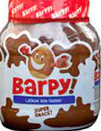
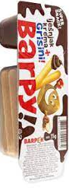
Our brands – can be your brand

Slide 8









Our partners in market research and buisness consulting:

Slide 9

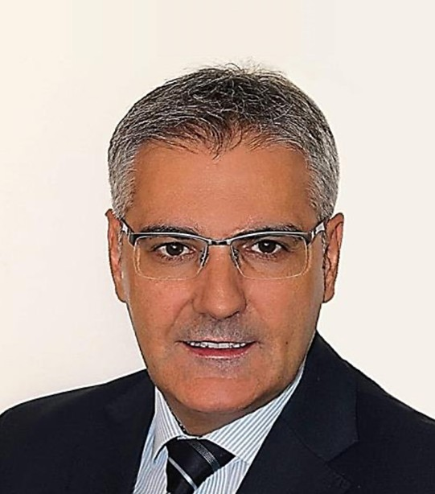

Head office
Representative office
Dr. Otto Meyer str. 24C 86169 Augsburg, Deutschland
Office: +49 821 54 01 62 84
GSM: +49 162 37 45 081
Trnjanska cesta 63/1 10000 Zagreb, Croatia
GSM: +385 91 944 0 646
Ivica Dzalto, Mr.Sc. CEO
Email: office@brand-ambasador.net
Management Consulting & Business Building Company Brand Ambassador EU certified member

