Slide 1
Application of a Reinforcement Learning Algorithm in the Development of Computer Games
Marino Linić

Slide 2
History
Dartmouth workshop (1956): 8 weeks
Reinforcement learning only recognized since the 1980s along supervised and unsupervised learning
Supervised learning: labeled datasets
Unsupervised learning: clustered datasets
Neither of these are required for RL

Slide 3
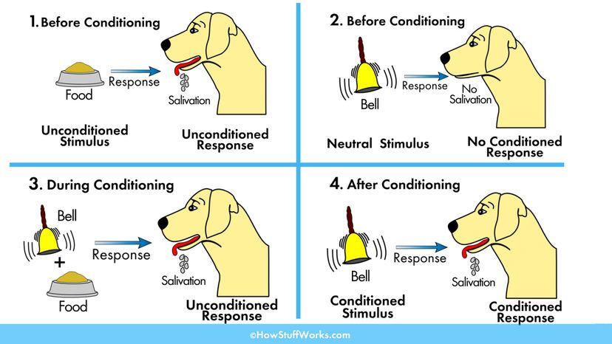
Pavlov’s dogs: 1897

Slide 4
RL is inspired by how biological organisms learn
No input and output pairs: learns on its own
Trial and error
Optimization (large scale dynamic programming)
Association (search) and exploration (memory)
Antagonism: exploration vs. exploitation
RL disproportionately used in video games in part because simulations are representative of real life

Slide 5
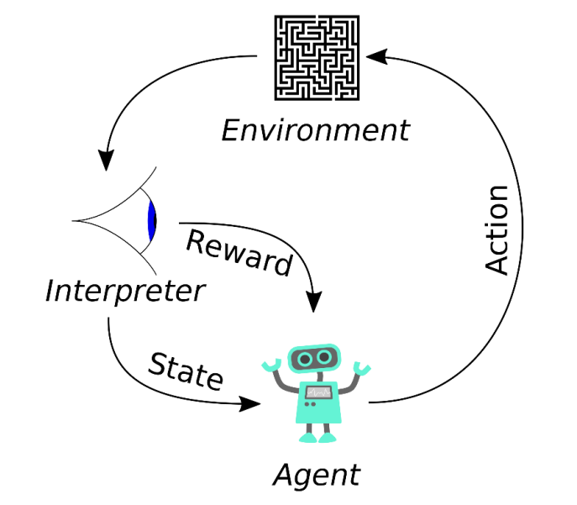

Slide 6
Hyperparameters
Used to fine-tune ML algorithms
Learning rate: How fast will the agent update information?
Discount rate: How long-term oriented will the agent be?
Epsilon: How often will the agent act randomly (explore)?

Slide 7
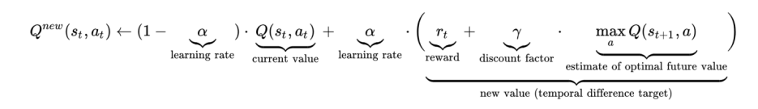
Q-learning
Introduced in 1989, widely used
Simple
A variant of Bellman equation (recursive long-term reward seeking)
Values stored in Q-table

Slide 8
Methodology
2D Game – Thomas Loops Green
Player needs to reach goal and avoid obstacles
Python (language)
PyGame (platform)
NumPy (multidimensional arrays)
Matplotlib (data)

Slide 9
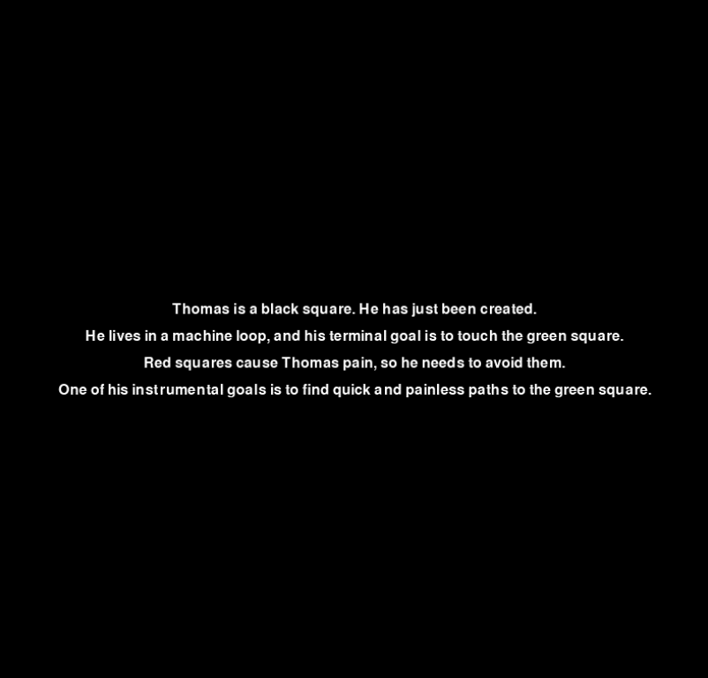

Slide 10
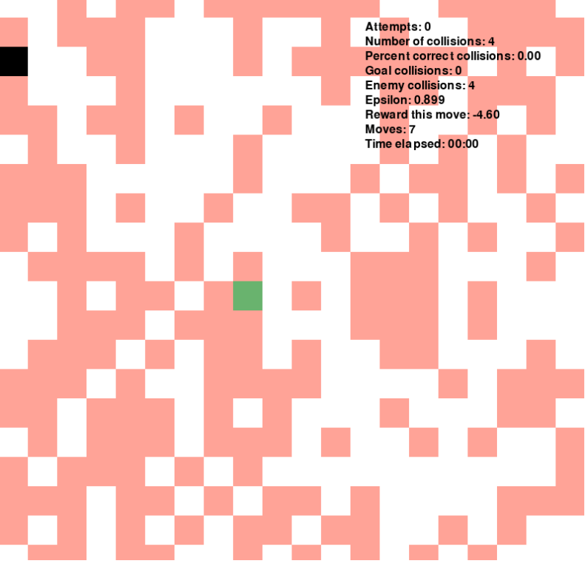

Slide 11
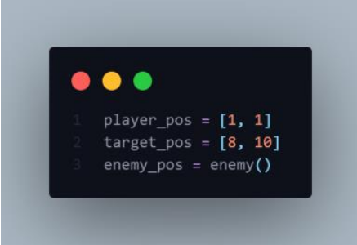
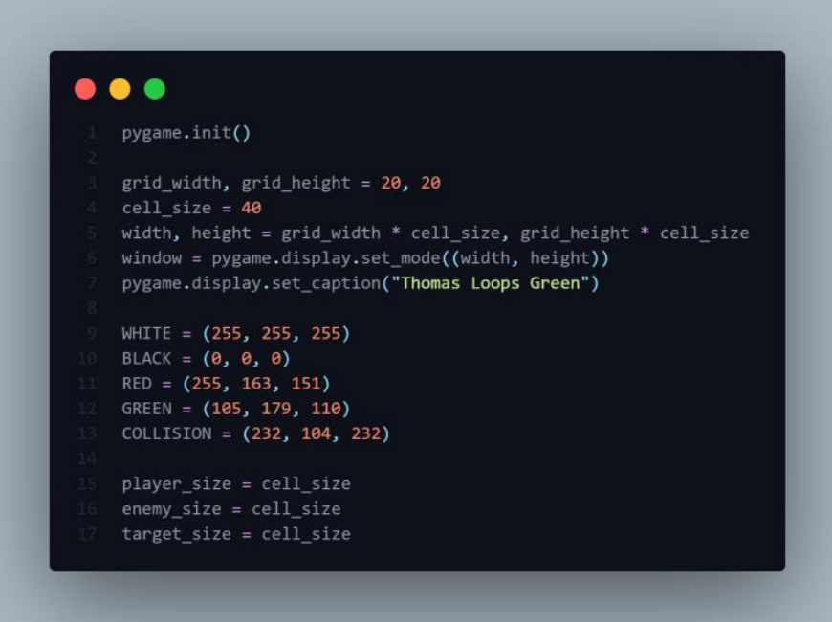
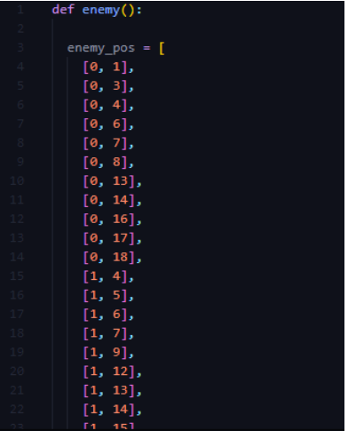
Setting up the window

Slide 12
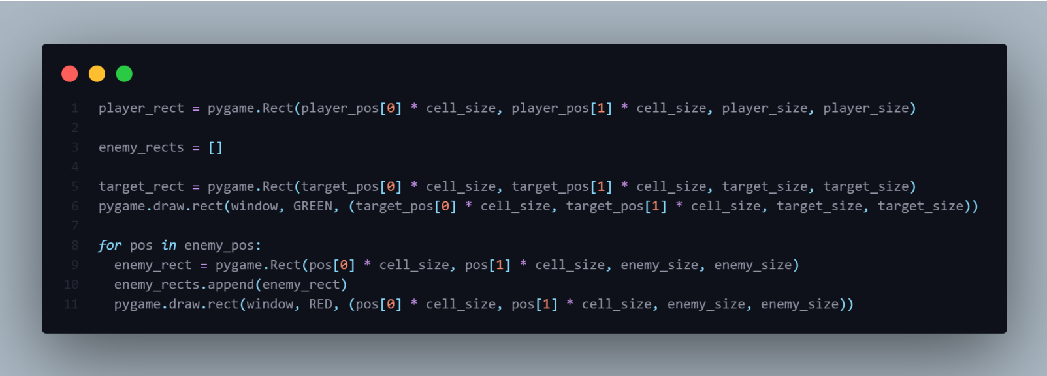
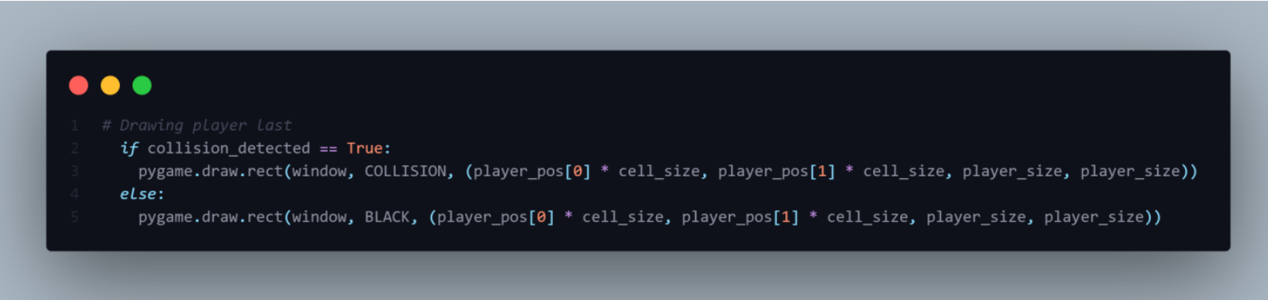
Drawing objects

Slide 13
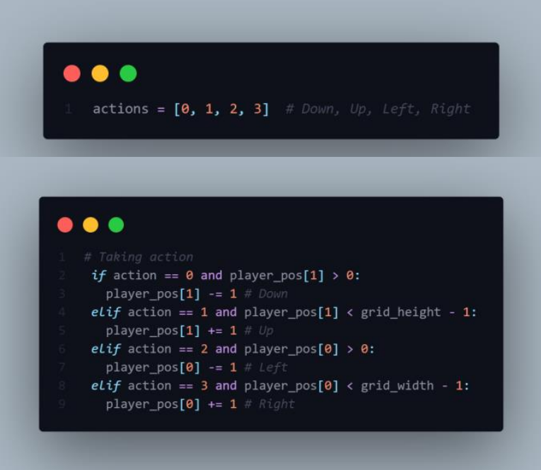
Movement

Slide 14
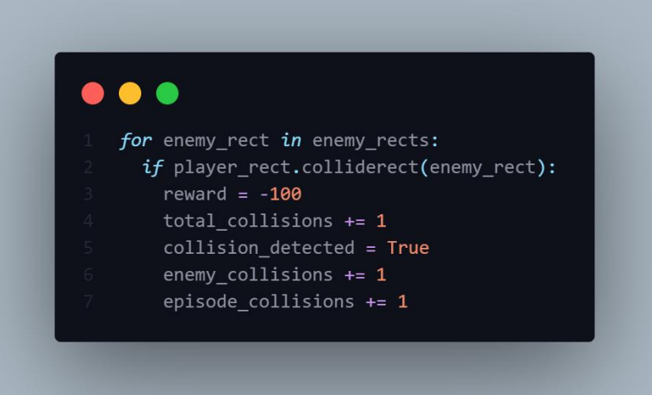
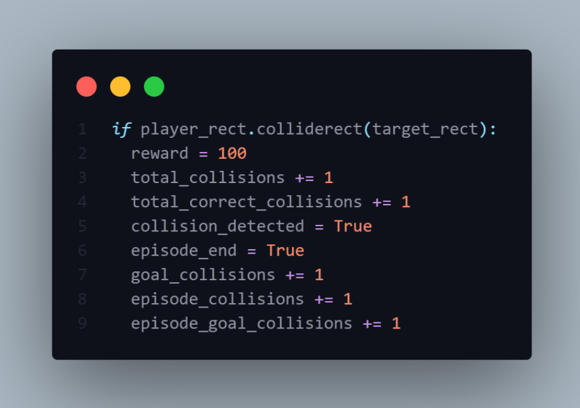
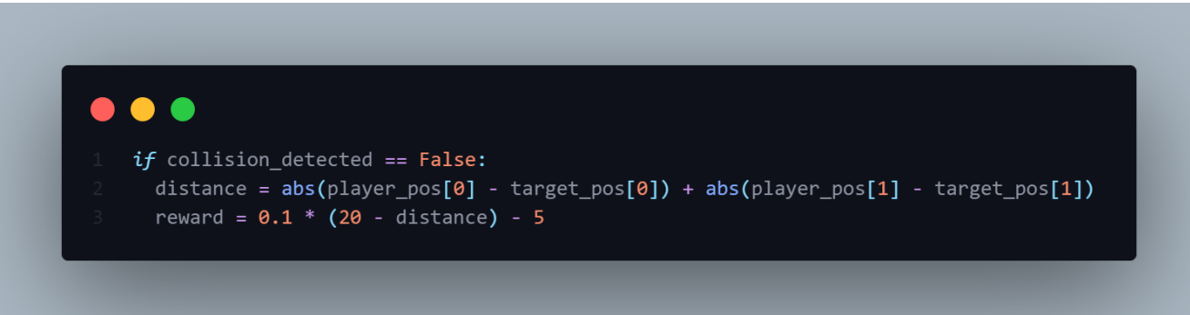
Collisions and rewards

Slide 15
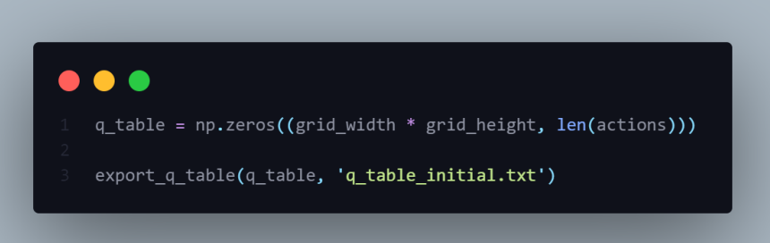
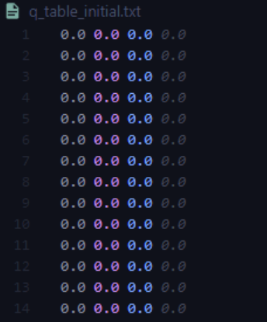
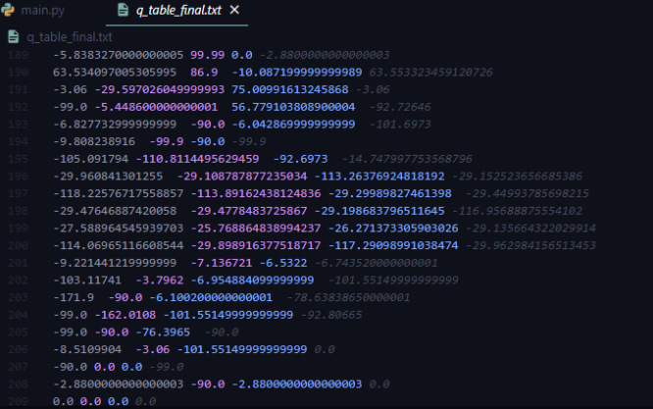
Q-table

Slide 16
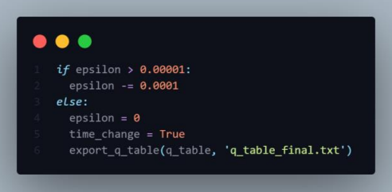

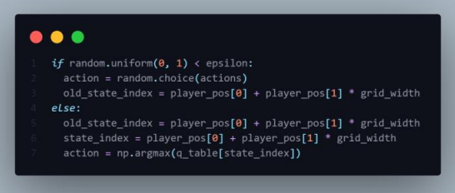
Hyperparameters
- taking random action

Slide 17
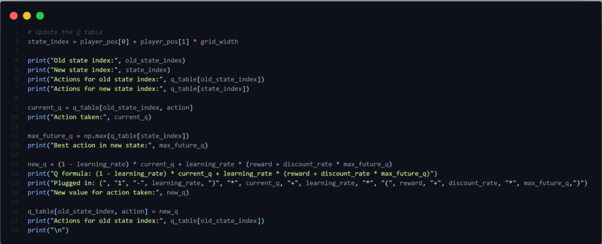
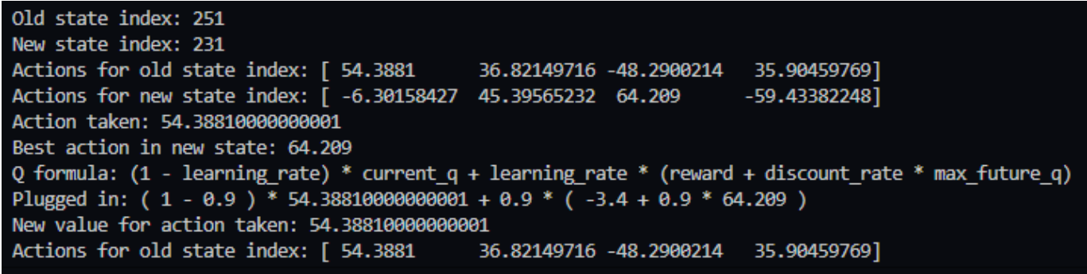
Updating the Q-table

Slide 18
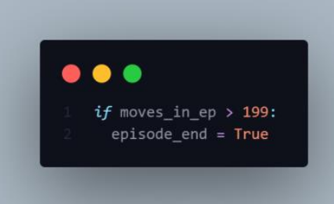
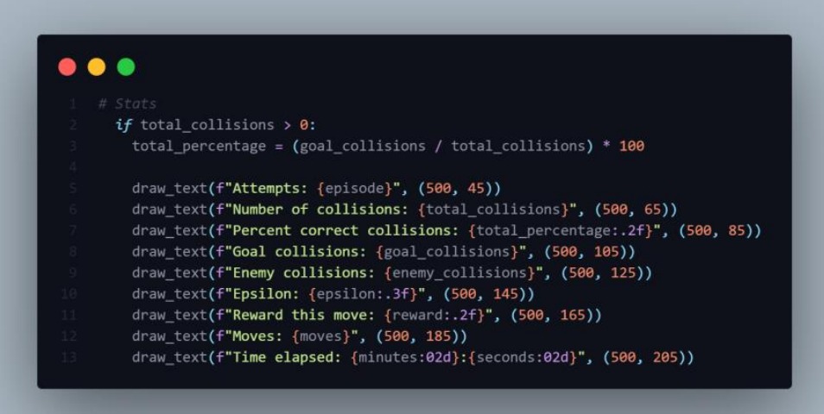
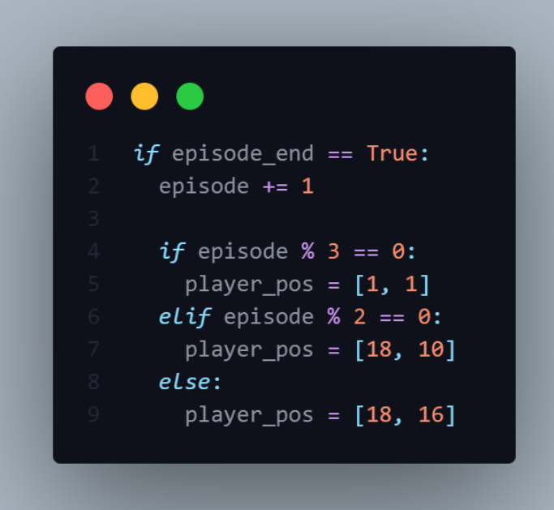
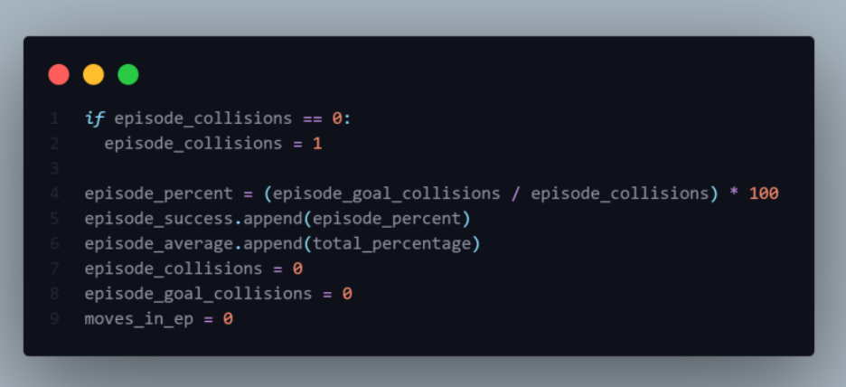
Episodes

Slide 19
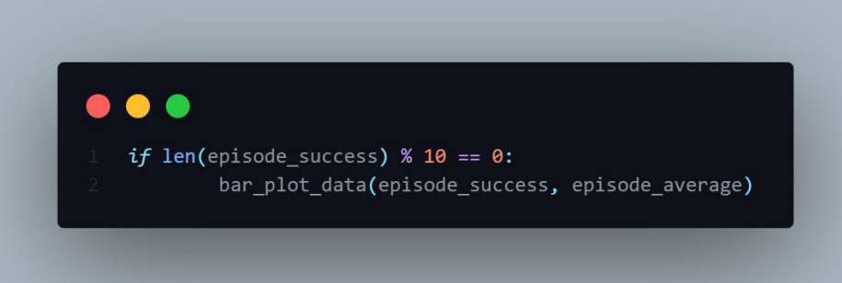
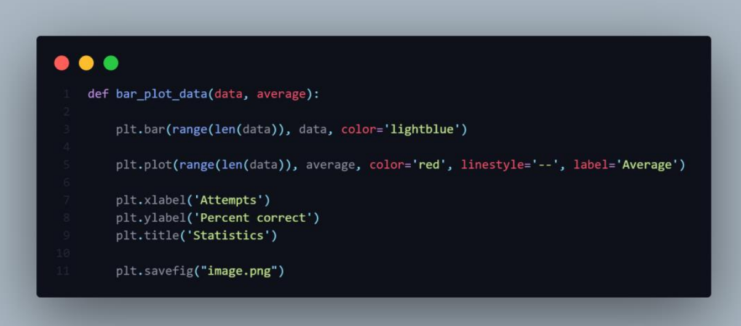
Plotting

Slide 20
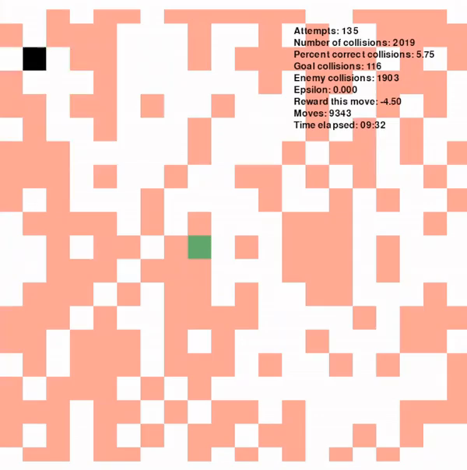
Results
https://i.imgur.com/XlvAFsQ.mp4
9000+ moves
130 episodes
Long-term rewards

Slide 21
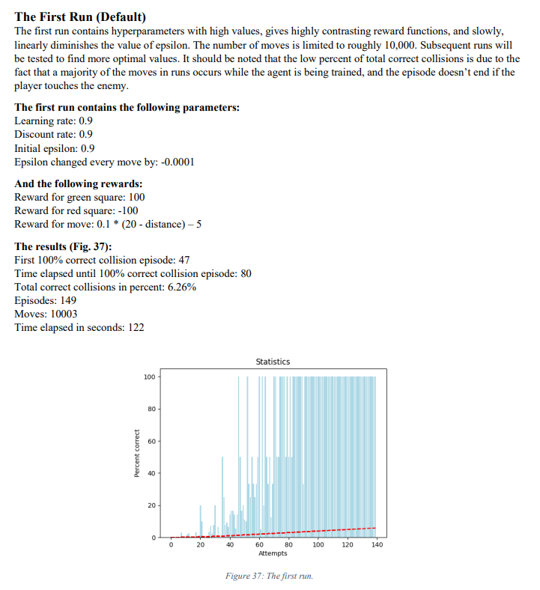
Optimization

Slide 22
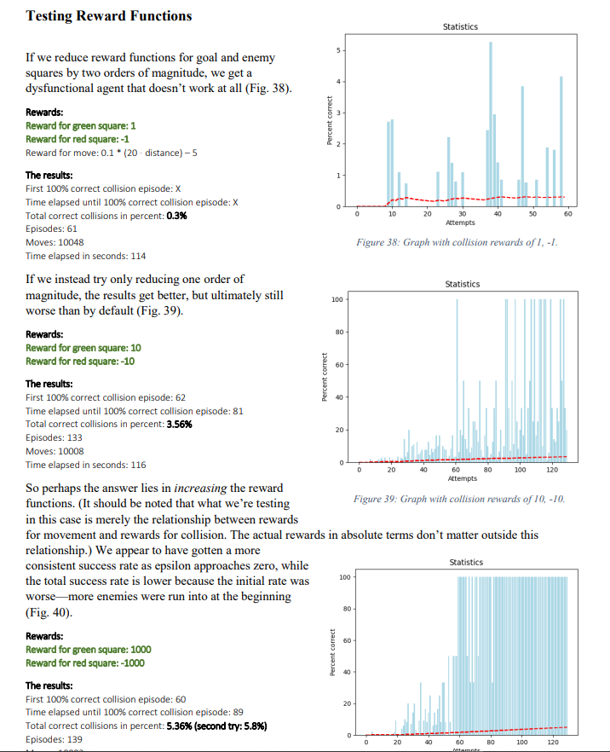
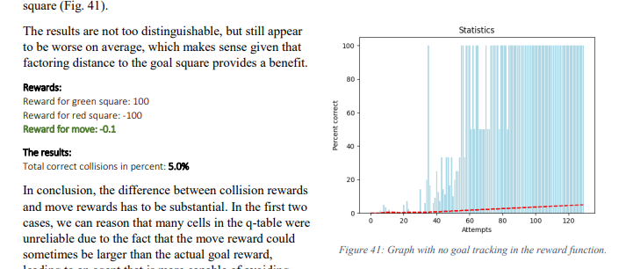
Rewards

Slide 23
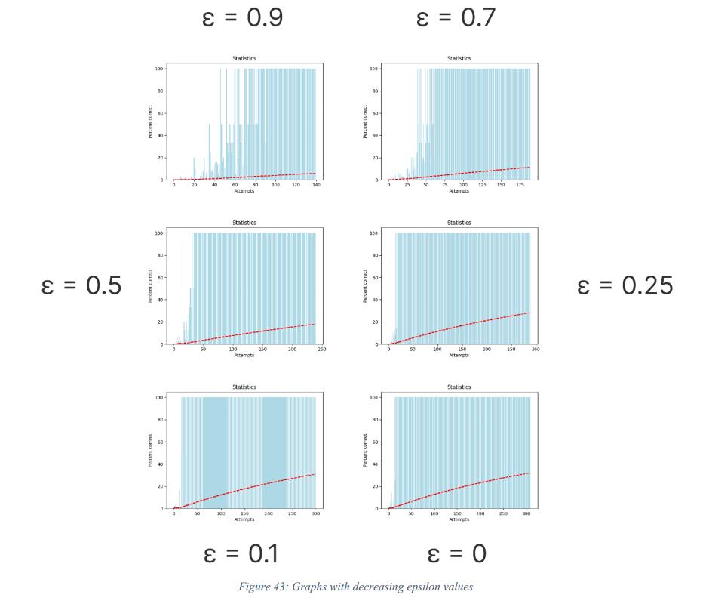
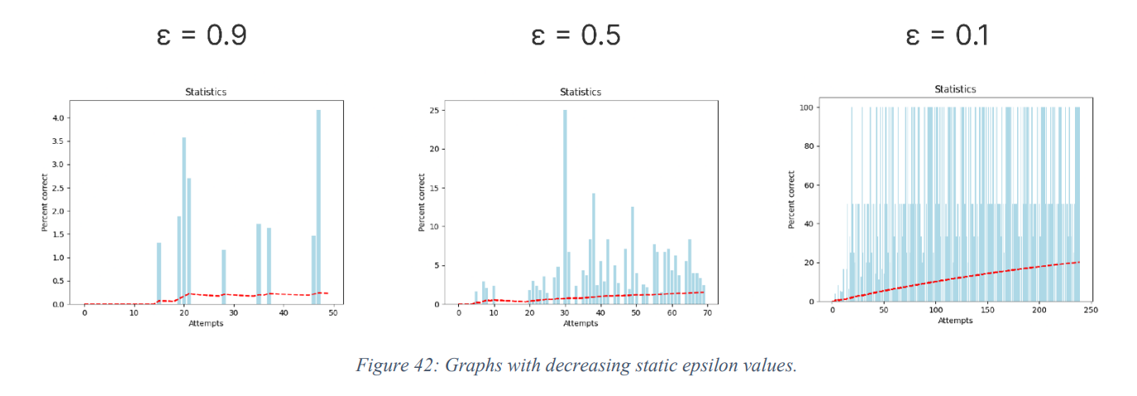
Epsilon
Constant epsilon
Decreasing epsilon

Slide 24
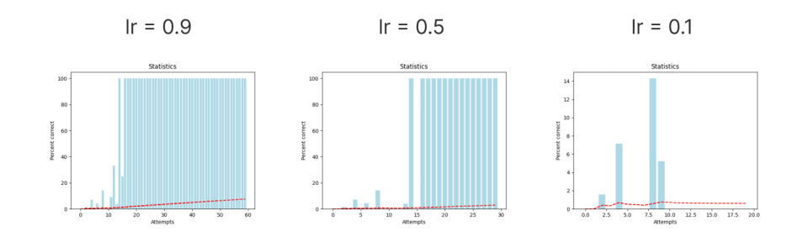
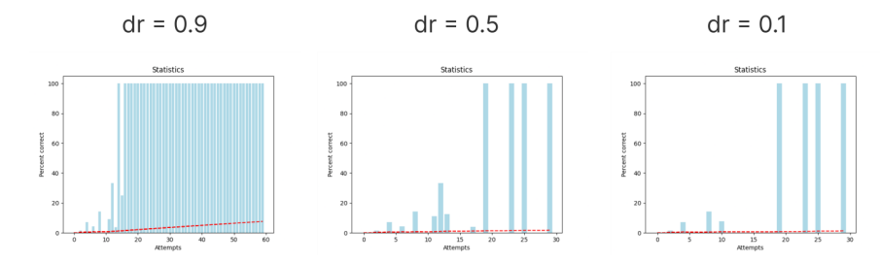
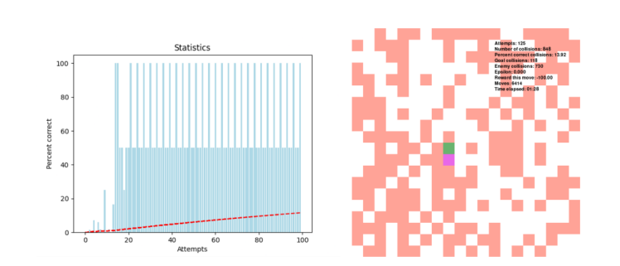
Learning and Discount rate
dr = 1

Slide 25
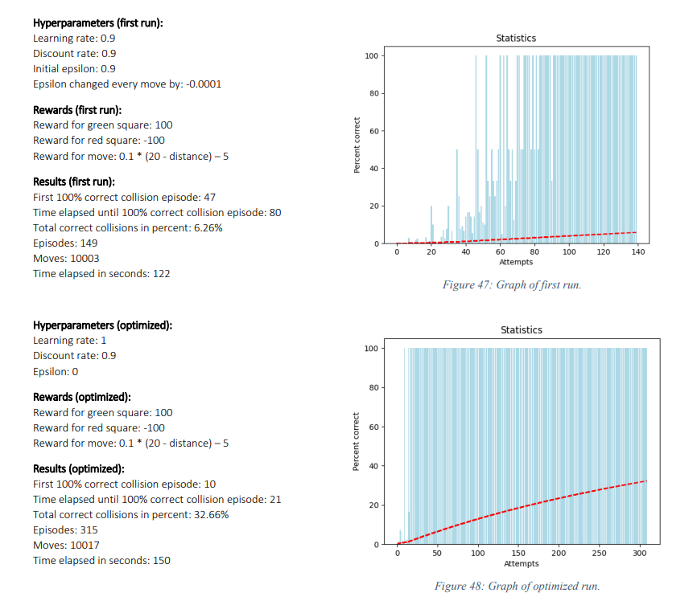
Result (optimized)
70-80% decrease in time it takes to train
Correct collisions increase by 422%
https://youtu.be/J_X5qe4ZC9w

Slide 26
Limitations
Simple simulation (even some features of Q-learning were redundant)
Constrained environment

Slide 27
Improvements
Health items, weapons
Agent could be trained as NPC
Training the agent to react to moving objects by training on sensitivity to all objects (not just enemies) and thus creating potential non-static enemies for the player

Slide 28
Thank you!
This paper hoped to illuminate and simplify understanding reinforcement learning in video games and how to implement it using Q-learning.
marino.linic@student.uniri.hr

