Slide 1

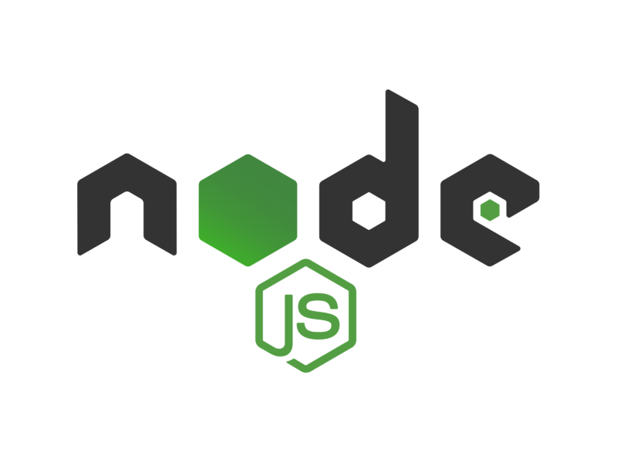
EXPRESS

Slide 2
WHAT IS EXPRESS.JS?
Express.js, or simply Express, is a back end web application framework for building RESTful APIs with Node.js, released as free and open-source software under the MIT License.
Express.Js is one of the best backend development JavaScript Frameworks. The primary usage of it is creating Restful API’s what accept request from frontend and send the appropriate response.

Slide 3
Why Express.js?
You only need to learn one language for both frontend and backend development, Which is JavaScript. To develop a web frontend, You need HTML, CSS, and JS. So, JavaScript is necessary and the same language is used to code backend if it’s Express.js.
The support of Node.js is one of the best reasons because of which you should choose Express.js. So that you can develop an Express.js backend with the support of all the NPM packages that make the process easier.
You would be able to debug your application faster than ever with the help of the debugging mechanism it offers to its users. This helps to find error points easily without taking much time.
While Express itself is fairly minimalist, developers have created compatible middleware packages to address almost any web development problem. There are libraries to work with cookies, sessions, user logins, URL parameters, POST data, security headers, and many more.

Slide 4
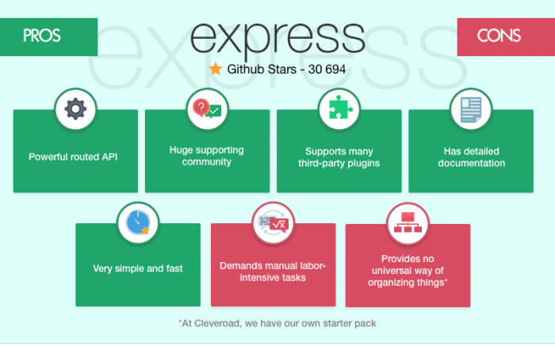
Pros & Cons

Slide 5
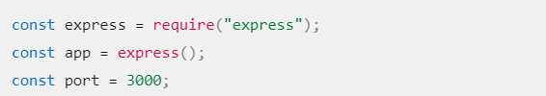
Create a simple server
The first two lines require() (import) the express module and create an Express application. This object, which is traditionally named app, has methods for routing HTTP requests, configuring middleware, rendering HTML views, registering a template engine, and modifying application settings that control how the application behaves.

Slide 6
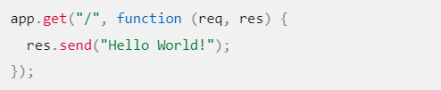
Create a simple server
The middle part of the code shows a route definition. The app.get() method specifies a callback function that will be invoked whenever there is an HTTP GET request with a path ('/') relative to the site root. The callback function takes a request and a response object as arguments, and calls send() on the response to return the string "Hello World!“.

Slide 7

Create a simple server
The final block starts up the server on a specified port ('3000') and prints a log comment to the console. With the server running, you could go to localhost:3000 in your browser to see the example response returned.

Slide 8
Create route handlers
Often it is useful to group route handlers for a particular part of a site together and access them using a common route-prefix (e.g. a site with a Wiki might have all wiki-related routes in one file and have them accessed with a route prefix of /wiki/). In Express this is achieved by using the express.Router object. For example, we can create our wiki route in a module named wiki.js, and then export the Router object, as shown in the picture (in the following slide)

Slide 9
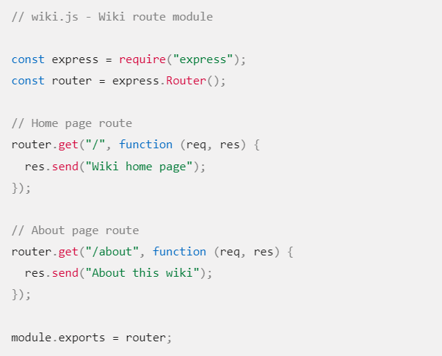
Create route handlers

Slide 10
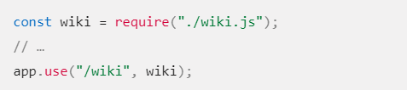
Create route handlers
To use the router in our main app file we would then require() the route module (wiki.js), then call use() on the Express application to add the Router to the middleware handling path. The two routes will then be accessible from /wiki/ and /wiki/about/.

Slide 11
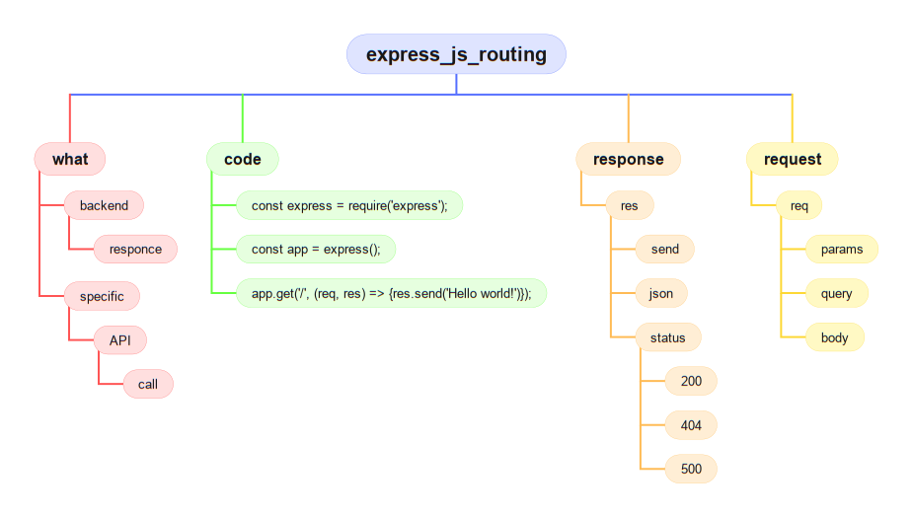

Slide 12
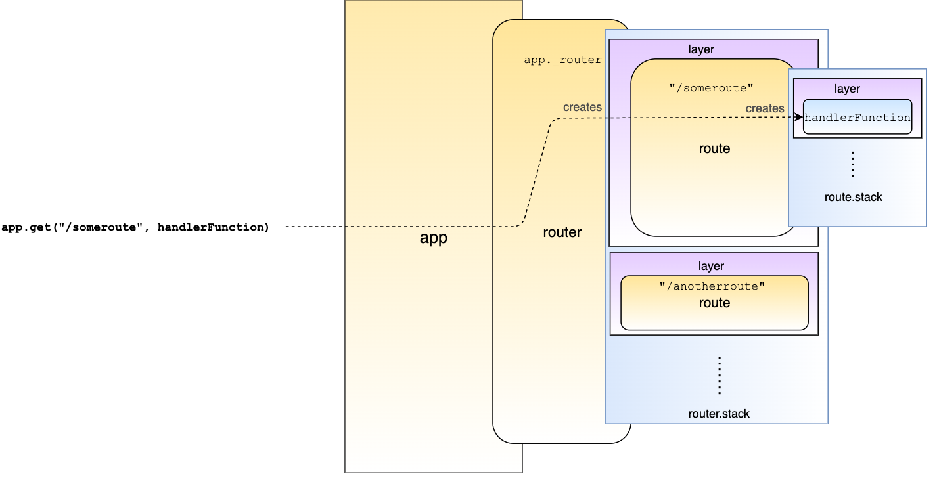

Slide 13
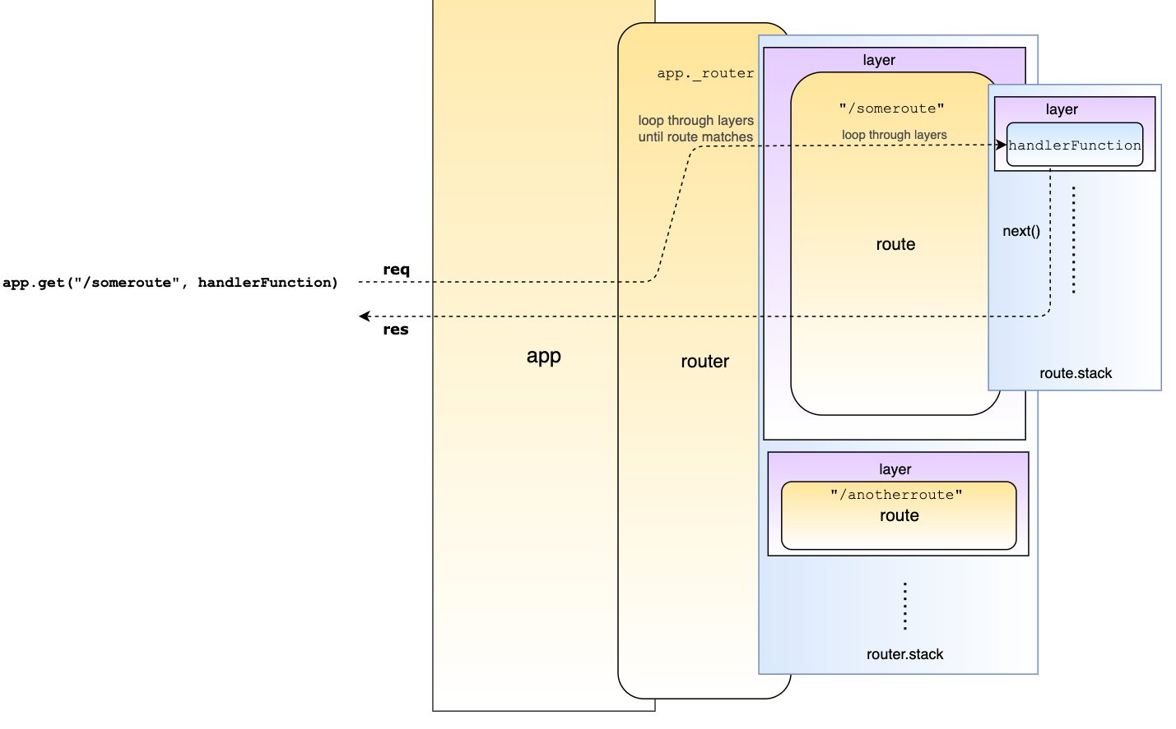

Slide 14
QUESTIONS?
You can find us at:
mail
main

