Slide 1



Front-end Project Work presentation
András Rákoczy
Nico Adelmann
Tamas Olaszki
Éva Bukli
Mario Weiss
THE ANTEM LABS

Slide 2

Project requirements:
To design a landing page for a CodeFactory product, that contains:
Testimonials
Videos
Information about the teachers
Information about the course space
Information about the course technologies
News section
Price offers
Different course formats (eg. intro, basic, advanced)
Links to the main website (codefactory.wien)

Slide 3

Further project requirements:
One-page website
Modern design
Without course registration
Responsive
The site has to be re-usable to represent any course CodeFactory has or may have in the future

Slide 4
Implementation:
We did not use any pre-made template
We have built the site up from scratch on Bootstrap basics
Used SASS to design it
With colors in variables for further customization

Slide 5
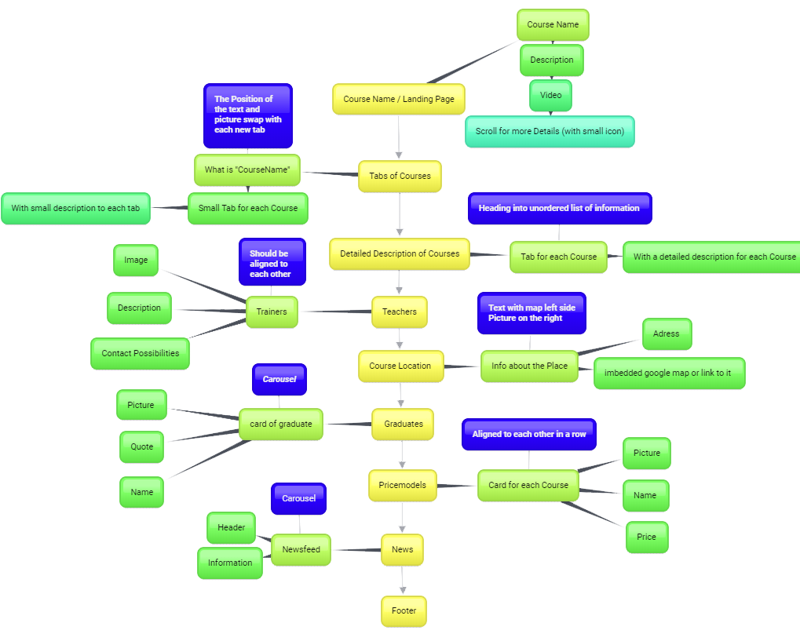
Contents of the page:

Slide 6
Documentation:
https://docs.google.com/document/d/1814xzH-7cGicayMihPksFF0xebH1SgexUEZz2S-dWTA/edit?usp=sharing

