Slide 1
frequency
price

Slide 2

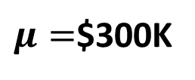
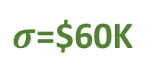
Relative
frequency
Population Distribution
(house prices)
$σ$=$60K
$$σ$$
$120K
$μ=$$300K
$480K

Slide 3

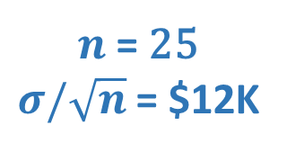
Relative
frequency
Sampling Distribution (survey results)
Population Distribution
(house prices)
$σ$=$60K
$n$ = 25
$σ/\sqrt{n}$ = $12K
$$σ$$
$$σ/\sqrt{n}$$
$120K
$274K
$μ=$$300K
$336K
$480K

Slide 4
Relative
frequency
Sampling Distribution (Survey Results)
95% of surveys
price
$305K
$980K
$1M

Slide 5
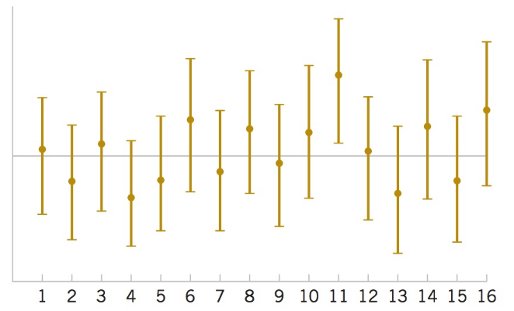

Sample mean
in Survey 1
$μ=$ $300K
Survey no.

