Slide 1

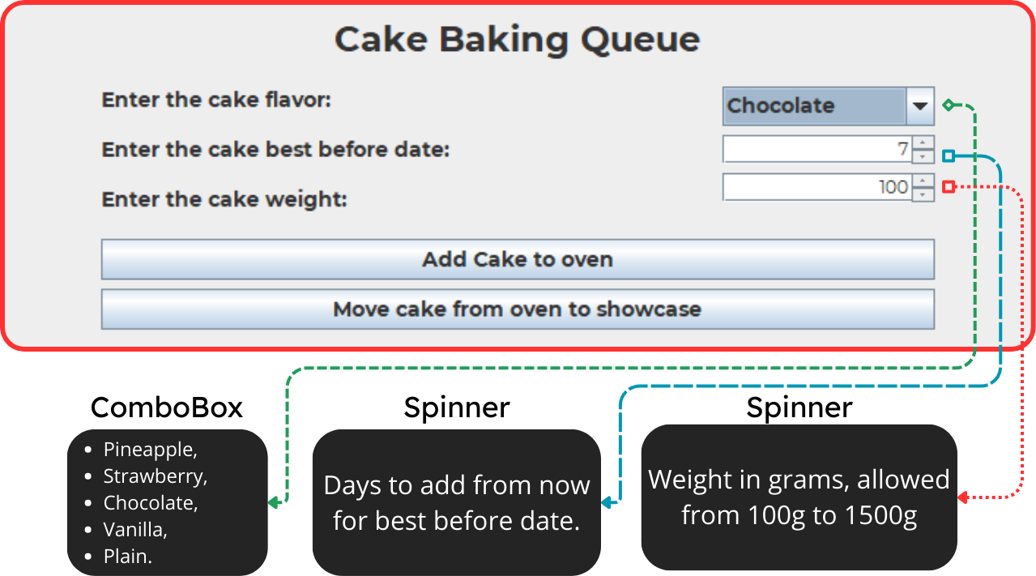
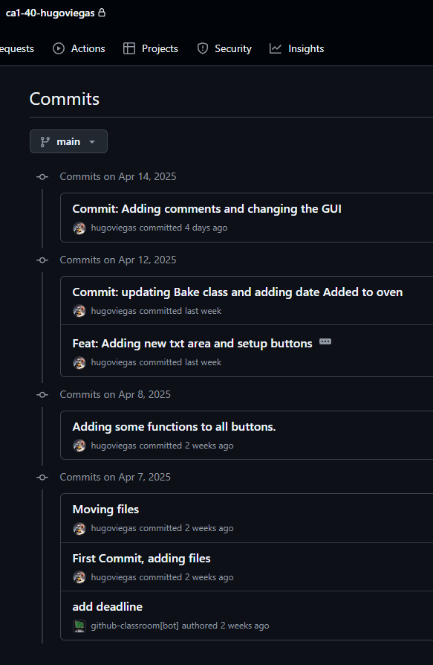
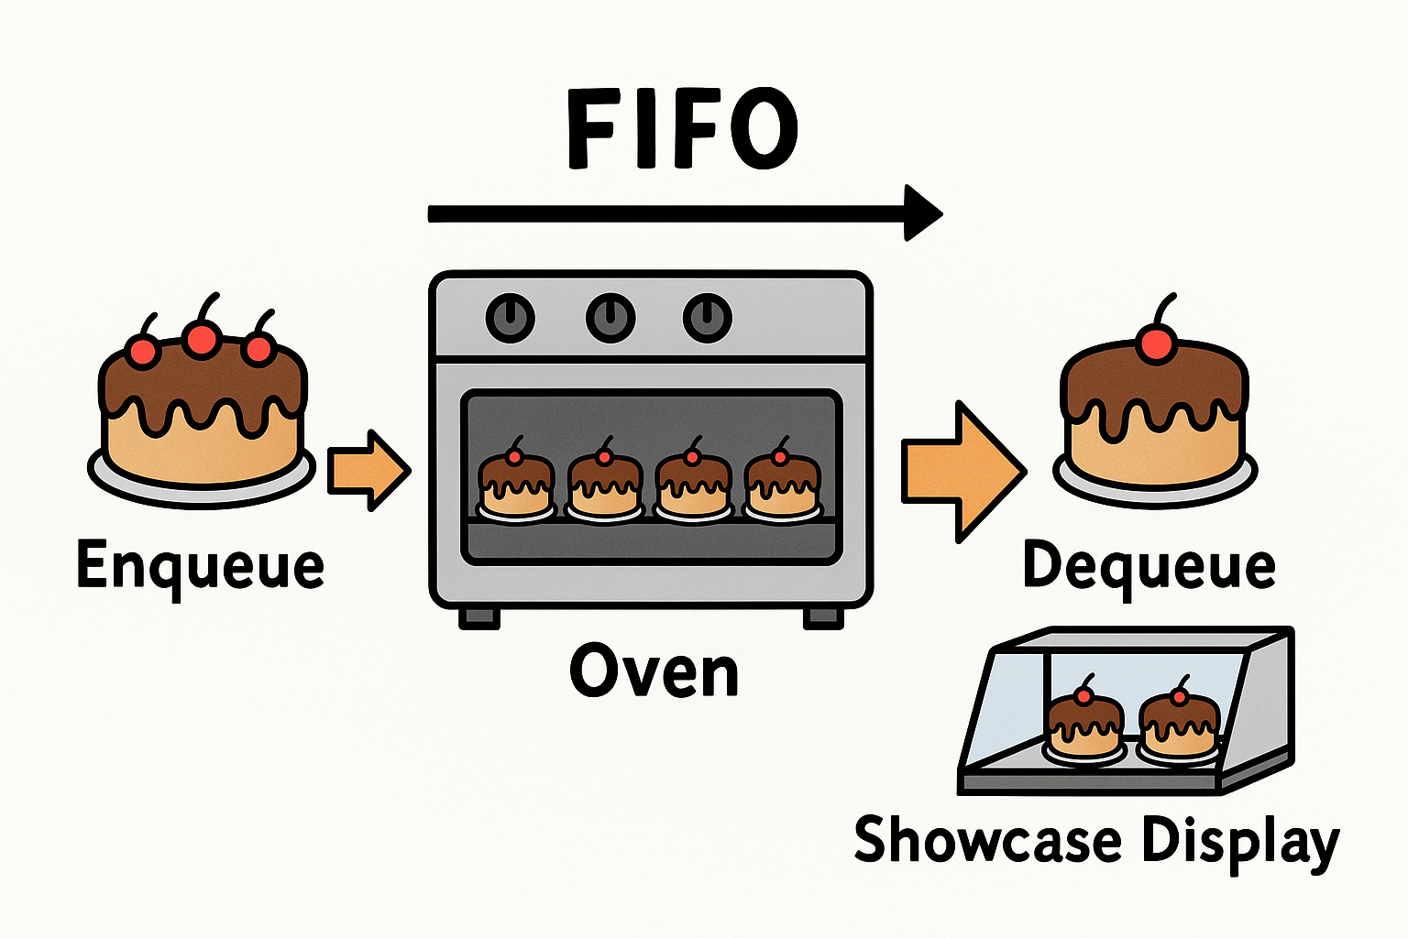
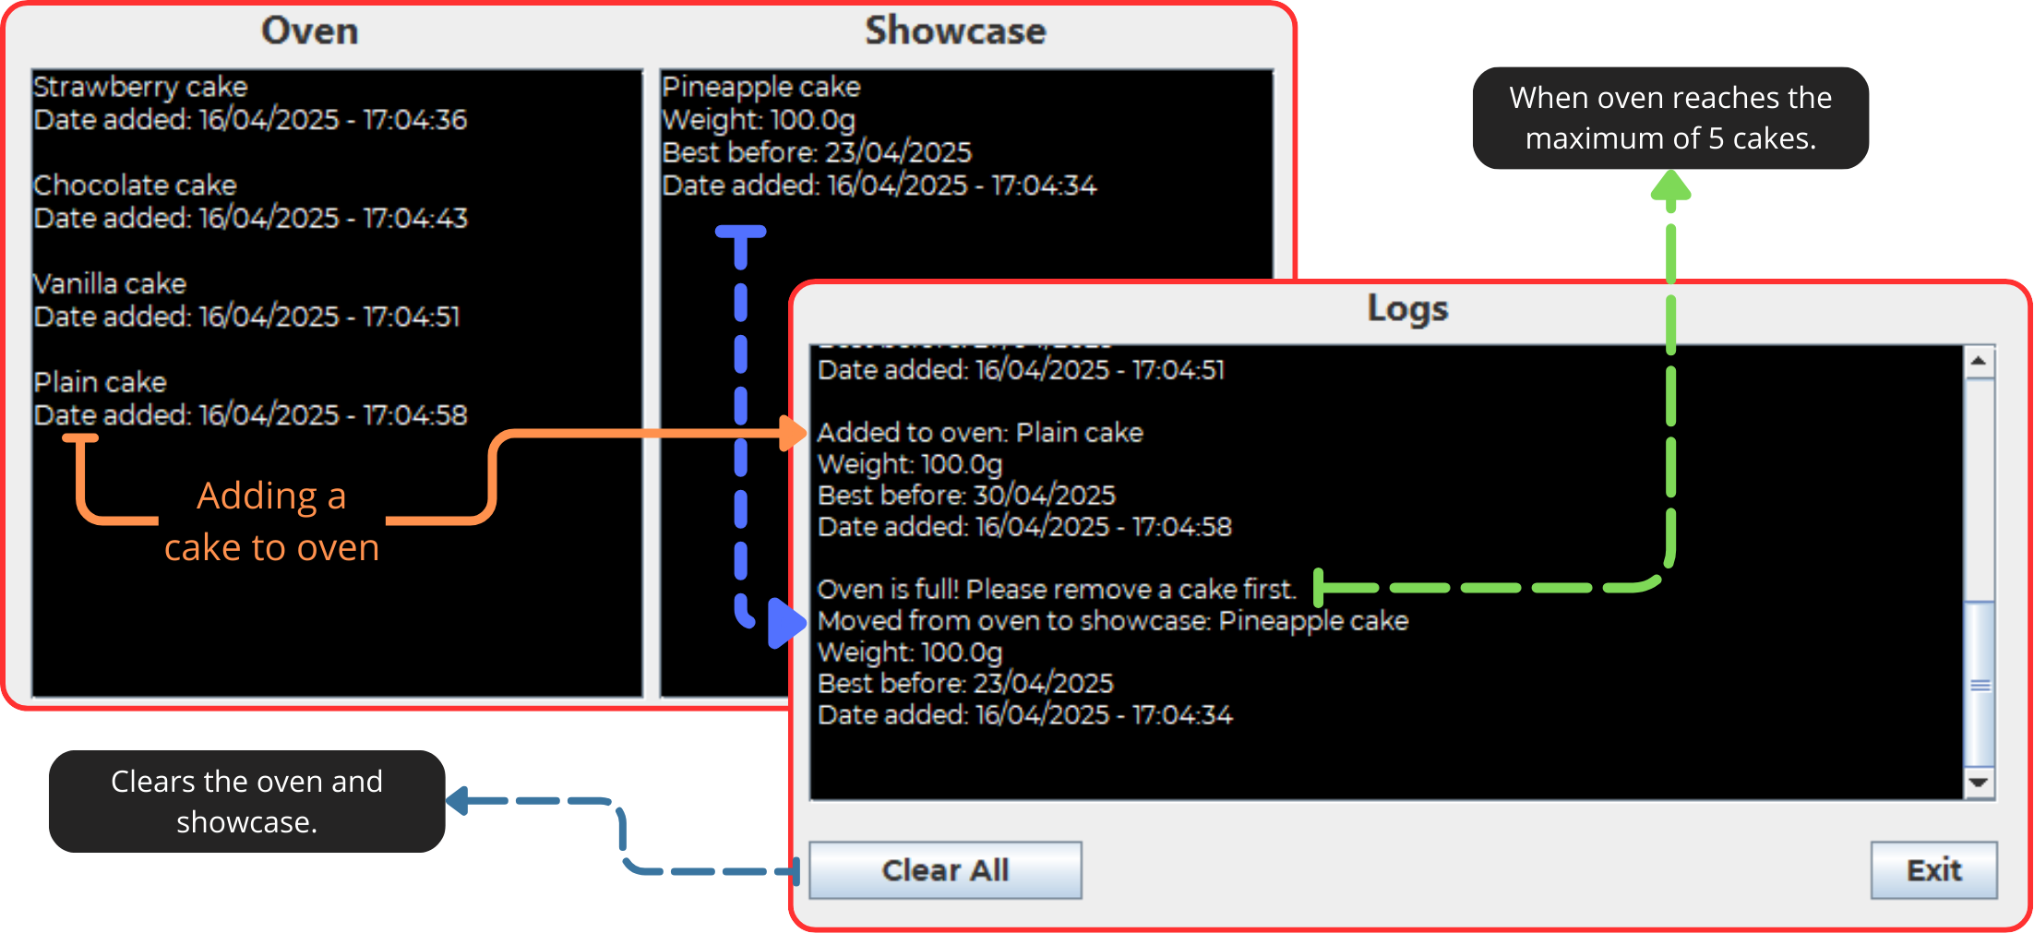
CA1 - Algorithms & Constructs, BakeACake java aplication.
Student: Hugo Gabriel Henriques Viegas
Lecturer: Muhammad Iqbal
Useful links: GitHub repository: https://github.com/CCT-College-Dublin/ca1-40-hugoviegas/
    Video link: https://youtu.be/GsXkv2TZU8M
Project Overview
This Java application uses a First-In, First-Out (FIFO) queue to simulate baking and showcasing cakes in a bakery.
Cakes are added to the oven queue (maximum capacity: 5) in the order they arrive. When done, they are removed from the front of the queue and moved to the showcase.
JAVA APLICATION
Cake Class
Holds cake properties (flavor, weight, best- before date, added date).
A short class proprieties from Cake:
QUEUE (FIFO)
The most efficient data structure for this bakery scenario is the queue, and to explain why, I'll provide a practical example. In real-world cake baking, we follow a specific timeline: approximately 10 minutes to prepare ingredients, 30 minutes to bake in the oven, and then removal before burning occurs. This process naturally demands a First-In-First-Out (FIFO) approach – the first cake placed in the oven must be the first one removed when it's ready.
My implementation uses Java's queue functionality to manage this process effectively. When utilizing the "enqueue" operation, I add a new cake to the end of the queue, simulating a cake being prepared and placed in the oven. Conversely, the "dequeue" operation removes the cake from the front of the queue, representing the removal of the first cake that entered the oven. This approach ensures fair processing where no cake gets overlooked or overcooked.
public String toString() { return flavor + " cake\n" +
"Weight: " + weight + "g\n" +
"Best before: " + bestBefore + "\n" + "Date added: " + dateAdded + "\n";
}
The application has a comboBox input that displays flavor options to the user and spinners for the expiration date and weights. To explain how it works:
We have a `getSelectedItem` method for the comboBox. Using this prevents the user from entering different flavors or making typos, making the process easy and quick.
For the expiration date input, I created a complex validation. My idea was to simplify things, so the best approach I found was to allow the user to just enter how many days until the cake expires. The validation then automatically adds that number of days to the current date. By using `DAY_OF_MONTH` and a calendar library, we can obtain the current system date, which also prevents the user from inputting incorrect dates. Additionally, this restricts the value to between 7 and 14 days.
For the weight, I also use a spinner, but it is simple: I seted the step to 50, with a minimum of 100g and a maximum of 1500g.
Commits done to upload all each steps that I’ve done during the project. Each commit has a specification and reason why commit, for example if I make a mess with the code, I could easily come back for the last working commit and continue.
Advantages of Using FIFO
Can remove the first that was inserted.
Follow the order, keeping all in the same order.
Limitations
Fixed order: Urgent items can’t be moved up in line.
Fixed Capacity: Oven queue is limited to five cakes, so overflow handling is required.
REFERENCES
BeginnersBook (2022) Java – Add days to Date. Available at: https://beginnersbook.com/2017/10/java-add-days-to-date/ (Accessed: 11 April 2025)
Oracle (2025) String (Java Platform SE 8). Available at: https://docs.oracle.com/javase/8/docs/api/java/lang/String.html (Accessed: 14 April 2025)

