Slide 1


PROJECT ARQUITECTURE SOTFTWARE
CAMILO PRIETO
MARIO MANRIQUE
FELIPE FERRIN
MATEO FERRER

Slide 2
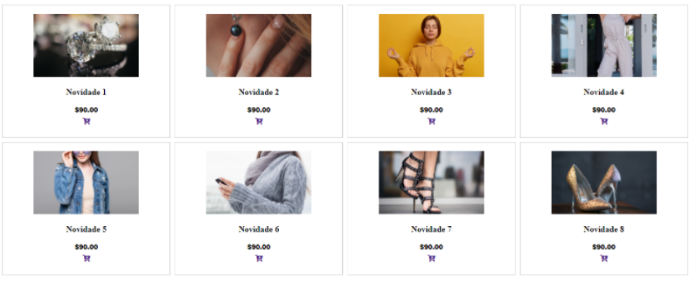
CATALOGUE

Slide 3
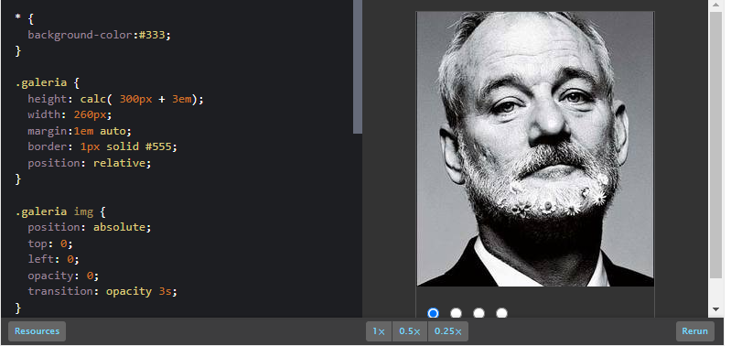
EXAMPLES

Slide 4


TECHNOLOGIES

Slide 5

HOSTING AND DOMAIN

Slide 6

PROTOTYPE

Slide 7
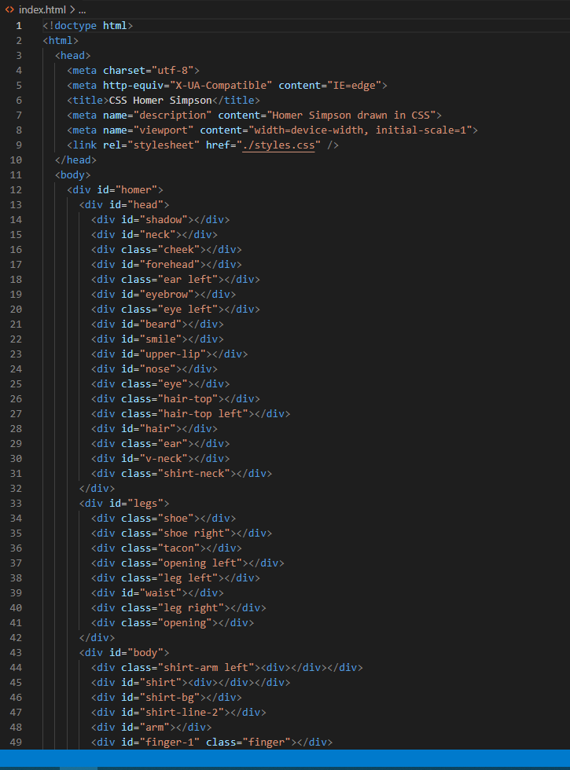
HTML SOURCE CODE

Slide 8
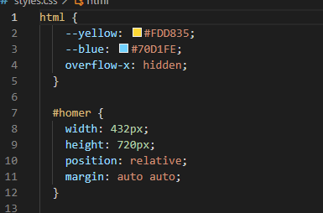
CSS SOURCE CODE

Slide 9

THE IMAGES CAN BE DOWNLOADED AND DISPLAYED

Slide 10

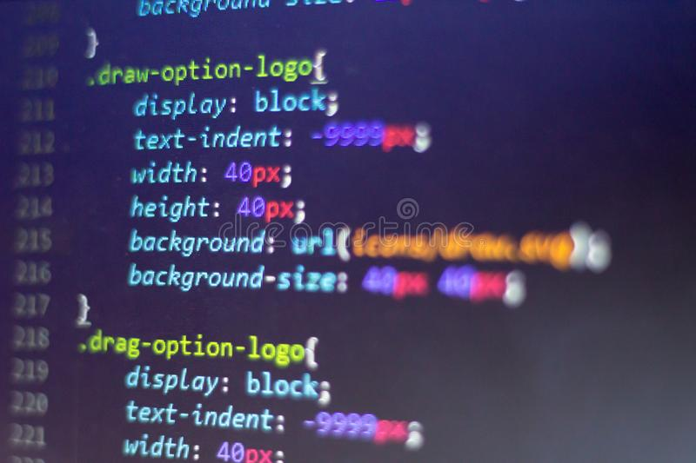
DOWNLOAD FORMATS IMAGES

Slide 11

ADMINISTRATOR ROLE

Slide 12

USER ROLE

Slide 13

FAVORITES SECTION

Slide 14

THANKS!!!

