Slide 1
Oscilloscope
Authors:
Bufu Mario
Bolfa Larisa
-AES 1st year-
Coordinator:
Prof.Mirsu Radu
-2019-

Slide 2
Content
Project scope and objectives
Hardware
Experimental results
Annexes
5.1. Source Code-Code Composer
5.2. Source Code-Processing
6. Bibliography

Slide 3
Project scope and objectives:
The purpose of this project is to simulate an oscilloscope using a TIVA board. The input signal will be transmitted from the PCB via USB to a PC, where it can be visualized real-time.

Slide 4
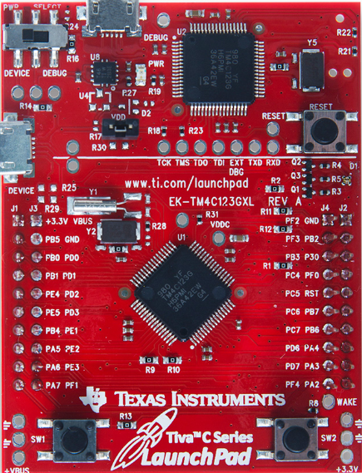
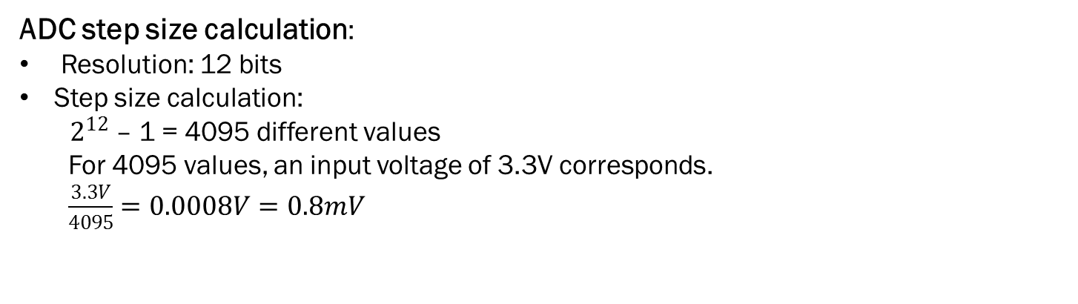
Hardware:
The hardware used is Tiva C Series TM4C123G.
Features of ADC modules:
12 shared analog input channels
12-bit precision ADC
Single-ended and differential-input configurations
Flexible trigger control: Controller (SW), Timers, Analog Comparators, PWM, GPIO
ADC step size calculation:
Resolution: 12 bits
Step size calculation:
${ 2}^{12}$ – 1 = 4095 different values
For 4095 values, an input voltage of 3.3V corresponds.
$\frac{3.3V}{4095}=0.0008V=0.8mV$

Slide 5
Experimental results

Slide 6
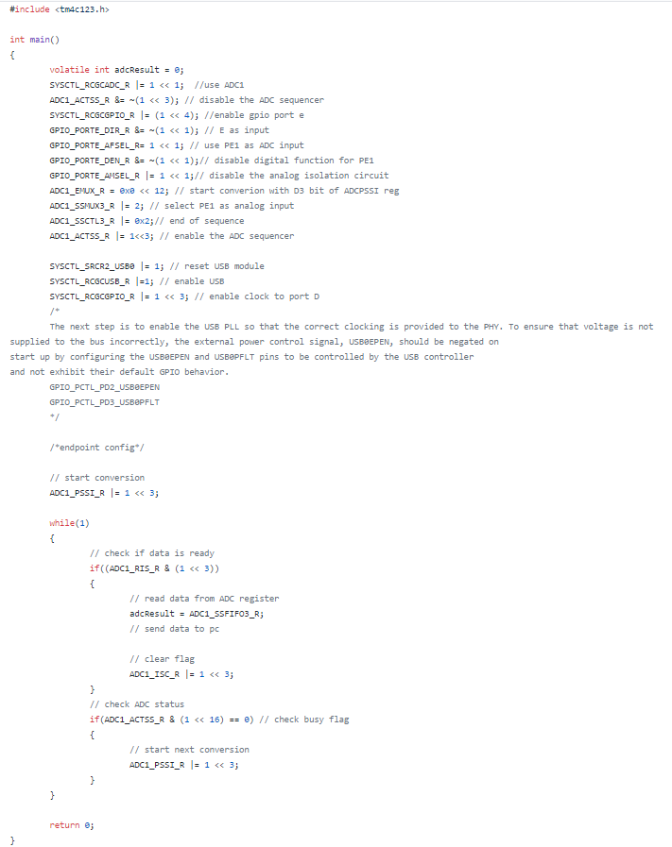
Annexes
Source Code – Code Composer

Slide 7
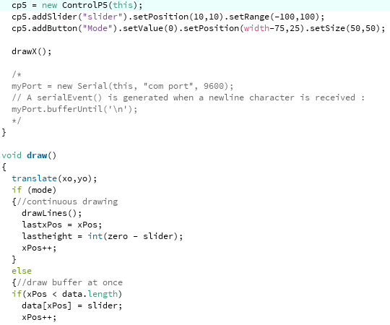
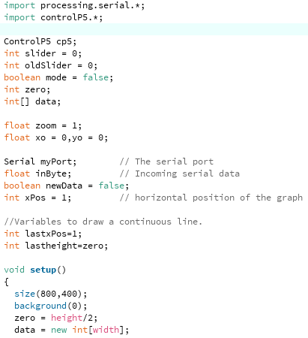
Annexes
2. Source Code – Processing

Slide 8
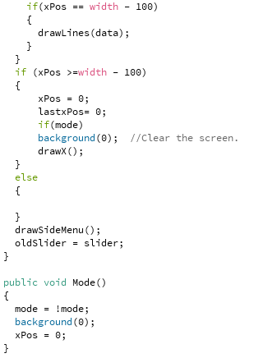
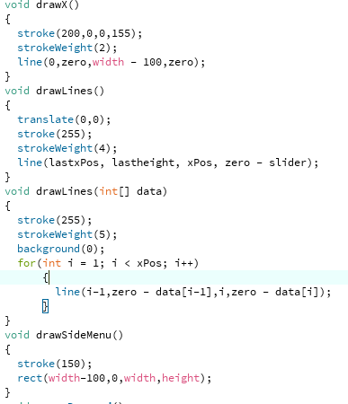

Slide 9
Bibliography
http://shukra.cedt.iisc.ernet.in/edwiki/EmSys:ADC_Programming_with_the_Tiva_TM4C123G
https://www.engr.colostate.edu/ECE251/Labs/TM4C_datasheet_ADC.pdf
https://processing.org/
https://sites.google.com/site/luiselectronicprojects/tutorials/tiva-tutorials/tiva-adc/understanding-the-tiva-adc

