Slide 1
Oscilloscope
Authors:
Bufu Mario
Bolfa Larisa
-AES 1st year-
Coordinator:
Prof.Mirsu Radu
-2019-

Slide 2
Content
Project scope and objectives
Hardware platform
Experimental results
Conclusions
Annexes
5.1. Source Code-Code Composer
5.2. Source Code-Processing
6. Bibliography

Slide 3
Project scope and objectives:
The purpose of this project is to simulate an oscilloscope using a TIVA board. The input signal will be transmitted from the PCB via USB to a PC, where it can be visualized real-time.

Slide 4
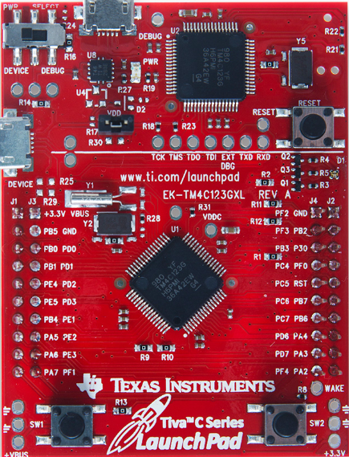
Hardware:
The hardware used is:
Tiva C Series TM4C123G

Slide 5
Experimental results

Slide 6
Conclusions

Slide 7
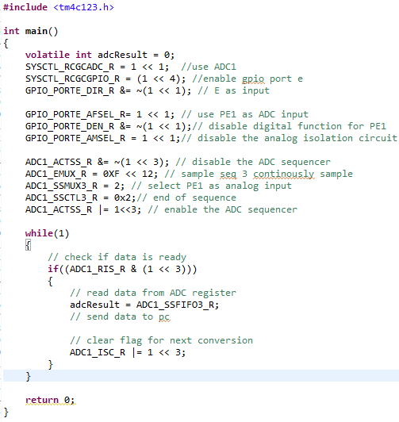
Annexes
Source Code – Code Composer

Slide 8
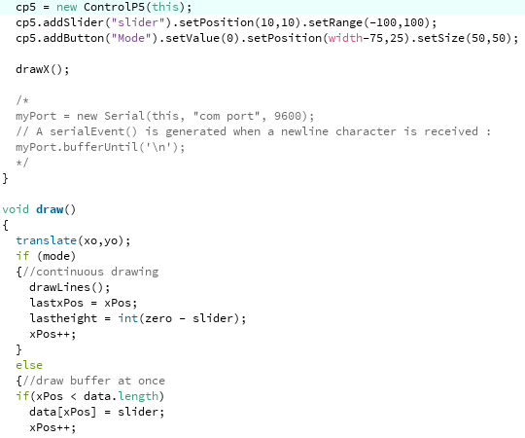
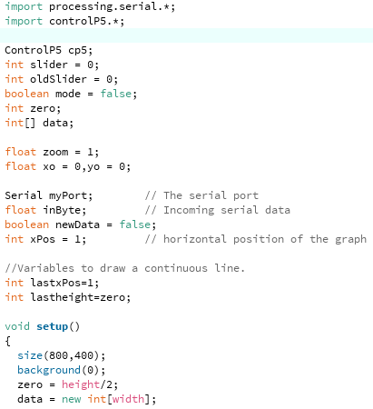
Annexes
2. Source Code – Processing

Slide 9
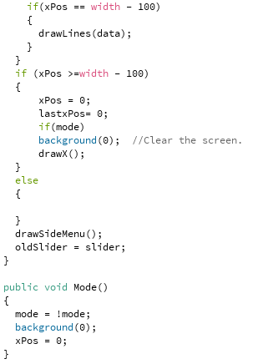
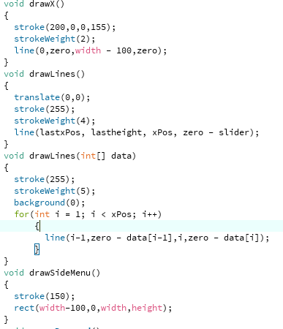

Slide 10
Bibliography
http://shukra.cedt.iisc.ernet.in/edwiki/EmSys:ADC_Programming_with_the_Tiva_TM4C123G
https://www.engr.colostate.edu/ECE251/Labs/TM4C_datasheet_ADC.pdf
https://processing.org/

