Slide 1
Configuration Management
Sicoe Oana-Maria
Universitatea Politehnica din Timişoara
Facultatea de Automatică şi Calculatoare

Slide 2

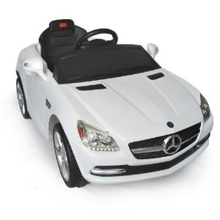
Proiect implementat:
Self driving/app-controlled car:

Slide 3
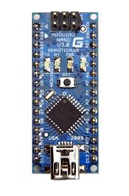
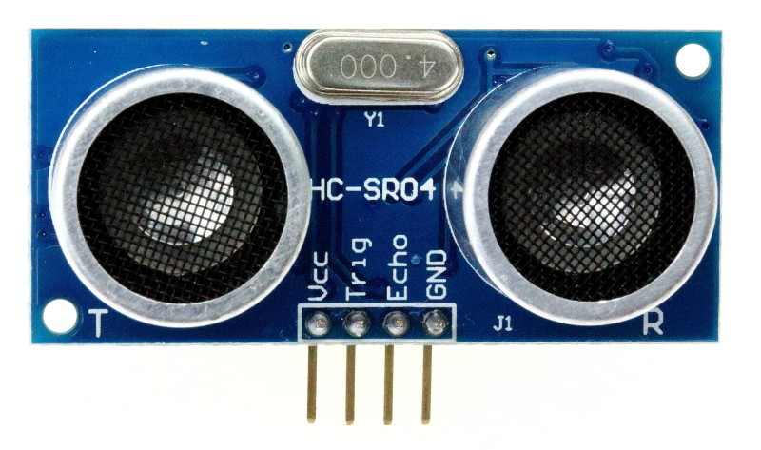
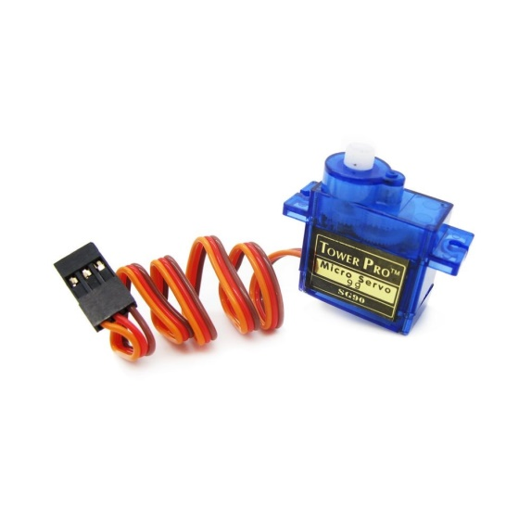
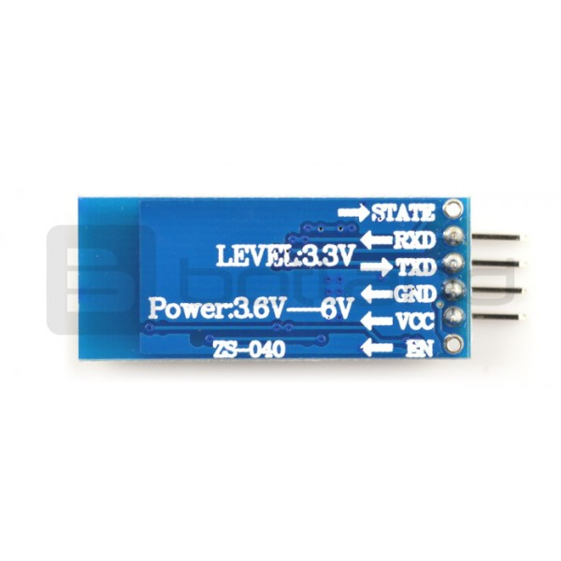
Requirements and specifications:

Slide 4
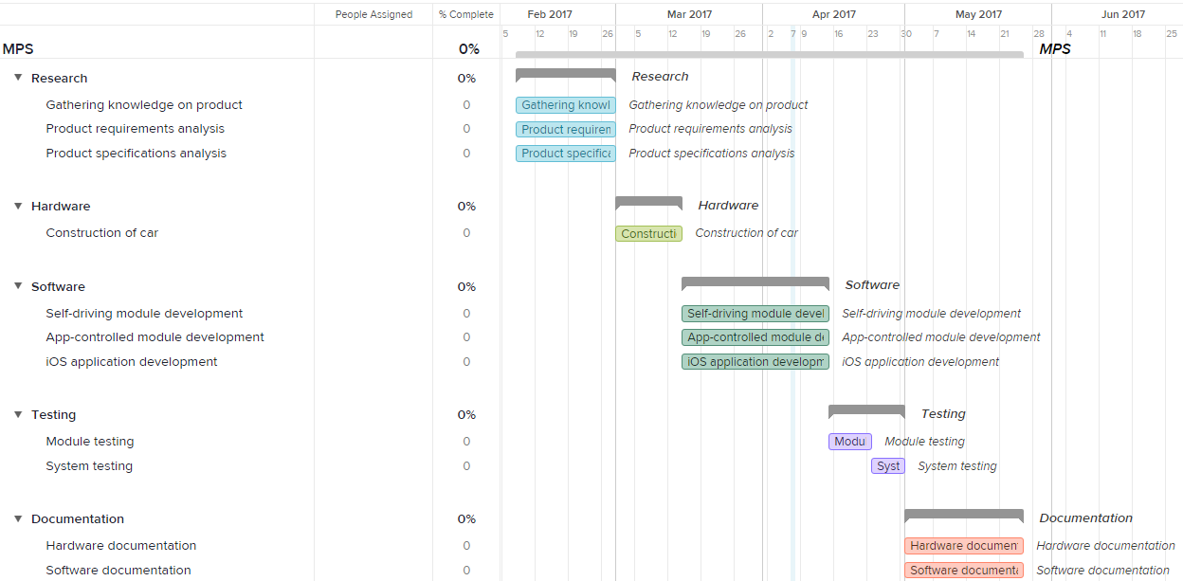
Gantt chart

Slide 5
Configuration management- Generalitati
Disciplines:
CM Planning and Management;
Configuration Identification;
Configuration Control;
Configuration Status Accounting;
Configuration Verification and Audit;

Slide 6


Contextul proiectului actual:

