Slide 1

HCI - Assignment n.2
Design and prototyping of an application using human-centered approach
Deliverable n. 1: Requirement Analysis
Project Title: TaskPad
Group: Mário Silva, Daniel Gomes, Luís Valentim
Lab Class: P6

Slide 2
Introduction
TaskPad
In Today’s Society, having the ability to do multitasking is fundamental.
However,not everyone can manage its personal tasks, the right way.
People have need to Scheduling activities and events.
Also there’s a need of noting down important tasks on the spot.
Simple Way to do All of This?

Slide 3
Project Objectives
TaskPad
Description
To-Do app that helps users easily keep track of different projects and tasks
Main Goals
Have a really small learning curve for beginners to start planning their life, personally and professionally.
Make it simple and straightforward to use.

Slide 4
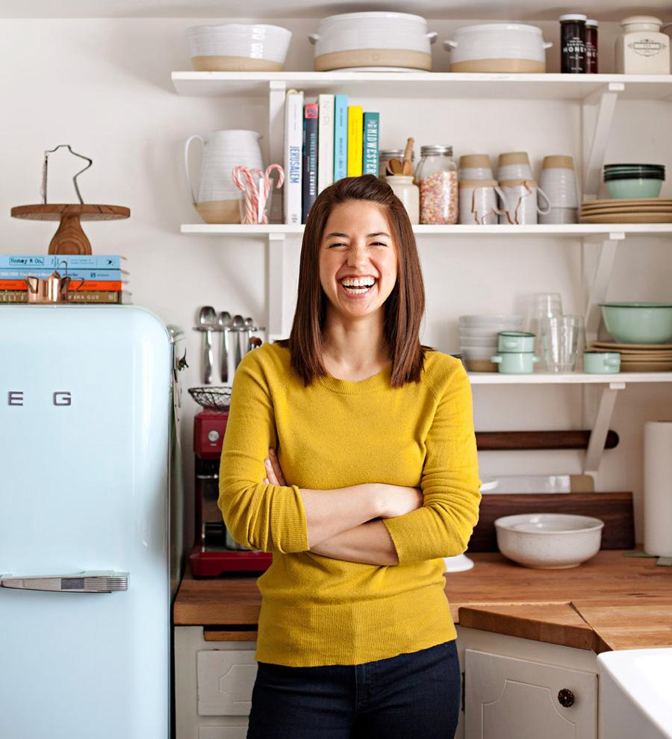
First Persona
TaskPad
Miriam Coelho
She is 25 years old
Recently majored in Economics
Starting her first job, unexperienced in leading team projects
Wants to be the best Team Leader she can be
Feels the need of something to help her organize all teams and the tasks of each one has to do.

Slide 5
Miriam’s Scenario
TaskPad
“Got assigned as a Team Leader for a project in the company she works and for that reason, she needs a way to assign tasks and manage all the members of the team. However Miriam doesn’t know much about tools that can help her do it.”

Slide 6
Miriam’s Tasks
TaskPad
Create Several Pages
Manage Members in a Page
Create topics per Page
Each Topic will have several tasks
Invite Team Members to collaborate

Slide 7

Second Persona
TaskPad
Leandro Silva
He is 20 years old
Studying Software Engineering
Easily forgets both shores and work tasks
Wants to be more productive and organized
Searching for a way to conciliate his main tasks, like university projects with the rest of his personal activities (playing videogames with his friends).

Slide 8
Leandro’s Scenario
TaskPad
“Leandro had a rough week at university due to all of the assignments he had thus he forgot to buy groceries and now has to order an expensive takeaway service. He definitely needs something to help him not forget his daily tasks and his university duties.”

Slide 9
Leandro’s Tasks
TaskPad
Set reminders
Add topic and tasks to it.
Easily access topics
Remove already done tasks.
Access a calendar to check every topic’s date
Share his personal page with friends

Slide 10
Non-Functional Requirements
TaskPad
Small learning curve
Simple naming features
The Design must be pleasant to the user, but minimalistic
Users should not commit many mistakes while doing their main tasks
Errors: Help users recover from their errors
Efficiency: users should reach their goals easily and quickly
Memorability: users might return to the interface after some time and start efficiently working with it right away

Slide 11
Functional Requirements
TaskPad
Have a personal page
Create projects pages
Invite people to pages
Create, change and delete topics and tasks of a page
Have a due date for each task
Easy to separate topics
Well adapted to mobile

