Slide 1

HCI - Assignment n.2
Design and prototyping of an application using human-centered approach
Deliverable n. 3: Application and Usability tests of the App for User Evaluation
Project Title: TaskPad
Group: Mário Silva, Daniel Gomes, Luís Valentim
Lab Class: P6

Slide 2
HCI - Assignment n.2
Usability Tests
Use Cases:
A - Create a page with the name “Uni Page”.
B - Invite the user “NewUser” to that page.
C - Create a topic called “IHC” and then add the task “ Make the prototype”.
D - Delete the page “Uni Page”.

Slide 3
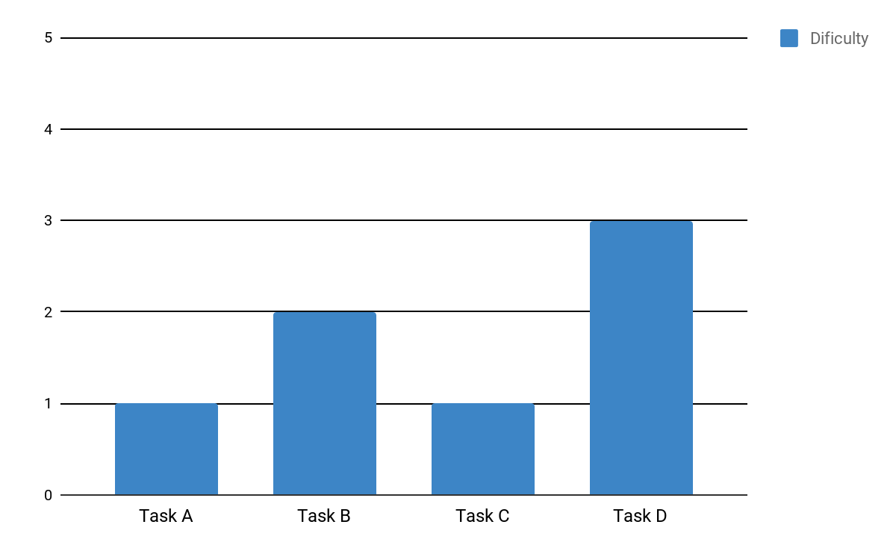
HCI - Assignment n.2
Usability Tests - Results

Slide 4
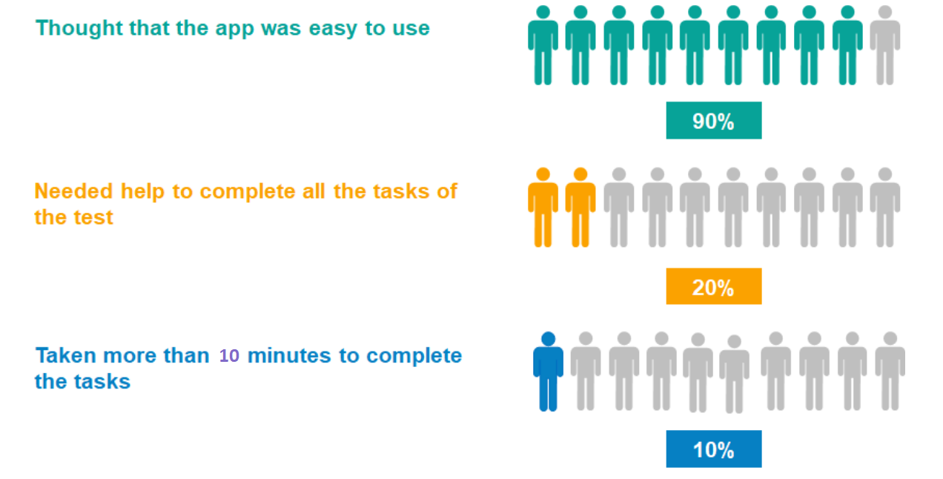
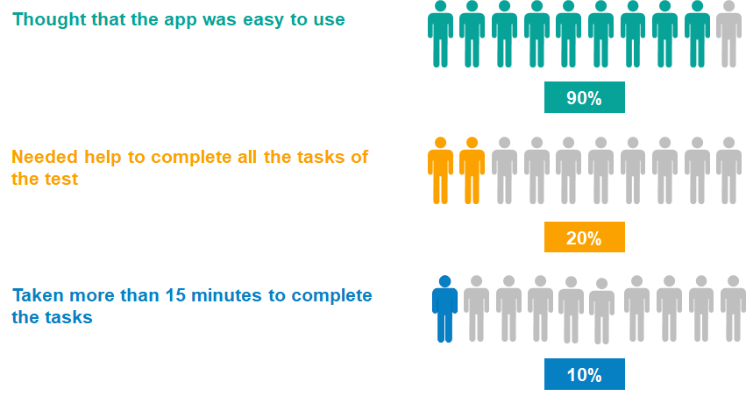
HCI - Assignment n.2
Usability Tests - Results

Slide 5
HCI - Assignment n.2
Post-Tasks Questionnaire
In order to check how “good” was the usability of our application, we created a questionnaire on Google Forms in which all participants submitted their opinion.
Link to the Form: https://docs.google.com/forms/d/1-OntuASs6jJhrHvjFhGf9v90KKvIhAVA5GSnT93-cj4/edit#responses

Slide 6
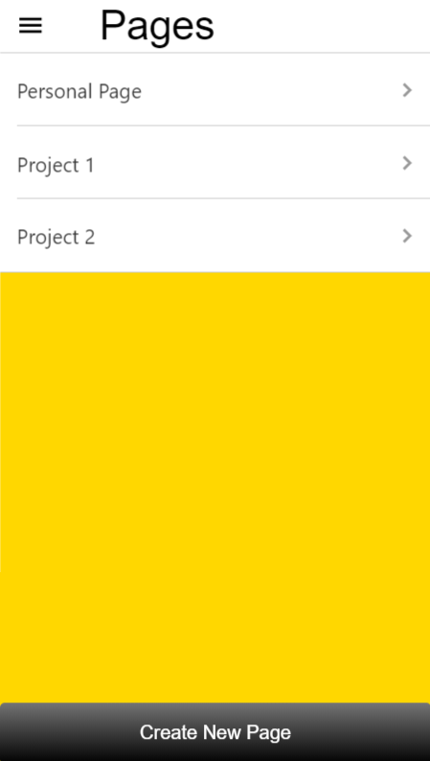
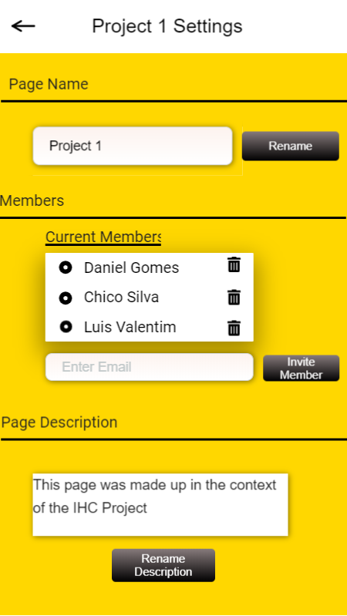
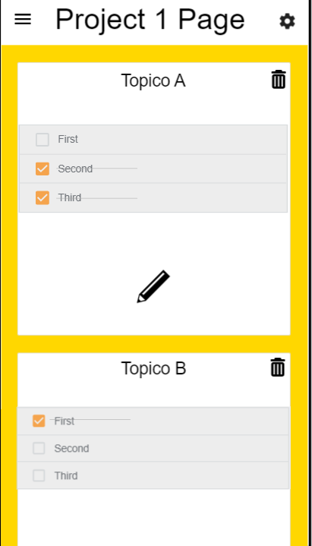
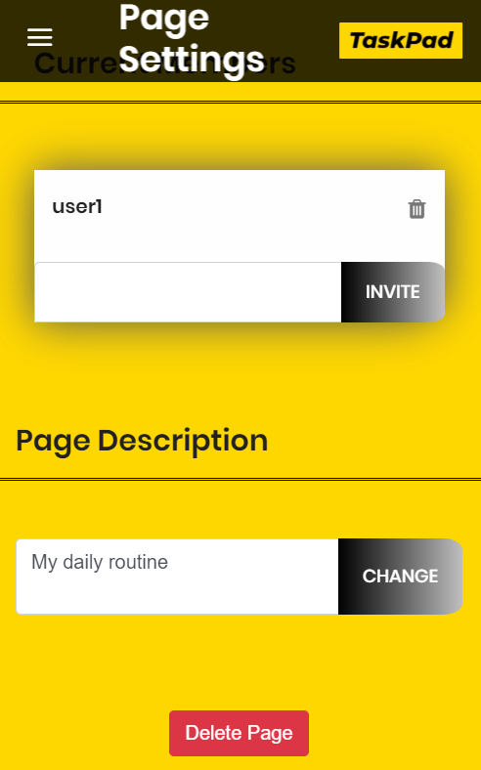
User Feedback
“Não existe a opção de remoção de páginas”
Antes
Depois

Slide 7
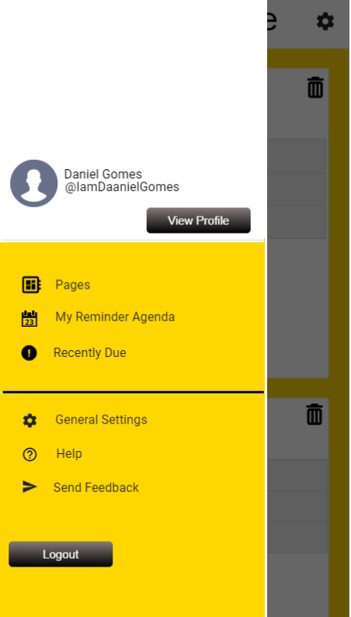
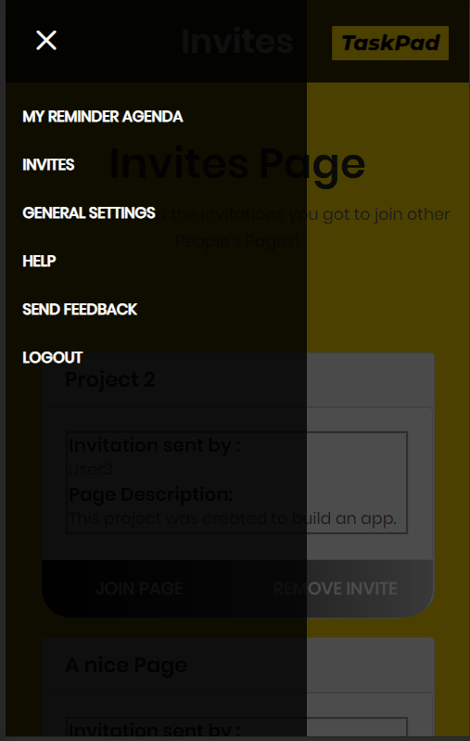
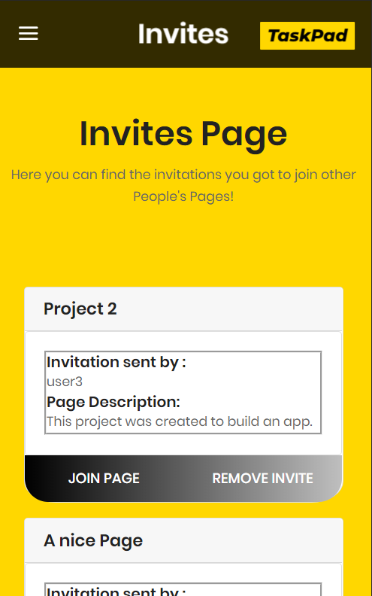
User Feedback
“Não dá para ver os convites que recebemos”
Antes
Depois

Slide 8
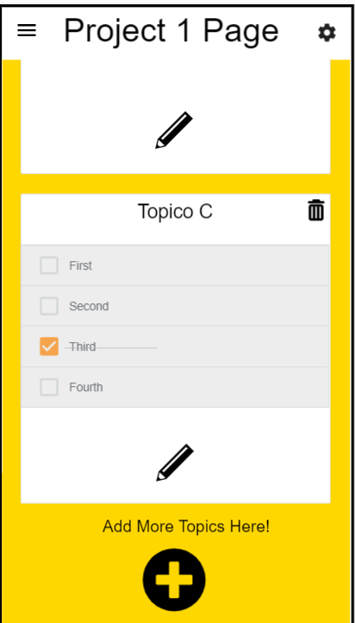
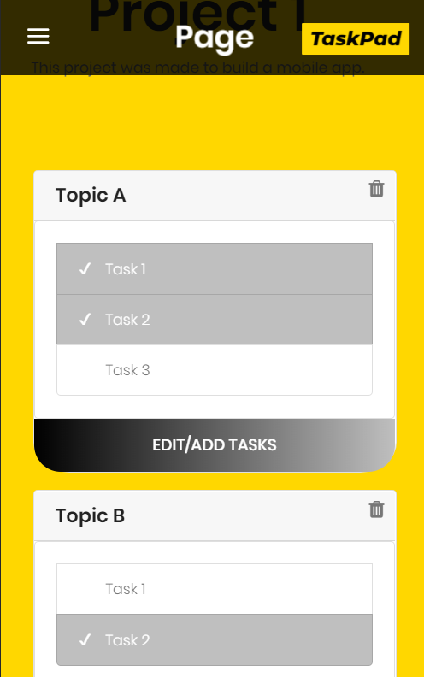
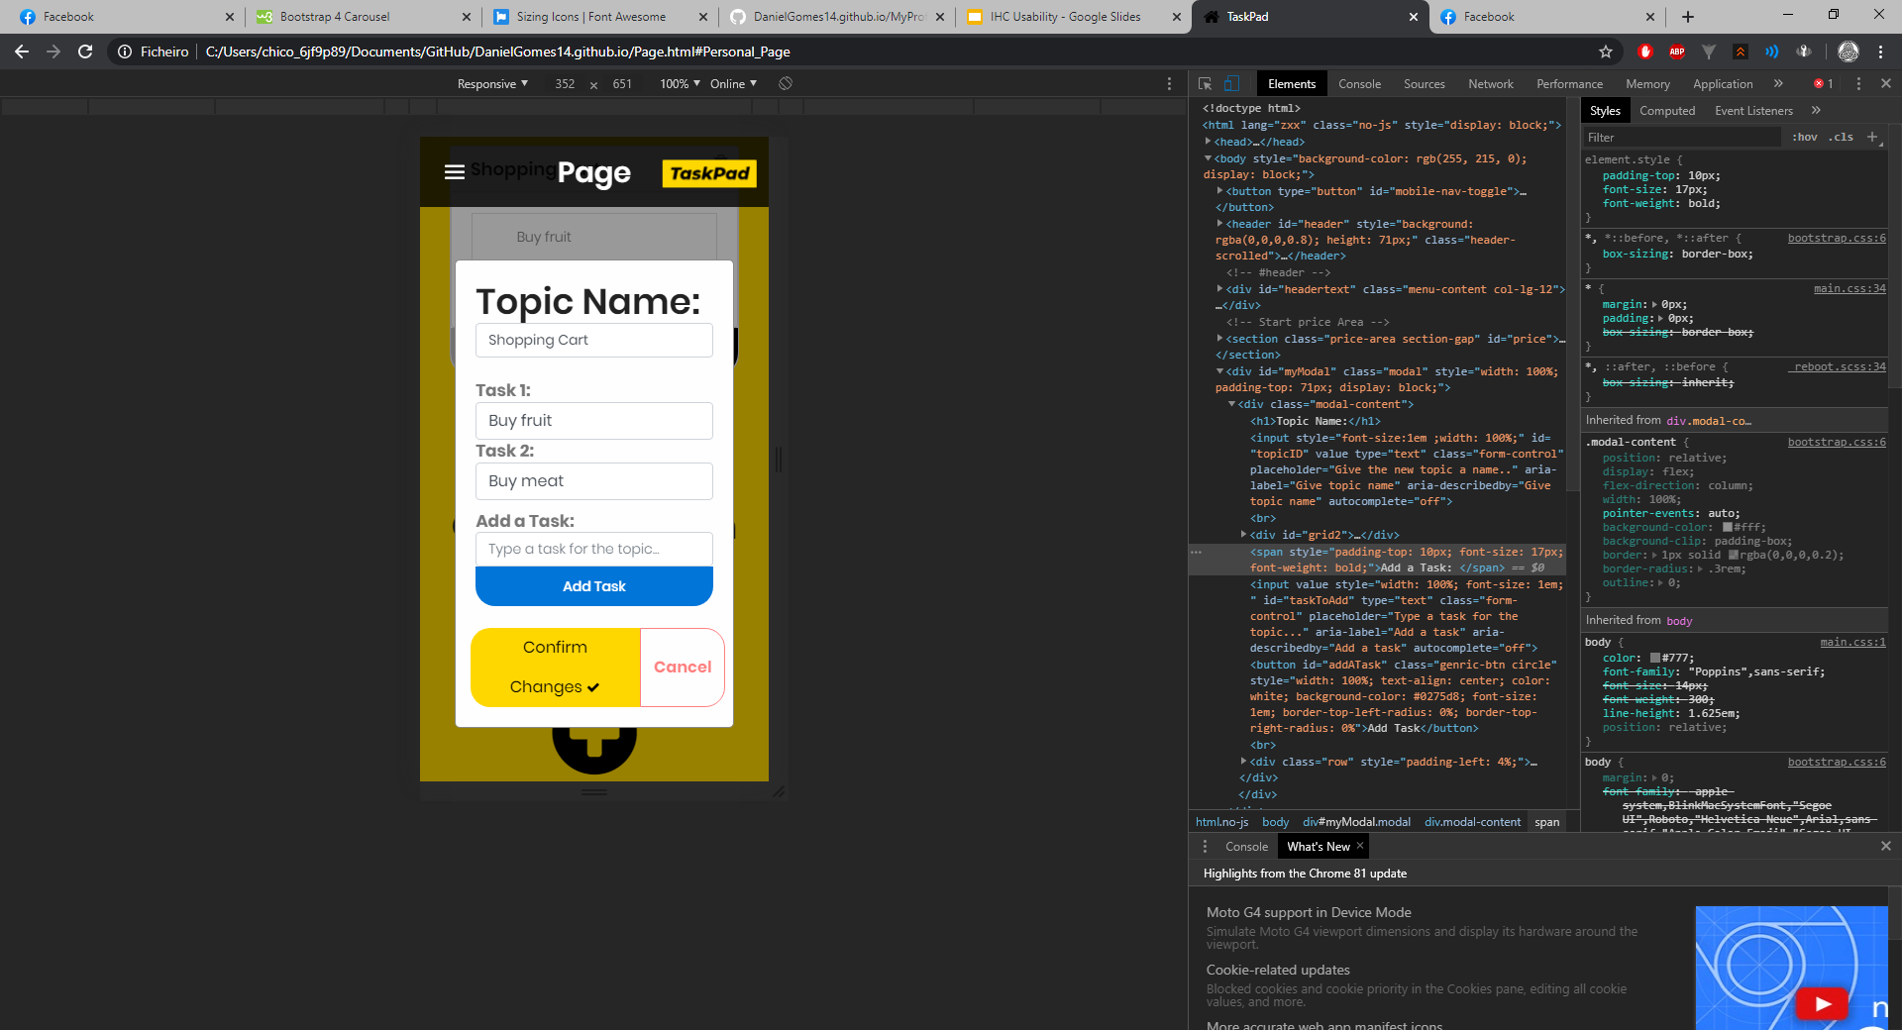
User Feedback
“Para adicionar tarefas é preciso pressionar no botão de editar o Tópico, o que não é explícito”
Antes
Depois

