Slide 1


What is Social Engineering?
MARIO GETAW
Getawm@wittenberg.edu

Slide 2
What Is It?
The method of manipulating, influencing, and tricking a target in order to gain access to a system or sensitive data
Common methods include phishing, spam, shoulder surfing, eavesdropping, typo catching, and many others
Phishing attacks are often for quick and easy financial gains, but they can also be used in large-scale attacks on big conglomerates
Facebook and Google - $100 million
Notes:
Emphasize to audience phishing is highlighted because that is what the presentation will focus on.

Slide 3
Why Are These Attacks So Effective?
Phishing attacks are so effective because they take advantage of natural emotions and feelings that all humans have
Fear
Curiosity
Moral obligation
Ignorance
Phishing attacks often play the role of an authoritative figure to really instill these feelings into the victim

Slide 4
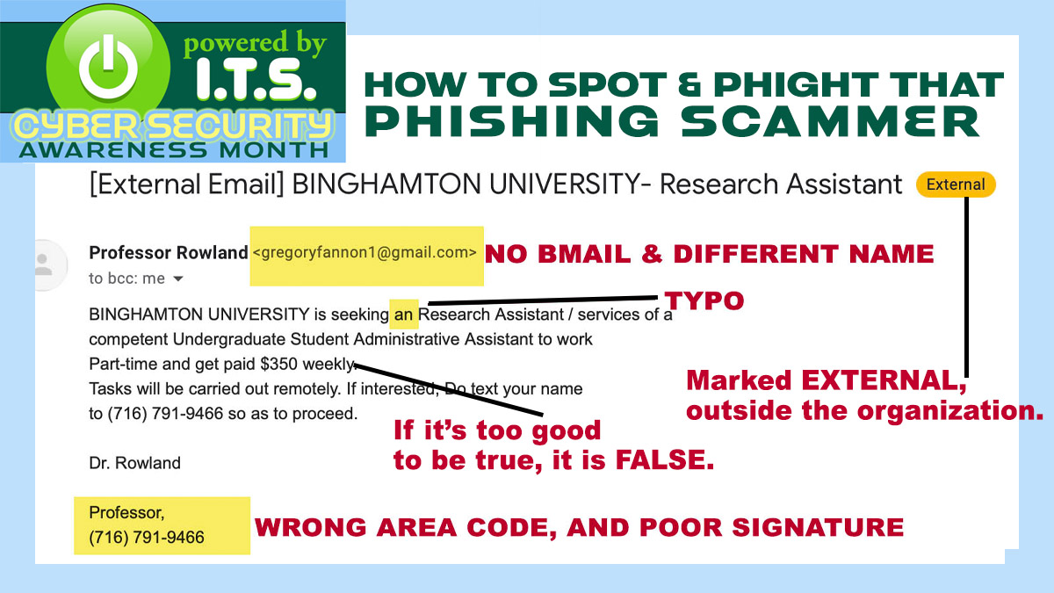
Examples
Notes:
BMAIL is a reference to Binghampton Email service for students offered thru gmail. Compare it to our “outlook” we wouldn’t get this type of request from someone not in our domain

Slide 5
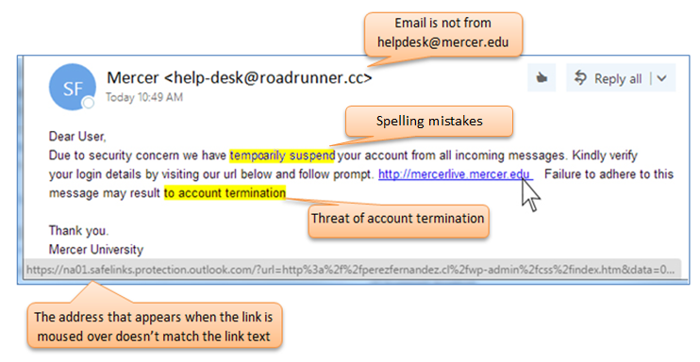
Notes:
Speak about typo catching and how threat agents can use this to gain access to very sensitive information such as bank login credentials (DNS cache poisoning)

Slide 6
Prevention
Become aware of the threat
Learn common tactics and plays on emotions (fear, ignorance, moral obligation, curiosity, etc.)
Monitor all accounts
Change passwords regularly
Never give out personal information via email
Be aware of suspicious URLs. Always inspect before clicking on one
Report any suspicions to a trusted authoritative figure

Slide 7
Works Cited
Salahdine, Fatima, and Naima Kaabouch. “Social Engineering Attacks: A Survey.” Future Internet, vol. 11, no. 4, Apr. 2019, p. 89. Crossref, https://doi.org/10.3390/fi11040089.
“What is Phishing?” Cisco.com, https://www.cisco.com/c/en/us/products/security/email-security/what- is-phishing.htmlPowered by TCPDF
Irwin, Luke. Oct. 2022, "The 5 Biggest Phishing Scans of All Time" https://www.itgovernance.eu/blog/en/the-5-biggest-phishing-scams-of-all-time
"Information Security: Phishing Examples", https://www.binghamton.edu/its/about/organization/information-security/phishing-examples.html
"Phishing", https://it.mercer.edu/student/security/phishing.htm

