Slide 1
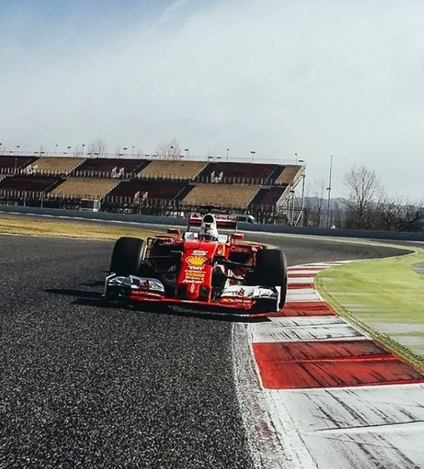


Slide 2
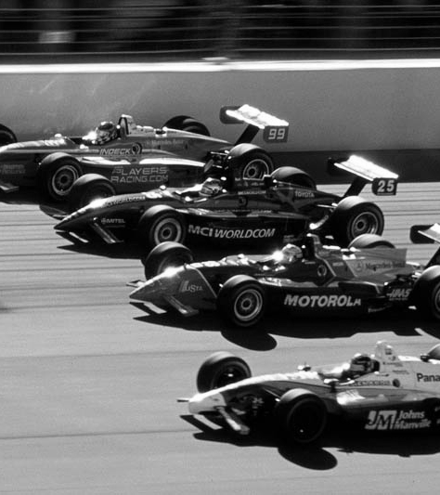
Champ Car World Series
Champ Car World Series Based on the famous car competitions that bear the same name of the game "Champ Car World Series" is a game in which the player has to move horizontally dodging other competitors and avoid colliding with them, the idea of the game is to stay as long as possible in the competition without colliding with another player.

Slide 3

Main Functionalities
Backlog Functionalities
The game initially tries to stay as long as possible in the competition, dodging the other competitors to avoid colliding with them.
- Implement player lives system
- Increased difficulty after a certain amount of time has passed.
- Speed acceleration by controls

Slide 4
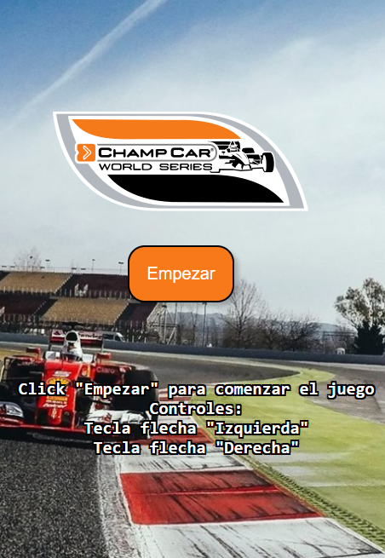
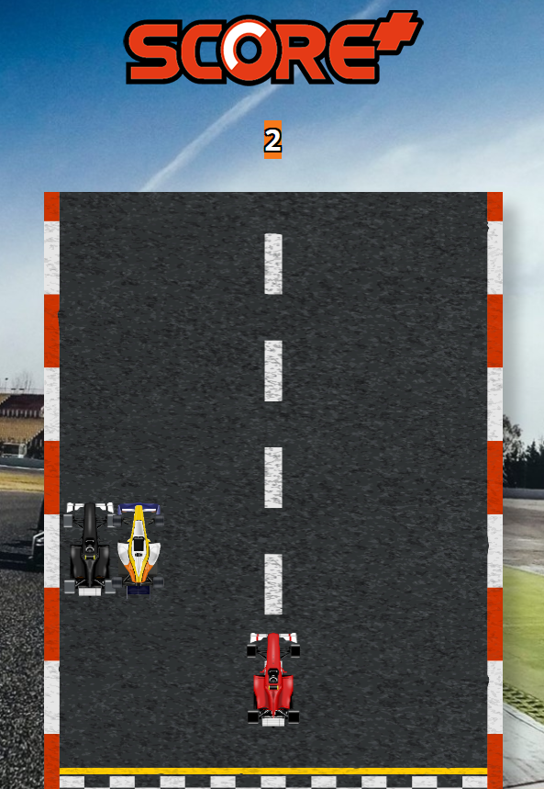
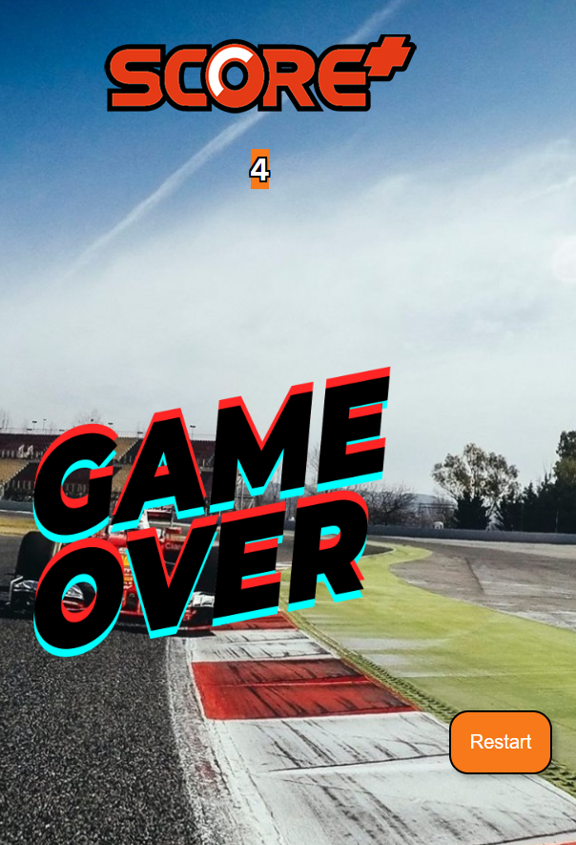

Slide 5
Challenges & Learnings
I can't always figure things out on my own. I often need help from others.
Visual understanding of what an object is and its classes and properties.

