Slide 1

Causes of Death
Mario GuardaDo​

Slide 2
Project flow
Retrieval of Relevant Datasets: Causes of death & GDP per Capita
EDA & Data Cleaning: Removal of empty rows and filling nulls using linear regression
Clean Data Manipulation: Uploading and merging of tables and creation of relevant fields
Visualizations: Creation of charts and maps to identify trends and patterns
Dashboard: Compilation of relevant visualizations to answer questions

Slide 3
Main Questions
Which are the leading causes of death in the world?
How do these causes of death vary over the last 30 years?
How do causes differ between high-income and low-income countries?
3

Slide 4
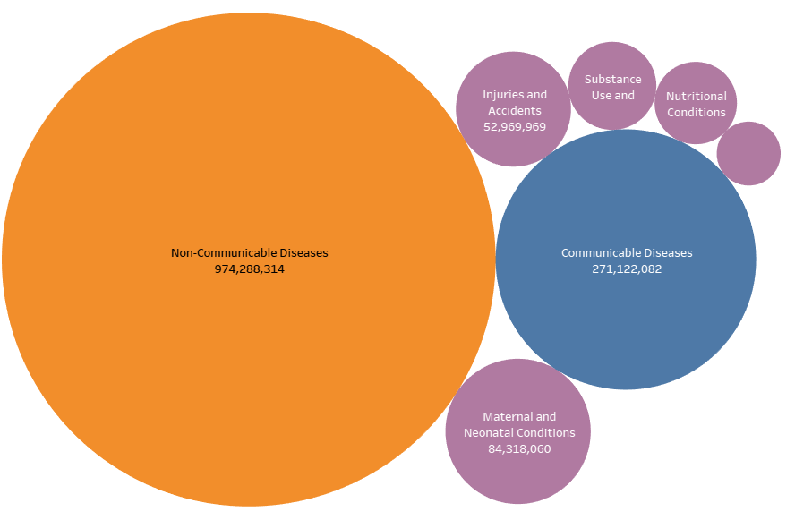

main causes of death in the last 30 years

Slide 5
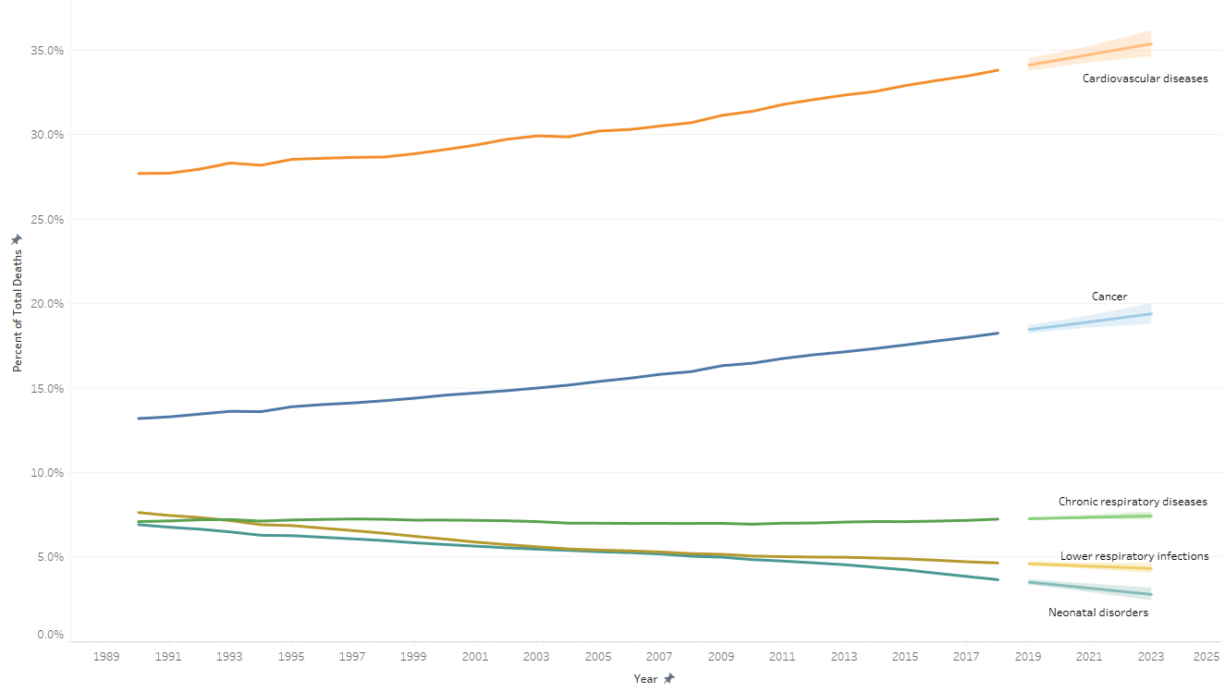
Trends of causes of death over time

Slide 6
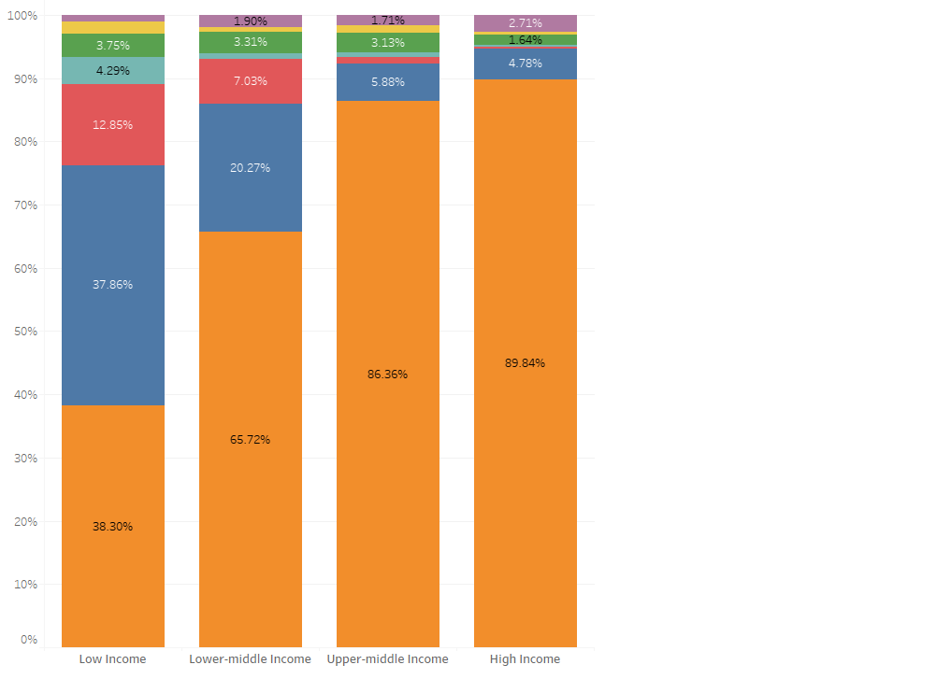
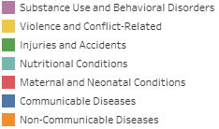
main causes of death By country income level

Slide 7
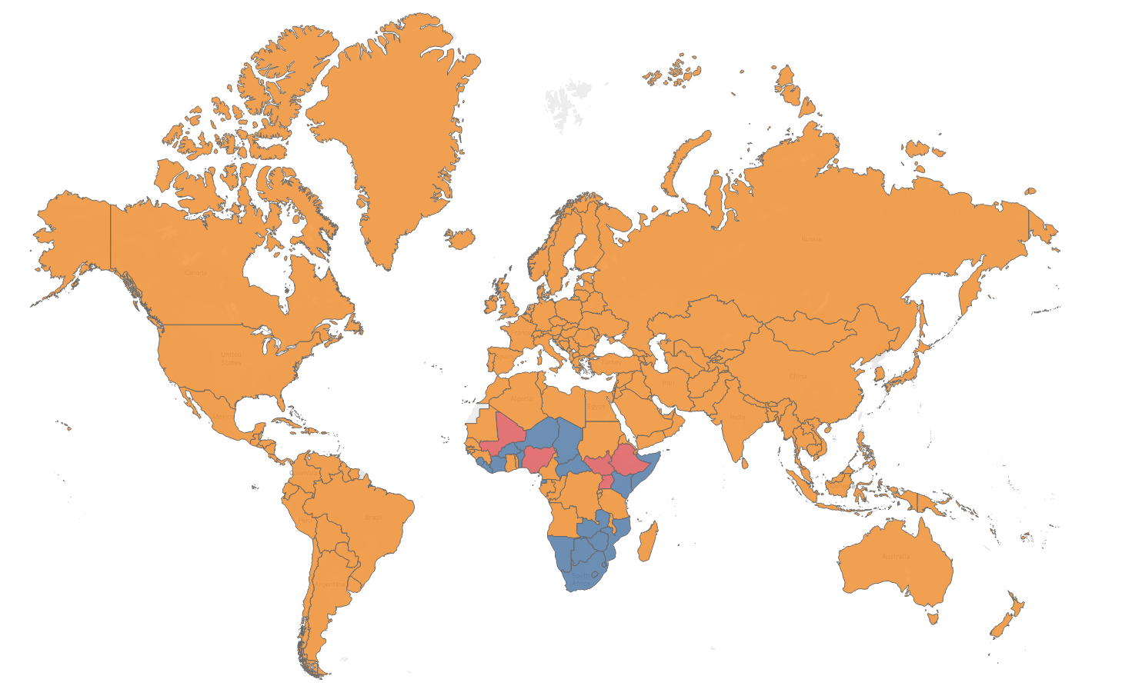

main causes by country in 2019

Slide 8
Summary
Non-communicable diseases, like Cardiovascular Disease and Cancer, are the leading causes of death worldwide, except in Sub-Saharan Africa.
Over time, the proportion of deaths due to Infectious Diseases, Maternal and Neonatal Conditions has decreased.
High-income countries have a much larger proportion of deaths due to Non-Communicable Diseases, Substance Use, and Behavioral Disorders than Low-income countries.

Slide 9

Thank you
Mario Guardado | linkedin.com/in/mario-guardado

