Slide 1
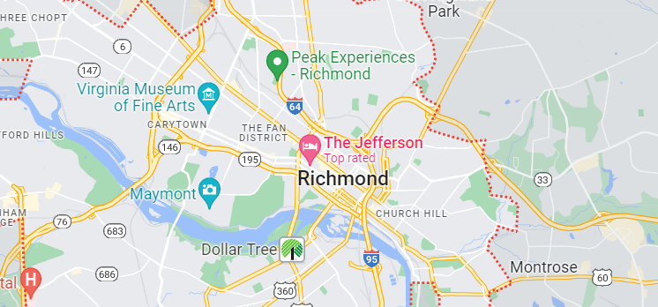
Statistical Modelling with Python
For the city of Richmond, Virginia

Slide 2

Project goals
To find meaningful correlations between public bike stations in the City of Richmond, Virginia, and the characteristics of businesses near them, by manipulating information about businesses and bike stations retrieved from online APIs.

Slide 3
Project Process
1. Creation of Yelp and Foursquare user accounts.
2. Retrieving relevant information about bike stations and businesses close to them.
3. Performing EDA and cleaning of the data retrieved from APIs.
4. Creation of a database containing all the cleaned information.
5. Merging relevant information to create a working dataframe on which to perform statistical analysis and modelling.
6. Exploration of the resulting dataframe using data visualization techniques.
7. Construction of a Linear Regression model illustrating relationships between bike stations businesses around them.
8. Review of the output of the model and removal of irrelevant data to improve the predictive power of the model.

Slide 4
Project Results
Yelp returns around 4 times more results than Foursquare, and also returns the user rating and 'price' level of each business, making Yelp a much better option for statistical modelling.
Of all the available business characteristics, only the number of Yelp reviews has any significant correlation to the total number of bikes in the nearest bike station. However, the predictive power of the model is minimal. (Adj. Rsquared=0.008)

Slide 5
Project challenges
Information retrieved from each APIs has different formatting, thus a different strategy is required to parse and convert each data set to a dataframe.
Correlation of each business to its nearest bike station was not available and required the use of search algorithms.
The task "Get the top 10 restaurants according to their rating" required the categorization of each venue into categories like 'Restaurant', 'Bar', 'Museum', etc. A very time-consuming task, that required the assistance of AI

Slide 6
Future Goals
Obtaining data from additional sources/APIs to find more meaningful relationships and/or improve the predictive power of the current model.

Slide 7

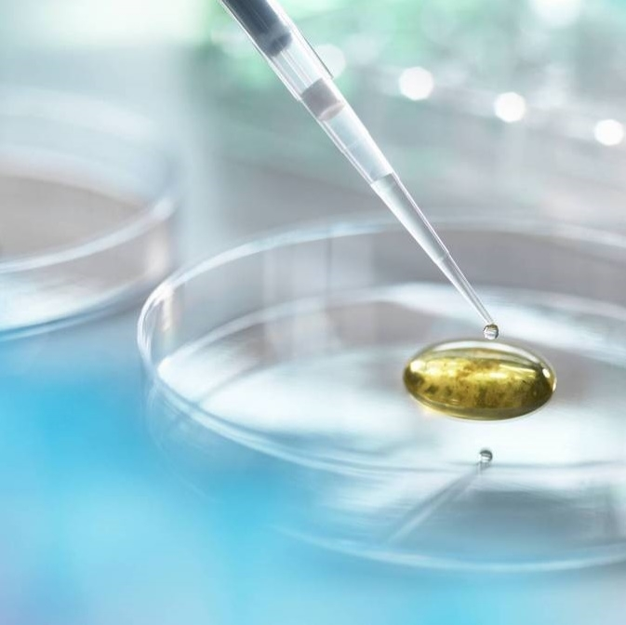
Thank you
Mario guardado​
linkedin.com/in/mario-guardado/

