Slide 1
AI AutoBot Trader
Project Completion Report (100%)
Author: Mario Hayden
Date: July 27, 2026
Overall Completion: 100%

Slide 2
Project Description
Automated algorithmic trading with ML and sentiment
Processes live and historical OHLCV (stocks + crypto) via Alpaca
Ingests financial news via Alpaca NewsClient and scores with VADER
Loads macro sentiment from a Kaggle-style CSV export
Uses Random Forest / XGBoost plus RSI, MACD, and ATR for signals
Executes trades with dynamic / fractional position sizing
Manages risk with broker-backed ATR trailing stop-losses
Includes Streamlit dashboard, scheduler, Docker, and deploy scripts

Slide 3
System Architecture
Async event-driven modular design
main.py
-> bot/trading_bot.py
data_pipeline.py (stock/crypto OHLCV)
news_sentiment.py (Alpaca News + VADER)
macro_sentiment.py (Kaggle CSV)
strategy_engine.py (ML signals)
allocation_engine.py (fractional sizing)
execution_client.py (orders + broker stops)
stream_client.py (stock/crypto WebSocket)
scheduler.py (trading windows)
connection_manager.py (retry / recovery)
dashboard_app.py (Streamlit UI)

Slide 4
Feature Completion (Part 1)
Core trading pipeline
Feature / Task | Done
Modular async bot architecture | 100%
Alpaca REST OHLCV pipeline | 100%
WebSocket live streaming | 100%
Technical indicators (RSI/MACD/ATR) | 100%
News sentiment (VADER + crypto aliases) | 100%
Macro sentiment (Kaggle CSV) | 100%
ML training and inference | 100%
Order execution and allocation | 100%

Slide 5
Feature Completion (Part 2)
UI, testing, crypto, and deployment
Feature / Task | Done
ATR trailing stops (broker + software) | 100%
Auto-start trading (AUTO_START) | 100%
Trading window scheduler | 100%
Streamlit dashboard UI | 100%
Live market prices | 100%
Manual buy/sell UI | 100%
Backtesting | 100%
Integration / unit tests | 100%
Crypto OHLCV support | 100%
Production deployment | 100%
OVERALL PROJECT | 100%

Slide 6
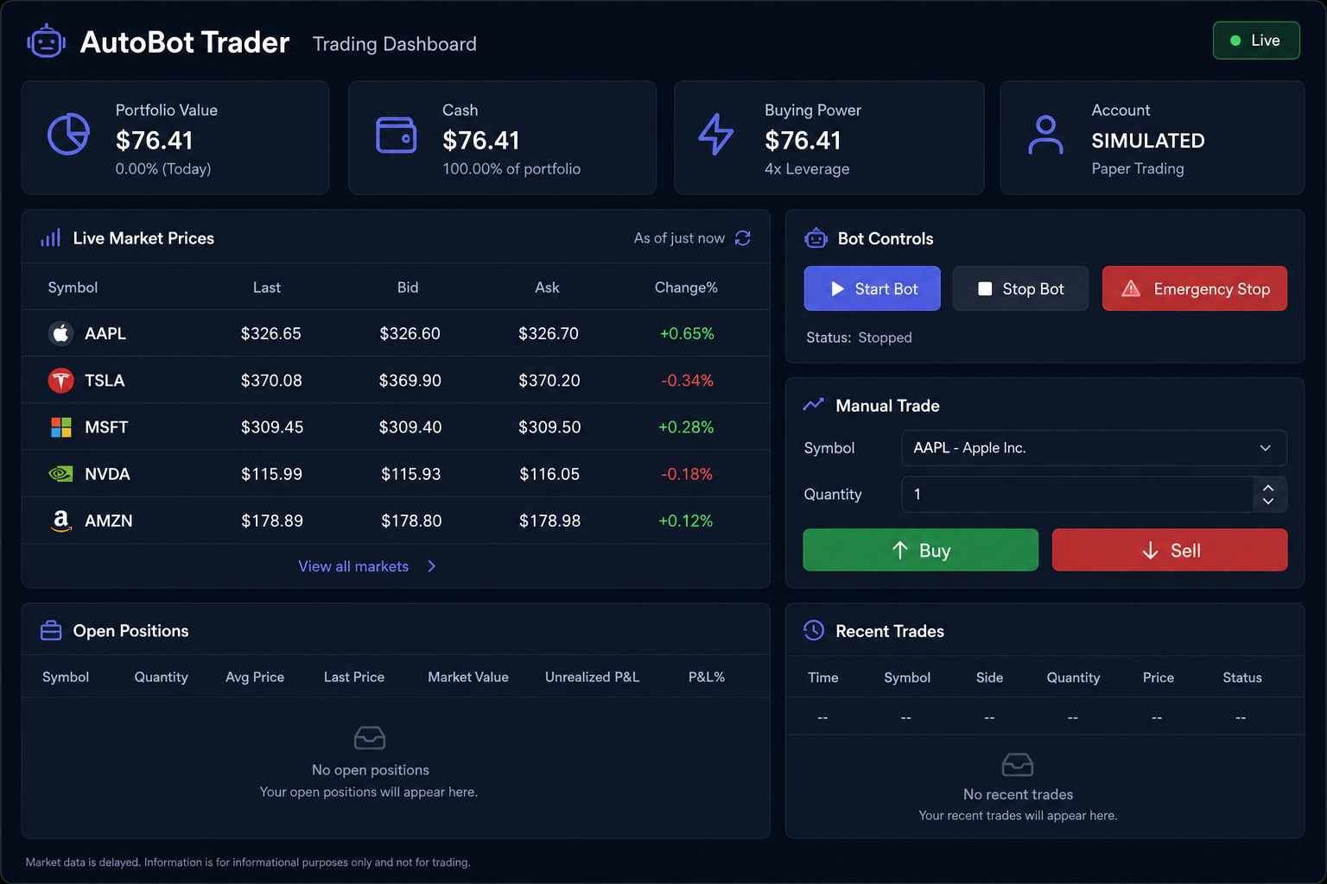
User Interface Screenshot
Streamlit dashboard with live prices and manual trade

Slide 7
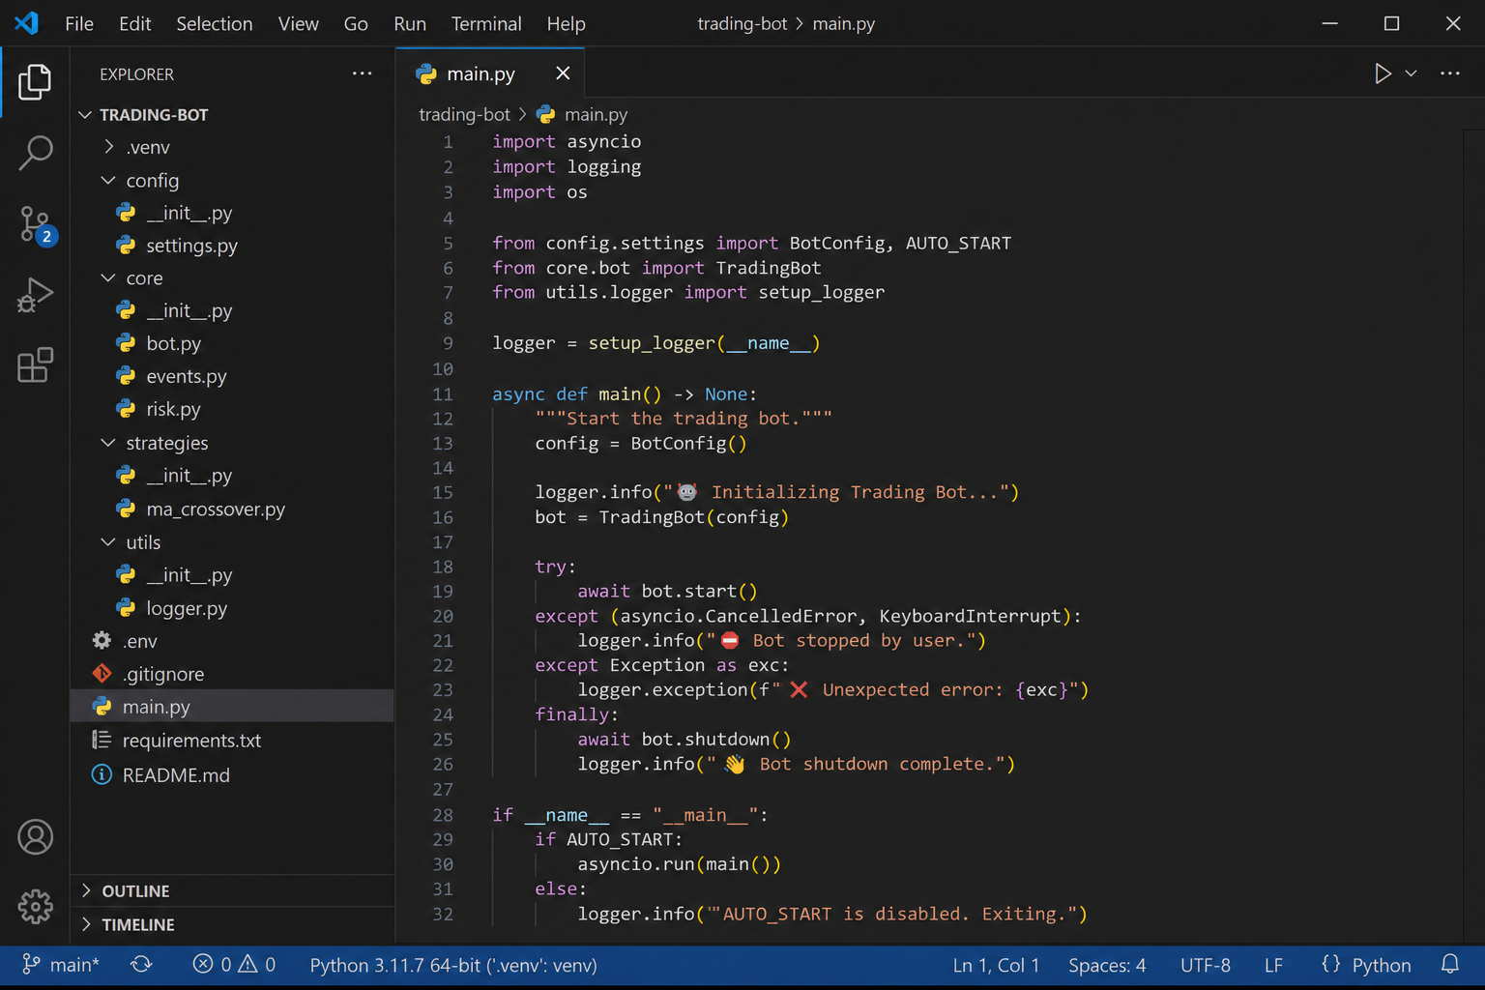
Code Screenshot
main.py - schedule-aware auto-start

Slide 8
Code Listing
bot/trading_bot.py - execution loop
async def execution_tick(self, symbol):
sentiment, macro = self._combined_sentiment(symbol)
frame = await self.data_pipeline.fetch_bars(symbol)
bar_state = self.data_pipeline.latest_bar_state(...)
signal = self.strategy_engine.evaluate(bar_state)
await self.execution_client.process_signal(signal, bar_state)

Slide 9
How the Bot Learns to Trade
Offline training, then live inference
1. Training (offline): python train_model.py reads train_data.csv
2. Features: RSI, MACD, and news/macro sentiment_score
3. Target: short-term price direction (up = 1, down = 0)
4. Model: Random Forest (default) or XGBoost → saved as model.pkl
5. Live trading: bot computes the same features and asks model.pkl for buy/sell/hold
6. Allocation sizes the order; ATR trailing stops manage risk
7. Fallback: if the model is missing, RSI/MACD rules still trade
Note: the bot does not auto-retrain after each trade — retrain manually to improve

Slide 10
Technology Stack
Frameworks and libraries used
alpaca-py - market data, news, and trading API
pandas / numpy - feature engineering
scikit-learn / XGBoost - ML direction classifier
pandas-ta - RSI, MACD, ATR (with pandas fallback)
pydantic - validated market and position schemas
vaderSentiment - news headline scoring
Streamlit - web dashboard UI
python-dotenv - secure API credential management
backtrader - historical strategy backtesting

Slide 11
Challenges Encountered
Problems faced and how they were resolved
Alpaca WebSocket connection limit when multiple instances ran
-> Fixed with REST polling and a reconnect circuit breaker
ML models overfit on historical data vs live markets
-> Added sentiment features and rule-based fallback
Fractional share orders rejected (GTC not allowed)
-> Switched fractional orders to DAY time-in-force
Windows wrote bot flag file with UTF-8 BOM
-> Built UTF-8-safe flag file reader/writer
pandas-ta broke on NumPy 2.x
-> Added pure-pandas indicator fallback

Slide 12
How to Run
Commands to verify the project
cd aiautobottrader
pip install -r requirements.txt
python train_model.py
python main.py
streamlit run dashboard_app.py
python test_bot.py
python backtest.py
docker compose up -d --build
Status: crypto, scheduler, Docker deploy, and broker ATR stops complete (100%)

Slide 13
Thank You
AI AutoBot Trader
Mario Hayden
100% Complete

