Slide 1
Time series project

Slide 2
Content
EDA
Models
Models used
Predictions Types
Metrics
APP

Slide 3
EDA

Slide 4
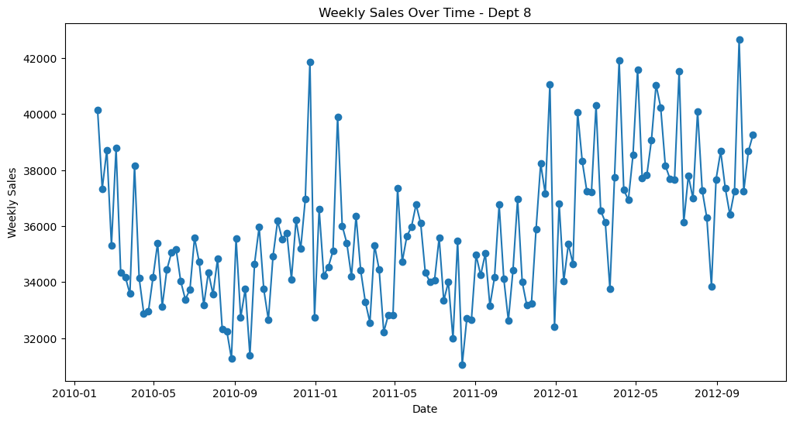
EDA

Slide 5
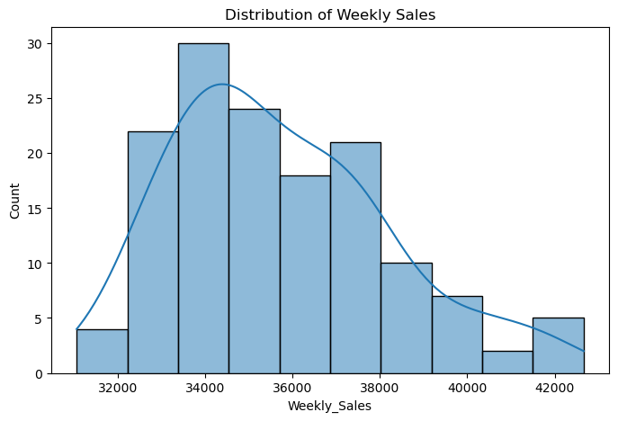
EDA

Slide 6
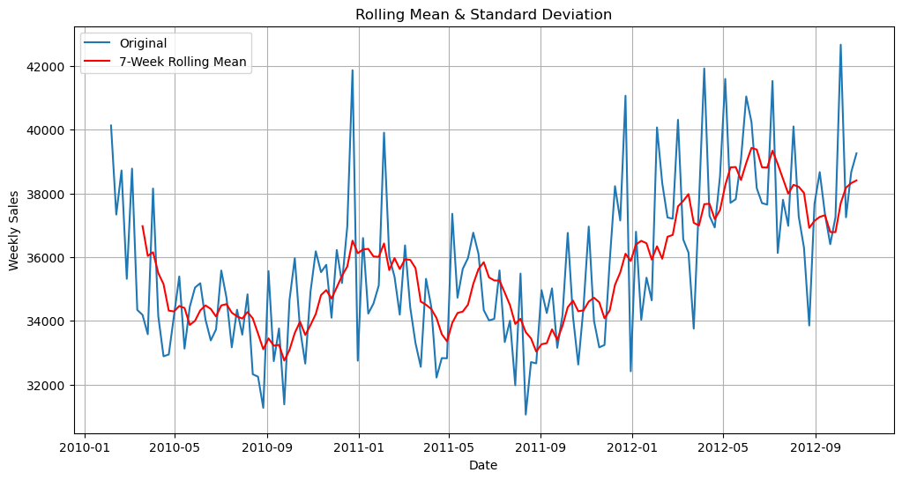
EDA

Slide 7
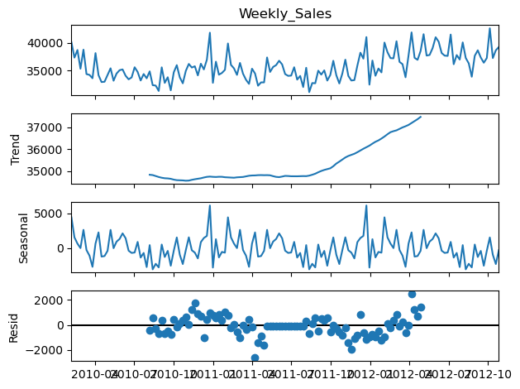
EDA

Slide 8
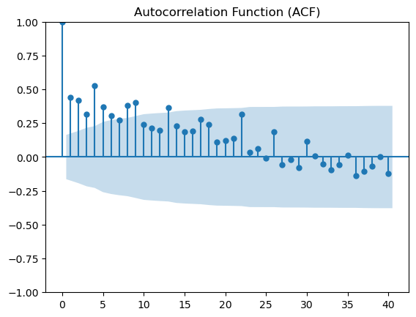
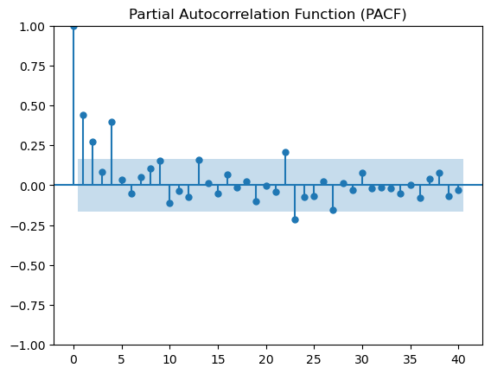
EDA

Slide 9
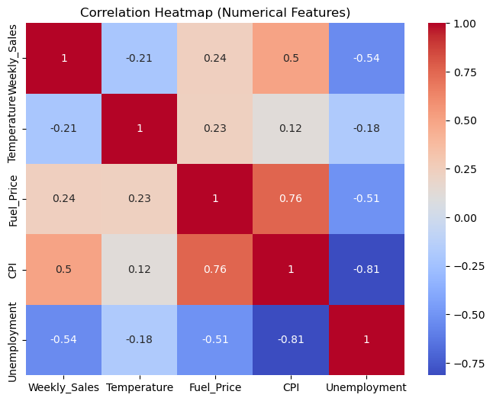
EDA

Slide 10
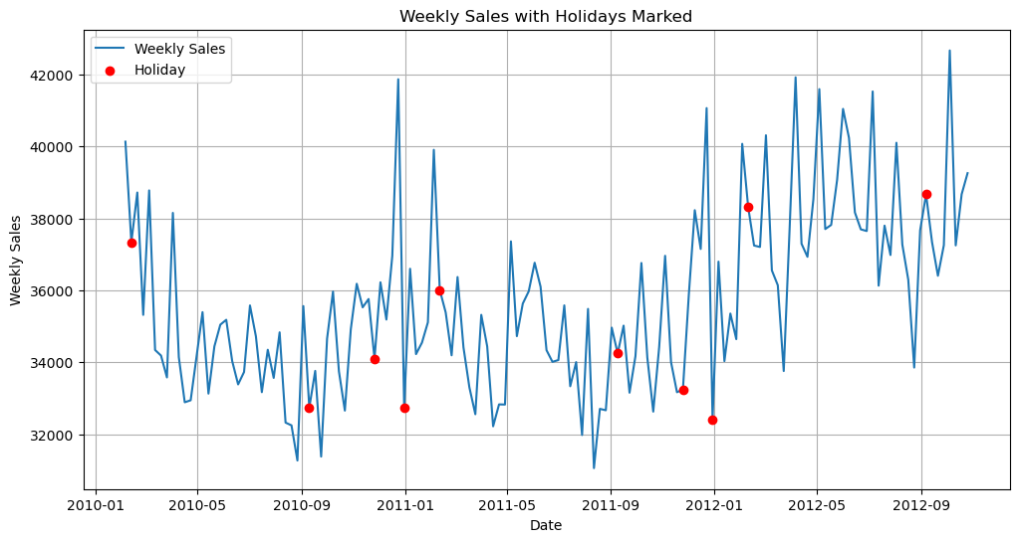
EDA

Slide 11
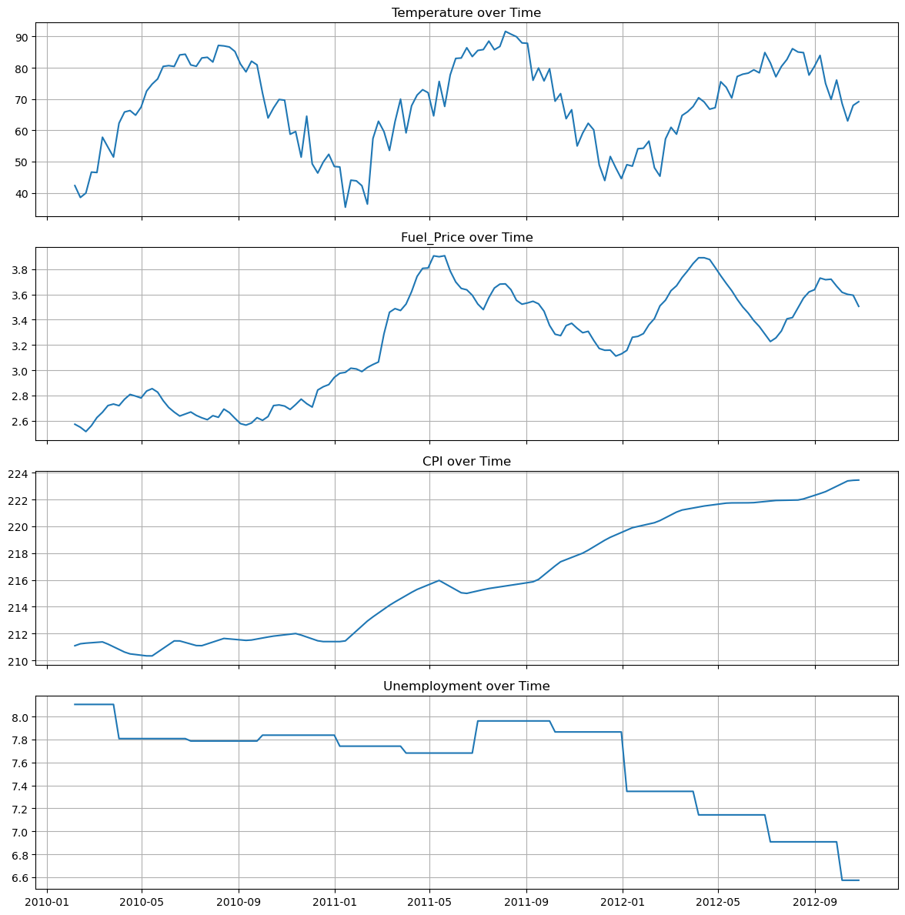
EDA

Slide 12
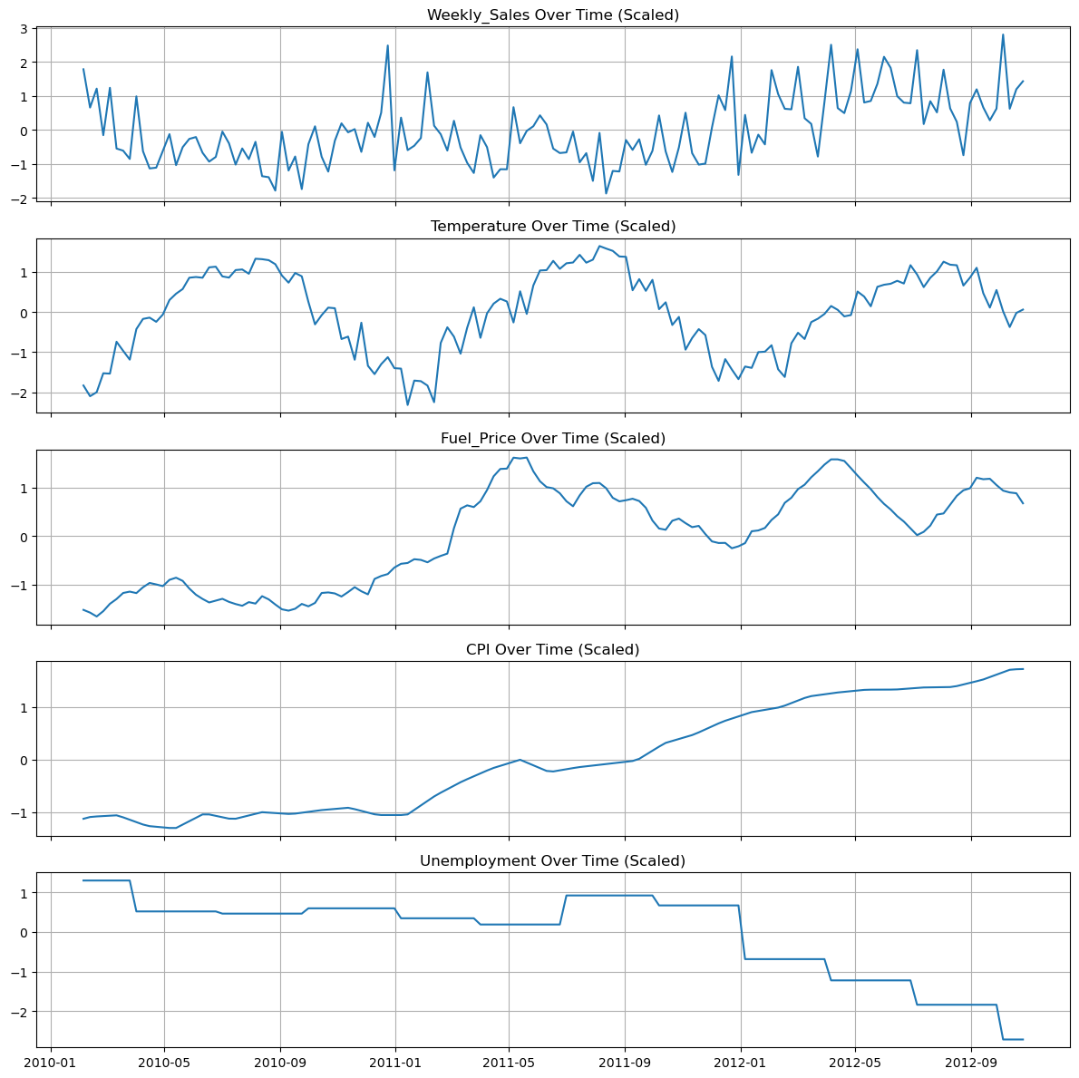
EDA

Slide 13
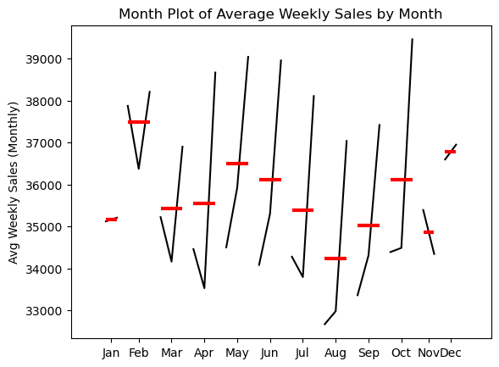
EDA

Slide 14
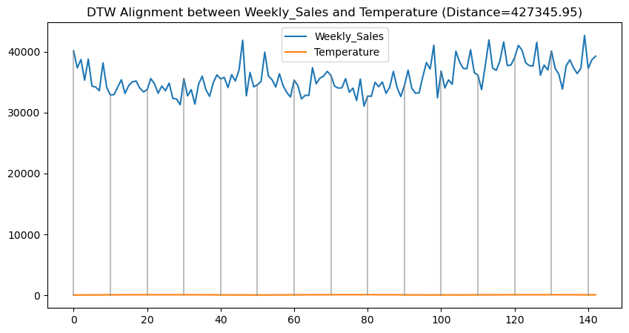
EDA

Slide 15
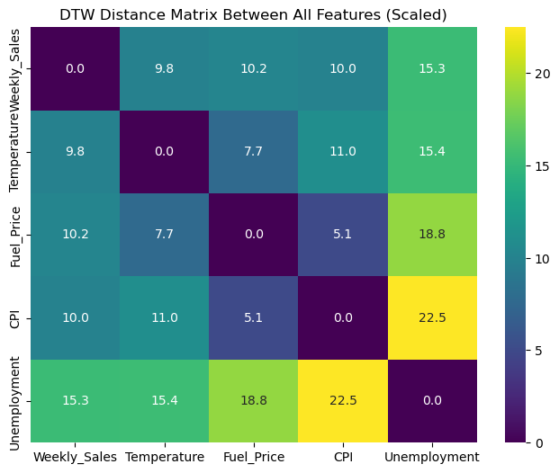
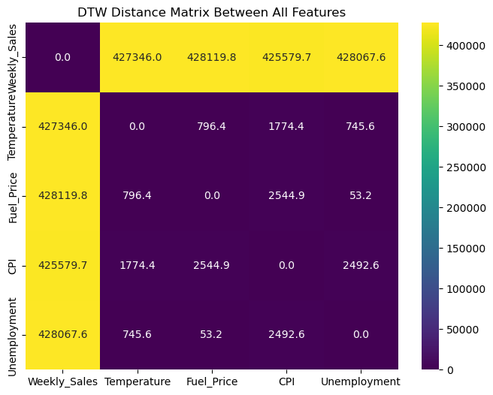
EDA

Slide 16
EDA

Slide 17
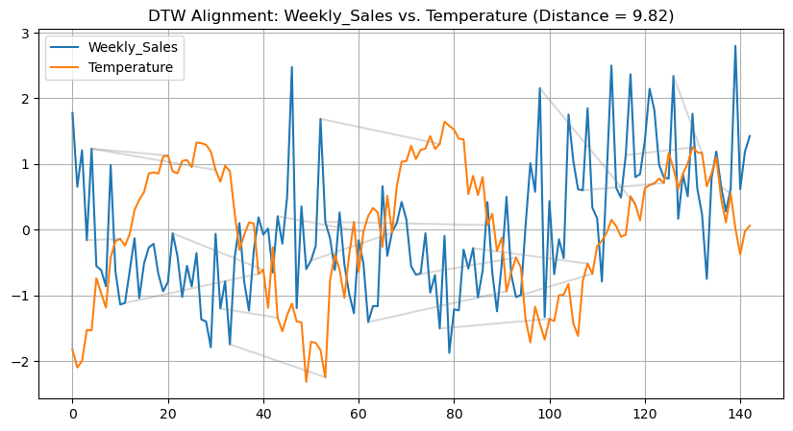
EDA

Slide 18
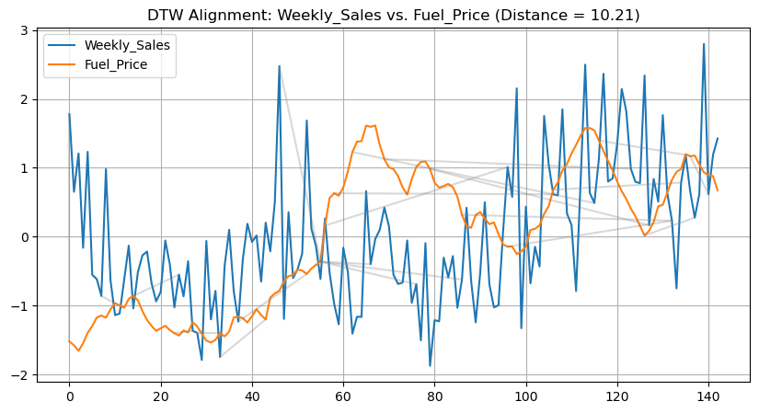
EDA

Slide 19
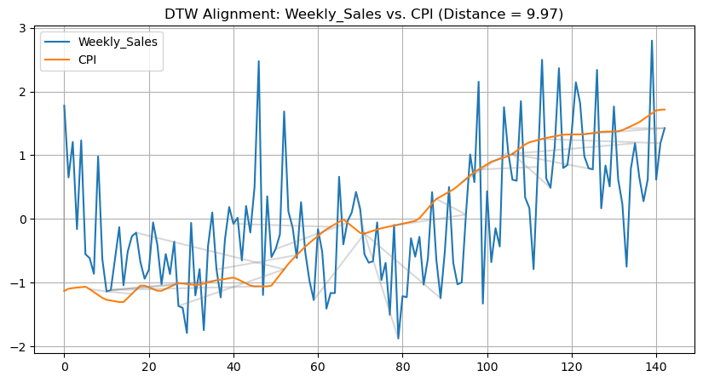
EDA

Slide 20
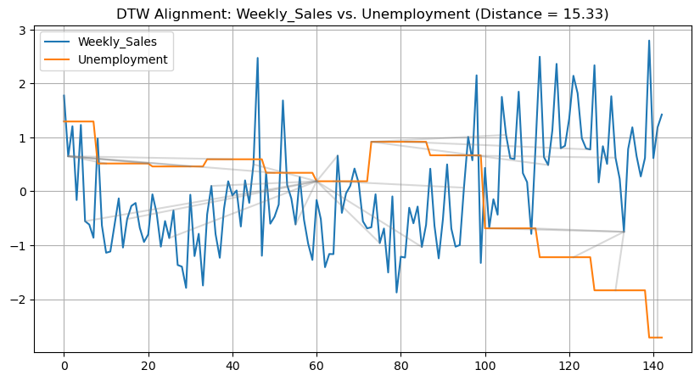
EDA

Slide 21
Models

Slide 22
Models Used
Statistics
ARIMA
SARIMA
SARIMAX
ML
XGBoost
RandomForest
DecisionTree
LinearRegression
DL
CNN
LSTM
RNN
GRU
ANN
FCN
CNN-LSTM
NBEATS

Slide 23
Prediction Type
All points
Recursive

Slide 24
Metrics
RMSE
MAE
MAPE
DTW

Slide 25
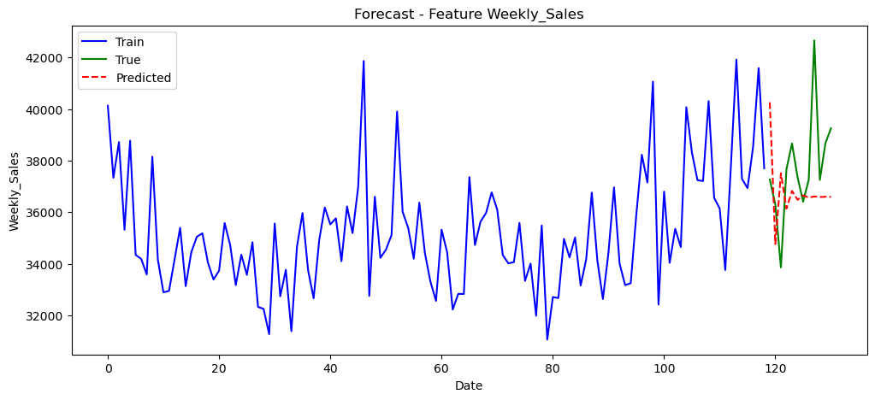
ARIMA

Slide 26
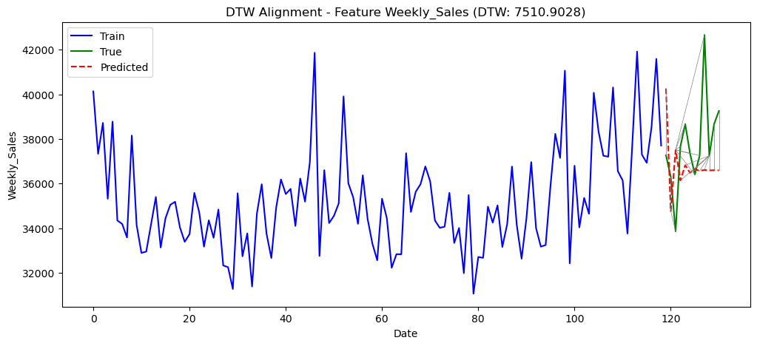
ARIMA

Slide 27
ARIMA
RMSE : 6678632.56836884
MAE : 2066.6489928077317
MAPE: 0.05401239630263602
DTW : 7510.902834948435

Slide 28
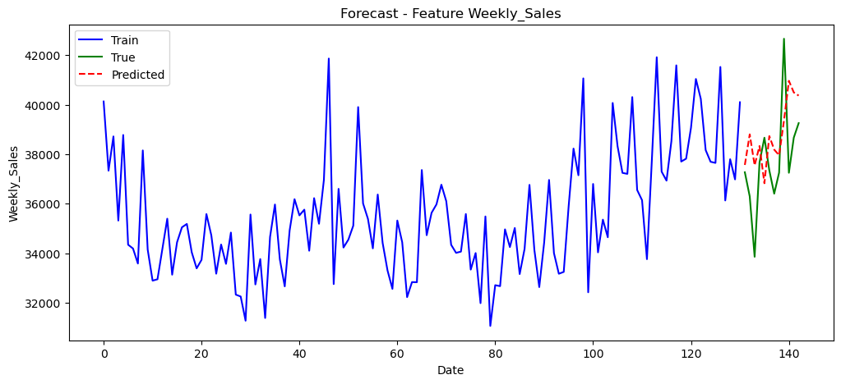
SARIMAX

Slide 29
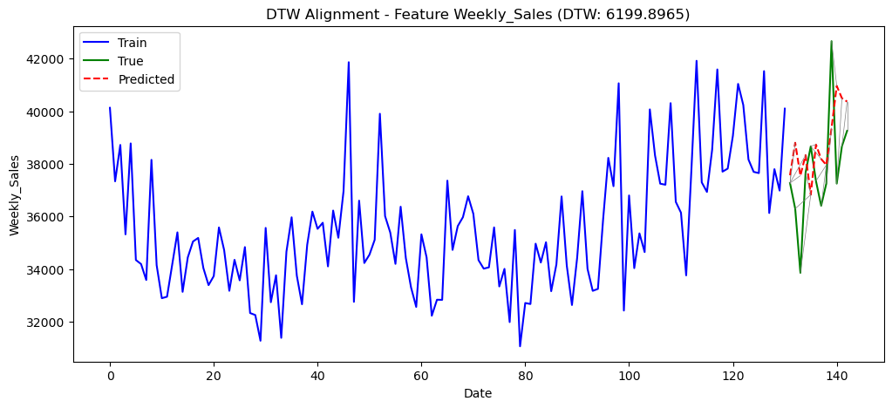
SARIMAX

Slide 30
SARIMAX
Results for SARIMAX: {'rmse': 4891228.637080251, 'mae': 1901.6965871250486, 'mape': 0.05073137800128114, 'dtw': 6199.896452893665}

Slide 31
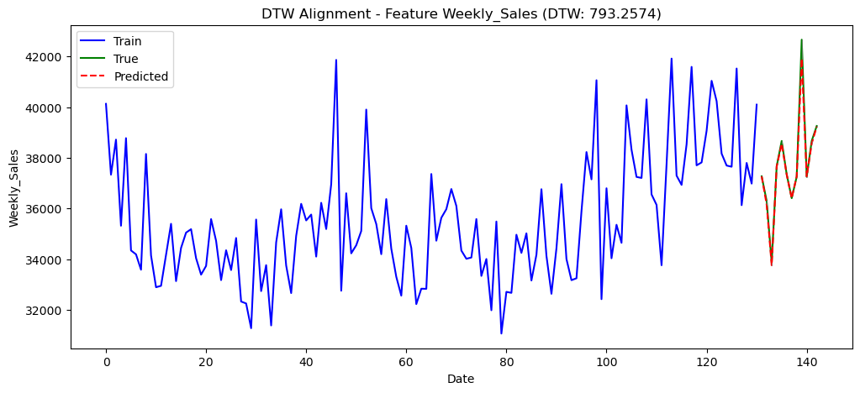
XGBoost

Slide 32
XGBoost
Results for XGBoost: {'rmse': 52438.10335947087, 'mae': 107.44380339358577, 'mape': 0.0026790424529315664, 'dtw': 793.2573607056227}

Slide 33
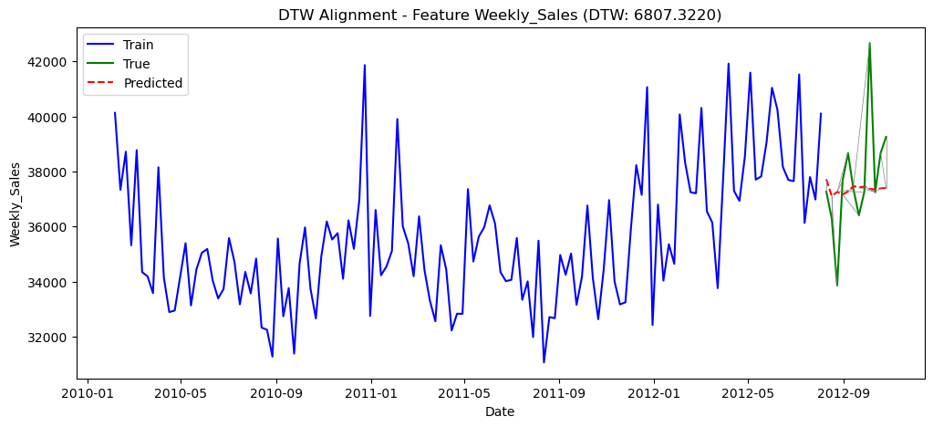
RNN

Slide 34
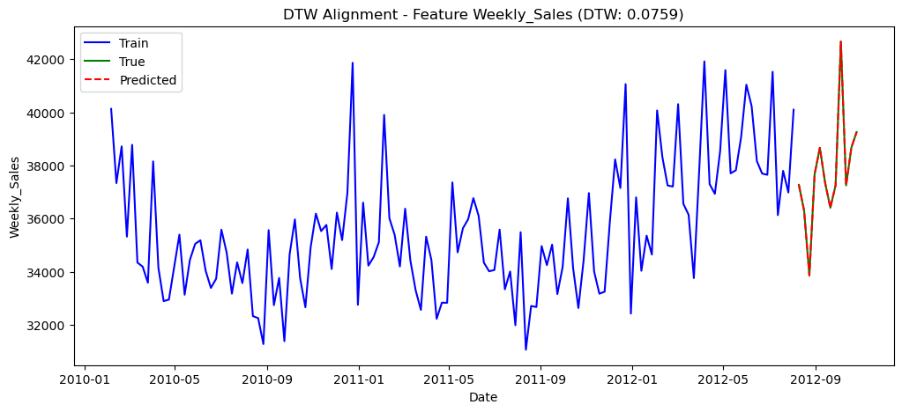
RNN

Slide 35
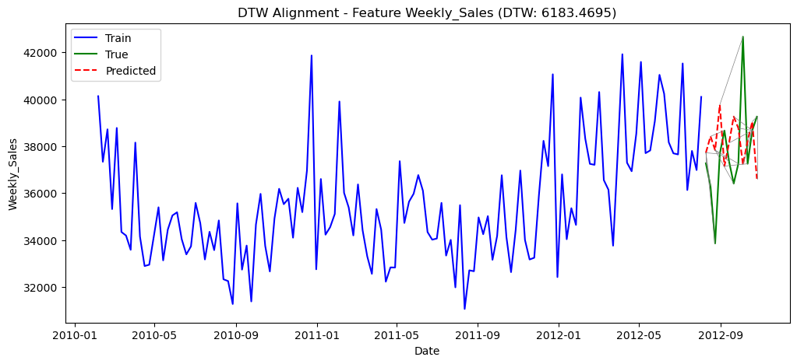
ANN

Slide 36
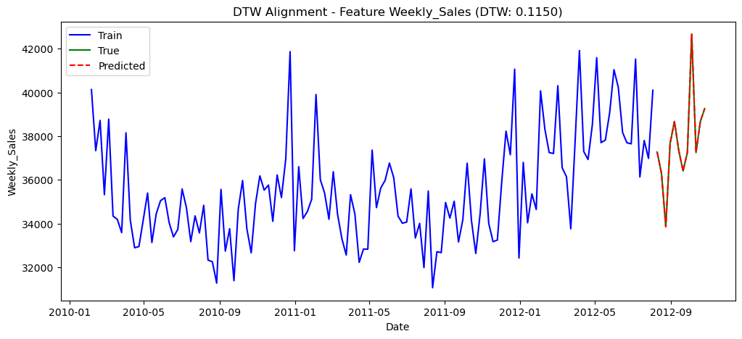
ANN

Slide 37
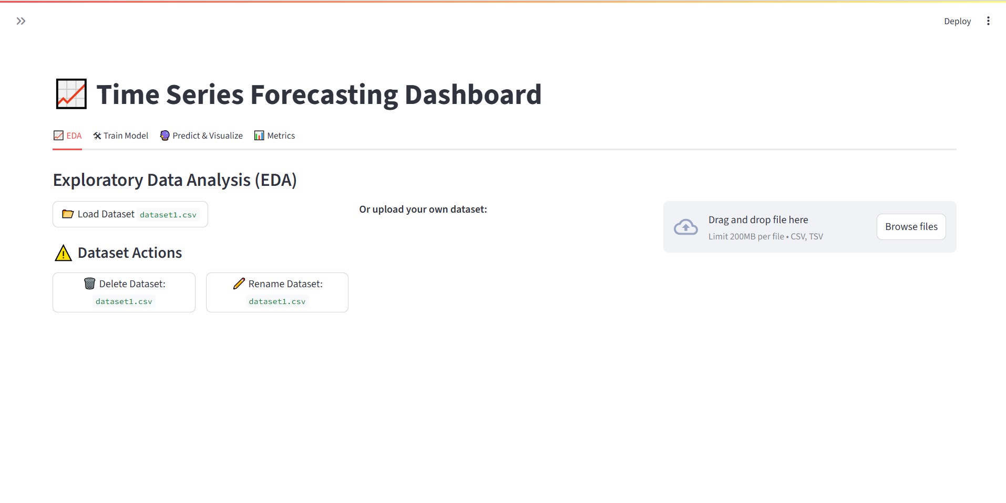
APP

Slide 38
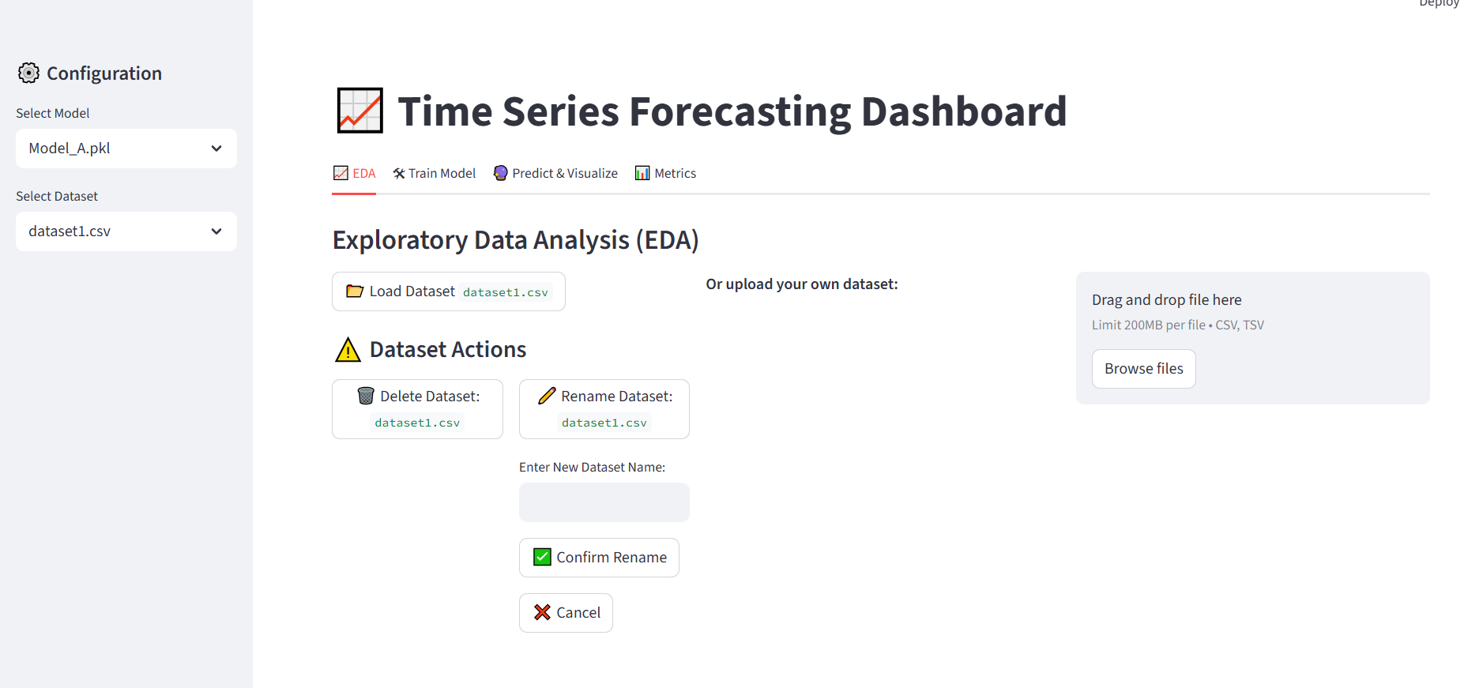
APP

