Slide 1
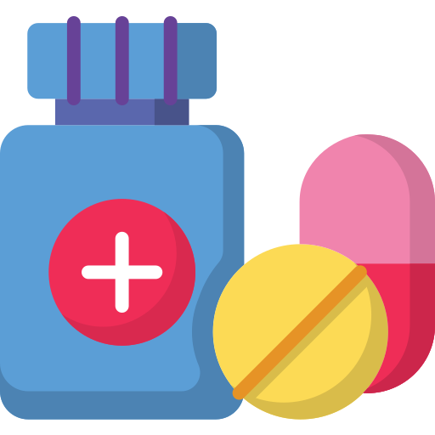
Medicine Reminder
System of alarms related to the reminder of medicine prescriptions.

Slide 2
Project definition
On these days the lifestyle is too fast and that means having too much things on the mind, forgetting things like medical prescriptions that are important to being healthy
To solve that problem, we develop app, that will remind the user to take her medicine

Slide 3
Requirements
RF001 ​ | Home page ​
Description ​ | When the app starts, the system will show a list of all the alarms already created by the user. The system will give the option to manage those alarms. The options that the system will give are the following:​ A list of already created alarms​ Edit​ Add ​
RF003 ​ | Add ​
Description ​ | The system will allow adding new alarms. The data that must be entered to add an alarm are:​ Medication name​ Period of time (how often should the medication be taken)​ Duration (for how many days will the alarm be active)​ Notes (specification reminders)​
RNF003 ​​ | Automatic suspension​​
Description ​​ | The system will automatically deactivate the reminders once the duration of the medication entered by the user (days) has expired. ​​

Slide 4
Sprints
First sprint
Basic Alarm
Second sprint
Notifications
Third Sprint
Basic Database
Fourth Sprint
Database improvement and design creation
Fifth Sprint
Notifications
Sixth Sprint
Intelligent Assistant
Two documentation meetings

Slide 5


Advances
The project complies all the requirements except the full implementation of the intelligent assistant .
RF001
RF002
RNF003
Intelligent
Assistant

Slide 6
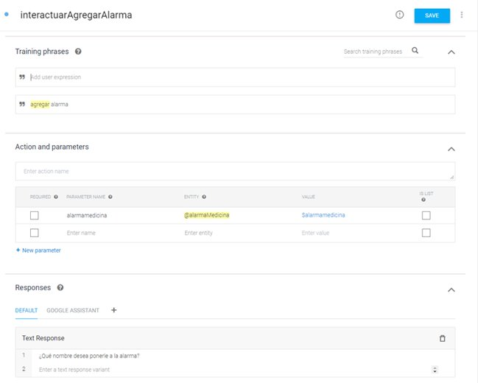
Intent to start add alarm

Slide 7
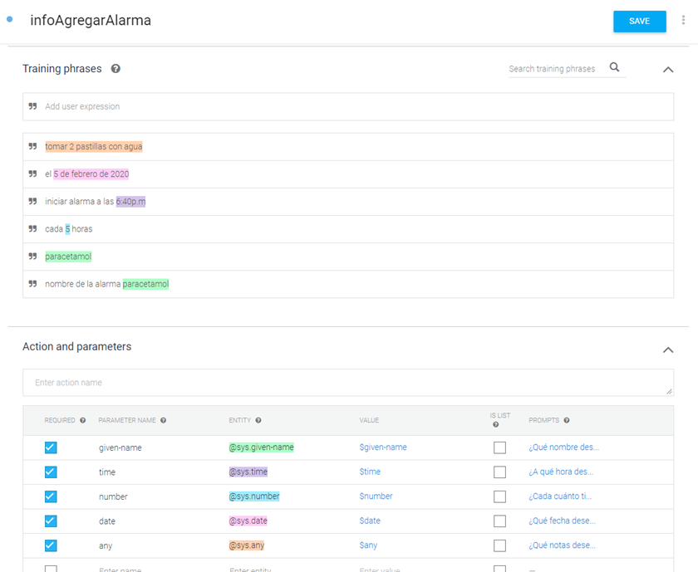
Intent where parameters to add an alarm are received

Slide 8
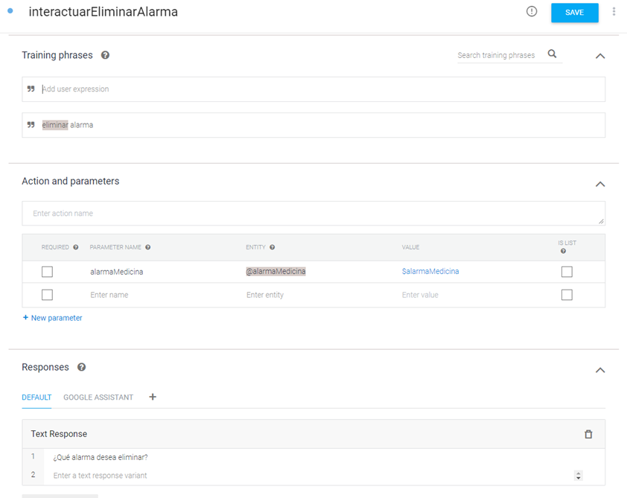
Intent to start delete alarm

Slide 9
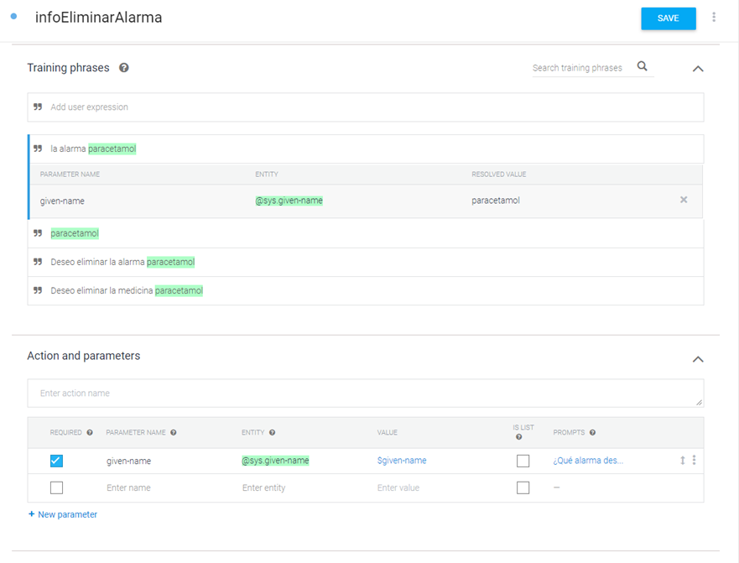
Intent where parameters to delete an alarm are received

Slide 10

Process
We used the scrum method, but focusing on the system being iterative-incremental where the need to have an analysis, a design, coding and tests (in that same order) will be carried out for each functionality added as time passes to allow the evolution of the product.

Slide 11
Supervision
The supervision of the project was done through sprints because we used the scrum method.
The project was divided as follows:
Database
Alarm
Notifications
Intelligent Assistant
Design

Slide 12

We also made use of logs where as we were advancing in the development process, each of the advances and changes that were made to the system were written down.

