Slide 1
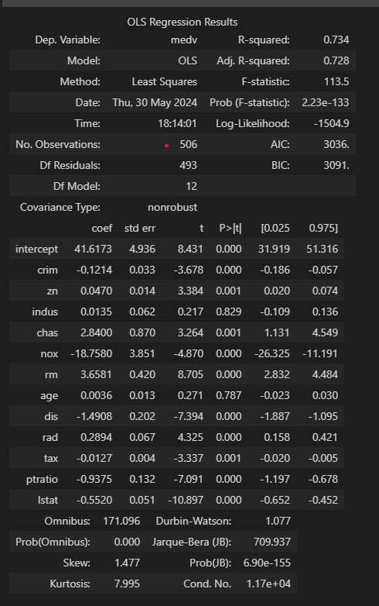
R-squared: it is > 0.6 so the model is good for predictions. The 0.734 means that 73.4% of the predictions can be explained by the predictors.
If you have low R-square but p-value good this means that the variables are good to the model, but not enough. You need more variables to improve the model
coef: .. Slopes of the predictors (b1, b2…) except the Intercept (b0)
0.025 – 0.975 → confidence interval for each variable. This represents a Gaussain (Bell curve).
(2) F-statistic: it is much larger than 1 … this means that at least 1 predictor has a relationship with the response
We can also reject the null hypothesis based on the F-statistic. If the F-statistic is> 1, it means that at least one predictor is related to the response.
(4) P > |t| (p-value): p-value represents the significance of the predictor to the result. The lower, the better. Rule of tumb, a good p-value is < 0.05
(3) Prob (F-Statistic) = is the p-value of the F-statistic and is used to support the F-statistic interpretation

