Slide 1

Subclipse

Slide 2
Subeclipse
Installazione Subeclipse

Slide 3
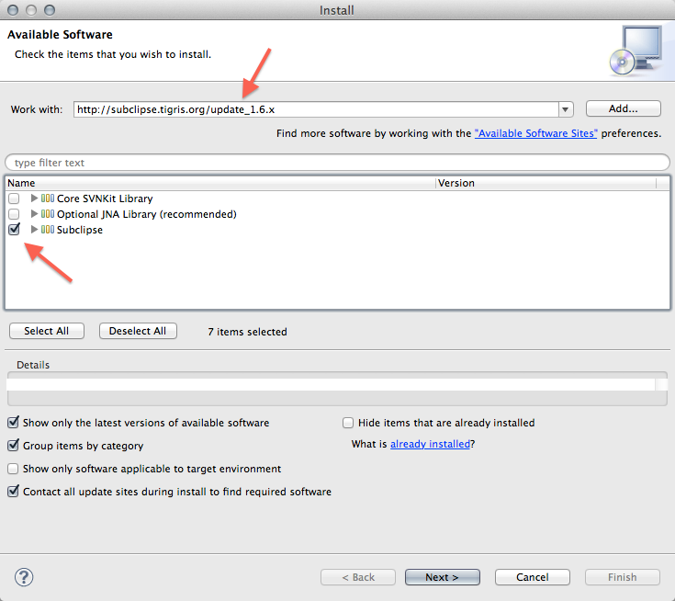
Subeclipse

Slide 4
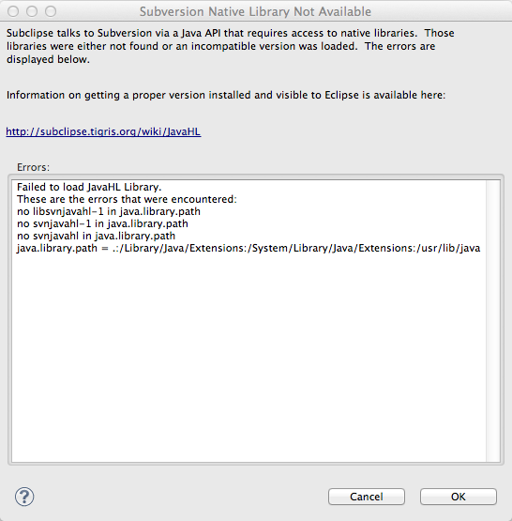
Subeclipse

Slide 5
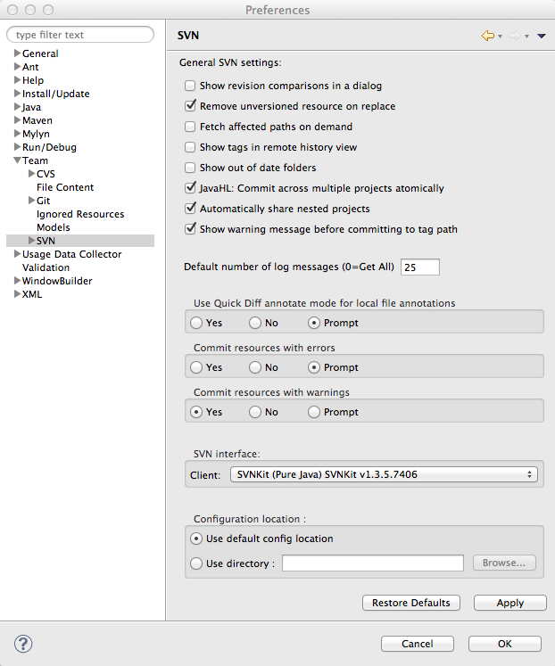
Subeclipse

Slide 6
Subeclipse
SVN Repository Setup
"Window » Open Perspective » Other"

Slide 7
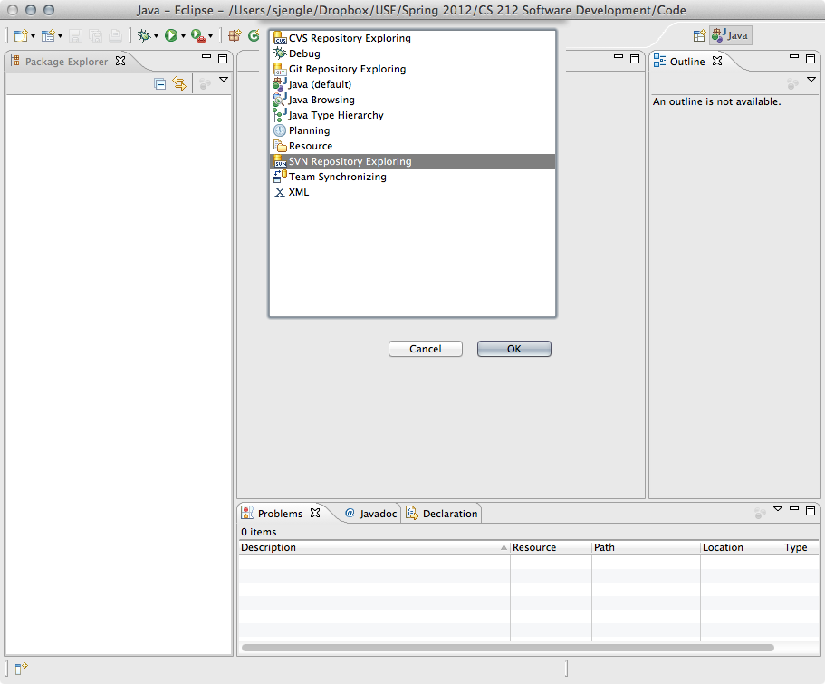
Subeclipse

Slide 8
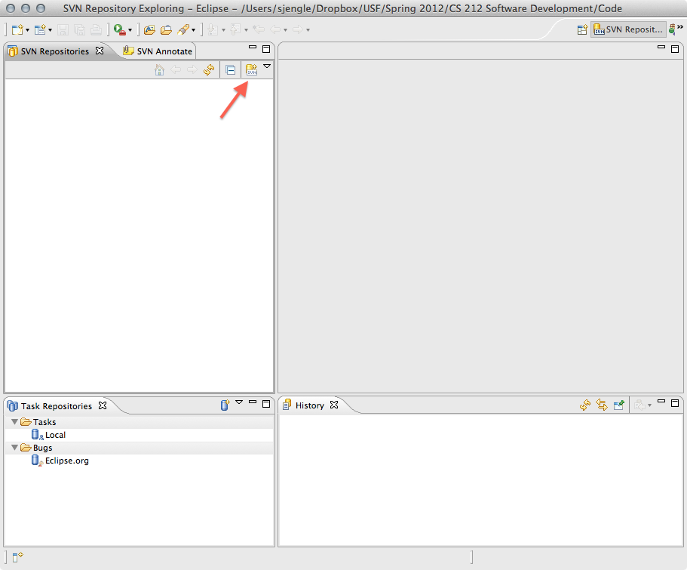
Subeclipse

Slide 9
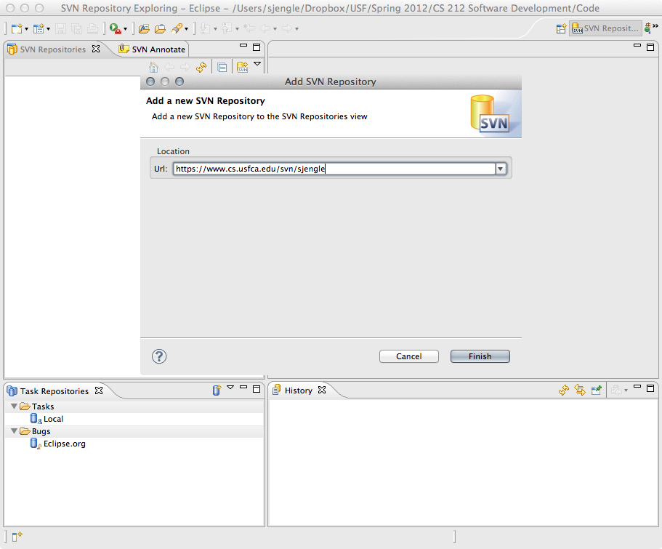
Subeclipe

Slide 10
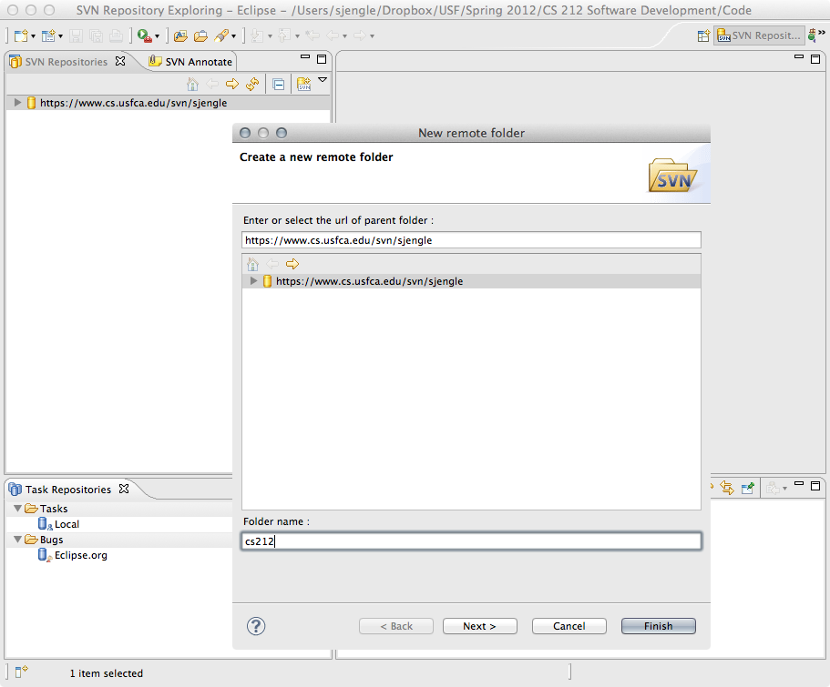
Subeclipse

Slide 11
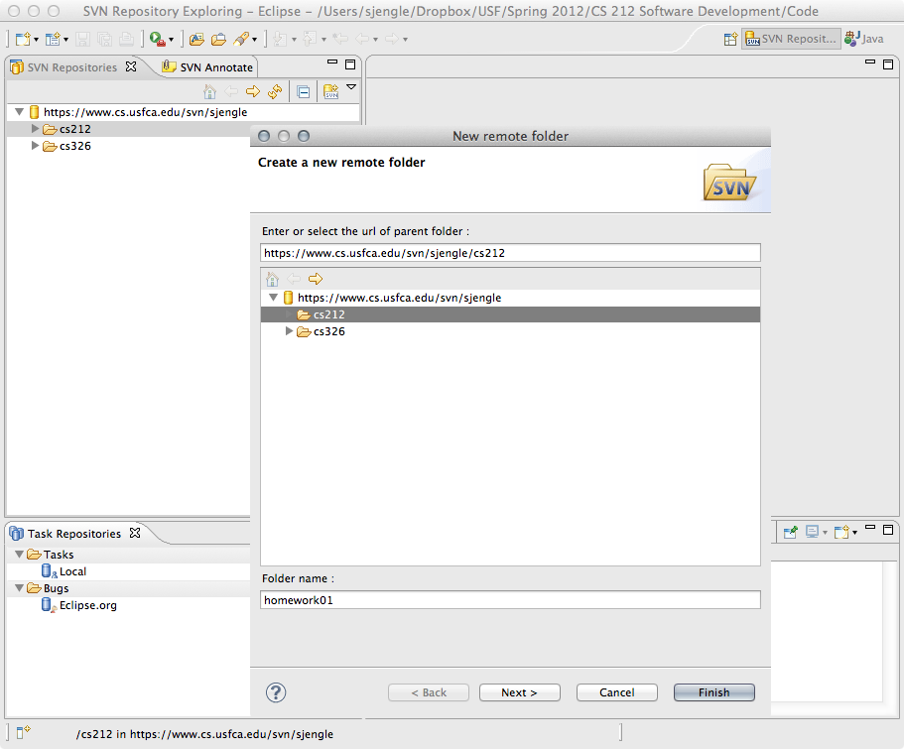
Subeclipse

Slide 12
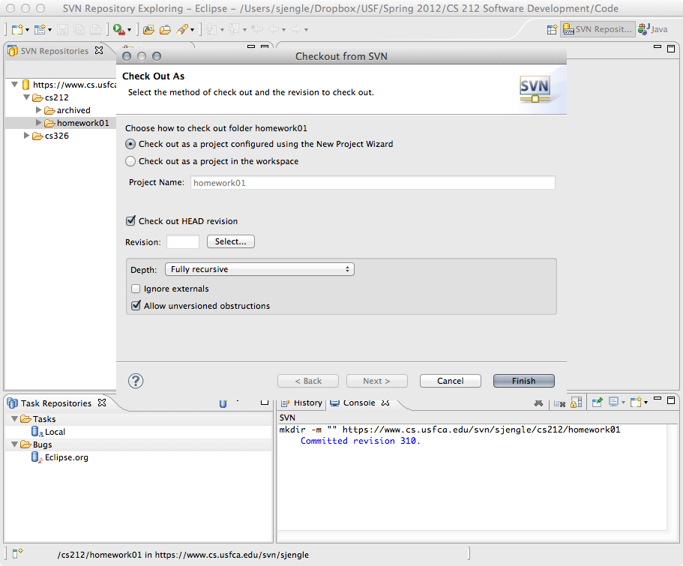
Subeclipse

Slide 13
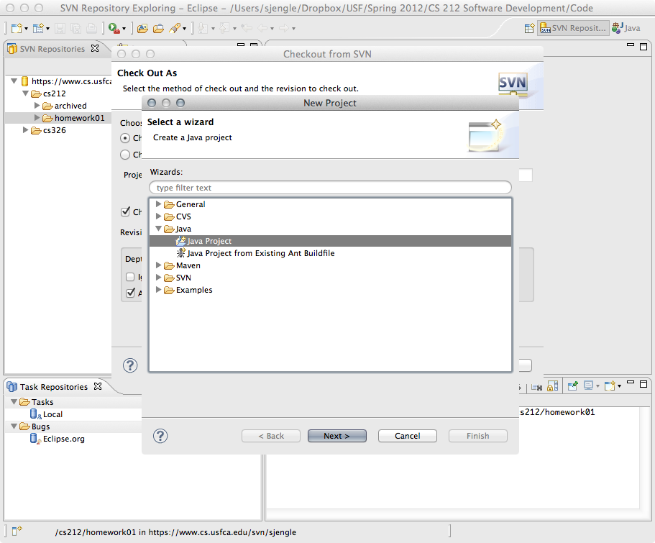
Subeclipse

Slide 14
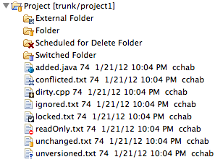
Subsclipse

