Slide 1
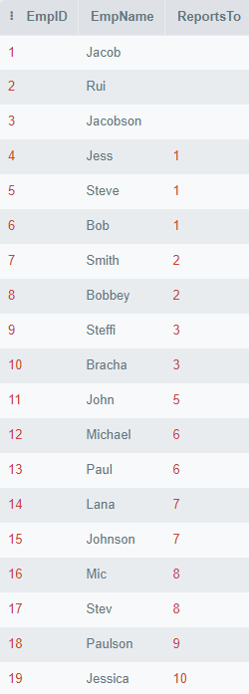

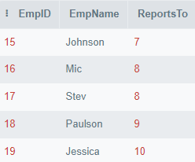
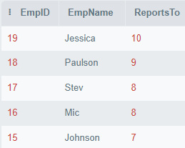
SELECT * FROM Employees WHERE EmpID>(SELECT COUNT(*) FROM Employees)-5;
SELECT TOP 5 * FROM Employees ORDER BY EmpID DESC;

