Slide 1
Arithmetic Operators

Slide 2
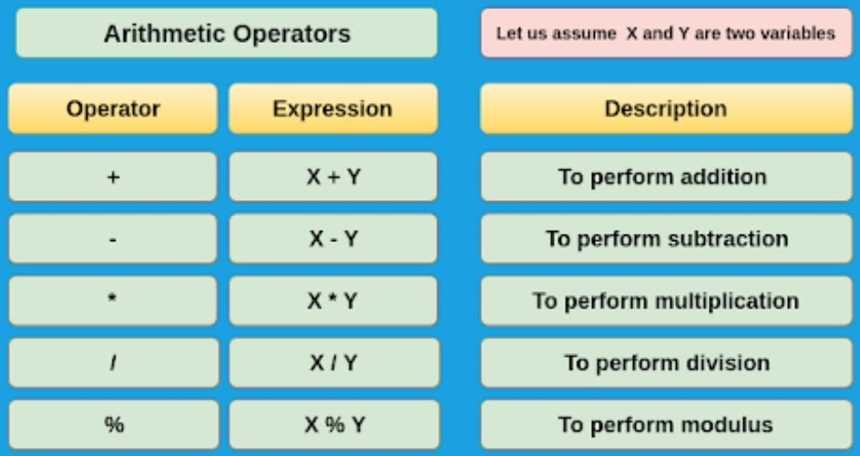

Slide 3
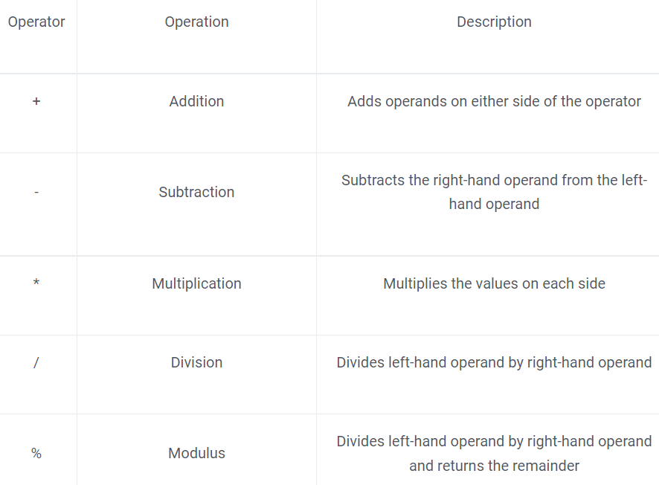
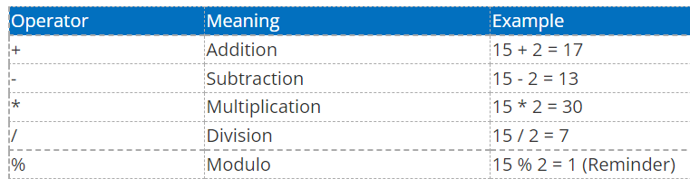

Slide 4
fid | Fname | address | salary
1 | Lesla | LA | 2500
2 | Gruce Tom | CN | 2500
3 | Dany | Tex | 5000
4 | Mark | bonv | 5600
5 | Samuel | Arg | 8000
fid | Fname | address | salary | Revised Salary
1 | Lesla | LA | 2500 | 2550
2 | Gruce Tom | CN | 2500 | 4550
3 | Dany | Tex | 5000 | 5050
4 | Mark | bonv | 5600 | 5650
5 | Samuel | Arg | 8000 | 8050
fid | Fname | address | salary | Revised Salary
1 | Lesla | LA | 2500 | 2350
2 | Gruce Tom | CN | 2500 | 4350
3 | Dany | Tex | 5000 | 4850
4 | Mark | bonv | 5600 | 5450
5 | Samuel | Arg | 8000 | 7850

